Slide 1
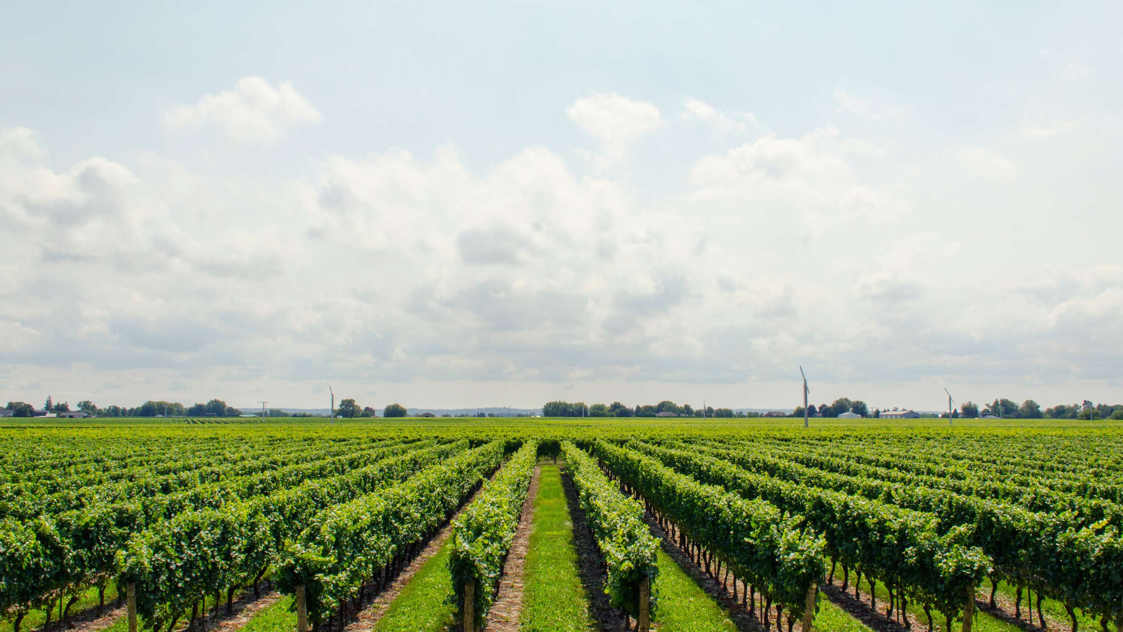

M. Keerthi Sri 2520030079 Cluster:1 Section:4
Predictive farming
For Better Yield
Under the guidance
of
Supervisor: Surekha
Assistant Professor
Department of CSE

Slide 2

Abstract:
Agriculture is a critical sector for the economy, but farmers often face challenges such as unpredictable weather, inefficient resource usage, and poor crop planning, which can lead to reduced yields and financial losses. This project, "Predictive Farming for Better Yields," aims to address these challenges by using historical and real-time agricultural data to provide actionable insights. By analyzing factors such as soil quality, weather patterns, and crop history, the system can predict potential outcomes and offer guidance on crop selection, irrigation, and harvesting.

Slide 3

Existing System:
In the current agricultural system, farmers mostly depend on traditional farming methods, personal experience, and local knowledge to decide which crops to grow.
Crop selection is often influenced by seasonal patterns or advice from nearby farmers rather than data analysis.
However, this approach has several limitations. Farmers may not have access to accurate information about soil conditions, rainfall patterns, or temperature variations, which can lead to poor crop selection and reduced yields. Additionally, the lack of digital tools and predictive analysis makes it difficult for farmers to plan their farming activities effectively.
As a result, the existing system often leads to inefficient resource utilization, lower productivity, and increased risk of crop failure.

Slide 4

Proposed System:
The proposed system, Predictive Farming for Better Yields, is a web-based application designed to assist farmers in making better agricultural decisions using data-driven analysis.
The system collects important farming inputs such as soil type, rainfall, and temperature from the user and processes this information to recommend the most suitable crop for cultivation.
The application is developed using HTML, CSS, and JavaScript, providing a simple and user- friendly interface. It uses basic data structures such as arrays and objects to analyze the input data and generate crop predictions. The system also supports multiple languages so that farmers from different regions can easily use the platform.
By using this system, farmers can select appropriate crops, improve productivity, optimize resource usage, and reduce the risk of crop failure, leading to more efficient and sustainable farming practices. 🌾

Slide 5
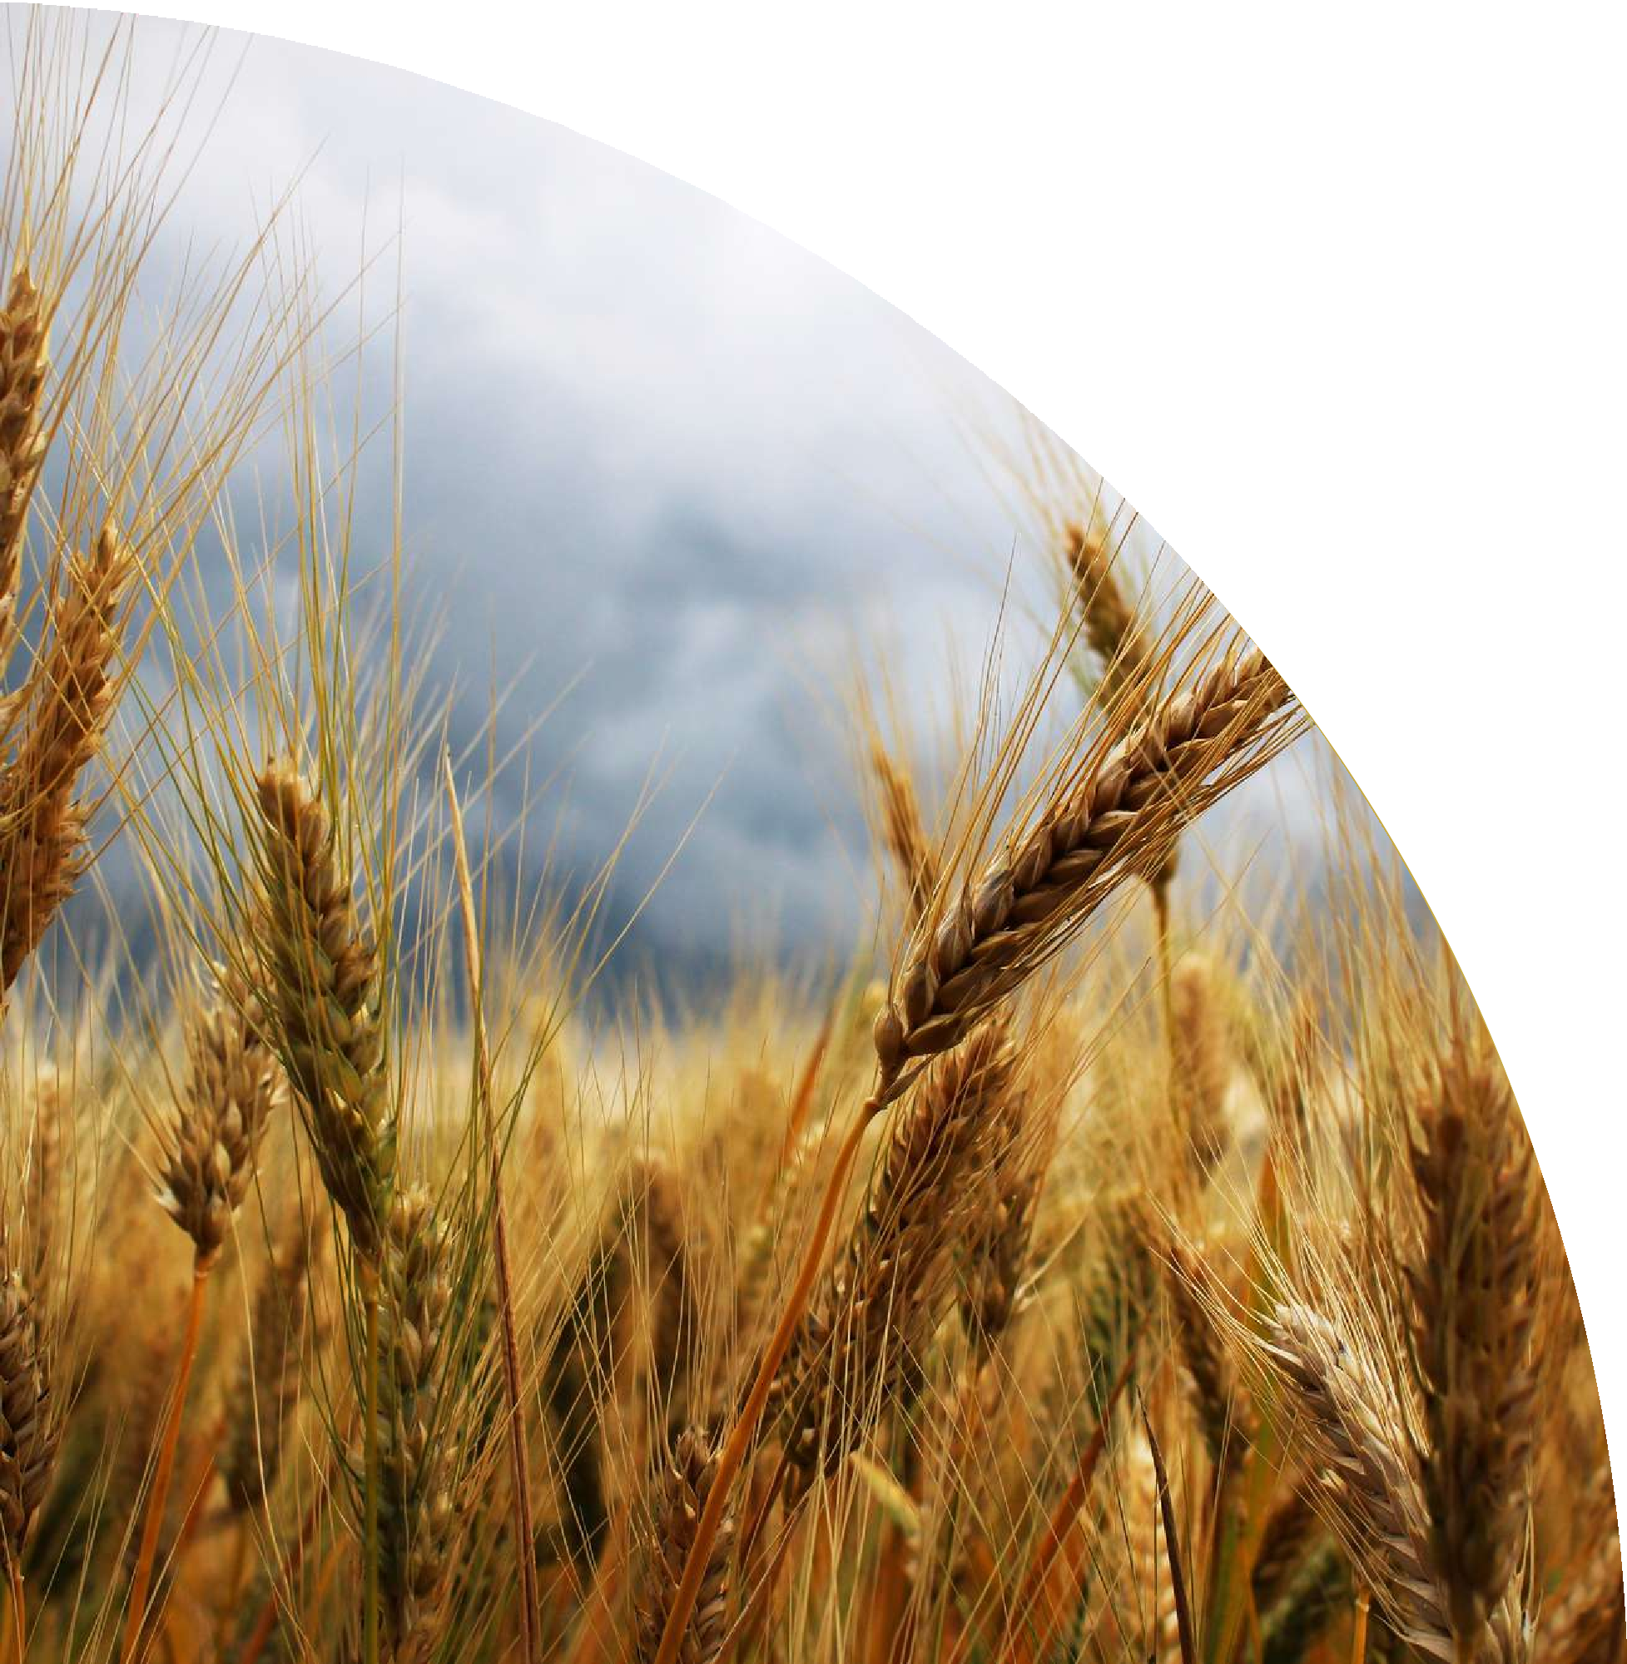
System Architecture diagram:
+
+
| Farmer |
| (User) |
+
+
+
| v
+ +
| Web Interface |
|
| (HTML, CSS UI)
| Input: Soil, Rain, |
| Temperature |
+ +
+ +
+
|
| _
| Application Logic |
| (JavaScript) |
>
| Data Processing & |
| Crop Prediction |
+
+ +
|
v
+ +
| Recommendation |
| Output Display |
| Suggested Crop |
+ +
+ +
| Crop Dataset |
| (Arrays & Objects) |
| Soil, Rainfall, Temp |
| Crop Conditions |
- - >
+ + +

Slide 6
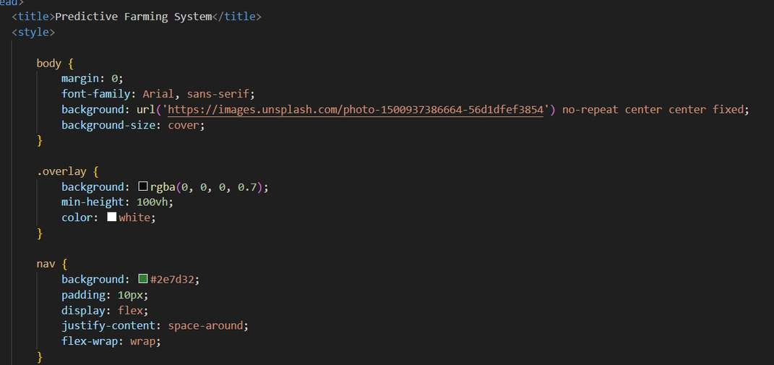
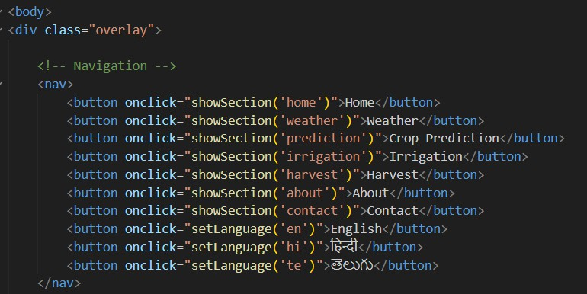
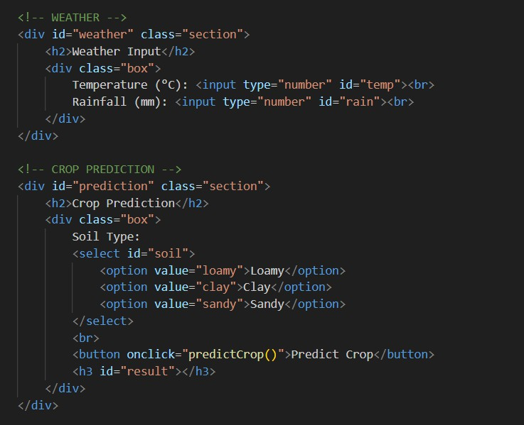
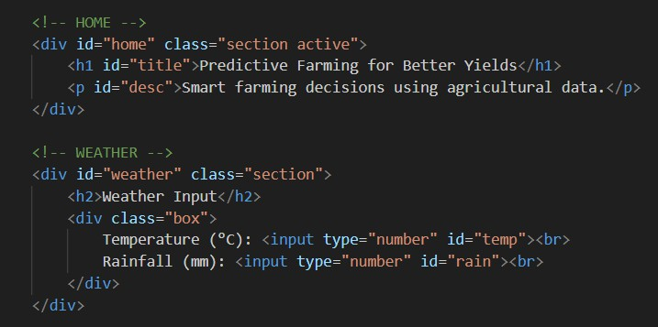
Project Modules:
CO-1
CO-2

Slide 7
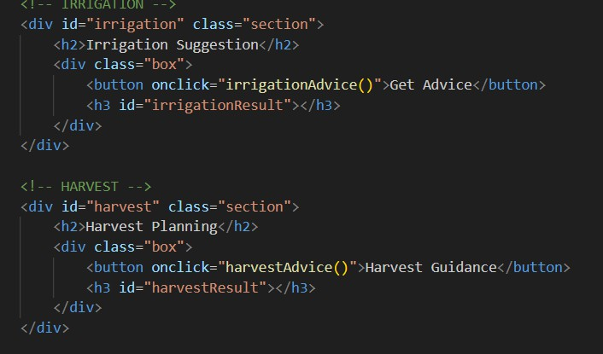
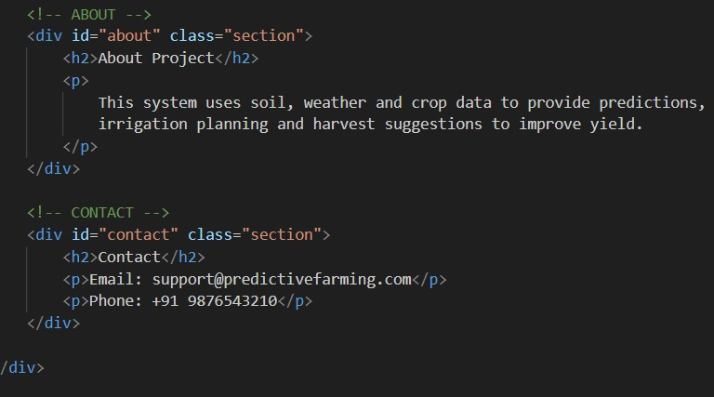
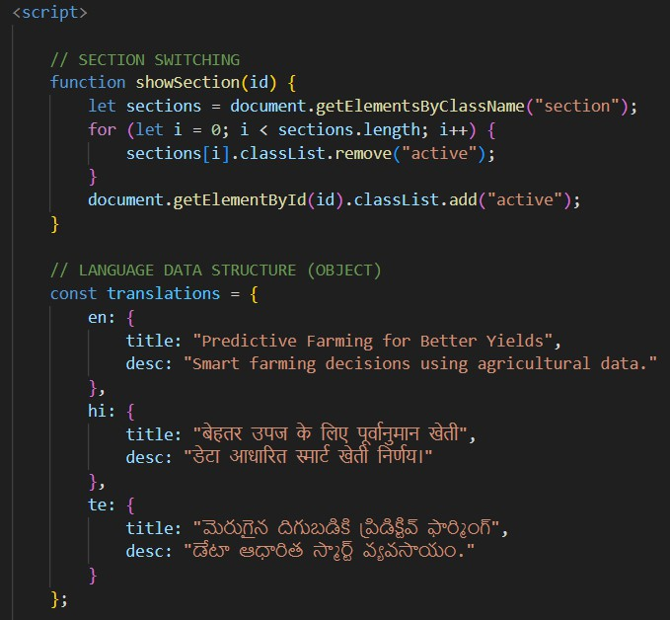
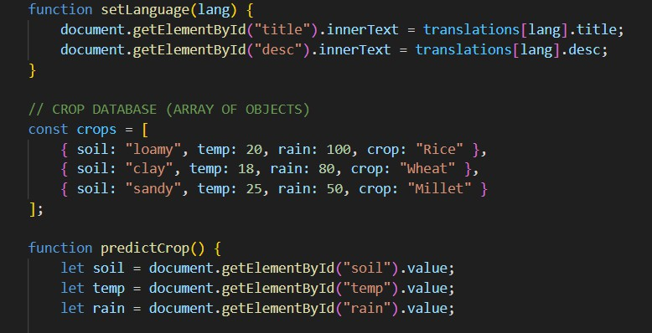
CO-3
CO-4

Slide 8
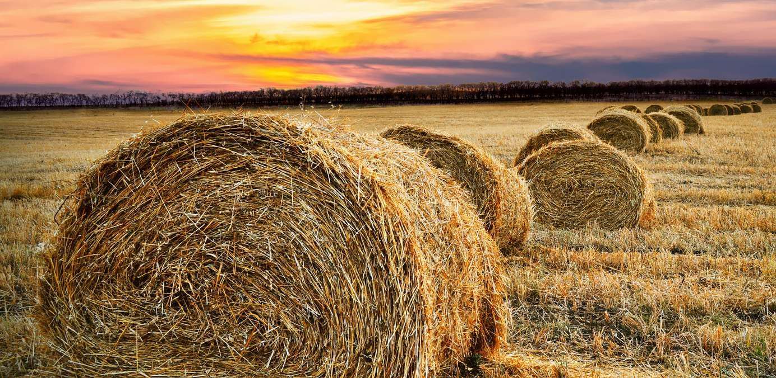
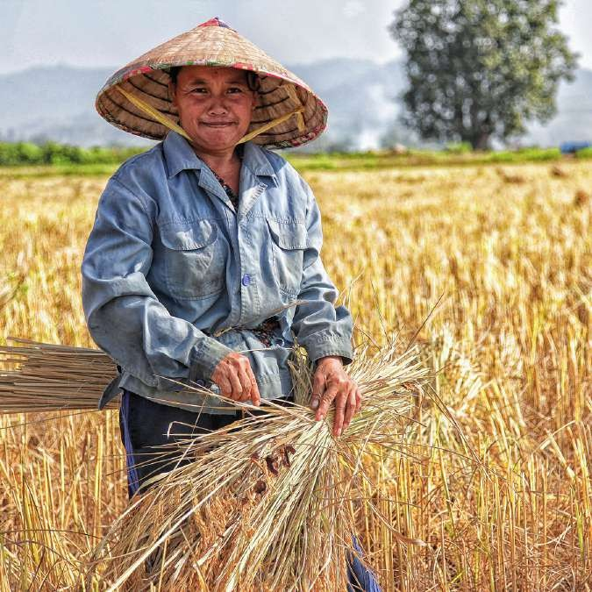
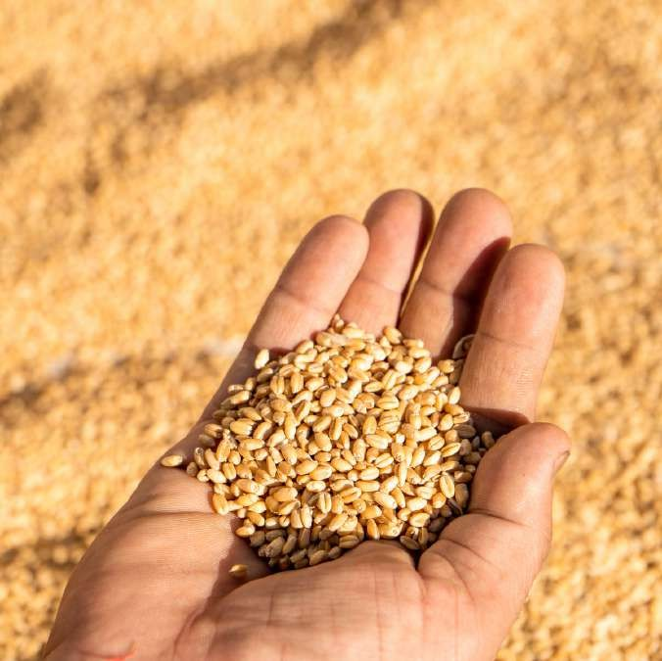
Objectives of the Project :
To develop a web-based application that helps farmers make better agricultural decisions. To recommend suitable crops based on factors such as soil type, rainfall, and temperature. To improve crop productivity by providing data-driven farming suggestions.
To create a user-friendly system that is simple and easy for farmers to use.
To support multiple languages so that farmers from different regions can access the application easily.
To promote efficient and sustainable farming practices through better resource utilization. 🌾

Slide 9
FWD CO’S ATTAINMENT:
CO
CO1 CO2 CO3 CO4 CO5
Evaluation Criteria (Given)
Internet Fundamentals, HTML Structure & Basic CSS Forms, Semantic HTML & Advanced CSS Layouts JavaScript Programming Fundamentals
DOM Manipulation, Events & API Integration
Advanced Web Development, GitHub Version Control & Deployment
CO Attainment from the Given Code
The project uses proper HTML structure with sections, navigation bar, headings, forms, and buttons. Basic CSS styling is applied for background images, colors, fonts, and layout design to create a visually appealing web interface.
The application includes input forms and dropdown menus to collect soil type, rainfall, and temperature. CSS is used for layout design, overlays, navigation bar, and styled containers, demonstrating advanced layout and form design.
The system implements JavaScript functions, loops, arrays, and objects for crop prediction. Crop data is stored in arrays of objects, and logical conditions are used to determine suitable crops based on user input.
The project uses DOM manipulation and event handling such as button clicks to switch sections, update prediction results, and display irrigation and harvest advice dynamically using JavaScript.
The project integrates HTML, CSS, and JavaScript into a complete web application that can be uploaded and managed using GitHub for version control and d

Slide 10
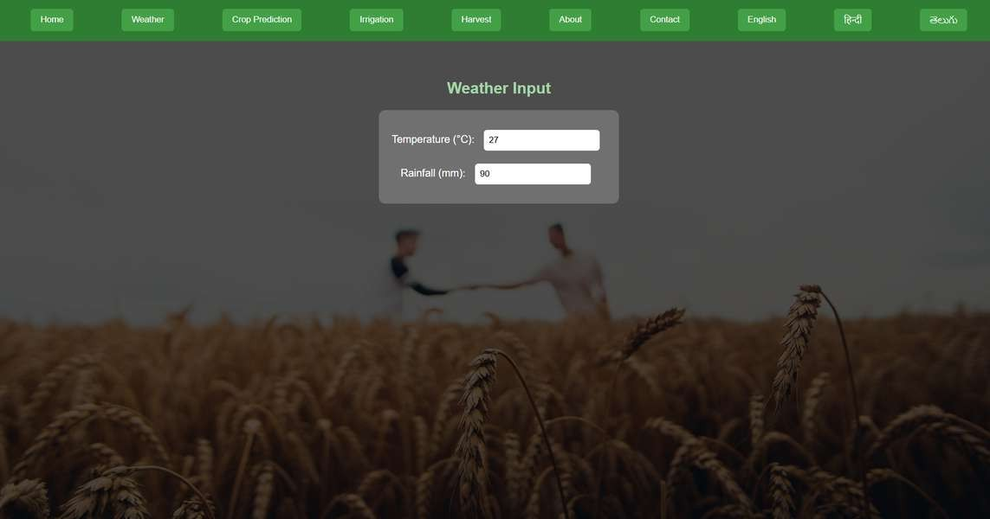
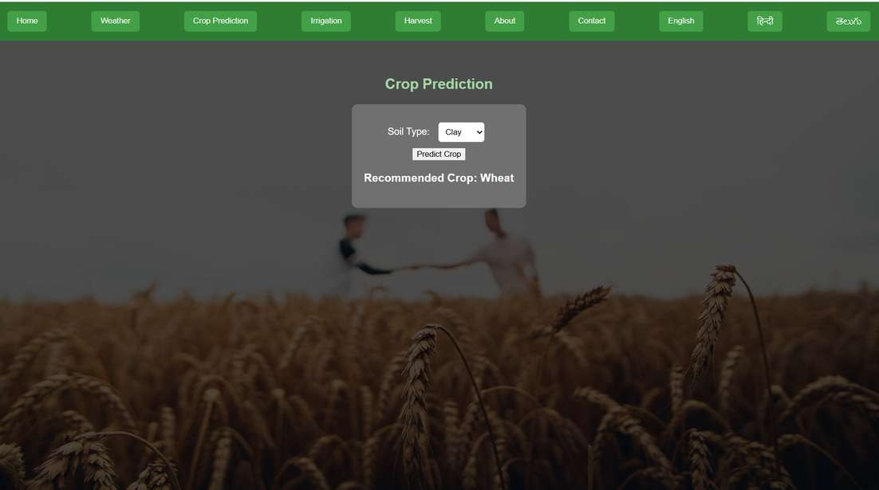
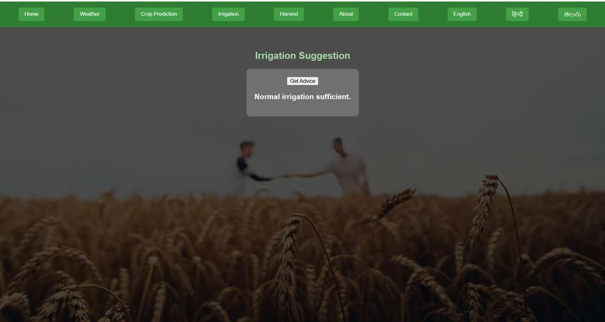
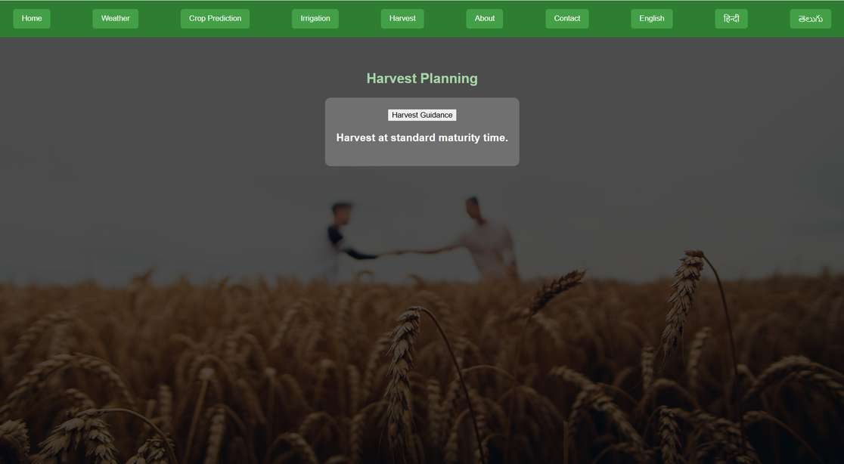

Slide 11
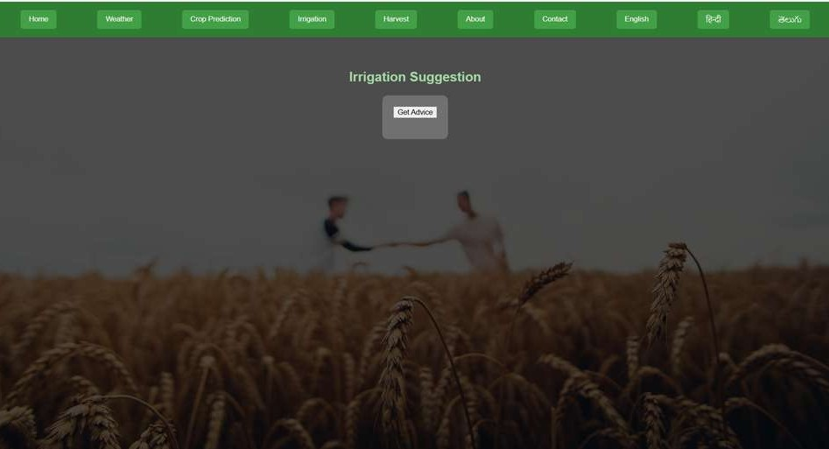
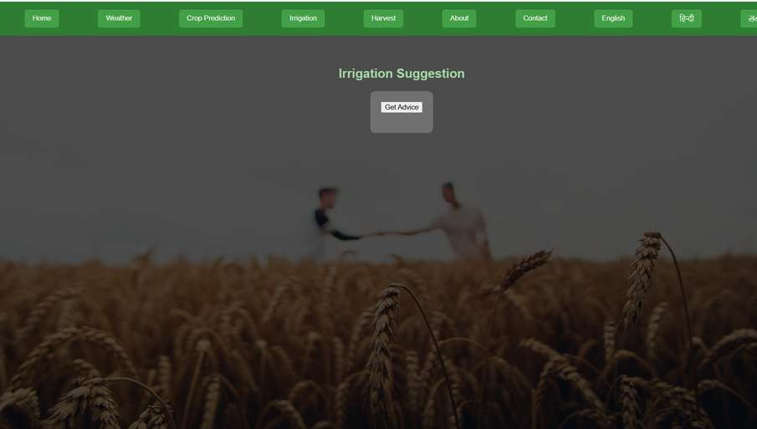
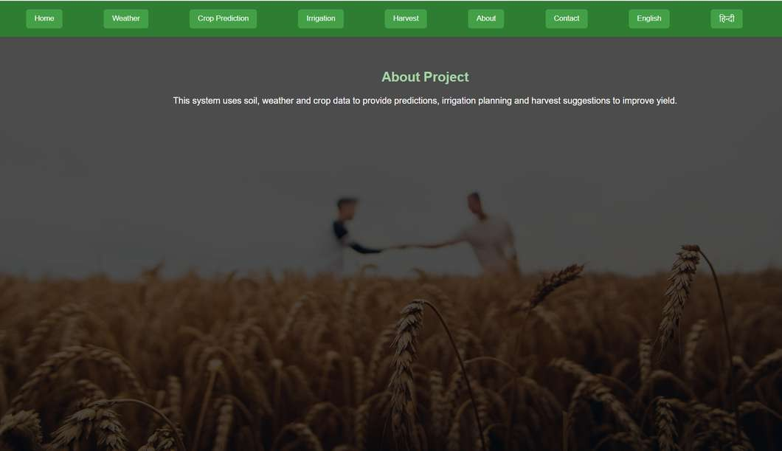
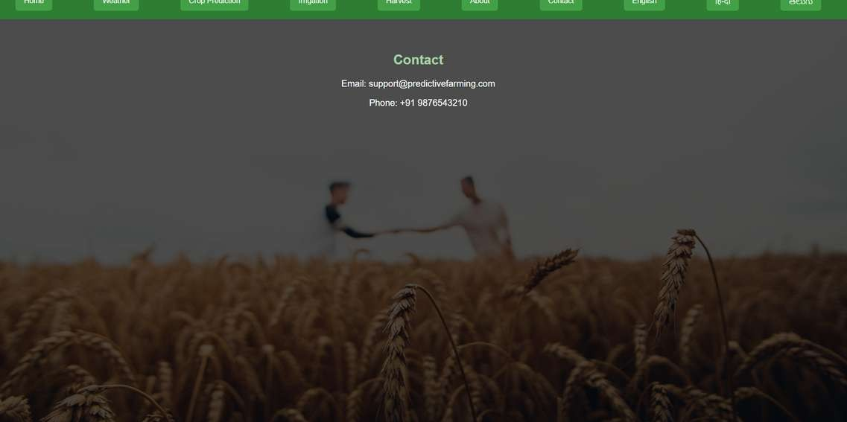

Slide 12
Conclusion:
The Predictive Farming for Better Yields system helps farmers make better agricultural decisions using data analysis.
It analyzes soil type, temperature, and rainfall to recommend suitable crops.
The application is developed using HTML, CSS, and JavaScript with simple data structures.
The system provides additional features like irrigation advice and harvest planning.
It includes a user-friendly interface with multi-language support for better accessibility.
The project promotes efficient resource usage and improved crop productivity. It encourages sustainable and data-driven farming practices. 🌾
01

Slide 13
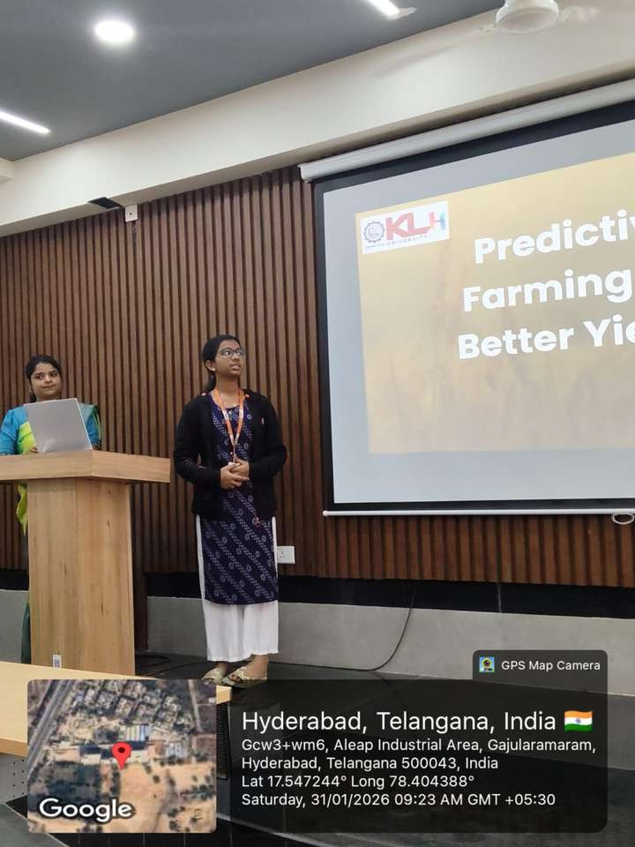
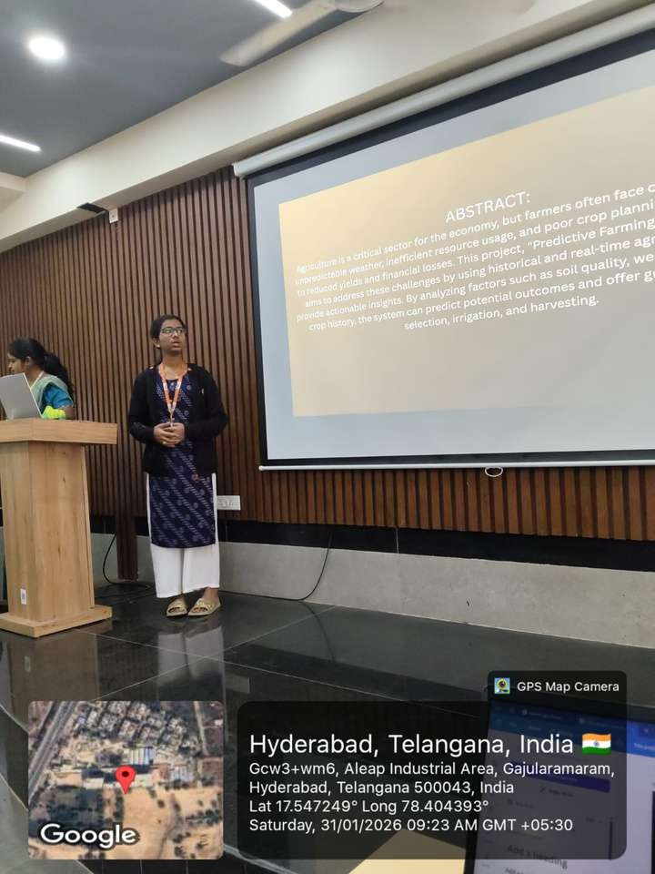
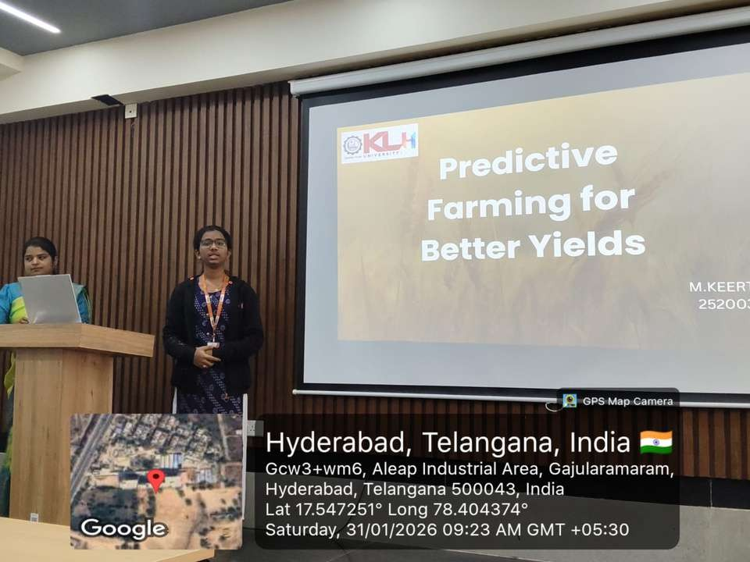
Geo-tagged Photos:

Slide 14
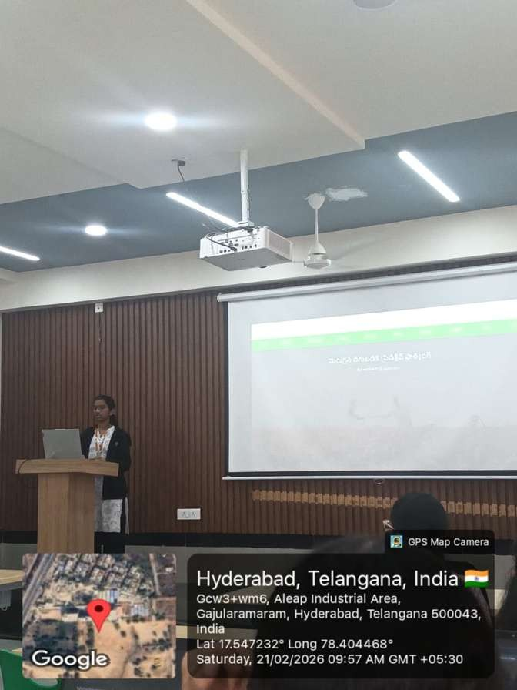
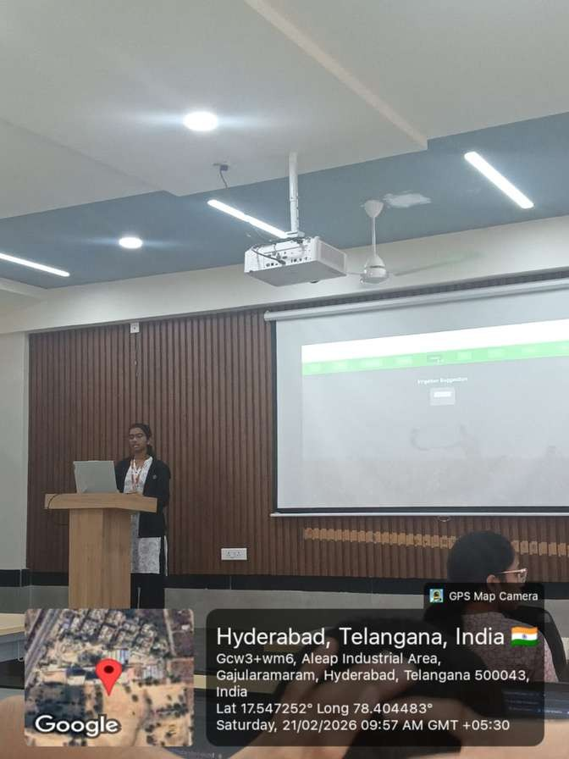
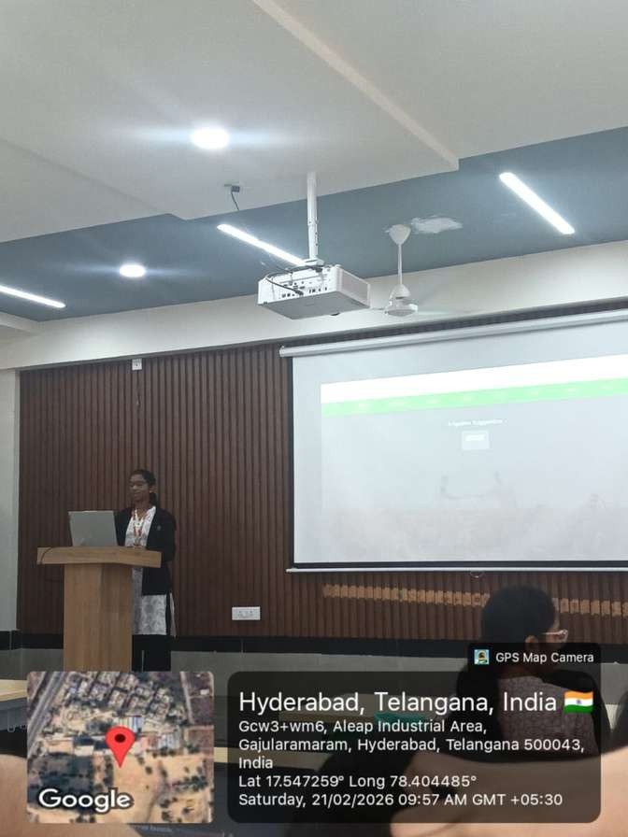

Slide 15

Thank You.

