Slide 1

CVR COLLEGE OF ENGINEERING DEPARTMENT OF COMPUTER SCIENCE AND ENGINEERING DATA PREPROCESSING FRAMEWORK FOR SUPERVISIED MACHINE LEARNIng by Yerrabachu Keerthy Rao – 17B81A0595 Bandanadam Madhuri – 17B81A05A8 Naga Jahnavi Kommareddy – 17B81A05B9 Under THE guidance of U . Jhashuva – Asst Professor

Slide 2
CONTENTS
Abstract
Introduction
Motivation
Literature review
Limitations of the existing models
Requirements
Architecture of the Model
Use case diagram
Sequence diagram
Test Cases
Implementation Details
Conclusions
Future scope
References

Slide 3
ABSTRACT
Many factors affect the success of machine learning (ML) on a given task. The representation and quality of the instance data is first and foremost. If there is much irrelevant and redundant information present or noisy and unreliable data, then knowledge discovery during the training phase is more difficult. It is well known that data preparation and filtering steps take considerable amount of processing time in ML problems. Data pre-processing includes data cleaning, normalization, transformation, feature extraction and selection, etc. The product of data pre-processing is the final training set. It would be nice if a single sequence of data pre-processing algorithms had the best performance for each data set but this is not happened. Thus, we present the most well know algorithms for each step of data pre-processing so that one achieves the best performance for their data set.

Slide 4
INTRODUCTION
What is data preprocessing?
Data preprocessing is a process of preparing the raw data and making it suitable for a machine learning model. It is the first and crucial step while creating a machine learning model.
When creating a machine learning project, it is not always a case that we come across the clean and formatted data. And while doing any operation with data, it is mandatory to clean it and put in a formatted way. So for this, we use data preprocessing task.
Why do we need Data Preprocessing?
A real-world data generally contains noises, missing values, and maybe in an unusable format which cannot be directly used for machine learning models. Data preprocessing is required tasks for cleaning the data and making it suitable for a machine learning model which also increases the accuracy and efficiency of a machine learning model.

Slide 5
Steps in data preprocessing
Data cleansing. Removing or correcting records with corrupted or invalid values from raw data, as well as removing records that are missing a large number of columns.
Instances selection and partitioning. Selecting data points from the input dataset to create training, evaluation (validation), and test sets. This process includes techniques for repeatable random sampling, minority classes oversampling, and stratified partitioning.
Feature tuning. Improving the quality of a feature for ML, which includes scaling and normalizing numeric values, imputing missing values, clipping outliers, and adjusting values with skewed distributions.
Representation transformation. Converting a numeric feature to a categorical feature (through bucketization), and converting categorical features to a numeric representation (through one-hot encoding, learning with counts, sparse feature embeddings, and so on). Some models work only with numeric or categorical features, while others can handle mixed type features. Even when models handle both types, they can benefit from different representation (numeric and categorical) of the same feature.
Feature selection. Selecting a subset of the input features for training the model, and ignoring the irrelevant or redundant ones, using filter or wrapper methods. This can also involve simply dropping features if the features are missing a large number of values.
Feature construction. Creating new features either by using typical techniques, such as polynomial expansion (by using univariate mathematical functions) or feature crossing (to capture feature interactions). Features can also be constructed by using business logic from the domain of the ML use case.

Slide 6
MOTIVATION
The main objective of any data analysis is to discover knowledge that will be used to solve problems or make decisions. However, problems with the data may prevent this. In most cases, imperfections with the data are not noticed until the data analysis starts. Various explanations have been given to the role and the need for data preprocessing.
Data preprocessing is a process of preparing the raw data and making it suitable for a machine learning model. It is the first and crucial step while creating a machine learning model. When creating a machine learning project, it is not always a case that we come across the clean and formatted data. And while doing any operation with data, it is mandatory to clean it and put in a formatted way. So for this, we use data preprocessing task. A real-world data generally contains noises, missing values, and maybe in an unusable format which cannot be directly used for machine learning models. Data preprocessing is required tasks for cleaning the data and making it suitable for a machine learning model which also increases the accuracy and efficiency of a machine learning model.

Slide 7
LITERATURE SURVEY
Changming Zhu and Daqi Gao (2016) studied the influence of data preprocessing. In this work, they researched the influence of data preprocessing and came up with a conclusion that using different preprocessing methods leads to different classification performances. Not all data preprocessing methods are effective for any one data set; therefore, they proposed a necessary method to determine the effectiveness of a data preprocessing method.
Theodoros Iliou et al (2015) proposed a Novel Machine Learning Data Preprocessing Method for Enhancing Classification Algorithms Performance. In this work, a novel data preprocessing method is proposed and evaluated in three difficult classification data sets. The results indicated that the generated features after proposed preprocessing method implementation to the original dataset markedly improved the performance of the classification algorithms.

Slide 8
Literature Review
S. Banumathi and Dr. A. Aloysius (2019) presented An Enhanced Preprocessing
Algorithms and Accuracy Prediction of Machine Learning Algortihms. The ML
supervised algorithms performances have been checked with selected features with cross validation. Their experimental study suggested that enhanced feature selection with supervised learning for data set that accurately predicts the target value.
Nazri Mohd Nawi et al (2013) presented about The Effect of Data Pre-Processing on Optimized Training of Artificial Neural Networks. Their main focus was to improve the accuracy of ANN models by using three selected pre-processing techniques. The simulations results showed that the use of pre-processing techniques increased the accuracy of the ANN classifier by at least more than 95%. This achievement could be interpreted in an important computational cost diminution related to the learning process of the network.

Slide 9
Literature Review
Data Preprocessing for Supervised Leaning was studied by S. B. Kotsiantis, D.
Kanellopoulos and P. E. Pintelas (2006). This paper addresses issues of data preprocessing that can have a significant impact on generalization performance of a ML algorithm.
Stamatios-Aggelos N et al (2019) presented about Data preprocessing in predictive data mining. In this work they presented the most well-known and widely used up-todate algorithms for each step of data preprocessing in the framework of predictive data mining. It is evident that the application of the preprocessing (or not), may affect the performance of a classifier.

Slide 10
Limitations of the existing work
Though lot of research has taken place on data pre-processing techniques still there is lot of scope for improvement in getting the data ready for efficient supervised learning due to the continuously evolving Machine Learning algorithms.
Choosing relevant Machine Learning algorithm is an important task as it is not a straightforward one. Therefore it is felt that further research is required in this area of data preprocessing.
Every step implemented in data pre-processing is very crucial and directly impacts the performance of Machine Learning algorithm

Slide 11
SOFTWARE Requirements
Operating System: Windows 7 or higher version
Platform: Jupyter Note Book or Jupyter Lab
Programming Language: Python 3.5
Python Libraries: NumPy, Pandas, MATPLOT LIB, SK Learn
Anaconda Navigator

Slide 12
HARDWARE REQUIREMENTS
Computer System: A minimum configuration with Pentium IV , Intel Core i3 with 2 GHz processor
• A RAM of 512 MB or above
• Hard Disc Capacity of 10 GB or above
• Input device: Key board and Mouse
• Output Device: Monitor or PC

Slide 13
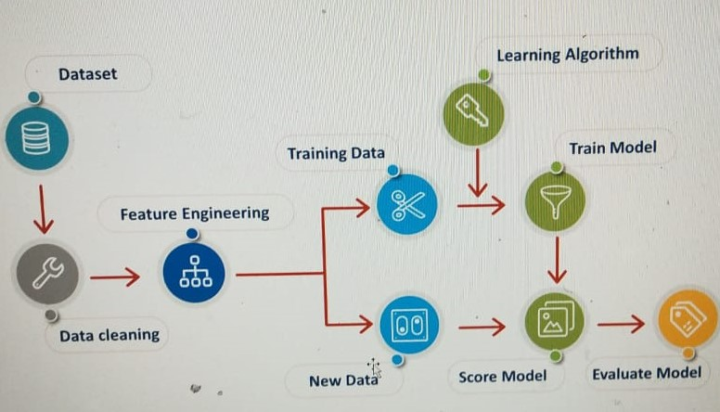
Architecture diagram

Slide 14
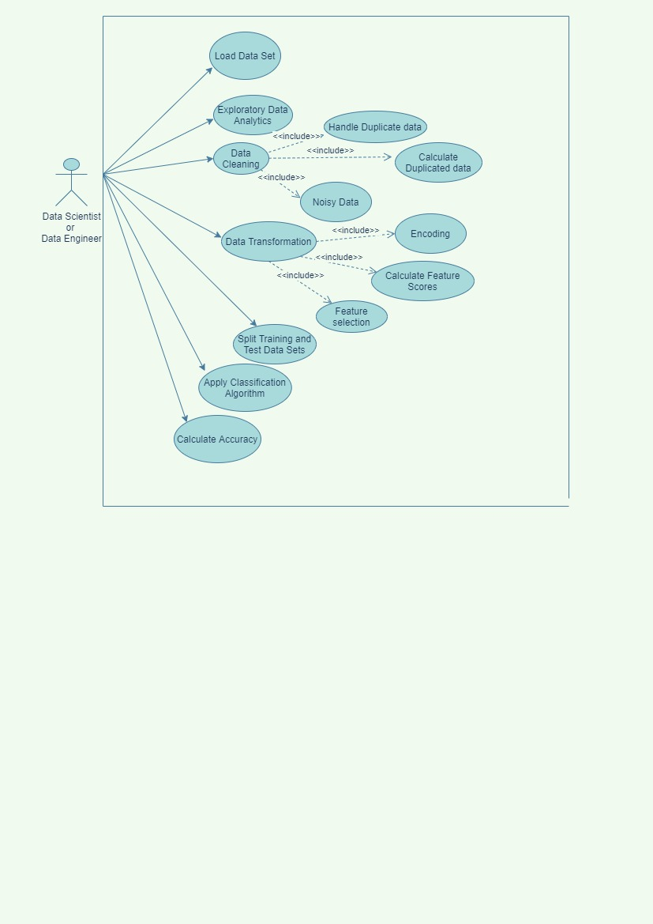
USE CASE DIAGRAM

Slide 15
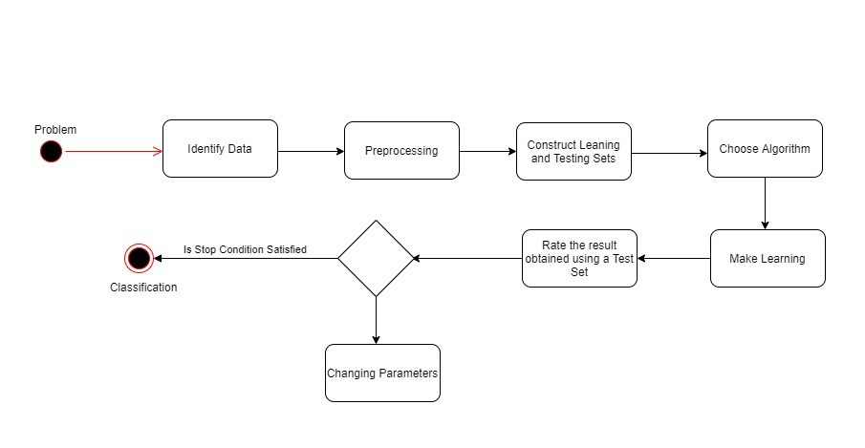
ACTIVITY DIAGRAM

Slide 16
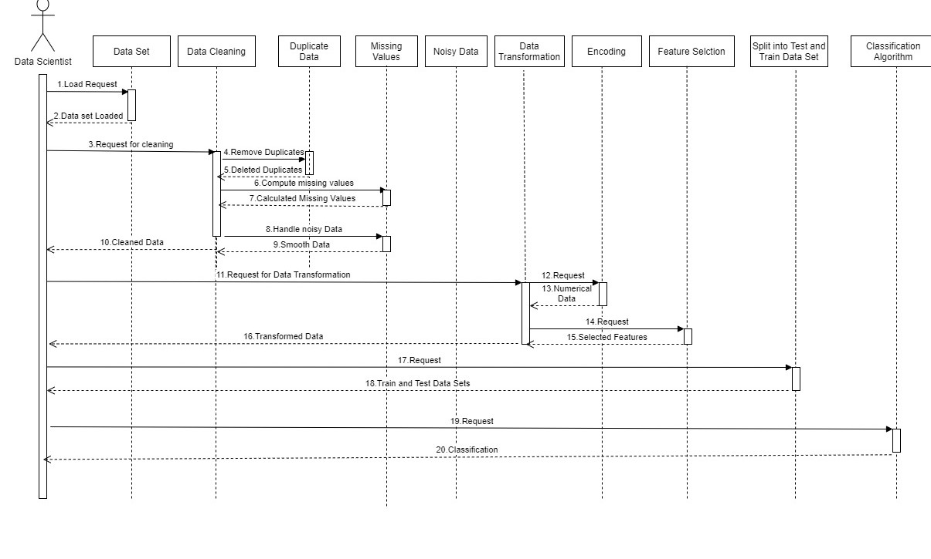
SEQUENCE DIAGRAM

Slide 17
TEST CASES (DATA SET)
Context: Predict next-day rain by training classification models on the target variable RainTomorrow.
Content: This dataset contains about 10 years of daily weather observations from many locations across Australia. RainTomorrow is the target variable to predict. It means -- did it rain the next day, Yes or No? This column is Yes if the rain for that day was 1mm or more.
There are 23 features in the data set.
['Location','MinTemp','MaxTemp','Rainfall','Evaporation','Sunshine','WindGustDir','WindGustSpeed','WindDir9am','WindDir3pm','WindSpeed9am','WindSpeed3pm','Humidity9am','Humidity3pm','Pressure9am','Pressure3pm','Cloud9am','Cloud3pm','Temp9am','Temp3pm','RainToday‘,’RainTomorrow’]
There are 1,45,460 rows in the data set.

Slide 18
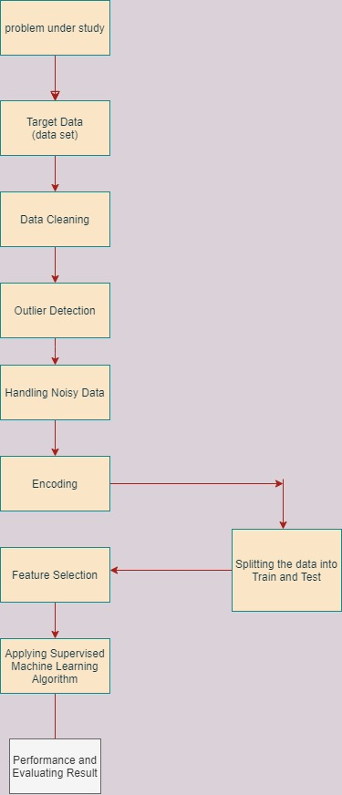
SEQUENCE OF STEPS

Slide 19
IMPLEMTATION DETAILS
Jupyter Lab is used for implementation.
Exploratory Data Analysis
EDA to understand the nature of the data and decide what data Pre-processing algorithms to be used. The techniques used in this stage include the following:
To take a closer look at the data took help of “ .head()”function of pandas library which returns first five observations of the dataset. Similarly “.tail()” returns last five observations of the data set.
Total number of rows and columns in the data set using “.shape”.
The independent and dependent variables in the dataset are found and the .info( ) method is used to find the information about the data set such as the data type and the number of non- null values in each feature.
various summary statistics are found for each feature . The summary statistics include count, mean, standard deviation, minimum and maximum values and the quantiles of the data.
The cardinality and the unique values in each feature are calculated . The number of null values in each feature are calculated and their distribution s analyzed using a matrix and a heat map.

Slide 20
Data Cleaning
Following tasks are performed in data cleaning :
.The number of missing values in each row of the data set are computed and the rows containing more than 50% missing values are dropped.
Duplicate records are eliminated to avoid redundancy in the dataset.
The missing values in continuous features are substituted by mean.
The missing values in categorical features are substituted by mode.
The percentage of null values in the dataset are evaluated after handling missing data to crosscheck whether all the missing values are handled properly or not.
HANDLING NOISY DATA(outliers):
Outliers are detected using Z-Score and has been removed.
These are the tasks performed in Data cleaning, later the cleaned dataset is displayed on desktop and this cleaned dataset is further used in preprocessing.

Slide 21
DATA TRANSFORMATION
The following steps were implemented for data transformation:
The encoding feature is chosen based on the cardinality of the feature. Cardinality is the number of unique values in each feature. Integer encoding was used to convert each categorical feature into numerical type.
.round( ) method is used for all the floating type value features to rounded off to nearest integers to avoid complexity.
The data set is split into training and test data sets. The test dataset size is 33 percent and the training data set is 67 percent. Random Sampling is used for splitting the dataset.
Feature selection is performed in order to select the best features that are more useful for predicting the target attribute. ANOVA f-test was used to find the scores for the features. According to the feature scores top 10 features were selected and the remaining are discarded.
Random forest classifier was applied to determine the target feature for test data and the accuracy was evaluated.
Logistic Regression is applied to determine the target feature for test data and the accuracy was evaluated.

Slide 22
conclusionS
▪ The data pre-processing strategy used to pre-process the Australian weather data. We used a combination of existing methods for data cleaning which gave better results.
▪ Existing systems to which we had referred gave only 65-70 percent where as our proposed solution gave 85 percent of accuracy.
▪ We also performed exploratory data analysis (EDA). The encoding technique is based on cardinality of particular categorical feature.
▪ We used ANOVA F classification function for feature selection as it is used mainly when target attribute is for classification problems. This methodology and choice of algorithm has produced 85 percent of accuracy on the test data for random forest classification algorithm
▪ The Pre-processed Set produced 85% accuracy to predict the target feature with random forest classifier
▪ The pre-processed Data Set produced 84% accuracy to predict the target feature with Logistic Regression algorithm.
▪ The data cleaning method used removed all the insignificant rows from the data set and was able to calculate the missing values in an effective manner.
▪ The data pre-processing techniques used have a huge impact on the performance of a machine learning algorithm. Therefore, it is very crucial to choose the proper data pre-processing algorithms.
▪ The proper choice can only be made by thoroughly understanding the nature of the data and the relationship between various features in the data set.

Slide 23
Future scope
There are some of the aspects of the project which can be improved in future such as:
Implementing a data integration strategy so that data from different sources can be integrated and processed.
A user interface can be developed where the data sets can be loaded and a wide variety of data preprocessing options can be provided in one platform to make data preprocessing more efficient.
Implementing a effective feature construction strategy which constructs new features from the existing features and helps in finding the target attribute with better accuracy.

Slide 24
references
https://www.researchgate.net/publication/282365998_A_Novel_Machine_Learning_Data_Preprocessing_Method_for_Enhancing_Classification_Algorithms_Performance#:~:text=In%20this%20paper%2C%20a%20novel,average%20performance%20lower%20than%2075%25
https://www.researchgate.net/publication/228084519_Data_Preprocessing_for_Supervised_Learning
https://www.kaggle.com/jsphyg/weather-dataset-rattle-package

Slide 25
1. Changming Zhu, Daqi Gao, “Influence of Data Preprocessing”, Journal of Computing Science and Engineering, Vol. 10, No. 2, June 2016, pp. 51-57, 2016
2. Stamatios-Aggelos N. Alexandropoulos, Sotiris B. Kotsiantis And Michael N. Vrahatis, “Data preprocessing in predictive data mining”, The Knowledge Engineering Review, Vol. 34, e1, 1–33, 2019
3. Theodoros Iliou, Christos-Nikolaos Anagnostopoulos, Marina Nerantzaki, “A Novel Machine Learning Data Preprocessing Method for Enhancing Classification Algorithms Performance”, 16th EANN workshops, September 25-28, 2015, Rhodes Island, Greece, 2015
4. S. Banumathi, Dr. A. Aloysius, “An Enhanced Preprocessing Algorithms And Accuracy Prediction Of Machine Learning Algortihms”, International Journal of Scientific & Technology Research Volume 8, Issue 08, August 2019
5. A. Famili a, Wei-Min Shen b, Richard Weber , Evangelos Simoudis, “Data Preprocessing and Intelligent Data Analysis”, Intelligent Data Analysis 1, Elsevier, 3-23, 1997
6. Carlos Vladimiro Gonzalez Zelaya, “Towards Explaining the Effects of Data Preprocessing on Machine Learning”, IEEE 35th International Conference on Data Engineering (ICDE), 2019
7. Nazri Mohd Nawi* , Walid Hasen Atomi, M. Z. Rehman, “The Effect of Data Pre-Processing on Optimized Training of Artificial Neural Network”, Science Direct, Elsevier Procedia Technology 11 ( 2013 ) 32 – 39
8. Sotiris Kosiantis, Dimitris Kanellopoulos, P.E.Pintelas, “Data Preprocessing for Supervised Learning”, International Journal Of Computer Science Volume 1 Number 1 2006 Issn 1306-4428
9. https://www.kaggle.com/datasets

Slide 26
Thank you

