Slide 1
Density-based Place Clustering in Geo-Social Networks
Submitted By -
Keerti Chaudhary (181CO226)
Shumbul Arifa (181CO152)

Slide 2
Introduction
Clustering is a common task of data mining
it divides a set of objects into groups
objects in the same group (called a cluster) are similar to each other
objects in different clusters are dissimilar
In GeoSNs (eg. Facebook Places) , users are allowed to capture their geographic locations and share them by an operation named check-in.
A checkin is a triplet ⟨u, p, time⟩ modeling the fact that user u visited place with point location p = ⟨x, y⟩ at a certain time

Slide 3
Introduction
Geosocial Network clustering deals with the unsupervised grouping of places into clusters and finds important applications in urban planning and marketing.
The information regarding the relation of people to the clustered sites is not considered by current spatial clustering models.
The paradigm of density-based clustering needs to be improvised for its application on sites in which visitors are users of a geosocial network.
In our project, we have used Bright Kite and Gowalla datasets to implement Geosocial Network data clustering using various clustering approaches,
Partitioning approaches like K-means
Hierarchical approach like BIRCH
Density-based approaches like DBSCAN, HDBSCAN, and OPTICS.
Later we have also implemented Voronoi-based graphs.
We have also evaluated the different clustering algorithms using evaluation metrics like the Silhouette score, Calinski Harabasz score, and Davies Bouldin score.

Slide 4
Clustering
Clustering is a process that partitions a given data set into homogeneous groups based on given features such that similar objects are kept in a group whereas dissimilar objects are in different groups.
It is the most important unsupervised learning problem.
It deals with finding structure in a collection of unlabeled data.
For clustering algorithms to be advantageous and beneficial some of the conditions need to be satisfied.
Scalability - Data must be scalable otherwise we may get the wrong result.
The clustering algorithm must be able to deal with different types of attributes.
A clustering algorithm must be able to find clustered data with an arbitrary shape.
The clustering algorithm must be insensitive to noise and outliers.
Interpret-ability and Usability - Results obtained must be interpretable and usable so that maximum knowledge about the input parameters can be obtained.

Slide 5
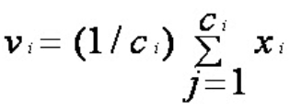
K-means algorithm
Let X = {x1,x2,x3,……..,xn} be the set of data points and V = {v1,v2,…….,vc} be the set of centers.
Randomly select ‘c’ cluster centers.
Calculate the distance between each data point and cluster centers.
Assign the data point to the cluster center whose distance from the cluster center is the minimum of all the cluster centers.
Recalculate the new cluster center using:
where ‘ci’ represents the number of points in the ith cluster.
Recalculate the distance between each data point and newly obtained cluster centers.
If no data point was reassigned then stop, otherwise repeat from step 3).
Advantages - Fast , robust, easy to understand
Disadvantages - requires a priori specification of the number of cluster centers

Slide 6
BIRCH - algorithm
Building a clustering feature CFtree out of the data points, a height-balanced tree data structure.
The algorithm scans all the leaf entries in the initial CF tree to rebuild a smaller CF tree while removing outliers and grouping crowded subclusters into larger ones. This step is marked optional in the original presentation of BIRCH.
Here an agglomerative hierarchical clustering algorithm is applied directly to the subclusters represented by their CF vectors. It also allows the user to specify either the desired number of clusters or the desired diameter threshold for clusters. After this step, a set of clusters is obtained that captures major distribution patterns in the data.
The centroids of the clusters produced in step 3 are used as seeds and redistribute the data points to their closest seeds to obtain a new set of clusters.
Advantages - fast and do not need to know the expected number of clusters beforehand
Disadvantages - Favors only clusters with spherical shape and similar sizes and Handles only numeric data

Slide 7
DBSCAN - algorithm
Let X = {x1, x2, x3, ..., xn} be the set of data points. DBSCAN requires two parameters: ε (eps) and the minimum number of points required to form a cluster (minPts).
Start with an arbitrary starting point that has not been visited.
Extract the neighborhood of this point using ε (All points which are within the ε distance are neighborhood).
If there are sufficient neighborhoods around this point then the clustering process starts and the point is marked as visited else this point is labeled as noise (Later this point can become part of the cluster).
If a point is found to be a part of the cluster then its ε neighborhood is also the part of the cluster and the above procedure from step 2 is repeated for all ε neighborhood points. This is repeated until all points in the cluster are determined.
A new unvisited point is retrieved and processed, leading to further cluster or noise discovery.
This process continues until all points are marked as visited.
Advantages - Does not require a priori specification of the number of clusters and detects noise
Disadvantages- fails in the case of varying density clusters

Slide 8
HDBSCAN - algorithm
Construct the k-nearest-neighbors (k-NN) graph, with an undirected edge connecting each point p to the k most similar points to p. Use the k-NN information to define a new metric called the mutual reachability distance between all pairs of points in the data.
Find the minimum spanning tree (MST) connecting all points in the data according to the mutual reachability distance. This tree represents a hierarchy of clusters, and the individual clusters can be extracted using a simple heuristic.
Advantages - built for the real-world scenario of having data with varying density and relatively fast
Disadvantages - not clear how to use it only with a subset of the data and Two dense data partitions on the bottom are not separated from the large clusters

Slide 9
OPTICS - algorithm
Mark every point in the dataset as unclustered. Corresponding to each point mark both core distance and reachability distance is undefined.
Pick any point and evaluate the neighborhood of that point.
Advantages - doesn’t require a predefined number of clusters and Clusters can be of any shape, including non-spherical ones
Disadvantages - It fails if there are no density drops between clusters

Slide 10
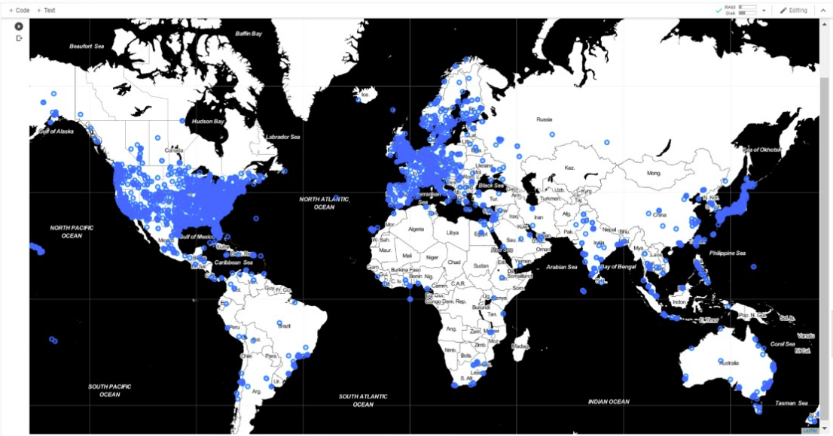

Slide 11
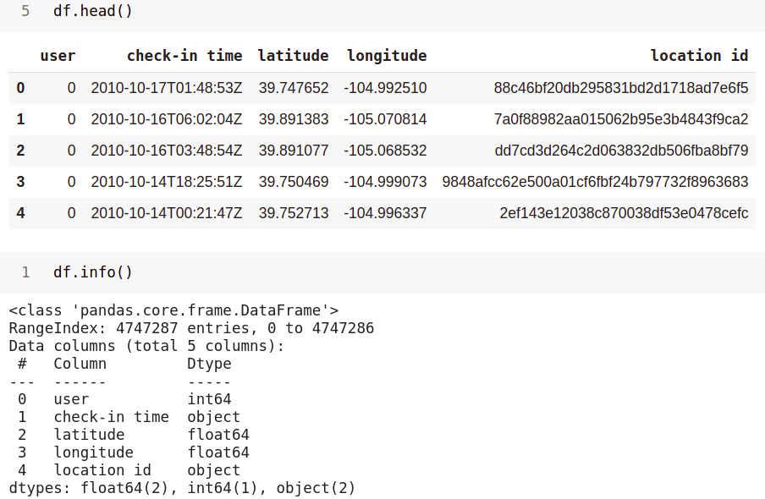
Brightkite Dataset

Slide 12
DBSCAN sklearn std library
(sklearn.cluster.DBSCAN)
class sklearn.cluster.DBSCAN(eps=0.5, *, min_samples=5, metric='euclidean', metric_params=None, algorithm='auto', leaf_size=30, p=None, n_jobs=None)
Parameters:
eps float, default=0.5
The maximum distance between two samples for one to be considered as in the neighborhood of the other.
min_samples int, default=5
The number of samples (or total weight) in a neighborhood for a point to be considered as a core point.

Slide 13
3. metric_params dict, default=None
Additional keyword arguments for the metric function.
4. algorithm{‘auto’, ‘ball_tree’, ‘kd_tree’, ‘brute’}, default=’auto’
The algorithm to be used by the NearestNeighbors module to compute pointwise distances and find nearest neighbors.
5. leaf_size int, default=30
Leaf size passed to BallTree or cKDTree. T
6. pfloat, default=2
The power of the Minkowski metric to be used to calculate distance between points.
7. n_jobs int, default=None
The number of parallel jobs to run.

Slide 14
Attributes:
core_sample_indices_ndarray of shape (n_core_samples,)
Indices of core samples.
components_ndarray of shape (n_core_samples, n_features)
Copy of each core sample found by training.
labels_ndarray of shape (n_samples)
Cluster labels for each point in the dataset given to fit(). Noisy samples are given the label -1.

Slide 15
OPTICS sklearn std library
(sklearn.cluster.OPTICS)
class sklearn.cluster.OPTICS(*min_samples=5,max_eps=inf, metric='minkowski', p=2, metric_params=None, cluster_method='xi', eps=None, xi=0.05, predecessor_correction=True, min_cluster_size=None, algorithm='auto', leaf_size=30, n_jobs=None)
Parameters:
Min_samples : int > 1 or float between 0 and 1, default=5
The number of samples in a neighborhood for a point to be considered as a core point
Max_eps : float, default=np.inf
The maximum distance between two samples for one to be considered as in the neighborhood of the other.
Metric : str or callable, default=’minkowski’
Metric to use for distance computation. Any metric from scikit-learn or scipy.spatial.distance can be used.

Slide 16
4. p: int, default=2
Parameter for the Minkowski metric from pairwise_distances.
5. Cluster_method : str, default=’xi’
The extraction method used to extract clusters using the calculated reachability and ordering.
6. Eps : float, default=None
The maximum distance between two samples for one to be considered as in the neighborhood of the other.
7. xi : float between 0 and 1, default=0.05
Determines the minimum steepness on the reachability plot that constitutes a cluster boundary.
8. predecessor_correctionbool, default=True
Correct clusters according to the predecessors calculated by OPTICS

Slide 17
Attributes :
labels_ : ndarray of shape (n_samples,)
Cluster labels for each point in the dataset given to fit(). Noisy samples and points which are not included in a leaf cluster of cluster_hierarchy_ are labeled as -1.
reachability_ :ndarray of shape (n_samples,)
Reachability distances per sample, indexed by object order.
ordering_ :ndarray of shape (n_samples,)
The cluster ordered list of sample indices.
core_distances_ndarray of shape (n_samples,)
Distance at which each sample becomes a core point, indexed by object order.

Slide 18
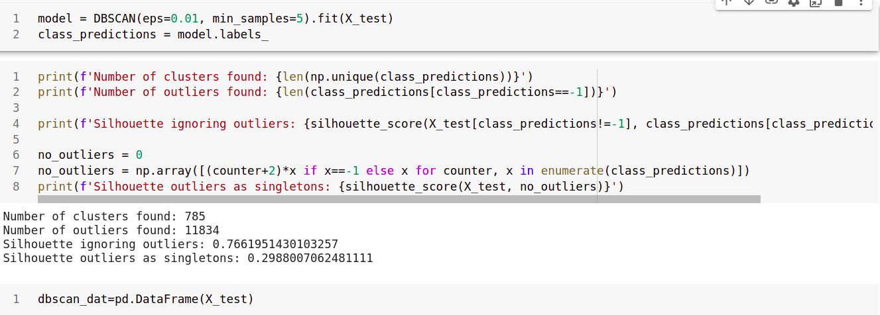
Computing DBSCAN

Slide 19
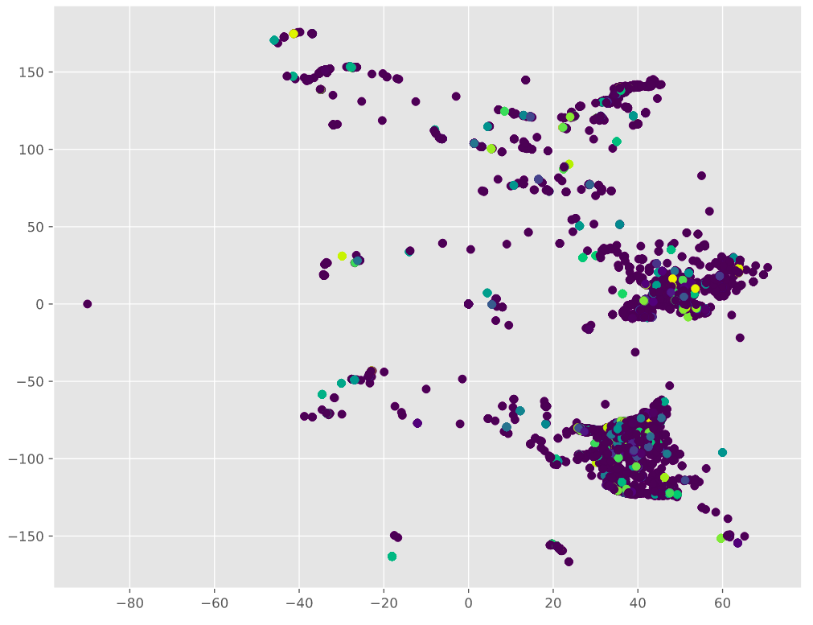

Slide 20
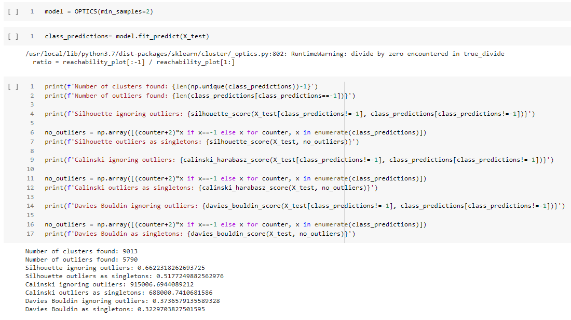
Computing OPTICS

Slide 21
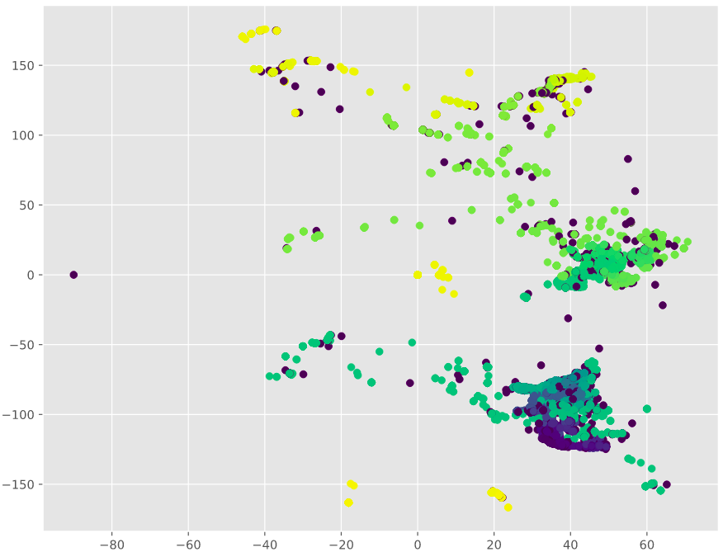

Slide 22
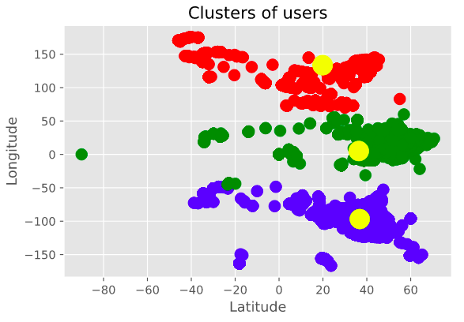

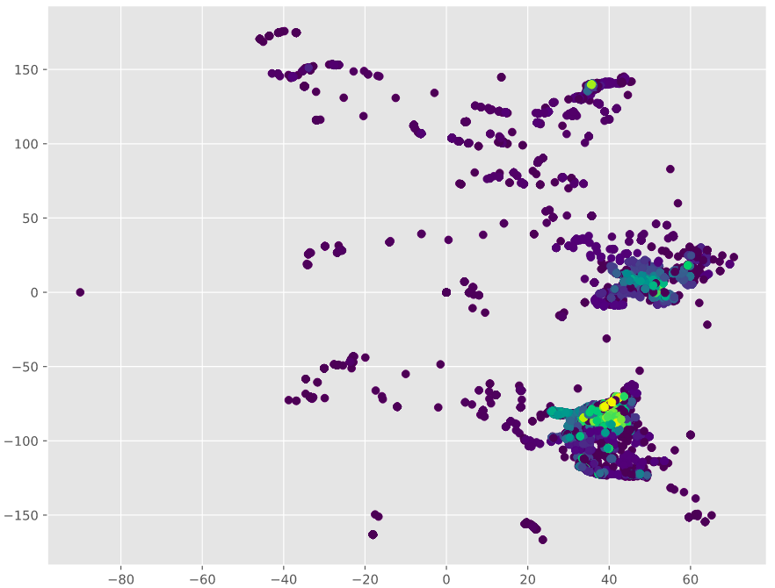
Scatter Plots
K-means
b. DBSCAN
c. HDBSCAN

Slide 23
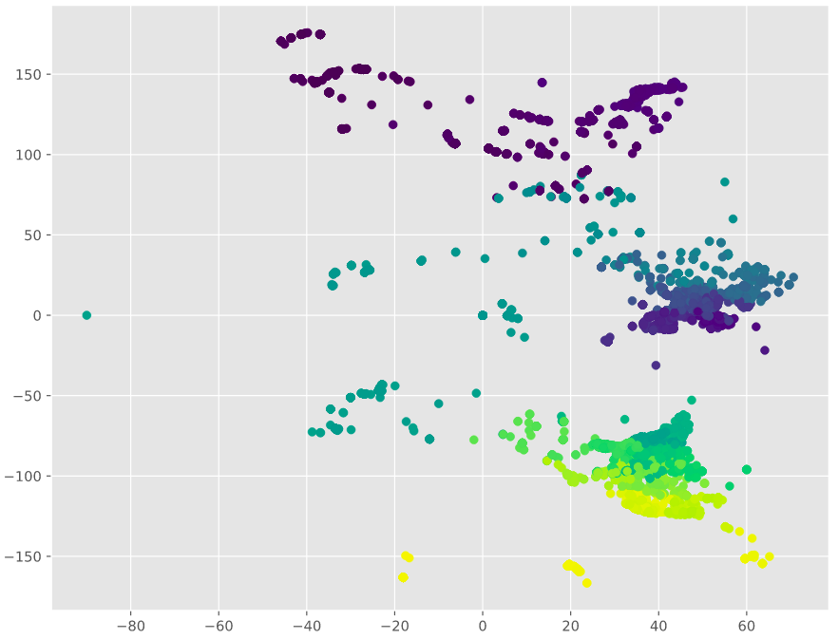
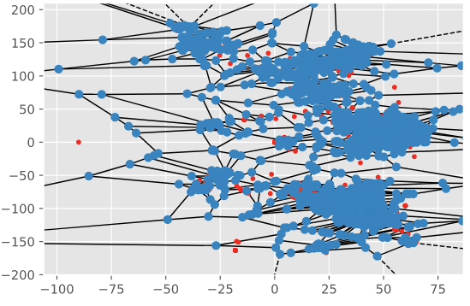
Scatter Plots
d. BIRCH
e. OPTICS
f. Voronoi

Slide 24

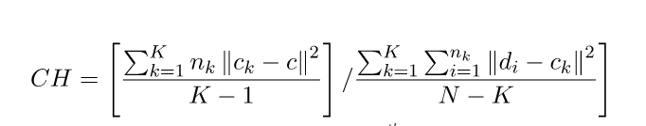
Evaluation metrics
Silhouette score
Silhouette score=(p−q)/max(p,q)
Davies–Bouldin index
Calinski-Harabasz index

Slide 25
OBSERVATION
Algorithm with the highest number of clusters = OPTICS
Algorithm with lowest numbers of clusters = K-means
Algorithm with highest Silhouette score = OPTICS
Algorithm with lowest Silhouette score = HDBSCAN
Algorithm with highest Calinski Harabasz score = DBSCAN
Algorithm with lowest Calinski Harabasz score = K-means
Algorithm with highest Davies Bouldin index = K-means
Algorithm with lowest Davies Bouldin index = DBSCAN

Slide 26
Observations on the datasets
Based on the Silhouette score OPTICS Algorithm performs best
Based on Calinski Harabasz score DBSCAN Algorithm performs the best.
Based on Davies Bouldin score DBSCAN Algorithm performs the best.

Slide 27
THANK YOU

