Slide 1
“Evaluation of Magist for ENIAC Partnership”
Is Magist a suitable partner for Eniac?
Are orders delivered On-Time?
Objective:
Product Performance Analysis
Seller Performance Analysis
Geographical Distribution Analysis
Delivery Performance Analysis
Customer Review Analysis

Slide 2
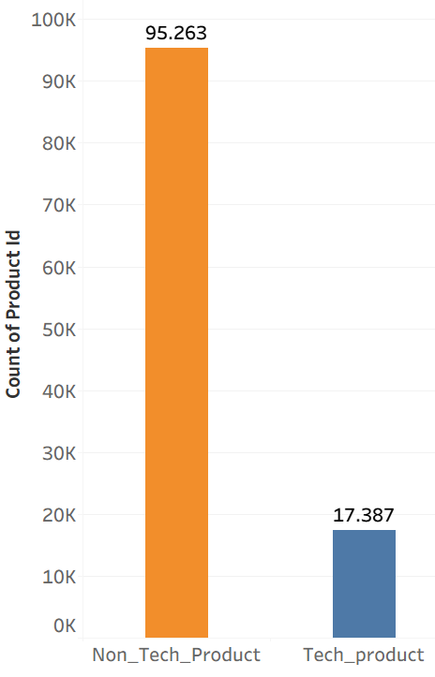
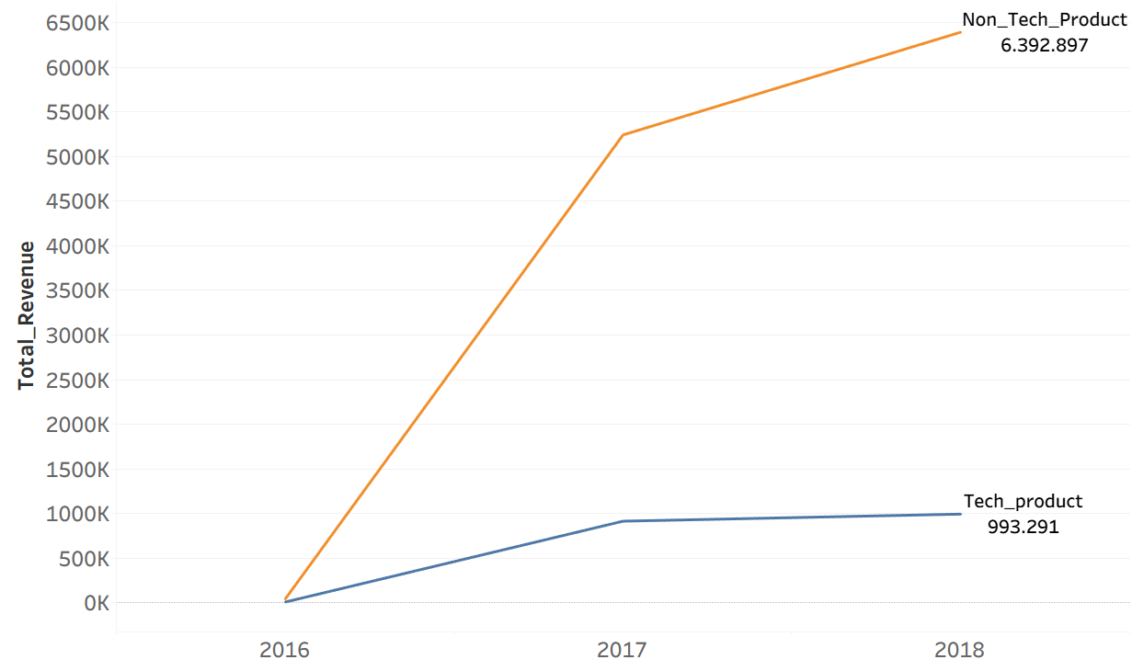
Product Performance Analysis
Product Sold
Revenue

Slide 3


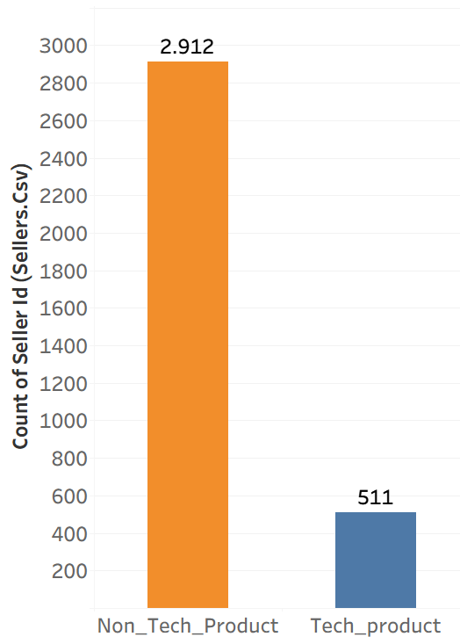
Seller Performance Analysis
Limited product variety
Higher dependency on few sellers –
supply risk.
Hard to grow business without strong seller base.

Slide 4
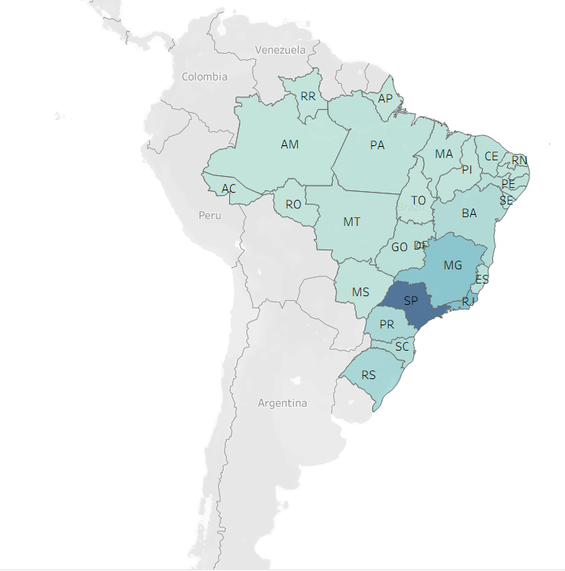

Geographical Distribution Analysis
Business Performance varies across Brazilian states.
Sales are concentrated in a few key states within Brazil.
Geographic distribution is uneven.

Slide 5
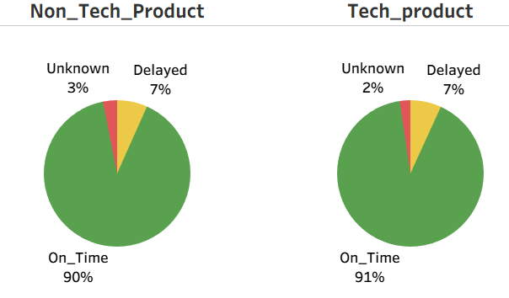
Delivery Performance Analysis
Majority of orders are delivered On_Time .
The delay rate is relatively low.
Unknown delivery indicates missing or incomplete tracking data.
This indicates that Magist has reliable logistics and delivery performance.

Slide 6
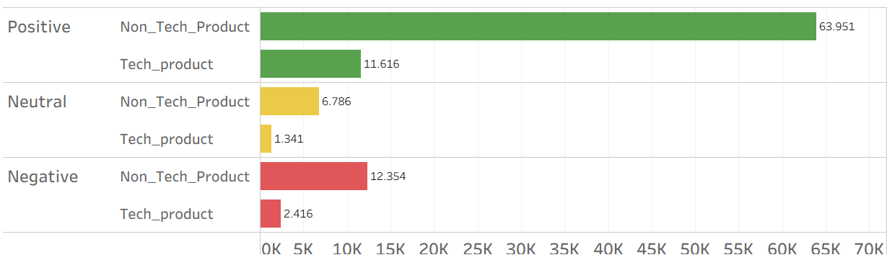
Customer Review Analysis
Non_tech products get more reviews compared to tech products.
Tech products have fewer customer responses or feedback.
Fewer purchases compared to non_tech products.

Slide 7
Conclusion
Eventhough delivery performance on Magist is reliable, tech products contribute only a small portion of Total revenue.
Limited market presence.
Indicates that Magist is not currently an Ideal platform for Eniac’s High-end Tech_products.
Therefore, we do not recommend a full_scale partnership.

Slide 8
Thank you

