Slide 1
“Evaluation of Magist for ENIAC Partnership”
Is Magist a suitable partner for Eniac?
How reliable is Magist’s delivery On-Time?
Objective:
Analyze Product Performance
Evaluate seller strength
Assess delivery reliability
Analyze customer satisfaction
Geographical Performance by Region(Brazil)

Slide 2
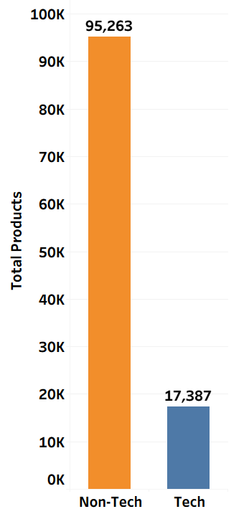
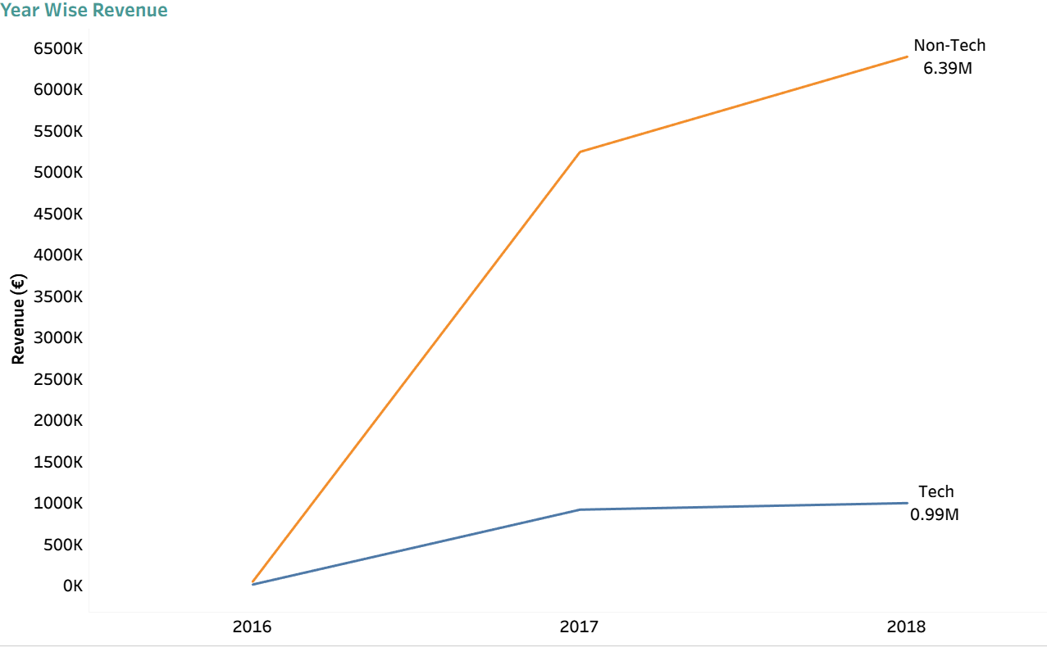
Analyze Product Performance “ How are products performing? ”
Product Sold
Revenue
Non-Tech products dominate sales and revenue .
Tech products show weak demand.
Risk for Eniac core category.

Slide 3

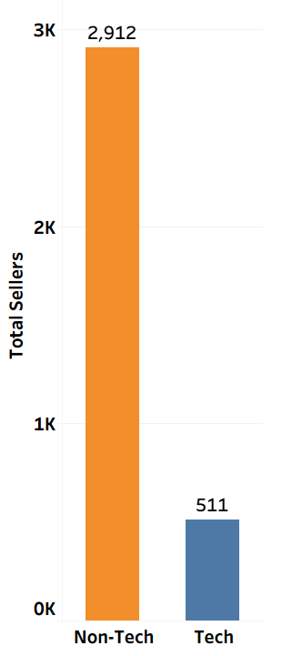

Evaluate seller strength “ Is the seller base strong enough?”
Limited product availability.
Higher dependency on few sellers –
supply risk.
Hard to grow business without strong seller base.

Slide 4
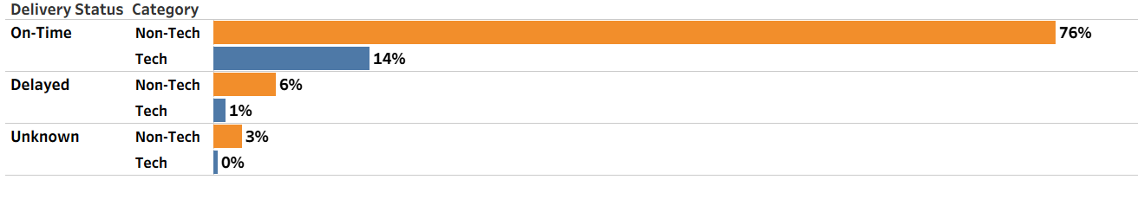
Assess delivery reliability “ How reliable is delivery performance? “
Majority of orders are delivered On-Time .
The delay rate is relatively low.
Unknown delivery indicates missing or incomplete tracking data.
This indicates that Magist has reliable logistics and delivery performance.

Slide 5
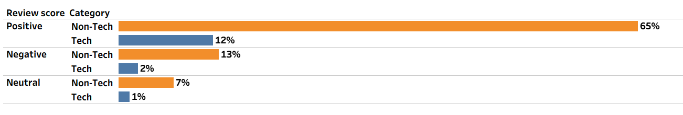
Analyze customer satisfaction “ Are customers satisfied with products? “
Non-Tech products get more reviews compared to Tech products.
Tech products have fewer customer responses or feedback.
Fewer purchases compared to Non-Tech products.

Slide 6
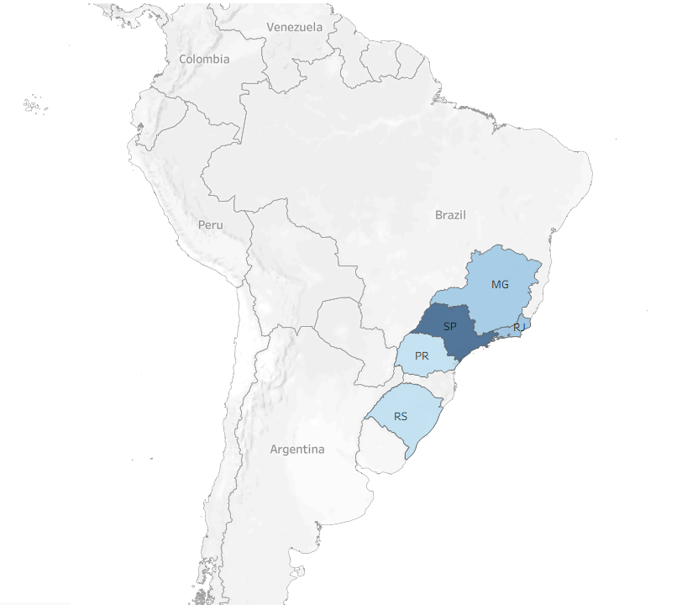
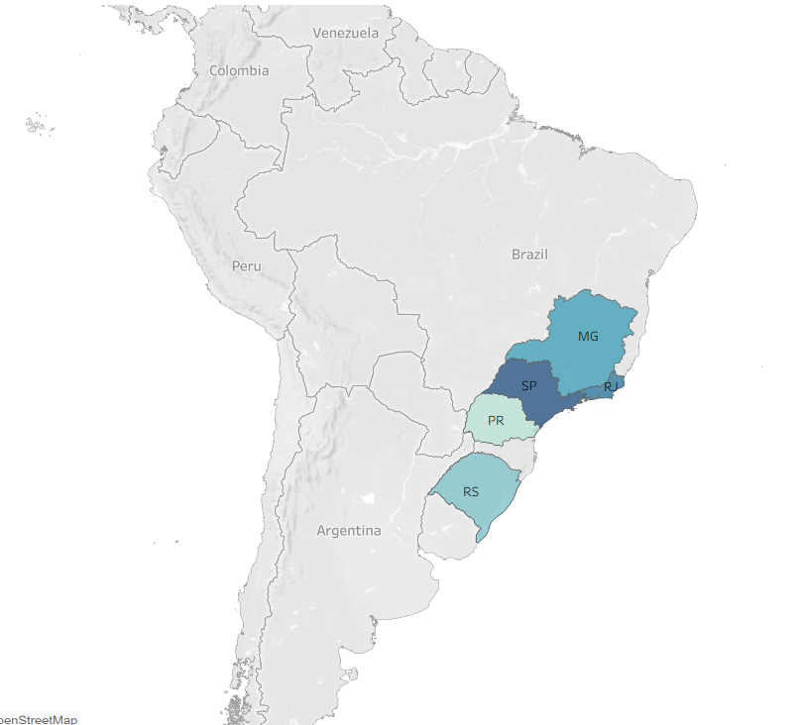
Geographical Performance by Region(Brazil) “ Which regions drive the most sales and On-Time delivery? ”
Top Revenue States
Top On-Time Delivery States
Sales performance varies significantly across Brazilian states.
The majority of sales are concentrated in the top three states: São Paulo (SP), Minas Gerais (MG), and Rio de Janeiro (RJ).
On-time delivery performance follows a similar geographic pattern, with the highest efficiency concentrated in the Southeast.
Both revenue and delivery metrics are strongest in the Southern and Southeastern regions (SP, MG, RJ, PR, and RS).

Slide 7
Conclusion
Even though delivery performance on Magist is reliable, Tech products contribute only a small portion of Total revenue.
Limited market presence.
Indicates that Magist is not currently an Ideal platform for Eniac’s High-end Tech-products.
Therefore, we do not recommend a full-scale partnership.

