Slide 1
P, NP, PS, and NPS
By Muhannad Harrim

Slide 2
Class P
P is the complexity class containing decision problems which can be solved by a Deterministic Turing machine (DTM) using a polynomial amount of computation time, or polynomial time.
P is often taken to be the class of computational problems which are "efficiently solvable" or "tractable“.
But P also contains problems which are intractable in practical terms; for example, some require at least n¹ºººººº operations

Slide 3
Deterministic Turing machine (DTM)
DTM is:
A Turing machine model (basic symbol-manipulating device which, despite its simplicity, can be adapted to simulate the logic of any computer).
Consists of a finite state control, a read/write head, and a tape made up of a two-way infinite sequence of tape squares (or cells).

Slide 4
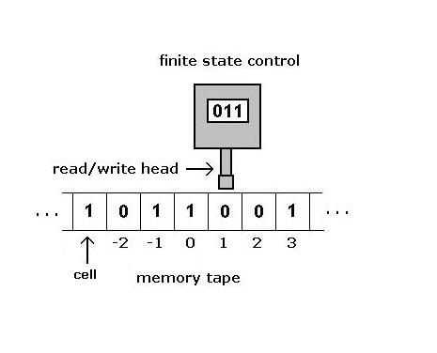
Deterministic Turing machine (DTM)

Slide 5
Deterministic Turing machine (DTM)
Hopcroft and Ullman define a one-tape Turing machine formula: M=(Q, Γ, b, ∑, δ, qo, F) where:
Q is a finite set of states
Γ is a finite set of the tape alphabet/symbols
b is the blank symbol (the only symbol allowed to occur on the tape infinitely often at any step during the computation) - Delimiter
Σ, a subset of Γ not including b is the set of input symbols
δ = Q x Γ → Q x Γ x {L,R} is a partial function called the transition function, where L is left shift, R is right shift.
qo is the initial state
F is the set of final or accepting states

Slide 6
Deterministic Turing machine (DTM)
A DTM program M with alphabet ∑ accepts any x: x є ∑* iff M halts in the acceptance final state (q_{Y}) when applied input x.
→ The language L_{M} recognized by the program M as the following:
L_{M} = { x є ∑* : M accepts x }

Slide 7
Class P & DTM
A formal definition for Class P with respect to DTM would be given as follows:
P = { L: there is a polynomial time DTM
program M for which L = L_{M} }

Slide 8
Class P & DTM
Conclusion:
A decision problem π belongs to P under the encoding scheme e if L(π, e) belongs to P, that is if there is a polynomial time DTM that solves π under encoding scheme e.

Slide 9
Class NP
The class NP is defined informally to be the class of all decision problems π which, under reasonable encoding schemes, can be solved “verified” by polynomial time using Non-Deterministic Turing machines (NDTM).
- Polynomial time verifiability doesn’t imply
polynomial time solvability.

Slide 10
Nondeterministic Turing machine
(NDTM)
NDTM model has exactly the same structure of DTM except it’s featured with a guessing module that has its own write only head.
The guessing module’s main purpose is providing the means for writing down the “guess” into the tape.

Slide 11
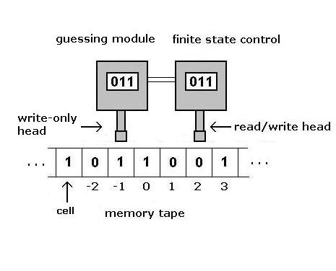
Nondeterministic Turing machine
(NDTM)

Slide 12
Nondeterministic Turing machine
(NDTM)
NDTM is also specified exactly the same way as DTM with respect to tape alphabet, input alphabet, blank symbol, states set, initial and final states, and the transition function.
However, It differs from DTM in the computation process, where in NDTM it takes two stages: the guessing and the checking.

Slide 13
Nondeterministic Turing machine
(NDTM)
If NDTM program stops at a q_{Y} then, then the computation is considered as an accepting computation.
Otherwise, All other computations (halting or not) are considered to be a non-accepting computation.

Slide 14
Nondeterministic Turing machine
(NDTM)
Also, a NDTM will have an infinite number of possible computations for a given input string x.
NDTM accepts x iff at least one of the possible structures (computations) is an accepting one.
L_{M} = { x є ∑* : M accepts x }

Slide 15
Class NP and NDTM
A formal definition for Class NP in respect to NDTM :
NP = { L : there is a polynomial time NDTM program M for which L_{M} = L }

Slide 16
Class NP and NDTM
Conclusion :
A decision problem π belongs to NP under the encoding scheme e if L(π, e) belongs to NP, that is if there is a polynomial time NDTM that “solves” (verifies) π under encoding scheme e.

Slide 17
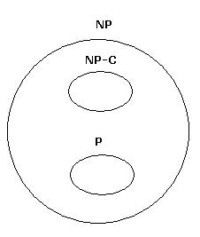
Class P and Class NP

Slide 18
Class P and Class NP
A controversial question:
Is P = NP ?

Slide 19
Polynomial Space (PS)
The emphasis on the computation resources is usually on the time used to perform the computation process (especially when measuring a performance issue or complexity).
However, the amount of space required is often just as important ( called the space requirement ).

Slide 20
Polynomial Space (PS)
In any Turing machine:
  the time used is the number of steps taken before halting or entering a final state.
  The space required is defined as the number of distinct tape squares (cells) “visited” by the read/write head.

Slide 21
Polynomial Space (PS)
Proof
Since the time taken to visit all cells < = the time used, then
the number of cells visited < = the time used.
→ the number of cells visited cannot be more than the steps of
computation
This implies:
Any Polynomial Solvable in polynomial time, It’s
solvable in polynomial space.

Slide 22
Polynomial Space (PS)
Although all problems solvable in polynomial time can be solved in polynomial space, it is still a controversial and unresolved question whether there exist problems solvable in polynomial space which cannot be solved in polynomial time.
- This is so difficult to conclude since all problems in NP,
including P and NP-C problems are solved in both polynomial
space and polynomial time.

Slide 23
Polynomial Space (PS)
PS
is the class of all languages recognizable by
polynomial space bounded DTM that halts
on all inputs.
i.e. All and Only the languages that are L_{M}
for some polynomial space bounded DTM M.

Slide 24
Nondeterministic Polynomial Space (NPS)
NPS
is the class of all languages recognizable by
polynomial space bounded NDTM that halts
on at least one of the possible input
structures.
i.e. All and Only the languages that are L_{M}
for some polynomial space
bounded NDTM M.

Slide 25
PS and NPS
Evidently, PS є NPS, since every DTM is technically NDTM.
However, The surprising result is that:
PS = NPS

Slide 26
PS and NPS
Theorem
If M is a polynomial-space bounded TM
(deterministic or nondeterministic), and p(n)
is its polynomial space bound, then there is a
constant c such that if M accepts its input w
of length n, it does so within c^{1 + p(n)} moves

Slide 27
PS and NPS
Proof
The essential idea is that M must repeat an ID (cell index) before making more than c^{1 + p(n)} moves
Having a constant c implies that there is a limited number of ID’s if already there is a limited space used in the TM.
Let t be the number of tape symbols of M
Let s be the number of states of M
Then the number of different ID’s of M when only p(n) tape cells are
visited is at most s x p(n) x t ^{p(n)}

Slide 28
PS and NPS
if c = t + s, then the binomial expansion of (t + s)^{1 + p(n)} is t^{1+ p(n)} + (1 + p(n)) s t ^{p(n)} + …
In the expression, notice that the underlined term is at least as large as s p(n) t ^{p(n)}
This proves that c^{1 + p(n)} is at least equal to the number of possible ID’s of M

Slide 29
PS and NPS
M accepts w of length n with sequence of moves that doesn’t repeat any ID
So → M accepts inputs by a sequence of moves that is less or equal to the number of distinct ID’s, which is c^{1 + p(n)}

Slide 30
PS and NPS
Savitch’s Theorem
PS = NPS

Slide 31
PS and NPS
To be more accurate
Savitch’s Theorem states that any
p(n)-space NDTM can be converted to a p2(n)-space DTM
one of the earliest results on space complexity

Slide 32
PS and NPS
Proof
The core of the proof lies on simulating a NDTM that has a polynomial space bound p(n) into a DTM with polynomial space bound of complexity O( p²(n) )

Slide 33
PS and NPS
This is done through a recursive program that tries to test whether a NDTM N can move from ID I to ID J in at most m moves
Let’s have a function called reach(I, J, m)
that decides if I can yield to J in m moves

Slide 34
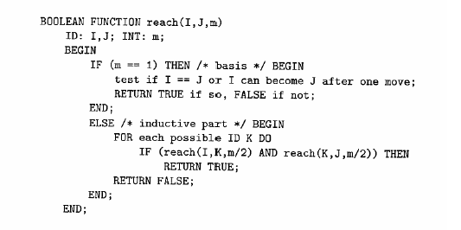
PS and NPS

Slide 35
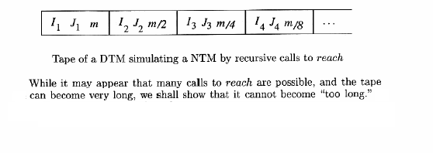
PS and NPS

Slide 36
PS and NPS
Assumptions
  If NDTM N accepts, it does it within c^{1 + p(n)} steps
  Given input w of length n
  DTM D discovers what N does with input w by
  calling the function reach(I₀,J,m) recursively where:
    I₀ is the initial ID of N with input w
    J is any accepting ID that uses at most p(n) tape cells
    m = c^{1 + p(n)}

Slide 37
PS and NPS
the recursive function imposes that there will never be more than log₂ m recursive calls that are active simultaneously
i.e one with m/2, one with m/4, … , down to 1
→ So, the upper bound of the number of stack
frames is no more than log₂(m) on the stack
→ log₂(m) is O( p(n) )

Slide 38
PS and NPS
So, D contains at most log₂(m) stack frames = (O( pn ))
The stack frames themselves require log₂(m) space, the reason is that the two ID’s each require only 1+p(n) cells to write down m, and m in binary requires log₂ c^{1 + p(n)} → log₂(m) = (O( pn ))
The total space required in D to simulate N is log₂ ²(m) → which is also O( p²(n) )

Slide 39
PS and NPS
The space bound of complexity O( p²(n) ) is
polynomial iff p(n) is polynomial
p(n) is polynomial
Then there is a polynomial space bound
DTM that corresponds to a polynomial space
bound NDTM

Slide 40
PS and NPS
So, after all:
PS = NPS

Slide 41
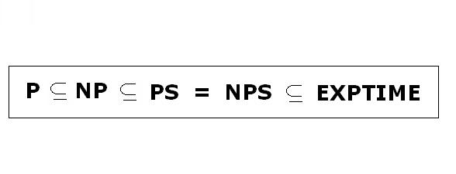
PS and NPS
At the End, we conclude that:

Slide 42
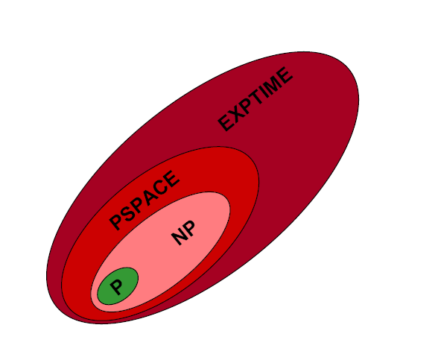
PS and NPS

