Slide 1
Linear algebra for ai/ml
Jiaul Paik

Slide 2
Topics today
Basics of Eigenvalue & Eigenvector
Data reduction
Auto-encoder
Principal Component Analysis

Slide 3
Autoencoder using Deep Neural Network

Slide 4
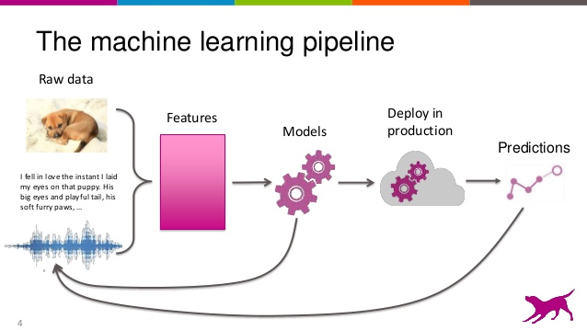
Feature Engineering: Feature Extraction
Features are generated by applying some function on the raw data

Slide 5
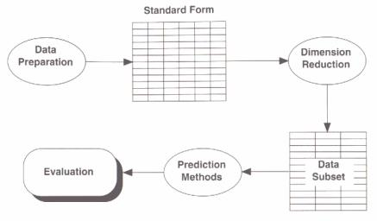
Feature/Dimensionality Reduction

Slide 6

Neural Network
Example 4 layer network with 2 output units:
x₁
x₂
x₃
Layer 4
Layer 3
Layer 1
Layer 2

Slide 7


Training a neural network
Given training set (x₁, y₁), (x₂, y₂), (x₃, y₃ ), ….
Adjust parameters θ (for every node) to make:
(Use gradient descent. “Backpropagation” algorithm.)

Slide 8

Feature generation/reduction with a neural network
Autoencoder.
Network is trained to output the input (learn identify function).
x₁
x₁
x₂
x₂
a₁
x₃
x₃
a₂
x₄
x₄
a₃
x₅
x₅
x₆
x₆
Layer 1
Layer 2
Layer 3

Slide 9
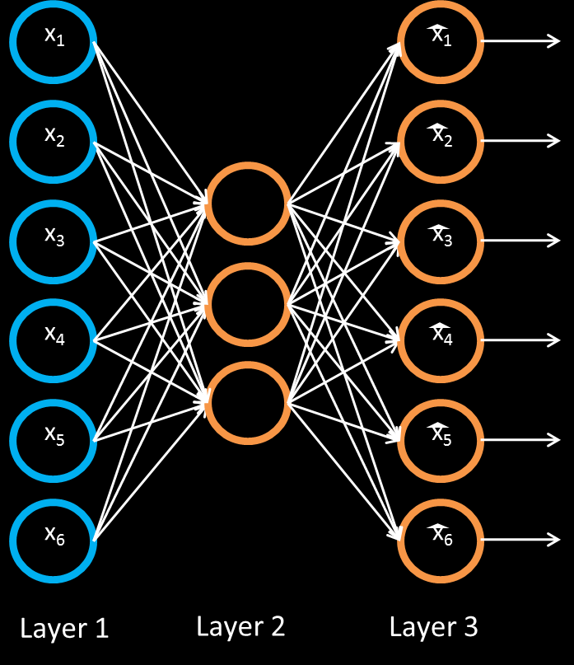
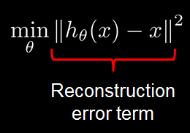
Feature generation/reduction with a neural network
Training a sparse autoencoder.
Given unlabeled training set x₁, x₂, …
Objective function:

Slide 10
Feature generation/reduction with a neural network
x₁
x₁
x₂
x₂
a₁
x₃
x₃
a₂
x₄
x₄
a₃
x₅
x₅
x₆
x₆
Layer 1
Layer 2
Layer 3

Slide 11

Feature generation/reduction with a neural network
x₁
x₂
a₁
x₃
a₂
x₄
a₃
x₅
New representation for input.
x₆
Layer 1
Layer 2

Slide 12
Feature generation/reduction with a neural network
x₁
x₂
a₁
x₃
a₂
x₄
a₃
x₅
x₆
Layer 1
Layer 2

Slide 13

Feature generation/reduction with a neural network
x₁
x₂
a₁
b₁
x₃
a₂
b₂
x₄
a₃
b₃
x₅
x₆
Train parameters so that

Slide 14
Feature generation/reduction with a neural network
x₁
x₂
a₁
b₁
x₃
a₂
b₂
x₄
a₃
b₃
x₅
x₆
Train parameters so that

Slide 15

Feature generation/reduction with a neural network
x₁
x₂
a₁
b₁
x₃
a₂
b₂
x₄
a₃
b₃
x₅
New representation for input.
x₆

Slide 16
Feature generation/reduction with a neural network
x₁
x₂
a₁
b₁
x₃
a₂
b₂
x₄
a₃
b₃
x₅
x₆

Slide 17

Feature generation/reduction with a neural network
x₁
x₂
a₁
b₁
c₁
x₃
a₂
b₂
c₂
x₄
a₃
b₃
c₃
x₅
x₆

Slide 18

Feature generation/reduction with a neural network
x₁
x₂
a₁
b₁
c₁
x₃
a₂
b₂
c₂
x₄
a₃
b₃
c₃
x₅
New representation
for input.
x₆
Use [c₁, c₃, c₃] as representation to feed to learning algorithm.

Slide 19
Principal Component Analysis (PCA)

Slide 20
Data Reduction
Summarization of data with many (p) variables by a smaller set of (k) derived (latent, composite) variables.
p
k
A
X
n
n

Slide 21
Data Presentation: Key questions?
Do we need a all n-dimension space to view data?
Better presentation (new axes) than original axes?
How to find the ‘best’ low dimension space that conveys maximum useful information?
One answer: Find “Principal Components”

Slide 22
Principal Components
All principal components (PCs) start at the origin
First PC is direction of maximum variance
Subsequent PCs are orthogonal to 1st PC and describe maximum residual variance
30
25
20
PC 1
y
15
10
5
0
0
5
10
15
20
25
30
x
30
25
20
PC 2
y
15
10
5
0
0
5
10
15
20
25
30
x

Slide 23
The Goal
We wish to summarize the underlying variance-covariance structure of a large set of variables through a few linear combinations of these variables.

Slide 24
Trick: Rotate Coordinate Axes
Suppose we have p features x₁,…,x_{p}.
Our goal is to develop a new set of p axes (linear combinations of the original p axes) in the directions of greatest variability:
This is accomplished by rotating the axes.
X₂
X₁

