Slide 1
Linear Algebra for AI/ML
Jiaul Paik

Slide 2
Latent Semantic Analysis of Text with SVD
Term-document matrices are very large
But the number of topics that people talk about is small (in some sense)
Clothes, movies, politics, …
Can we represent the term-document space by a lower dimensional latent space?

Slide 3
Similarity → Clustering
We can compute the similarity between two document vector representations x_{i} and x_{j} by x_{i}x_{j}^{T}
Let X = [x₁ … x_{N}]
Then XX^{T} is a matrix of similarities
X_{ij} is symmetric
So XX^{T} = QΛQ^{T}
So we can decompose this similarity space into a set of orthonormal basis vectors (given in Q) scaled by the eigenvalues in Λ
17

Slide 4
Singular Value Decomposition
For an M ⋅ N matrix A of rank r there exists a
factorization (Singular Value Decomposition = SVD)
as follows:
M⋅M
M⋅N
V is N⋅N

Slide 5
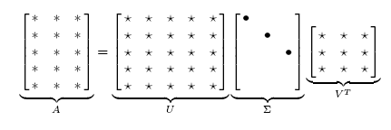
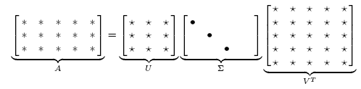
Singular Value Decomposition
Illustration of SVD dimensions and sparseness

Slide 6
Low-rank Approximation
Solution via SVD
set smallest r-k singular values to zero
k

Slide 7
Reduced SVD
If we retain only k singular values, and set the rest to 0, then we don’t need the matrix parts in color
Then Σ is k×k, U is M×k, V^{T} is k×N, and A_{k} is M×N
This is referred to as the reduced SVD
It is the convenient (space-saving) and usual form for computational applications
k

Slide 8
Latent Semantic Indexing via the SVD

Slide 9
What it is
From term-doc matrix A, we compute the approximation A_{k.}
There is a row for each term and a column for each doc in A_{k}
Thus docs live in a space of k<<r dimensions
These dimensions are not the original axes
But why?

Slide 10
Text Mining/NLP: Vector Space Model
Automatic selection of index terms
Partial matching of queries and documents (dealing with the case where no document contains all search terms)
Ranking according to similarity score (dealing with large result sets)
Term weighting schemes (improves retrieval performance)
Various extensions
Document clustering
Relevance feedback (modifying query vector)
Geometric foundation

Slide 11
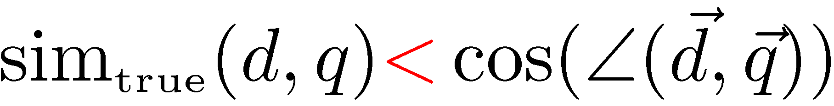
Problems with Lexical Semantics
Ambiguity and association in natural language
Polysemy: Words often have a multitude of meanings and different types of usage (more severe in very heterogeneous collections).
The vector space model is unable to discriminate between different meanings of the same word.

Slide 12
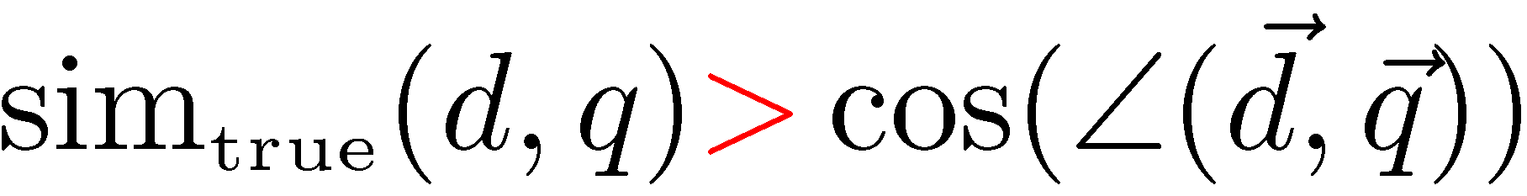
Problems with Lexical Semantics
Synonymy: Different terms may have an identical or a similar meaning (weaker: words indicating the same topic).
No associations between words are made in the vector space representation.

Slide 13
Polysemy and Context
Document similarity on single word level: polysemy and context
ring
jupiter
•••
space
voyager
meaning 1
…
planet
...
…
saturn
...
meaning 2
car
company
•••
dodge
ford
contribution to similarity, if used in 1st meaning, but not if in 2nd

Slide 14
Latent Semantic Analysis (LSA)
Perform a low-rank approximation of document-term matrix
General idea
Map documents (and terms) to a low-dimensional representation.
Design a mapping such that the low-dimensional space reflects semantic associations (latent semantic space).
Compute document similarity based on the inner product in this latent semantic space

Slide 15
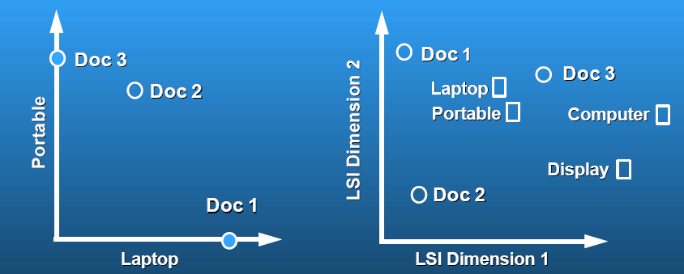
Latent Semantic Analysis
Latent semantic space: illustrating example
courtesy of Susan Dumais

Slide 16
LSA Example
37

Slide 17
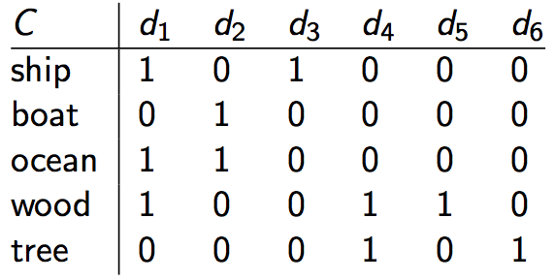
LSA Example
A simple example term-document matrix (binary)
37

Slide 18
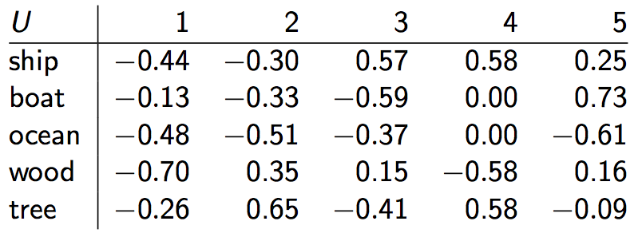

LSA Example
Example of C = UΣ$V^{T}$: The matrix U
38
Notes:
Semantic dimensions: column 2 = land/water.
One row per term, one column per min(M,N) where M is the number of terms and N is the number of documents.
This is an orthonormal matrix: (i) Row vectors have unit length. (ii) Any two distinct row vectors are orthogonal to each other.
Think of the dimensions as “semantic” dimensions that capture distinct topics like politics, sports, economics. 2 = land/water
Each number uij in the matrix indicates how strongly related term i is to the topic represented by semantic dimension j.

Slide 19
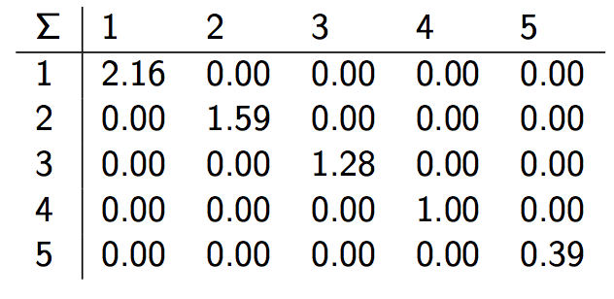

LSA Example
Example of C = UΣ$V^{T}$: The matrix Σ
39
Notes:
This is a square, diagonal matrix of dimensionality min(M, N) × min(M, N).
The diagonal consists of the singular values of C. The magnitude of the singular value measures the importance of
the corresponding semantic dimension. We’ll make use of this by omitting unimportant dimensions.

Slide 20
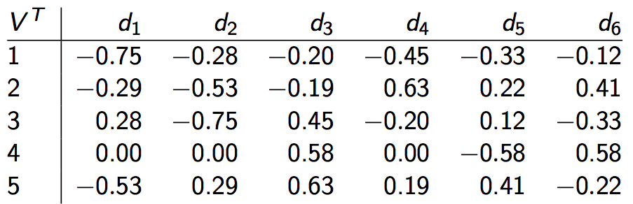
LSA Example
Example of C = UΣV^{T}: The matrix V^{T}
40
Notes:
One column per document, one row per min(M,N) where M is the number of terms and N is the number of documents.
Again: This is an orthonormal matrix: (i) Column vectors have unit length. (ii) Any two distinct column vectors are orthogonal to each other.
These are again the semantic dimensions from matrices U and Σ that capture distinct topics like politics, sports, economics.
Each number vij in the matrix indicates how strongly related
document i is to the topic represented by semantic dimension

Slide 21
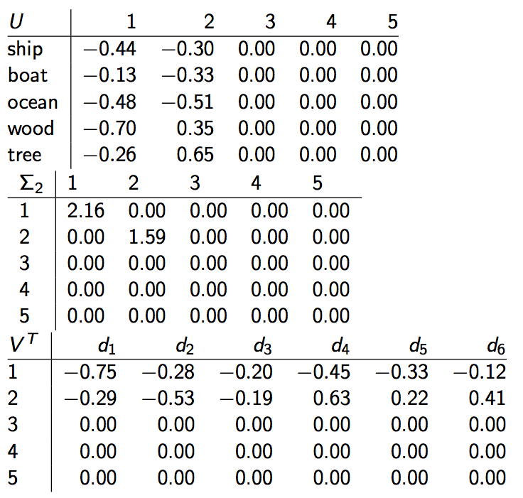
LSA Example: Reducing the dimension
41

Slide 22
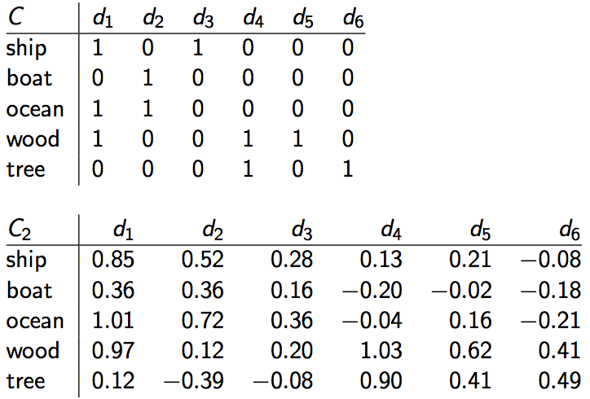
Original matrix C vs. C₂ = UΣ₂V^{T}
42

Slide 23
Why the reduced dimension matrix is better
Similarity of d2 and d3 in the original space: 0.
Similarity of d2 and d3 in the reduced space:
0.52 ∗ 0.28 + 0.36 ∗ 0.16 + 0.72 ∗ 0.36 + 0.12 ∗ 0.20 + −0.39 ∗ −0.08 ≈ 0.52
43

Slide 24
Simplistic picture
Topic 1
Topic 2
Topic 3

Slide 25
LSI has many other applications
In many settings in pattern recognition and retrieval, we have a feature-object matrix.
For text, the terms are features and the docs are objects.
Could be opinions and users …
This matrix may be redundant in dimensionality.
Can work with low-rank approximation.
If entries are missing (e.g., users’ opinions), can recover if dimensionality is low.
Powerful general analytical technique
Close, principled analog to clustering methods.

Slide 26
Thank you!

