Slide 1
Linear Algebra for AI/ML
Jiaul Paik

Slide 2
Topics
Recommender Systems
Content Filtering
Collaborative Filtering
CF: Neighborhood Methods
CF: Latent Factor Methods
Matrix Factorization
User / item vectors
Prediction model
Training by SGD

Slide 3
Recommender Systems
A Common Challenge:
Assume you’re a company selling items of some sort: movies, songs, products, etc.
Company collects millions of ratings from users of their items
To maximize profit / user happiness, you want to recommend items that users are likely to want

Slide 4

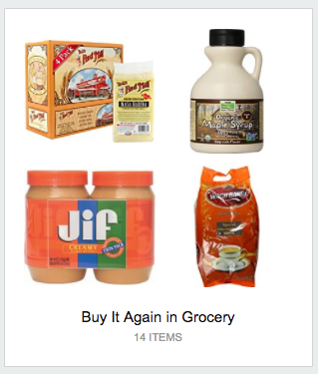
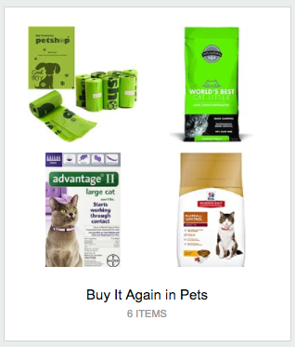

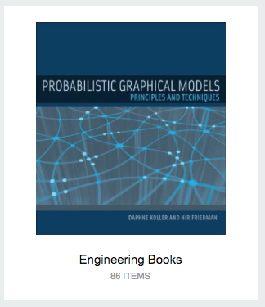
Recommender Systems

Slide 5
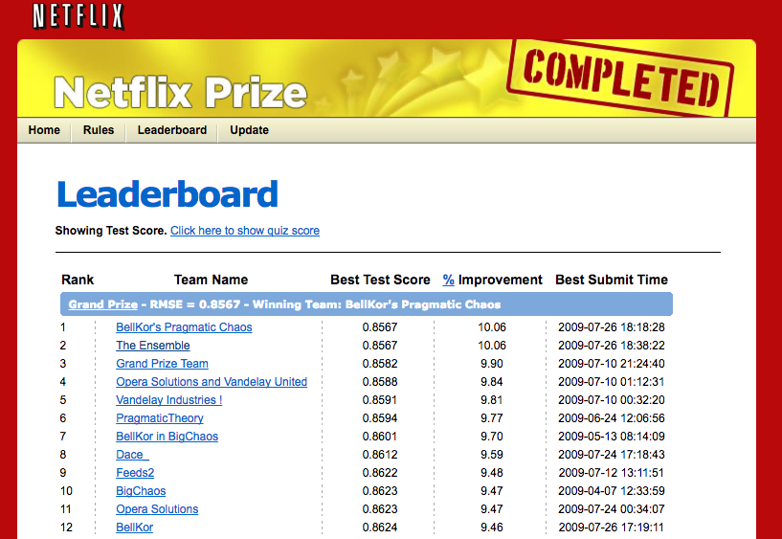
Recommender Systems
Problem Setup
500,000 users
20,000 movies
100 million ratings
Goal: To obtain lower root mean squared error (RMSE) than Netflix’s existing system on 3 million held out ratings

Slide 6
Recommender Systems
Setup:
Items: movies, songs, products, etc. (often many thousands)
Users: watchers, listeners, purchasers, etc. (often many millions)
Feedback: 5-star ratings, not-clicking ‘next’, purchases, etc.
Key Assumptions:
Can represent ratings numerically as a user/item matrix
Users only rate a small number of items (the matrix is sparse)
 | Doctor Strange | Star Trek: Beyond | Zootopia
Alice | 1 |  | 5
Bob | 3 | 4
Charlie | 3 | 5 | 2

Slide 7
Two Types of Recommender Systems
Content Filtering
Collaborative Filtering
Example: Pandora.com music recommendations (Music Genome Project)
Con: Assumes access to side information about items (e.g. properties of a song)
Pro: Got a new item to add? No problem, just be sure to include the side information
Example: Netflix movie recommendations
Pro: Does not assume access to side information about items (e.g. does not need to know about movie genres)
Con: Does not work on new items that have no ratings

Slide 8
Collaborative Filtering
Everyday Examples of Collaborative Filtering...
Bestseller lists
Top 40 music lists
The “recent returns” shelf at the library
Unmarked but well-used paths thru the woods
The printer room at work
“Read any good books lately?”
…
Common insight: personal tastes are correlated
If Alice and Bob both like X and Alice likes Y then Bob is more likely to like Y
especially (perhaps) if Bob knows Alice

Slide 9
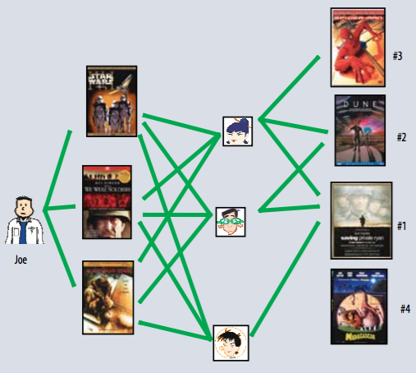
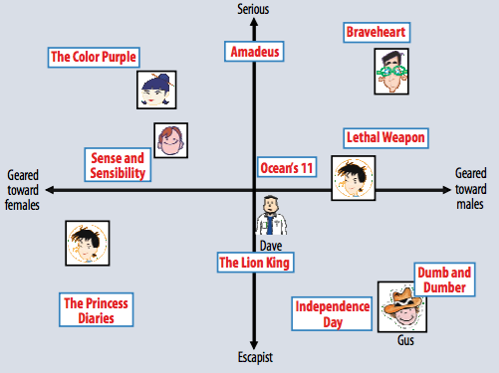
Two Types of Collaborative Filtering
1. Neighborhood Methods
2. Latent Factor Methods
Koren et al. (2009)

Slide 10
Two Types of Collaborative Filtering
1. Neighborhood Methods
In the figure, assume that a green line indicates the movie was watched
Algorithm:
Find neighbors based on similarity of movie preferences
Recommend movies that those neighbors watched
Koren et al. (2009)

Slide 11
Two Types of Collaborative Filtering
2. Latent Factor Methods
Assume that both movies and users live in some low-dimensional space describing their properties
Recommend a movie based on its proximity to the user in the latent space
Koren et al. (2009)

Slide 12
Matrix Factorization

Slide 13
Matrix Factorization
(with matrices)
User vectors:
Item vectors:
Rating prediction:
Figures from Koren et al. (2009)
Figures from Gemulla et al. (2011)

Slide 14
Matrix Factorization
(with vectors)
User vectors:
Item vectors:
Rating prediction:
Figures from Koren et al. (2009)

Slide 15
Matrix Factorization
(with vectors)
Figures from Koren et al. (2009)
Set of non-zero entries:
Objective:

Slide 16
Matrix Factorization
(with vectors)
Regularized Objective:
SGD update for random (u,i):
Figures from Koren et al. (2009)

Slide 17
Matrix Factorization
(with vectors)
Regularized Objective:
SGD update for random (u,i):
Figures from Koren et al. (2009)

Slide 18
Matrix Factorization
(with matrices)
User vectors:
Item vectors:
Rating prediction:
Figures from Koren et al. (2009)
Figures from Gemulla et al. (2011)

Slide 19
Matrix Factorization
(with matrices)
SGD
Figures from Koren et al. (2009)
Figure from Gemulla et al. (2011)
Figure from Gemulla et al. (2011)

Slide 20
Thank you!

