Slide 1
Eigenvalues and Eigenvectors

Slide 2
Refs
https://medium.com/sho-jp/linear-algebra-part-6-eigenvalues-and-eigenvectors-35365dc4365a

Slide 3
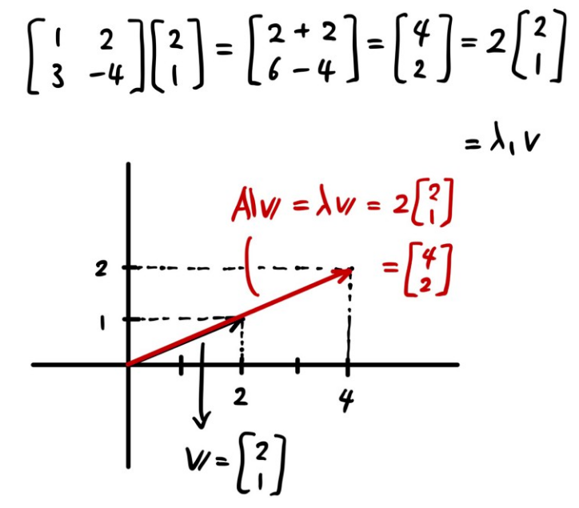

Eigenvectors are the vectors that does not change its orientation when multiplied by the transition matrix, but it just scales by a factor of corresponding eigenvalues.

Slide 4
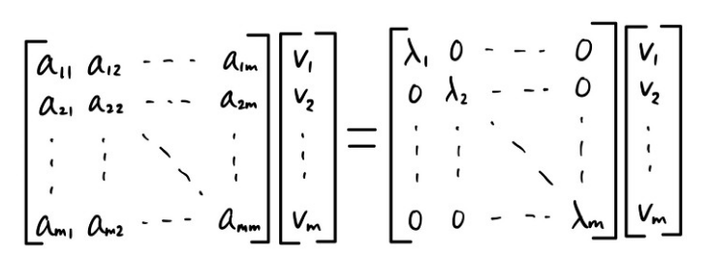
In diagonal Form:

Slide 5
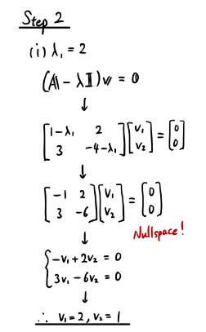
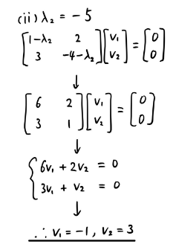
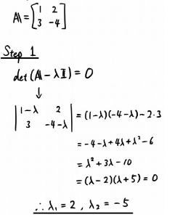
Steps to Obtain Eigen Vectors

Slide 6
Power Method
The Power Method is used to find a dominant eigenvalue (one having the largest absolute value), if one exists, and a corresponding eigenvector.
Eigenvalues of an matrix A are obtained by solving its characteristic equation:

Slide 7
For large values of n, polynomial equations like this one are difficult and time-consuming to solve.
Moreover, numerical techniques for approximating roots of polynomial equations of high degree are sensitive to rounding errors.
Alternative method:
find the eigenvalue of A that is largest in absolute value—we call this eigenvalue the
dominant eigenvalue of A.
Although this restriction may seem severe, dominant eigenvalues are of primary interest in many physical applications.

Slide 8
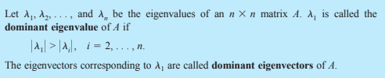
Dominant Eigenvalue and Dominant Eigenvector

Slide 9
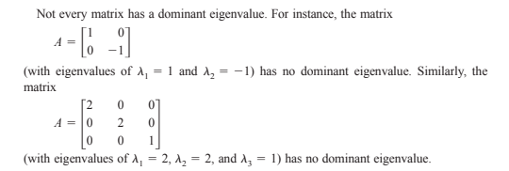

Slide 10
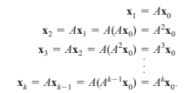
The power method for approximating eigenvalues is iterative:
First we assume that the matrix A has a dominant eigenvalue with corresponding dominant eigenvectors.
Then we choose an initial approximation of one of the dominant eigenvectors of A. This initial approximation must be a nonzero vector in Rn
For large powers of k, and by properly scaling this sequence, we will see that we obtain
a good approximation of the dominant eigenvector of A.

Slide 11

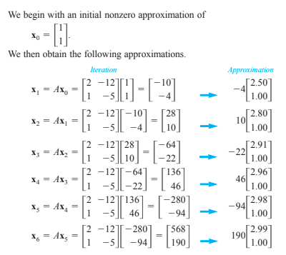

Slide 12
From the characteristic polynomial of A:
Eigen values -1 and -2,
The dominant eigenvector:

Slide 13
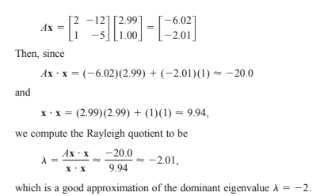

Eigenvalue from Eigenvector

Slide 14
power method tends to produce approximations
with large entries. In practice it is best to “scale down” each approximation before pro-

Slide 15
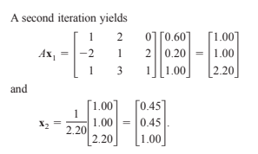
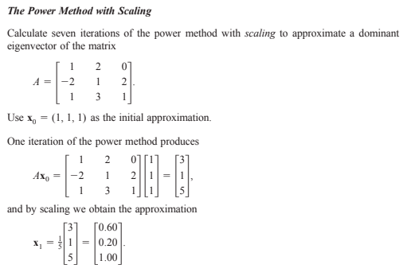
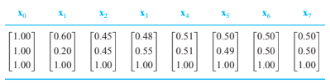

Slide 16
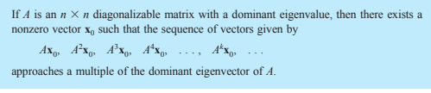
Convergence of Power Method

Slide 17
Proof
Since A is diagonalizable, it has n linearly independent eigenvectors with corresponding eigenvalues.
These eigenvalues are ordered so that is the dominant eigenvalue (with a corresponding eigenvector of x1).
Because the n eigenvectors are linearly independent, they must form a basis for Rn
For the initial approximation x0, we choose a nonzero vector with linear combination of those eigen vectors

Slide 18
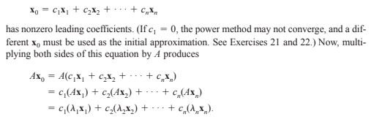

Slide 19
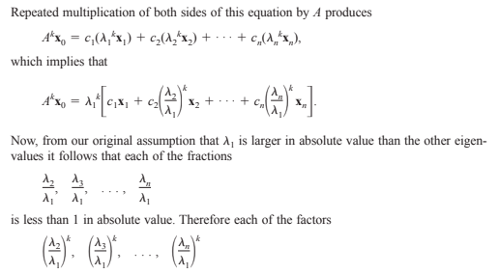
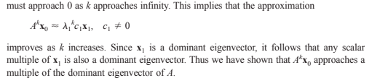

Slide 20


Slide 21
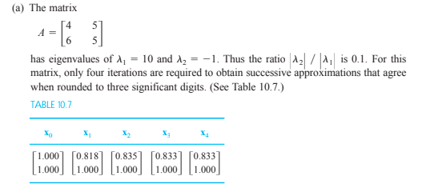
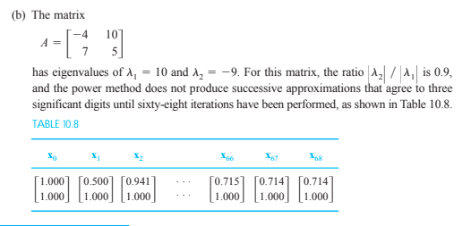
The Rate of Convergence

Slide 22
Page Rank Search
http://pi.math.cornell.edu/~mec/Winter2009/RalucaRemus/Lecture3/lecture3.html

Slide 23
Just open your favorite search engine, like Google, AltaVista, Yahoo, type in the key words, and the search engine will display the pages relevant for your search. But how does a search engine really work?

Slide 24
At first glance, it seems reasonable to imagine that what a search engine does is to keep an index of all web pages, and when a user types in a query search, the engine browses through its index and counts the occurrences of the key words in each web file. The winners are the pages with the highest number of occurrences of the key words. These get displayed back to the user.

Slide 25
First Level Solution: Early 90s
Text based ranking systems
it seems reasonable to imagine that what a search engine does is to keep an index of all web pages
when a user types in a query search, the engine browses through its index and counts the occurrences of the key words in each web file.
The winners are the pages with the highest number of occurrences of the key words. These get displayed back to the user.

Slide 26
Limitations
A search about a common term such as "Internet" was problematic. The first page displayed by one of the early search engines was written in Chinese, with repeated occurrences of the word "Internet" and containing no other information about the Internet.
Moreover, suppose we wanted to find some information about Cornell. We type in the word "Cornell" and expect that "www.cornell.edu" would be the most relevant site to our query. However there may be millions of pages on the web using the world Cornell, and www.cornell.edu may not be the one that uses it most often.
Suppose spammers decided to write a web site that contains the word "Cornell" a billion times and nothing else. Would it then make sense for our web site to be the first one displayed by a search engine?
The usefulness of a search engine depends on the relevance of the result set it gives back not the count.

Slide 27
Page Rank algorithm
invented by Larry Page and Sergey Brin
became a Google trademark in 1998
Basic idea:
the importance of any web page can be judged by looking at the pages that link to it.
If we create a web page i and include a hyperlink to the web page j, this means that we consider j important and relevant for our topic.
If there are a lot of pages that link to j, this means that the common belief is that page j is important. If on the other hand, j has only one backlink, but that comes from an authoritative site k, (like www.google.com, www.cnn.com, www.cornell.edu) we say that k transfers its authority to j; in other words, k asserts that j is important. Whether we talk about popularity or authority, we can iteratively assign a rank to each web page, based on the ranks of the pages that point to it.

Slide 28
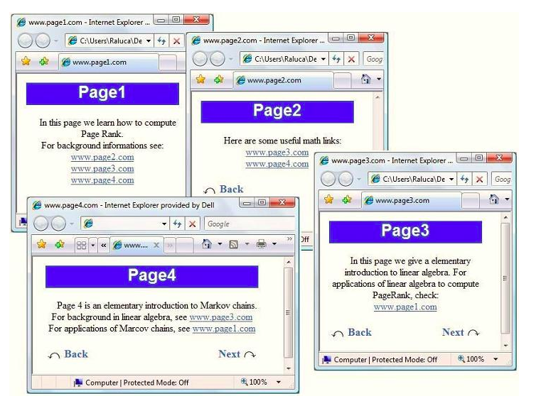
Consider small Internet consisting of just 4 web sites:

Slide 29
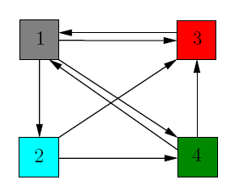
"translate" the picture into a directed graph with 4 nodes, one for each web site.
When web site i references j, we add a directed edge between node i and node j in the graph.
For the purpose of computing their page rank, we ignore any navigational links such as back, next buttons, as we only care about the connections between different web sites.

Slide 30
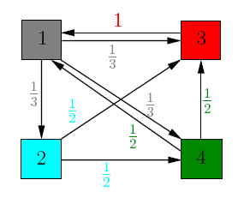
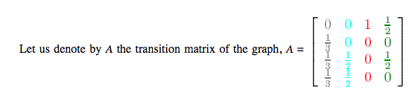
Weighted Assignment
Each page should transfer evenly its importance to the pages that it links to
. Node 1 has 3 outgoing edges, so it will pass on of its importance to each of the other 3 nodes.
Node 3 has only one outgoing edge, so it will pass on all of its importance to node 1.
In general, if a node has k outgoing edges, it will pass on of its importance to each of the nodes that it links to. Let us better visualize the process by assigning weights to each edge.

Slide 31
What are the importance values of these pages?

Slide 32
Dynamical systems point of view:
Suppose that initially the importance is uniformly distributed among the 4 nodes, each getting ¼.
Denote by v the initial rank vector, having all entries equal to ¼.
Steps:
Each incoming link increases the importance of a web page.
So at step 1, we update the rank of each page by adding to the current value the importance of the incoming links.
This is the same as multiplying the matrix A with v .
At step 1, the new importance vector is v₁ = Av.
Iterate the process.

Slide 33
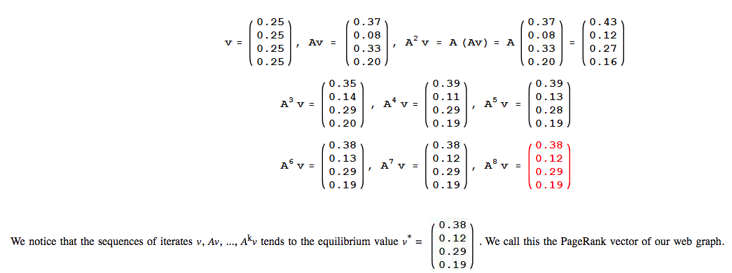

Slide 34
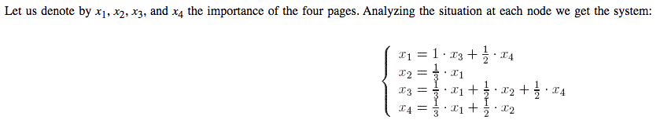
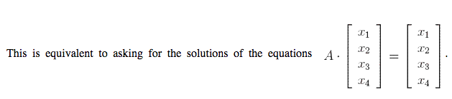
Linear algebra point of view

Slide 35
Linear algebra point of view
Choose v* to be the unique eigenvector with the sum of all entries equal to 1. (We will sometimes refer to it as the probabilistic eigenvector corresponding to the eigenvalue 1).

Slide 36
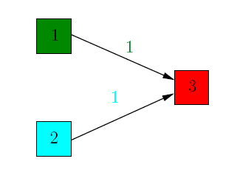
Identify the challenge with dangling node
Compute the rank of 3 pages:

Slide 37
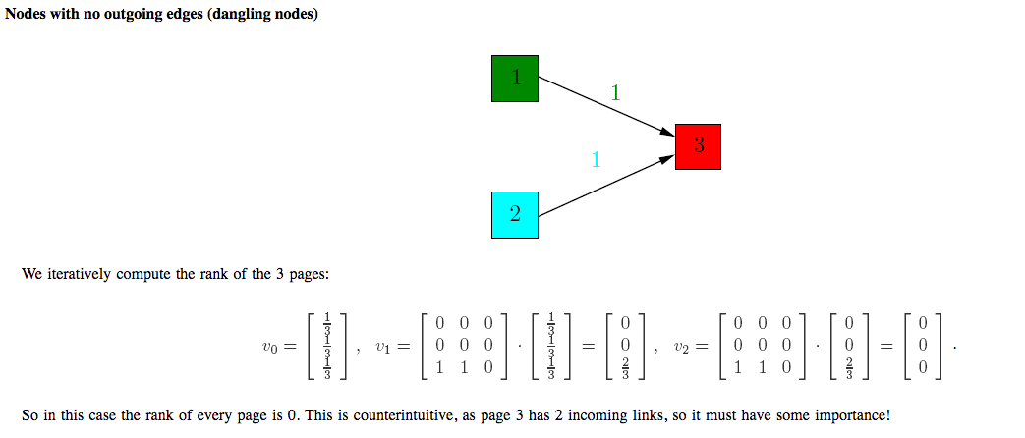
Identify the challenge with danling node

Slide 38
Identify the challenge with dangling node
Compute the rank of 3 pages:
Solution:

Slide 39
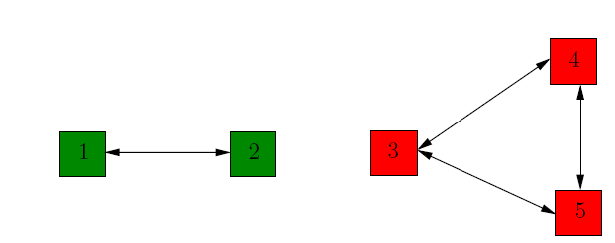
Disconnected components
A random surfer that starts in the first connected component has no way of getting to web page 5 since the nodes 1 and 2 have no links to node 5 that he can follow.

Slide 40
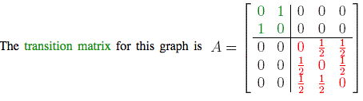
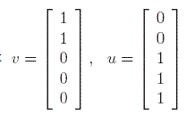
Disconnected components
u and v both are eigenvectors of eigenvalue 1, so that is confusing

Slide 41
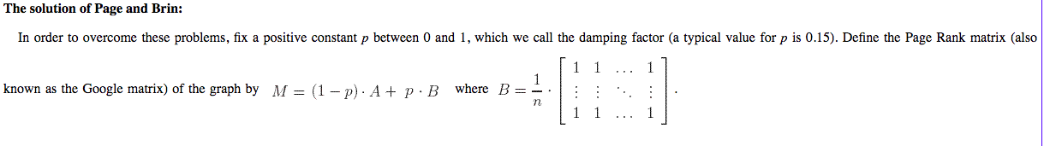

Slide 42
Assignment

Slide 43
To Conclude
From the mathematical point of view, once we have M, computing the eigenvectors corresponding to the eigenvalue 1 is, at least in theory, a straightforward task. Solve the system Ax = x! But when the matrix M has size 30 billion (as it does for the real Web graph), even mathematical software such as Matlab or Mathematica are clearly overwhelmed.
computing the probabilistic eigenvector corresponding to the eigenvalue 1 - use Power Method

