Slide 1
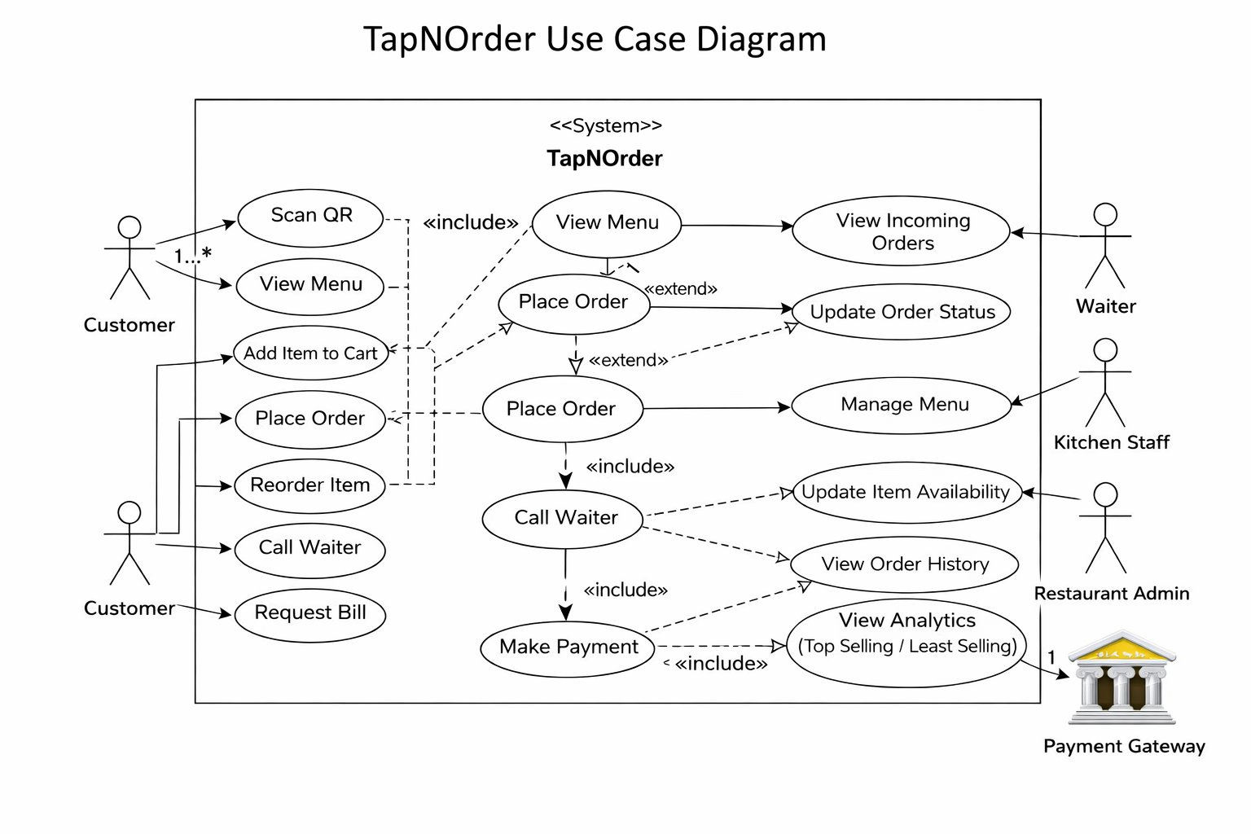
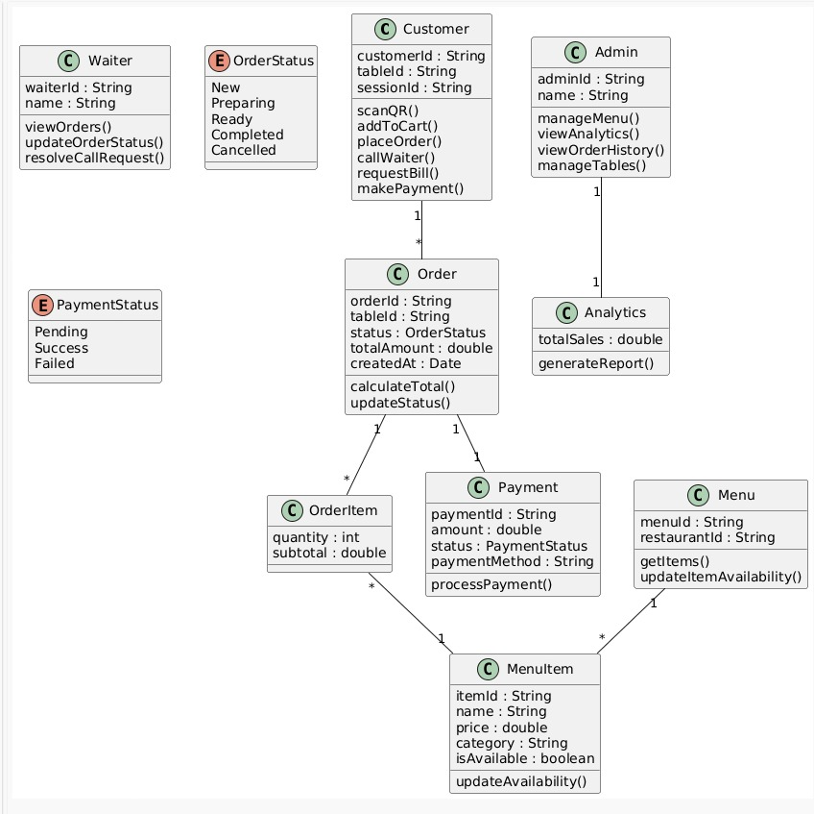
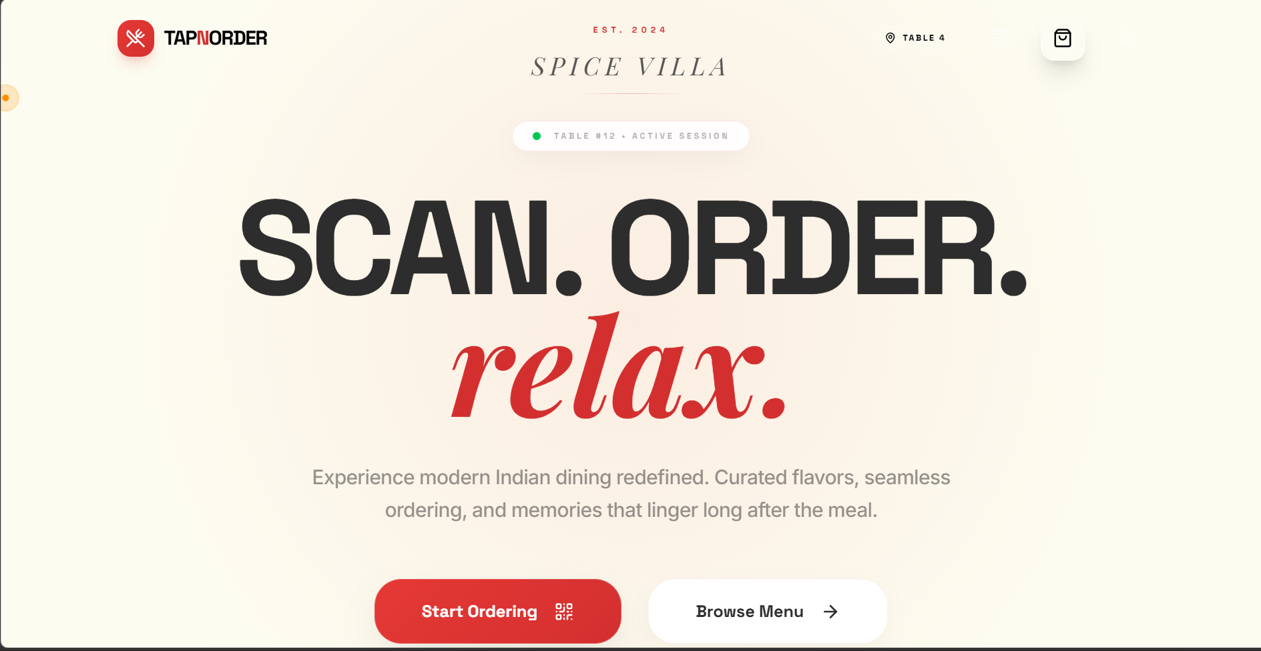
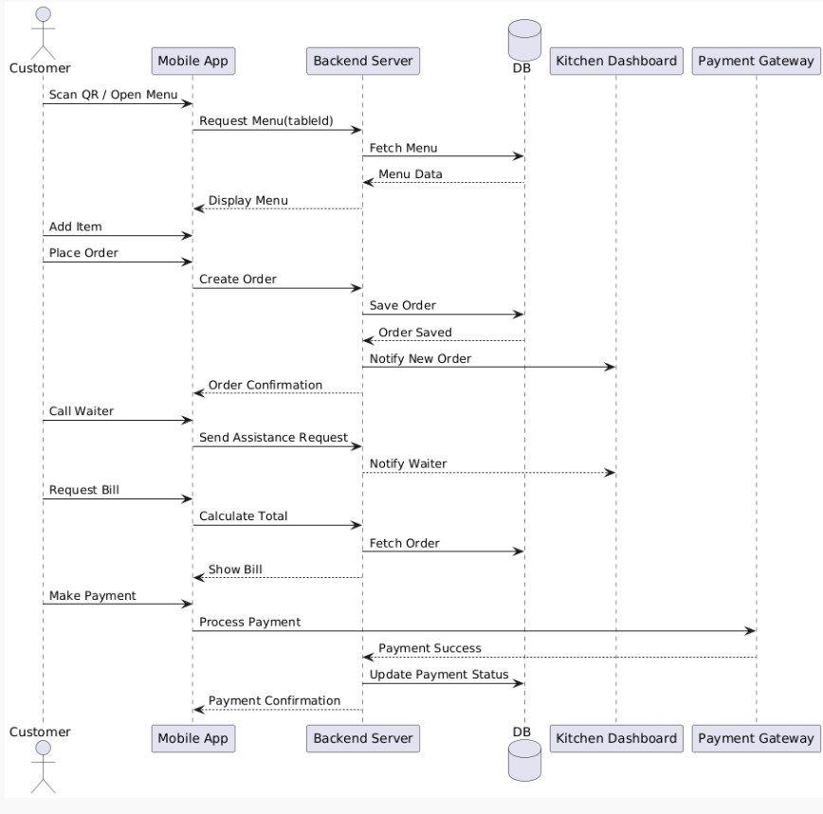
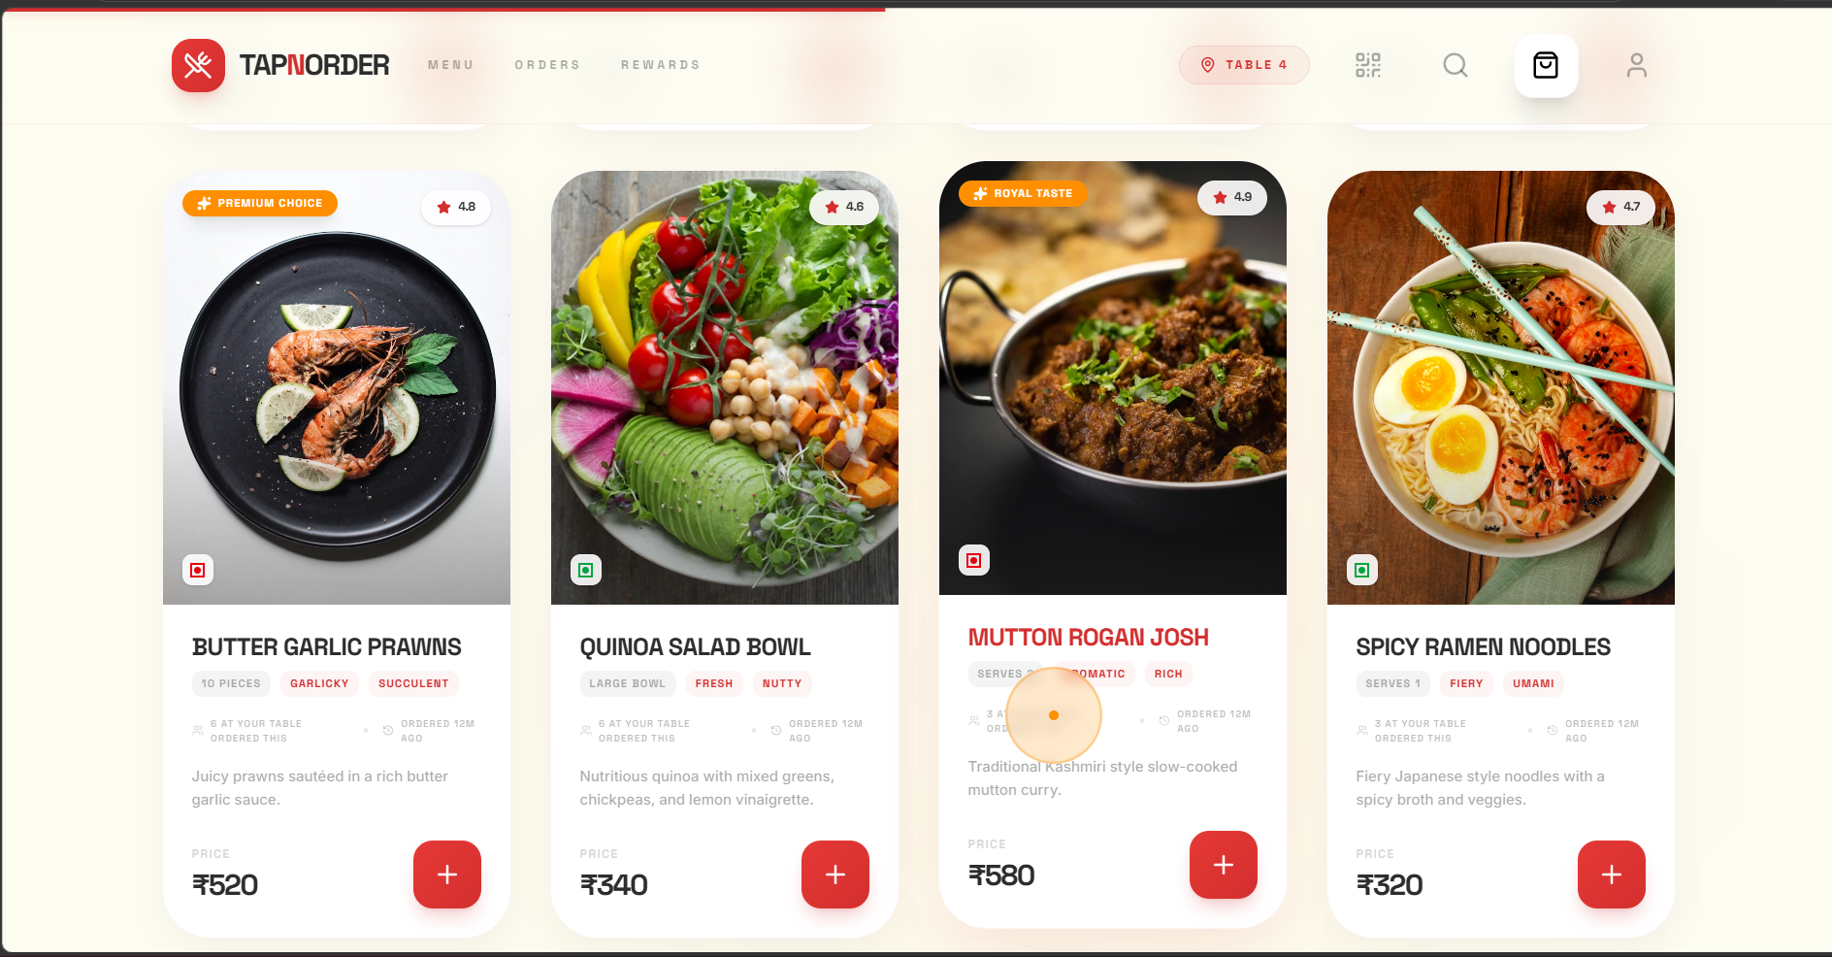
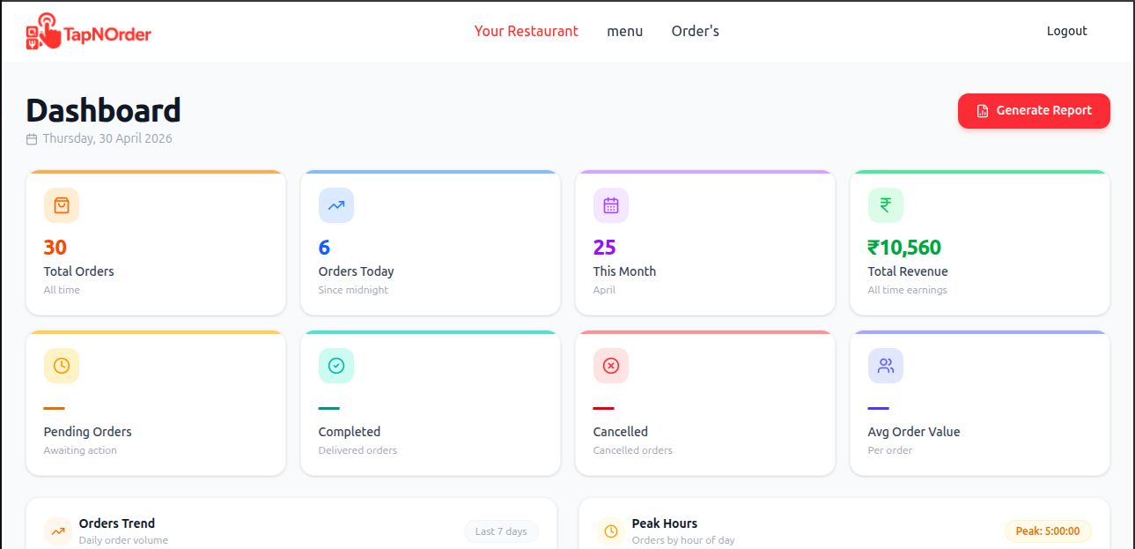

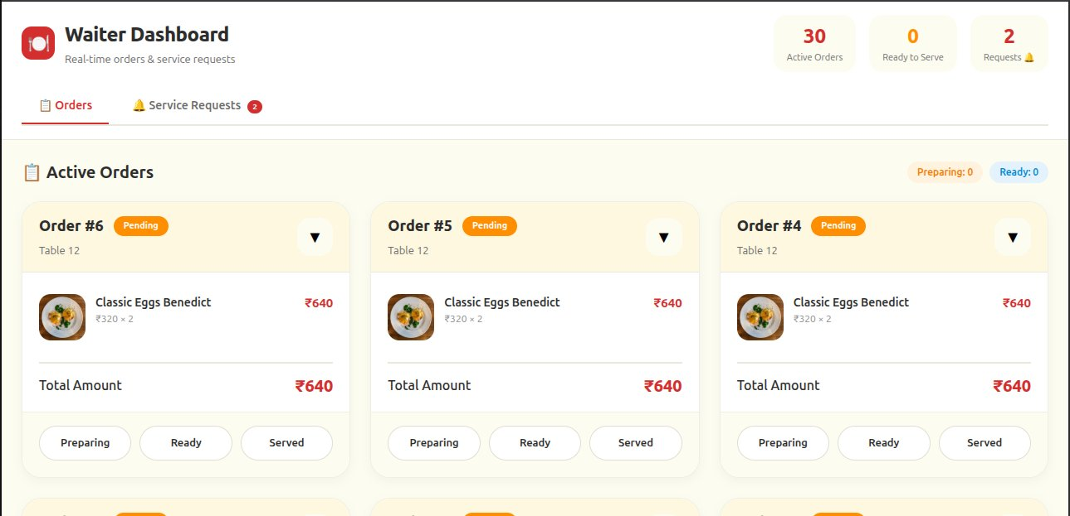
TapNOrder — Scan. Order. Relax.
TapNOrder
A QR-Based Smart Restaurant Ordering System
Scan. Order. Relax.
ANALYSIS & PLANNING
DESIGN & IMPLEMENTATION
Created By
Keerti Shekhamat & Gaurav Singh
Mentor: Dr. Amit Singhal
PROBLEM STATEMENT
Dine-in restaurants still rely heavily on manual processes, leading to delays and inefficiencies. Customers wait to place orders, group ordering is confusing, and there is limited real-time coordination between customers, staff, and the kitchen — resulting in a disconnected dining experience.
USP
Use Case Diagram
Class Diagram
No-login access, shared real-time cart, mood-based menu, and interactive dining features make TapNOrder fast, simple, and engaging.
Customer Landing Page
TECH STACK
Figma · Git/GitHub · HTML · CSS · JavaScript · Bootstrap · Flask · Firebase
PROPOSED SOLUTION
TapNOrder is a QR-based system that lets customers scan, order, request services, and pay directly from their phone — enabling fast, seamless, real-time dining.
Sequential Diagram
SYSTEM ARCHITECTURE OVERVIEW
Customer App
Backend Server
Kitchen Dashboard
OBJECTIVE
Scan QR → Browse menu → Add to cart → Place order → Pay
Flask REST API handles orders, sessions, payments, and notifications
Real-time order queue; staff update status: New → Preparing → Ready
Reduce wait times, simplify group ordering, and improve real-time communication between customers and staff.
Menu Browsing UI
KEY FEATURES
Admin Panel
Waiter Dashboard
Payment Gateway
QR-based menu access with no login
Mood-based recommendations & smart filters
Shared real-time cart for group ordering
Quick service requests + live bill & split payment
Engagement: rewards, photos, interactive add-ons
Analytics, menu management, revenue reports, table management
View active orders, handle service requests, update order status
Integrated payment processing with live bill & split payment support
CONCLUSION
TapNOrder improves restaurant efficiency by reducing delays and simplifying ordering, creating a smoother and more engaging dining experience.
LINK TO REPO
Admin Dashboard
Waiter Dashboard
TapNOrder · Scan. Order. Relax. · Keerti Shekhamat & Gaurav Singh · Mentor: Dr. Amit Singhal

