Slide 1
Phishing Awareness Training
Stay Safe Online – Think Before You Click
Understanding phishing attacks, fake websites,
and social engineering tactics.

Slide 2
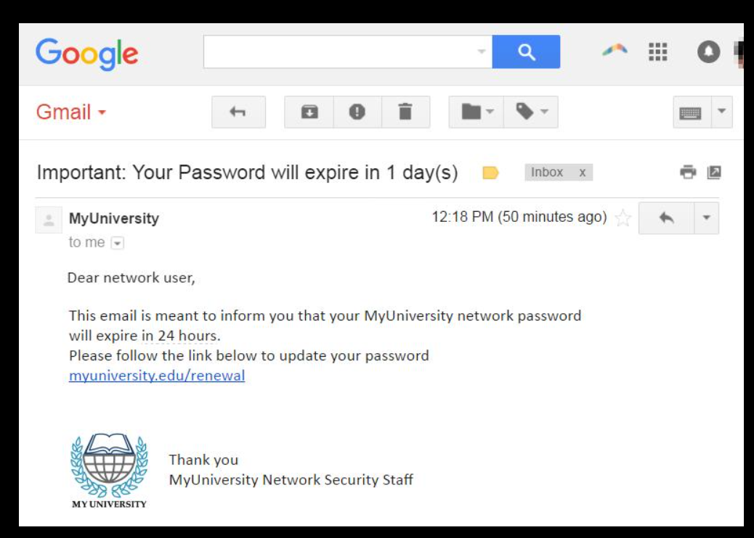
Introduction to Phishing
What is Phishing?
Phishing is a cyberattack where attackers pretend to be trusted organizations or people to steal:
Passwords
Banking details
OTPs
Personal information
Common Targets
Students
Employees
Online shoppers
Social media users
Common Methods
Emails
SMS (Smishing)
Phone calls (Vishing)
Fake websites

Slide 3
Types of Phishing
1. Email Phishing
Fake emails pretending to be banks, companies, or colleges.
2. Spear Phishing
Targeted attack on a specific person or organization.
3. Smishing
Phishing through SMS messages.
4. Vishing
Fraud phone calls asking for sensitive data.
5. Clone Phishing
Copy of a real email with malicious links.

Slide 4
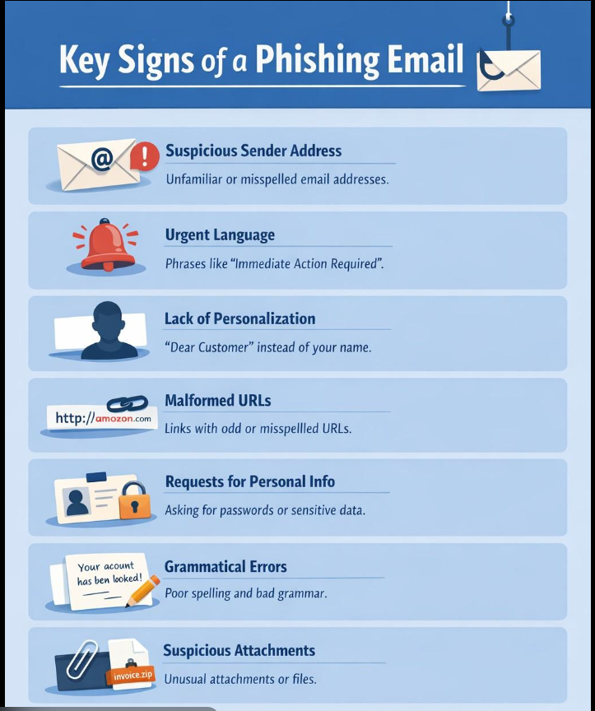
Recognizing Phishing Emails

Slide 5
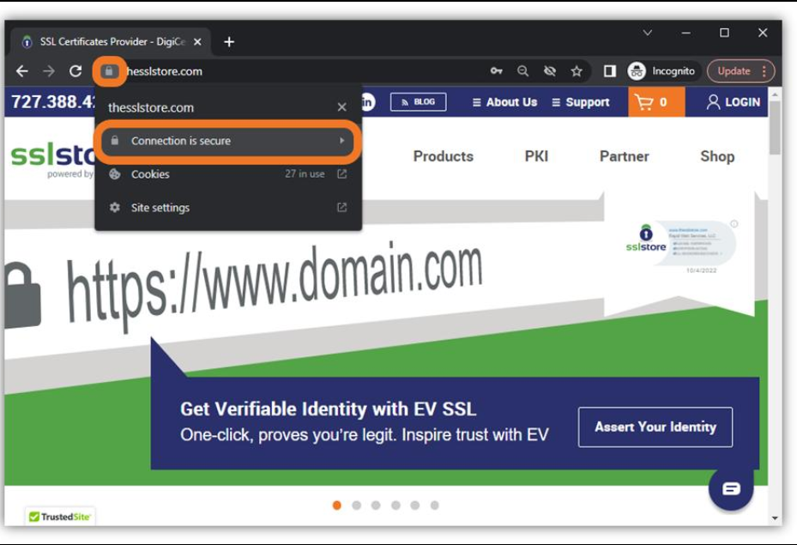
Fake Websites
• Check URLs carefully
• Look for HTTPS
• Avoid random ads
• Watch for poor website design

Slide 6
Social Engineering Tactics
• Fear tactics
• Urgency
• Fake rewards
• Trust impersonation
• Curiosity traps

Slide 7
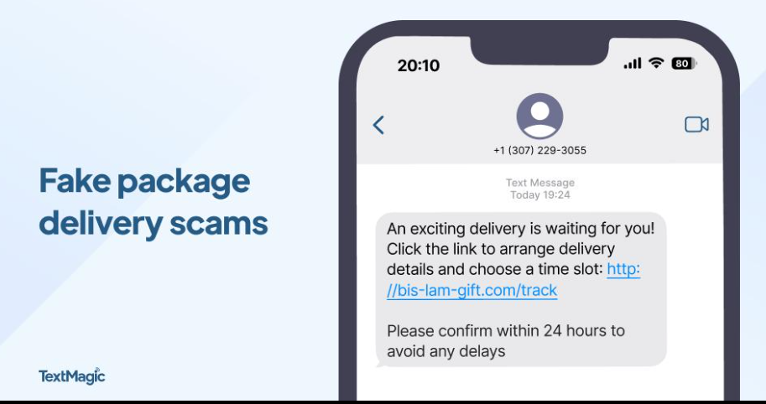
Real-World Examples
Example 1 – Fake Bank Email
• Victim receives: “Your account is locked. Click here to verify.”
• Result:
Login credentials stolen
Bank account compromised
Example 2 – College Portal Scam
• Students receive fake scholarship email links.
• Result:
Personal data stolen
Example 3 – Delivery Scam SMS
•“Your package delivery failed. Update address here.”

Slide 8
Best Practices
Safety Tips
Think Before You Click
• Do not open suspicious links.
Verify the Sender
• Contact the organization directly.
Use Strong Passwords
• Use:
Long passwords
Password managers
Different passwords for accounts
Enable Two-Factor Authentication (2FA)
Keep Software Updated
Report Suspicious Emails

Slide 9
What To Do If Attacked
Immediate Steps
Change passwords immediately
Enable 2FA
Contact your bank if financial data was shared
Scan your device for malware
Report the attack to authorities or IT department

Slide 10
Interactive Quiz
Q1) Which is a sign of phishing?
A) Professional email
B) Urgent request for passwords
C) Official company website
✅ Answer: B
Q2)What should you check before clicking a link?
A) URL
B) HTTPS
C) Sender email
D) All of the above
✅ Answer: D
Q3)What is Smishing?
A) Phone scam
B) SMS phishing
C) Fake website
✅ Answer: B

Slide 11
Conclusion
Always verify emails and websites
Never share passwords or OTPs
Be cautious of urgent messages
Cyber awareness is your best defense
“Stop – Think – Verify – Then Click”
- MS. Keerthi Bandi

