Slide 1
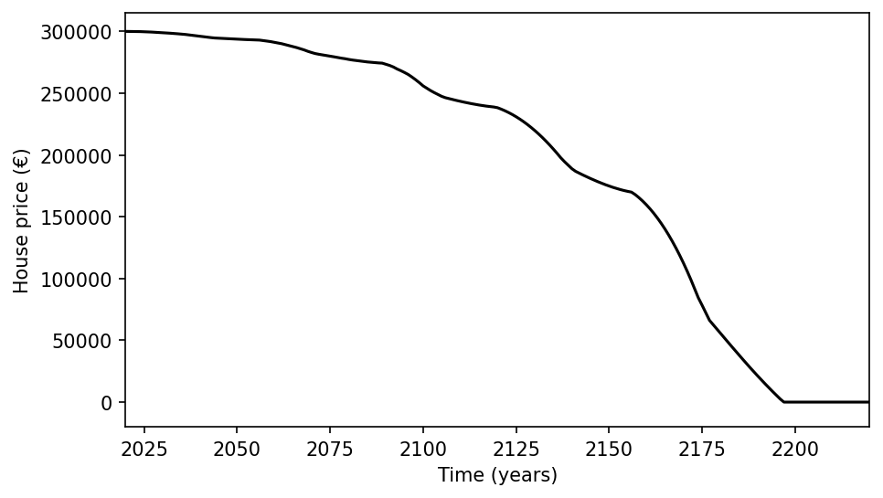
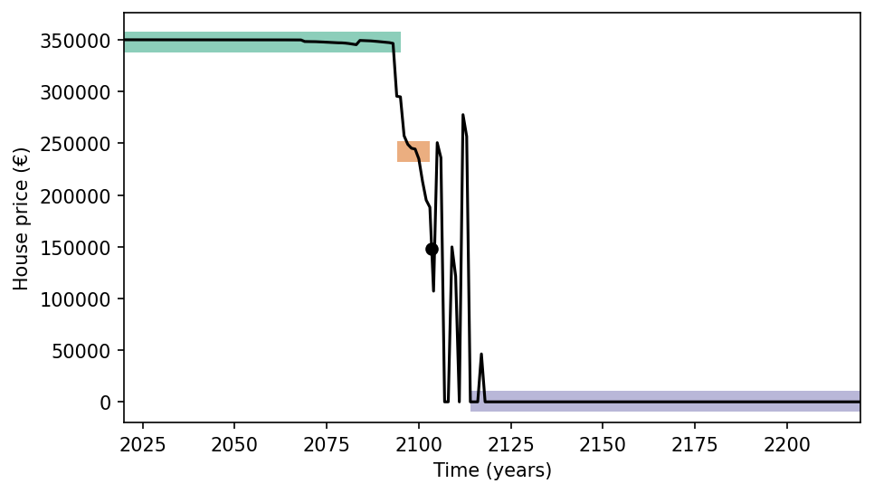
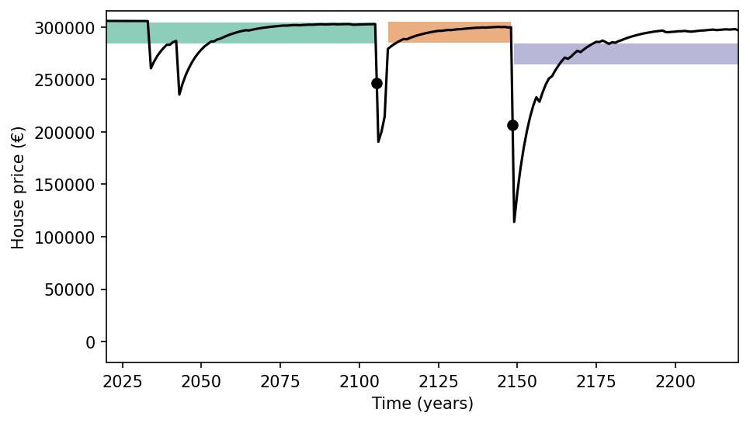
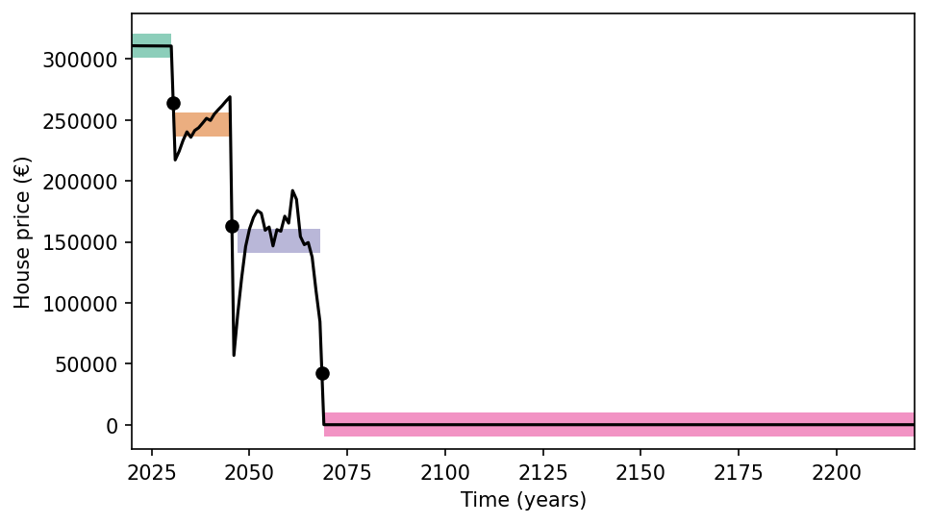
(A) No rapid change
(B) Stable before, but unstable after
C1 ☑ Rapid change
C2 ☒ Stable states
C3 ☐ Different states
C1 ☒ Rapid change
C2 ☐ Stable states
C3 ☐ Different states
(C) Stable states not substantially different
(D) Meeting all criteria, perfect SETP
C1 ☑ Rapid change
C2 ☑ Stable states
C3 ☑ Different states
☑
☒
☐
✅
☒
❎
C1 ☑ Rapid change
C2 ☑ Stable states
C3 ☒ Different states

Slide 2
(A) No rapid change
(B) Stable before, but unstable after
C1 ☑ Rapid change
C2 ☒ Stable states
C3 ☐ Different states
C1 ☒ Rapid change
C2 ☐ Stable states
C3 ☐ Different states
(C) Stable states not substantially different
(D) Meeting all criteria, perfect SETP
C1 ☑ Rapid change
C2 ☑ Stable states
C3 ☑ Different states
☑
☒
☐
✅
☒
❎
C1 ☑ Rapid change
C2 ☑ Stable states
C3 ☒ Different states

Slide 3
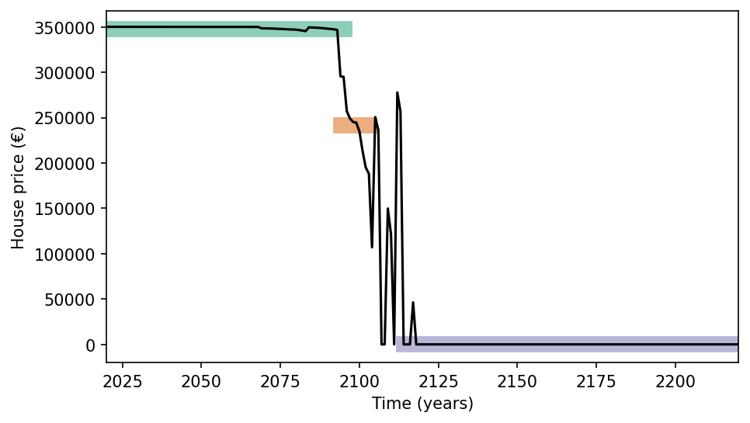
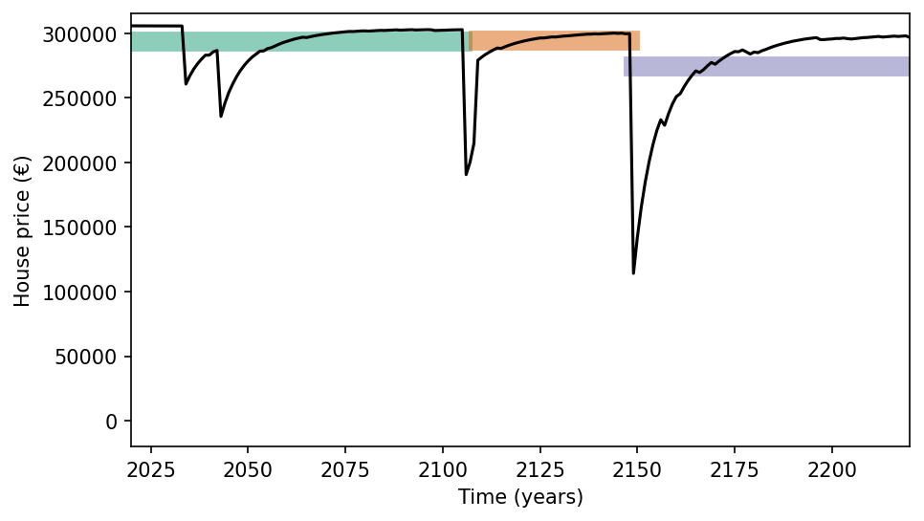
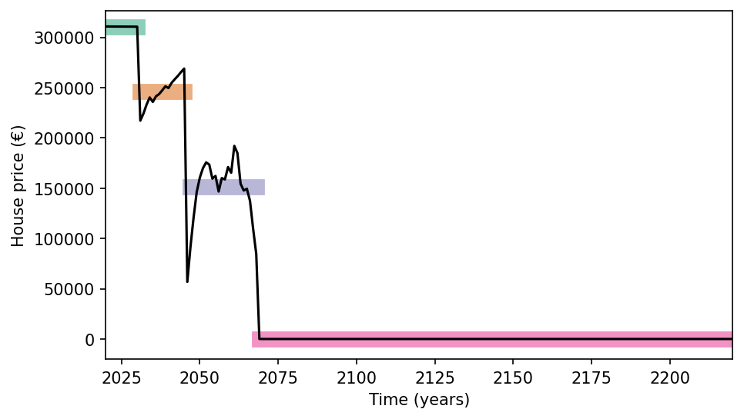
(A) No rapid change
(B) Stable before, but unstable after
C1 ☑ Rapid change
C2 ☒ Stable states
C3 ☐ Different states
C1 ☒ Rapid change
C2 ☐ Stable states
C3 ☐ Different states
(C) Stable states not substantially different
(D) Meeting all criteria, perfect SETP
C1 ☑ Rapid change
C2 ☑ Stable states
C3 ☑ Different states
☑
☒
☐
✅
☒
❎
C1 ☑ Rapid change
C2 ☑ Stable states
C3 ☒ Different states

Slide 4
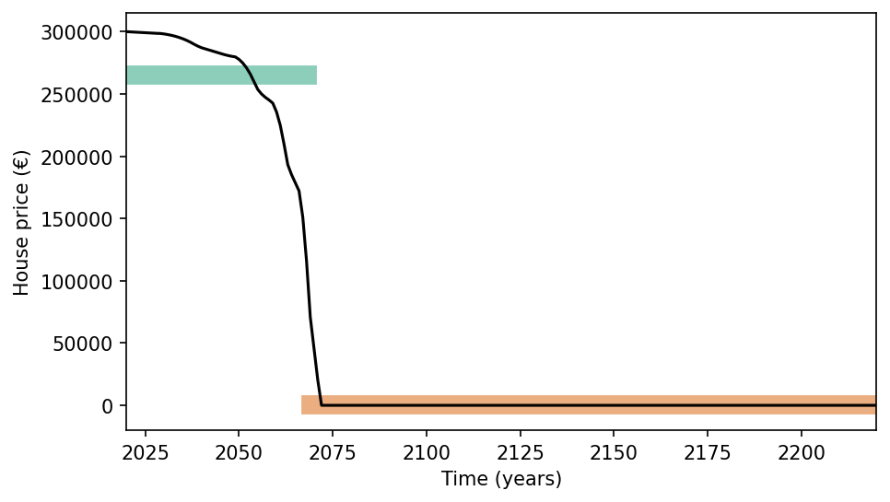
A
B
C1 ☒ No rapid change
C2 ☐ Stable states
C3 ☐ Different states
C1 ☑ Rapid change
C2 ☑ Stable states
C3 ☑ Different states
C
D
C1 ☑ Rapid change
C2 ☒ No stable states
C3 ☐ Different states
☑
☒
☐
✅
☒
❎
C1 ☑ Rapid change
C2 ☑ Stable states
C3 ☒ No different states

