Slide 1

Group 17
Keeyan Haghshenas
Umer Qazi
Joe Gordon
Dunbar Birnie
Ludwig Randazzo
Colter Mooney
Bohdan Kryzh
Ashish Motyala
Features
Demo Date: April 22 2:00PM - 2:30PM
DuckLab Investments
Multi-user & Cross-platform Application
Web app available at ducklabinvestments.azurewebsites.net
Android phone application accessible on the go
Alexa assistance for hands-free game updates
Custom Games
Allows users to create and join games to compete for ranking
Supports Timed game mode for a set length game
Supports Profit Goal game mode for another gaming experience
Solo mode investing practice for beginners and experts
Stock Commerce
Search thousands of stocks and their past history trends
Purchase and sell brand name stocks at real prices
Educational Support
Startup tutorial for new users and stock trading beginners
System Requirements
Any computer with internet access.
Any Android Device running Marshmallow 6.0 or later.
www.ducklabinvestments.azurewebsites.net

Slide 2
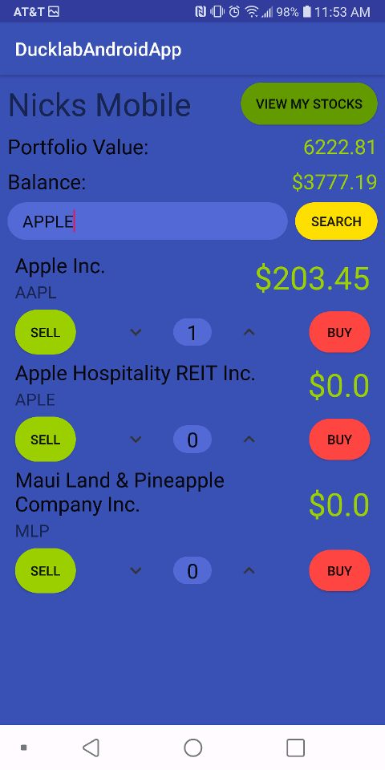
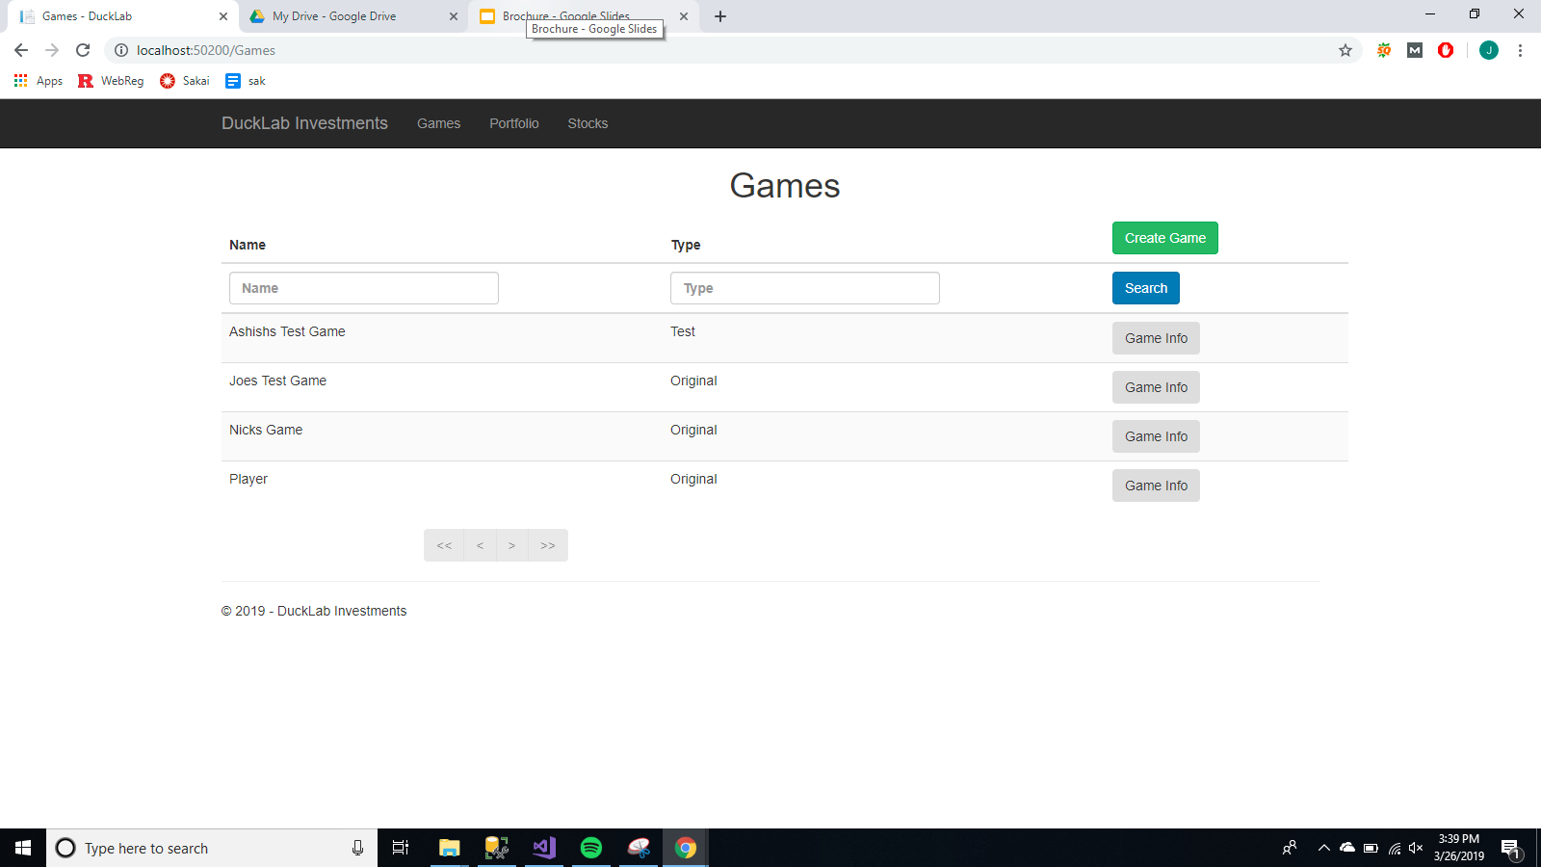
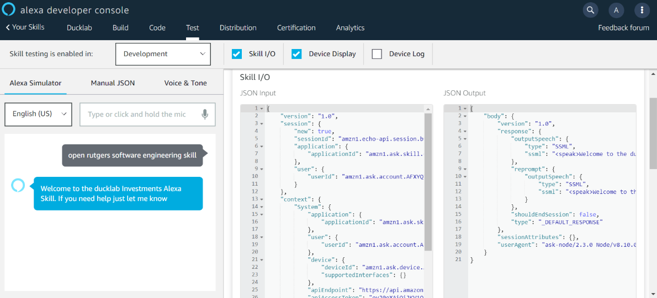
Android App Screenshot
The android app is a fully functional way to experience the game on the go.
Games Screenshot
Users have access to creating and joining leagues which show up on their personal portfolio.
Now Featuring Alexa Interface
Users can now interact with their stocks by giving verbal commands to Alexa.

