Slide 1

edraj.io The Data Managment Platform
Conception, v 0.2
Kefah Issa, Amman, Augst - 2016

Slide 2
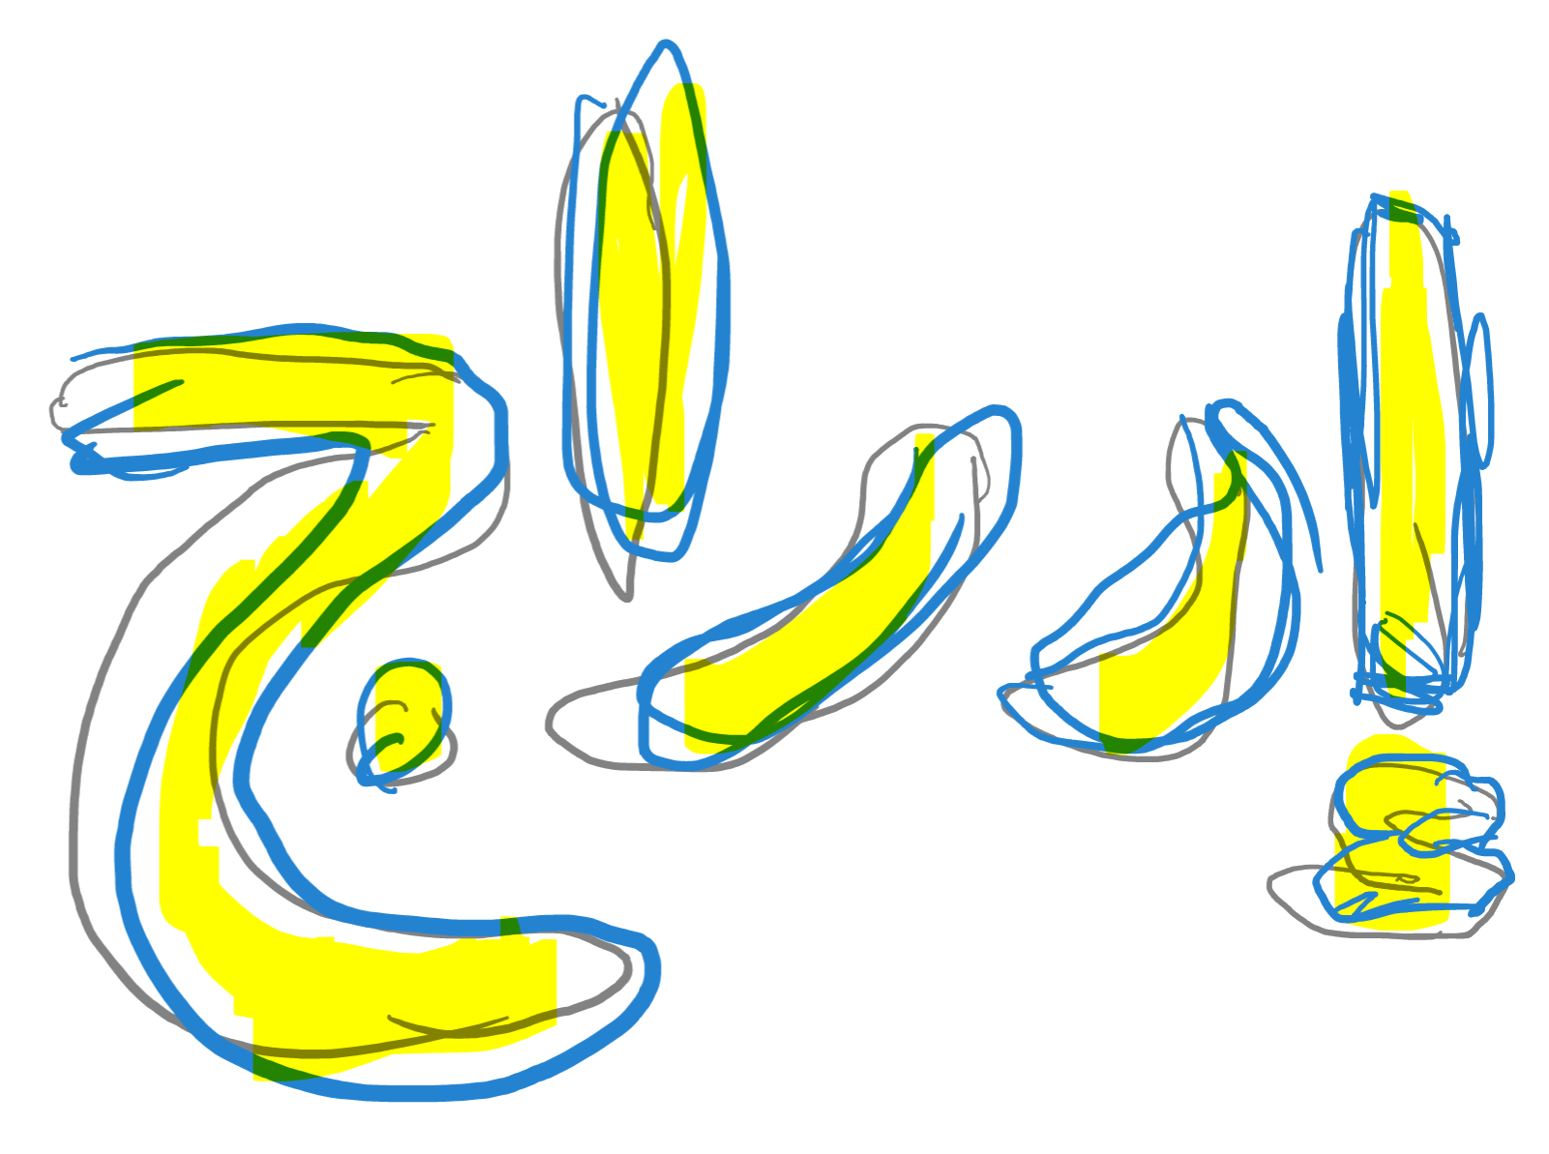

The problem
Users are overwhelmed with information of all sorts
  Personal content: Photos, Videos, Documents, files ...etc.
  Curated content: Collected content; actually the majorty of data users are involved with is the curated type.
The information is heavily fragmented and duplicated
  Many many apps and websites with stupid limitations: twitter 140 chars, facebook no rich text formatting, instagram and snapchat are plain d*#b :) ...etc.
  Each doing their best to lock-in users and their content.
  Duplicated identities
Not easy to move data around or make proper backups. E.g. I can't push articles I write on my blog to FB and vice versa. Those should be considered as distribution channels.
No proper meta data and semantics; hence making it difficult to find / navigate through.
Older content is burried deeply and is hard to find and surface.
Its difficult if not impossible to create any context-ware reporting.

Slide 3
Founding Principles
Future-proof data format (promot to beocme 1st class citizen): The authored data must become application-agnostic. The content should be associated with its own schema definition and meta data manifest. Schema defintion can make use of Avro. This should facilitate polymorphic interaction with the the data and the seperation of data-serving performance from at-rest authored reference (golden). We can use indexing engines like Elastic.io to index the data for performance.
No SPOF or provider lock-in: All data is federated / decenteralized / distributed. Leveraging DHT for both content and identities. (DHTs are used in bittorrent, bitcoin and many others). It should be easy for any one to setup a POD and join the band. All code should be accessible freely under GPL3 or simillar.
Security: Proper Identity, authentication,encryption and access control. PKI-based. Content can be signed by the auther (PGP). Oauth2.
Content (Data entities) can have proper OO structures and Graph-oriented relationships. Content can have blob attachements. It should be trivial to pull an excell sheet or a list for reporting, or even provide a real-time dashboard.
Enable light-weight mini-apps like data-handlers (persistance, rendering, ...etc), miners (local and external), bots and chat-bots to do all sorts of tasks.
Implement adaptors/facades to integrate with existing/legacy systems. Email: SMTP/IMAP/Pop3, XMPP, SIP, RTC, WebDav, API's: Facebook, twitter, Wordpress ...etc.
Leverage existing free and open source technologies and build on top.
Messaging (events exchange) is done in real-time.
This solution is mainly around establishing the standard and presenting one reference implementation.

Slide 4
Applications of such a technology
Email and messaging offering SMTP/IMAP/Pop3 API.
File and document management (access control, organization, backup) offering: Web, Webdav
Content publishing (Public sharing) is a breeze: CMS like: Blog, Wiki, Shopping store …
Inventory, HR and school management systems
Ticketing / problem tracking system
MSAccess-like/Spreadsheet-like where you shape the data in a modular fashion.
You name it.

Slide 5
Commercialization through value-added services
Digital safe: storing sensitive documents and information.
Improved identity management with guards against lost/theft
Improved indexing/crawling/mining
Innovative-apps: Bots and chat-bots
Financial mediation for paid services and goods
Provisioning of integrated persistence back-ends.
3rd party authentication / authorization
Public publishing your self and/or cause/business (aka hosting)
Nice and easy id reference: your_id@domain-name (email like)
Service reliability

Slide 6
Core Capabilities
Capabilities offer distinct functions and integrate operationally. Intensive research need to be done in order to determine the useful technologies that can be used.
Identity
Biography, Keys, contact details, interests …
Authentication(multifactor), Authorization, Roles
Delegation. Using DHT/SAML
Community-run, distributed social network: *diaspora
Peristence backends: Google drive, onedrive, s3, dropbox, ipfs ...etc.
File and Data management/distribution: camlistore/git-annext/ipfs/owncloud,syncthing,sparkleshare
Peer2peer communication and messaging: tox,bitmessage
Identity, Autherization and Authentication: Oauth 2.0, PKI, PGP
Content-addressable data and Identities have their own DHT.
Web Ontology Language: OWL
Content
Structured and otherwise, content-addressible,
free de-duping, access-control,
OOP/graph oriented
Social Graph
Contacts, friends, and followers
Mining and Indexing
Discovery and surfacing
(Inner/Outer/Vertical/Horizental)
Mini Apps/Bots
Autonomus activity: Serving specialized domains
Appointments, reservations, buying

Slide 7



Thank you …
https://github.com/kefahi/io
http://fb.com/kefahi
Kefah.issa@gmail.com

