Slide 1

Data Warehouses, Data Lakes, and Others
AnHai Doan
Notes:
Let me start this talk by telling you how I got to social media. For that, I need to go back to the year 2001.

Slide 2
Motivation
Two big needs for organizations
transaction processing
analytics (aka decision support, business intelligence, data science, etc.)
historical analysis
predictive analysis
often do the above using classification, clustering, association rule mining, anomaly detection, visualization, browsing/querying (including OLAP-style)
We have discussed the analytic pipeline, from raw data to insights
multiple teams may have to construct such pipelines
always doing them from scratch is very inefficient
should construct artifacts that help
data warehouses, data lakes, lakehouses, etc.

Slide 3
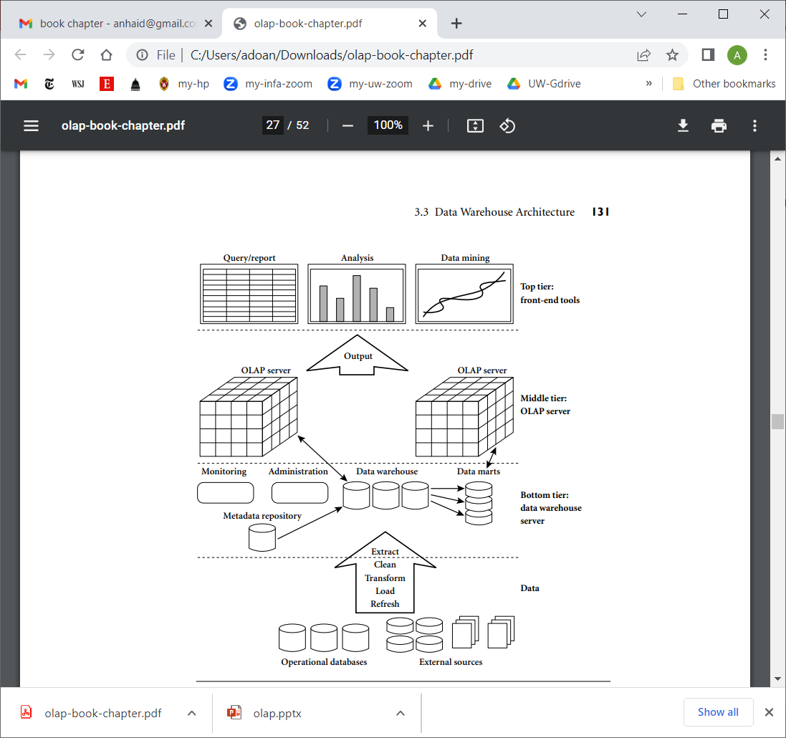
Data Warehouses

Slide 4
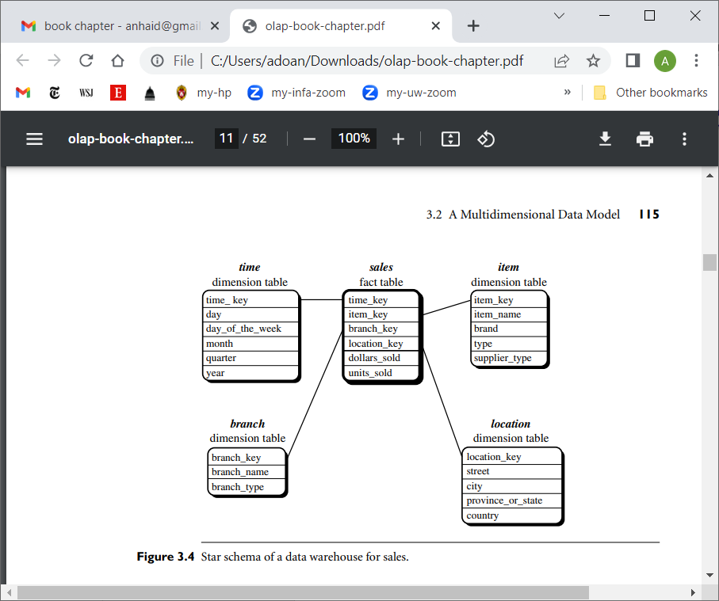
Data Warehouse Schema: Typically Star Schema

Slide 5
Star schema = fact table + dimension tables
Fact table: quantities of interest, on which we want to do analysis
Dim tables: the context, captured as a set of dimensions (factors)

Slide 6
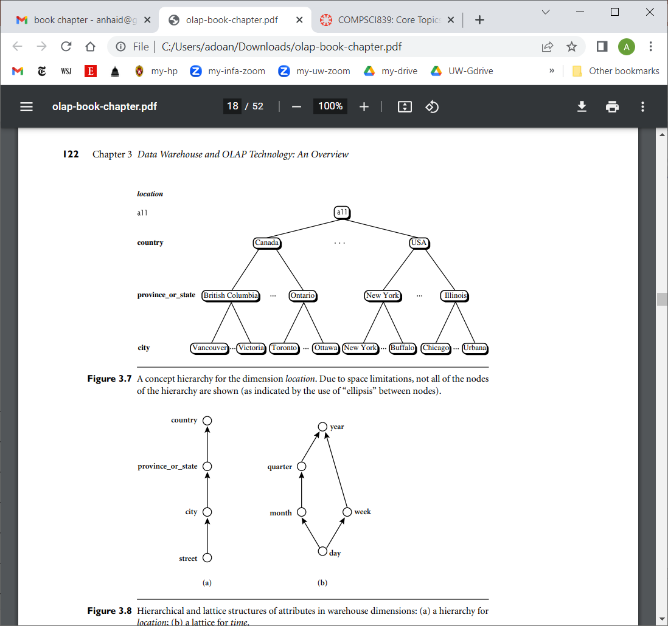
Hierarchies on Dimensions

Slide 7
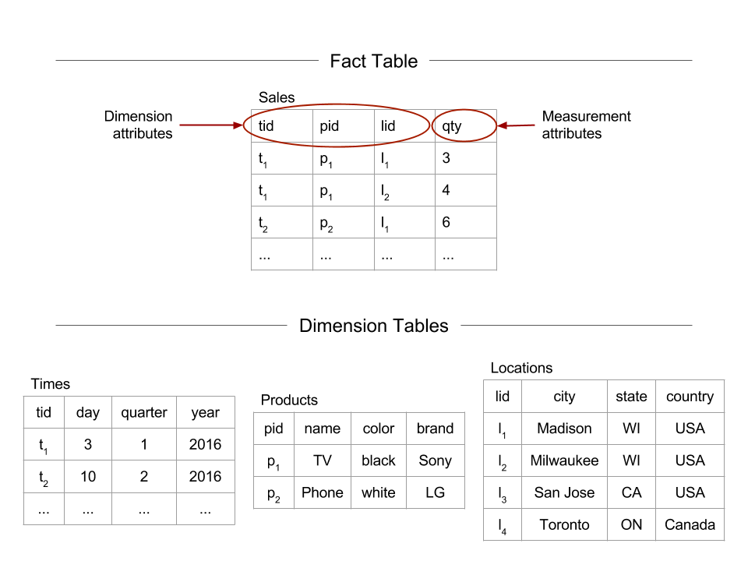

Slide 8
OLAP-Style Querying
Once constructed, a data warehouse can be used for many purposes
one of which is OLAP-style querying
OLAP-style querying
view the data as a cube
basic querying operations: roll up, drill down, slice, dice

Slide 9
Motivation for OLAP-Style Querying
Once you have created a data warehouse
say 1 fact table and 3 dimension tables
Can just let users come and query it via SQL queries
But this creates a problem
the kind of queries users ask here, called analytic queries, will be very different from transactional SQL queries
these analytic queries will touch a lot of data and take a long time to run
can’t just let users pose them
ideally we should identify a small set of basic operations that users often want to do, then optimize them
OLAP style querying using the model of a data cube accomplishes this
view the data warehouse as having a data cube
identify the common operations: roll up, drill down, slice, dice

Slide 10
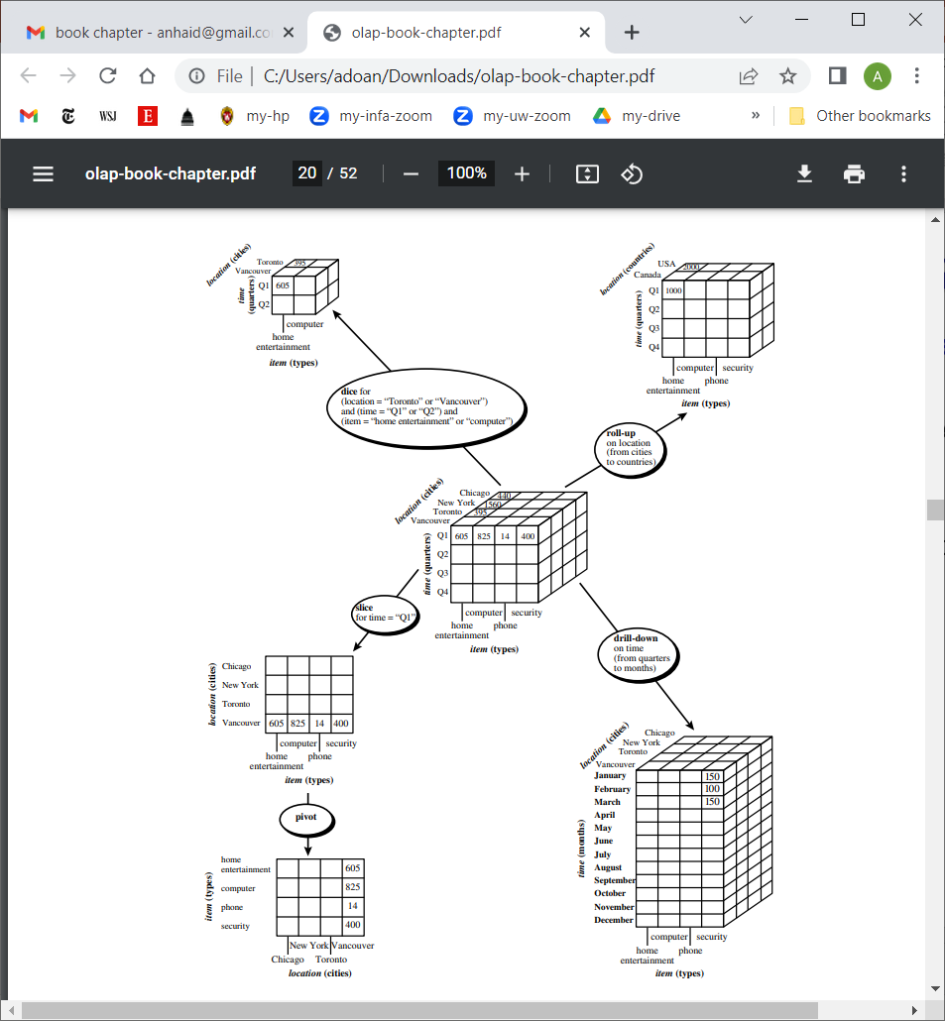

Slide 11
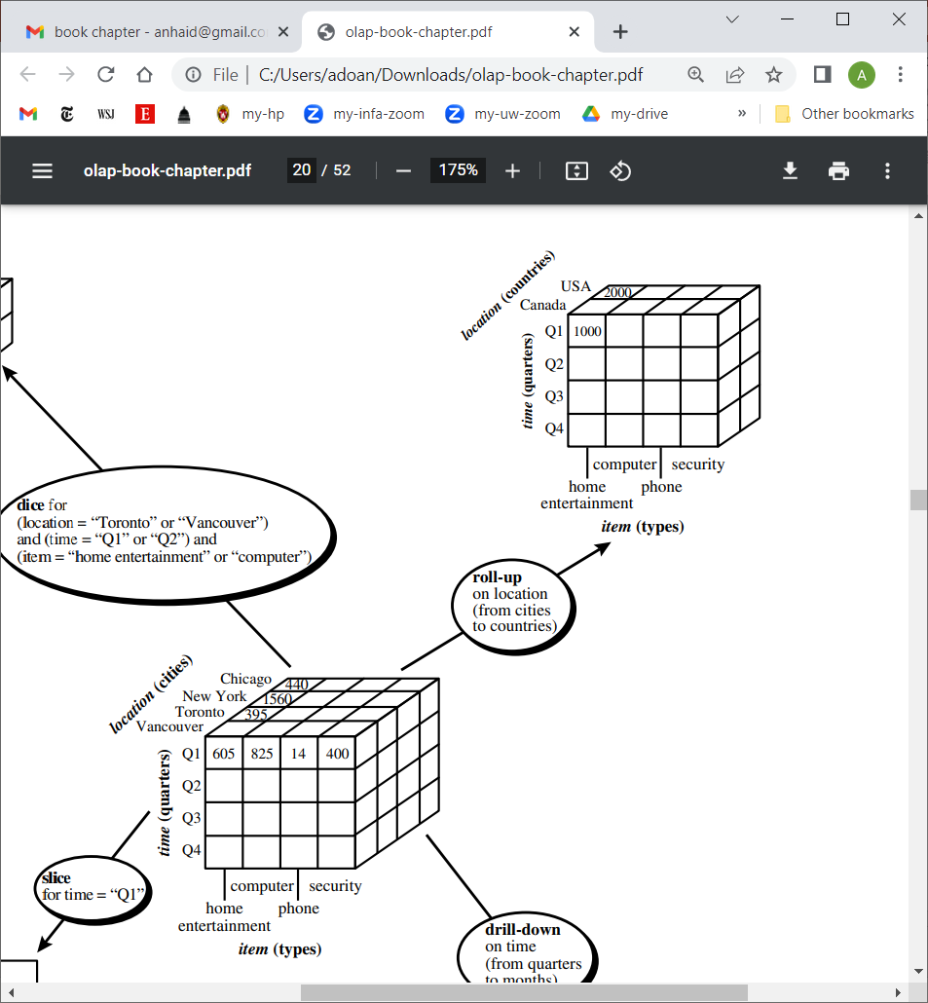

Slide 12
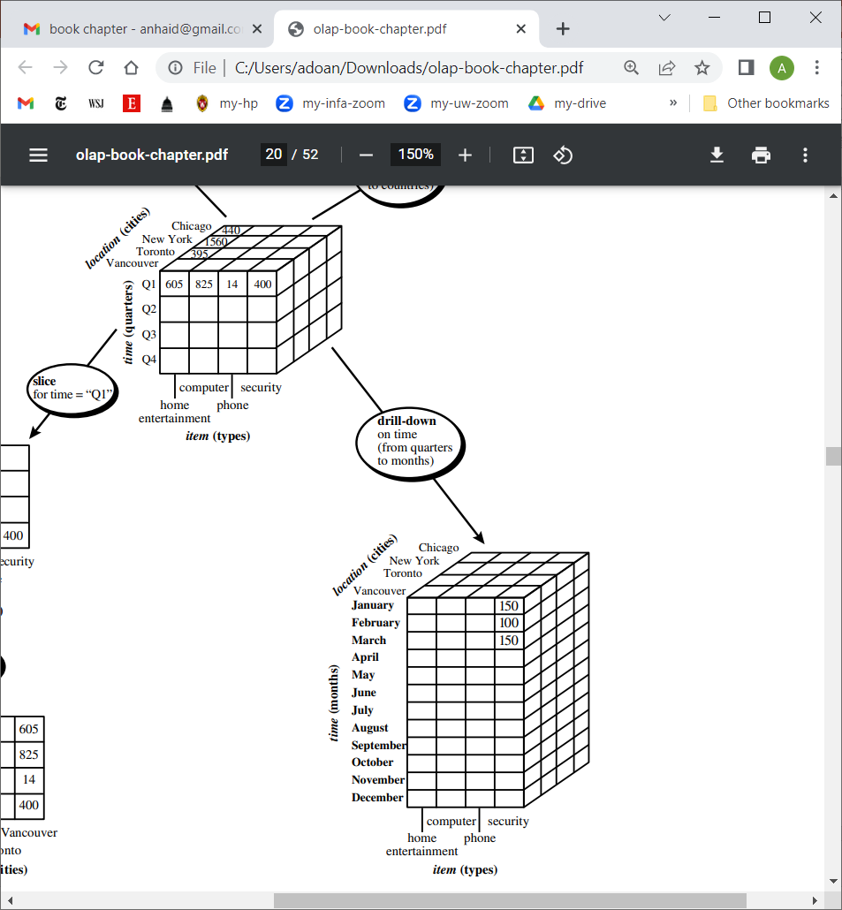

Slide 13
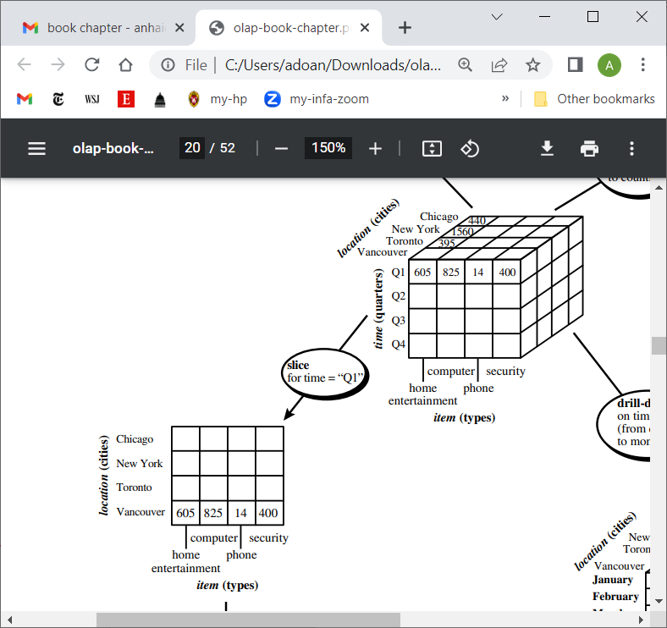

Slide 14
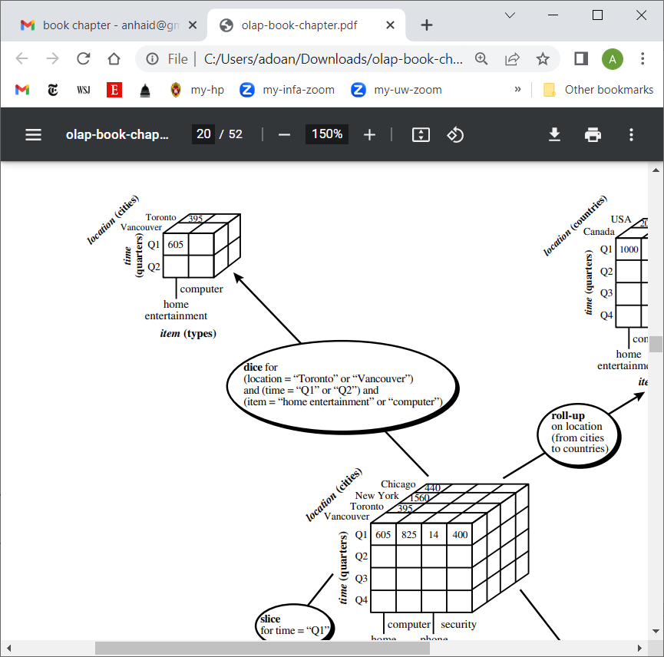

Slide 15
How Would a User Use OLAP
Give an example
At the start, the cube has too many data points
User must aggregate these and look at far fewer data points
So does a roll up, say in term of location
Then detects something interesting
So now want to do a slice and then drill down, say based on product categories
Then can drill down even more say in term of products

Slide 16
Transactional vs Analytic Systems
Often referred to as OLTP vs OLAP systems
How are they different?
purposes
freshness of data
types of queries

Slide 17
ETL (Extract, Transform, Load)

