Slide 1

Putting It All Together
AnHai Doan
Notes:
Let me start this talk by telling you how I got to social media. For that, I need to go back to the year 2001.

Slide 2
What We Have Learned So Far
Main technical challenges in the data integration pipeline
What they are? Why are they difficult? State of the art solutions?

Slide 3
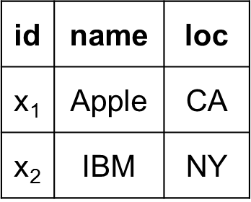
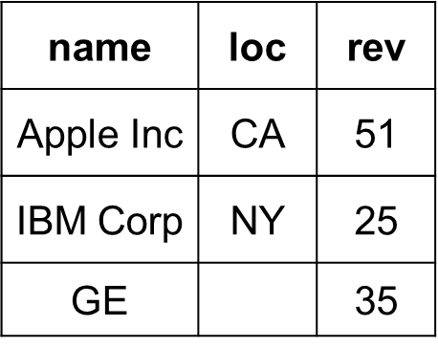
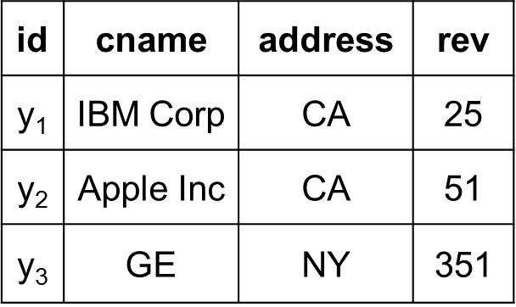
is there any
correlation
between
location and
revenue?
The raw data to insight pipeline
Data analysis
Data integration, data wrangling, …

Slide 4
X
Y
news articles
data extraction

Slide 5
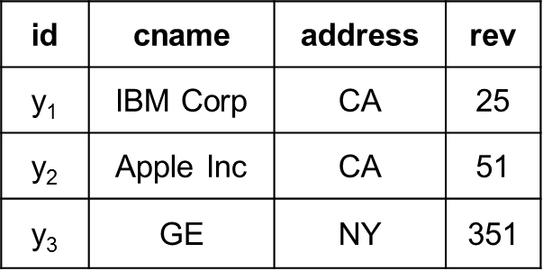
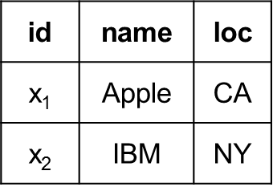
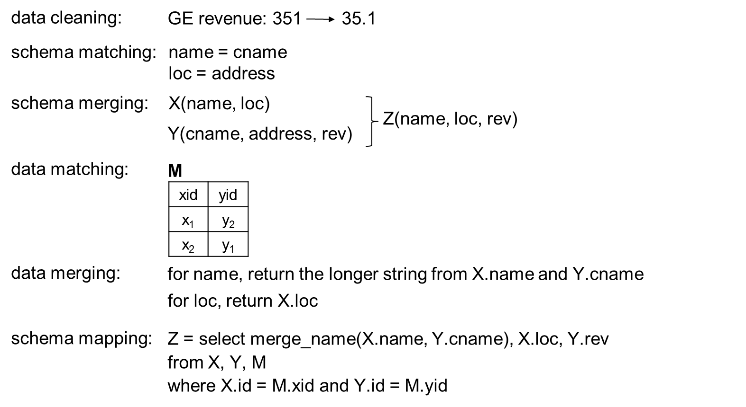
Y
X

Slide 6
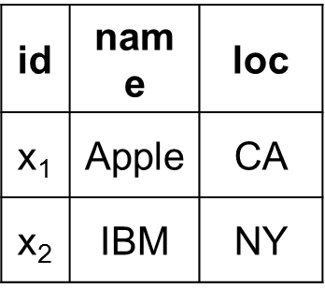
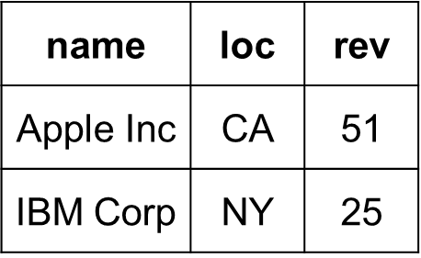
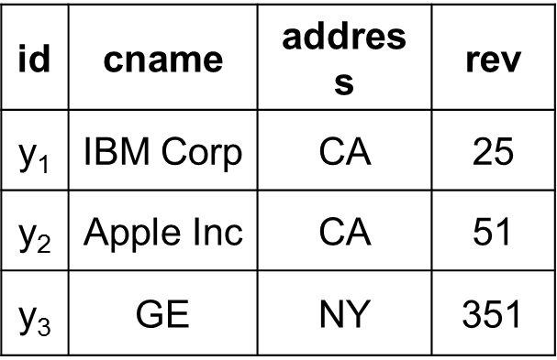
X
Z
Y

Slide 7
Now How Do We Do These in Practice?
Goals
Obtain data for reporting, monitoring
Analysis to see past trends, to predict future, obtain insights
Archiving data
Scenarios: small data, big data, recurring data
Issues
What do we need to do by hand?
What can we automate using pipelines?
How to write these pipelines?
Any software to support the above?
Who does what?

