Slide 1
Schema Matching for Data Catalogs

Slide 2
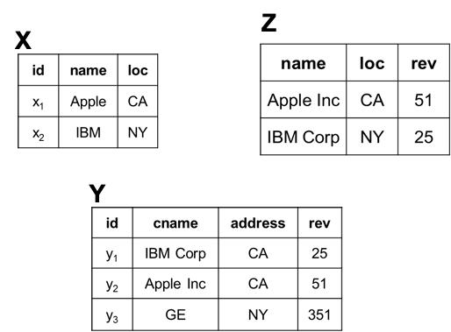
Schema Matching for a Data Catalog
Given a data catalog, find columns among the tables that refer to the same real-world concept
Matches:
Z.name = X.name
Z.name = Y.cname
X.name = Y.cname
Z.loc = X.loc
Z.loc = Y.address
X.loc = Y.address
Z.rev = Y.rev

Slide 3
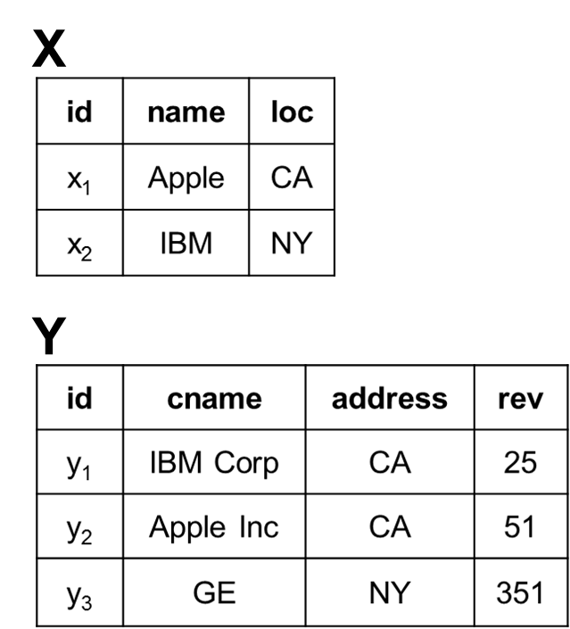
Reduction to an Entity Matching Problem
Convert each column in a table into a tuple in a big table A
Schema matching for the columns reduces to matching the tuples in A
An entity matching problem, can be solved using entity matching techniques
Table A of Traits for Each Column
ID | TableName | ColName | ColType
x.c1 | X | id | String
x.c2 | X | name | string
x.c3 | X | loc | string
y.c1 | Y | id | string
y.c2 | Y | cname | string
y.c3 | Y | address | string
y.c4 | Y | rev | numeric

Slide 4
Solving the EM Problem via Blocking & Matching
Block on A x A to obtain a much smaller set of tuple pairs
Use heuristics to quickly remove tuple pairs unlikely to match
Match the pairs in the output of blocking
Apply rule-based or ML-based matcher on remaining pairs to predict match/no-match
Table A of Traits for Each Column
ID | TableName | ColName | ColType
x.c1 | X | id | string
x.c2 | X | name | string
x.c3 | X | loc | string
y.c1 | Y | id | string
y.c2 | Y | cname | string
y.c3 | Y | address | string
y.c4 | Y | rev | numeric
(x.c1, y.c1)
(x.c1, y.c2)
(x.c3, y.c2)
…
(x.c1, y.c1) Yes
(x.c1, y.c2) Yes
(x.c3, y.c2) No
…
Blocking
Matching

Slide 5
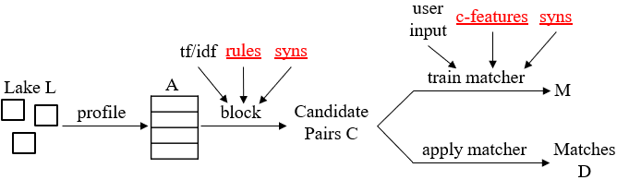
The Camel Solution
Given a data catalog, perform profiling, blocking, then matching to get matches

Slide 6
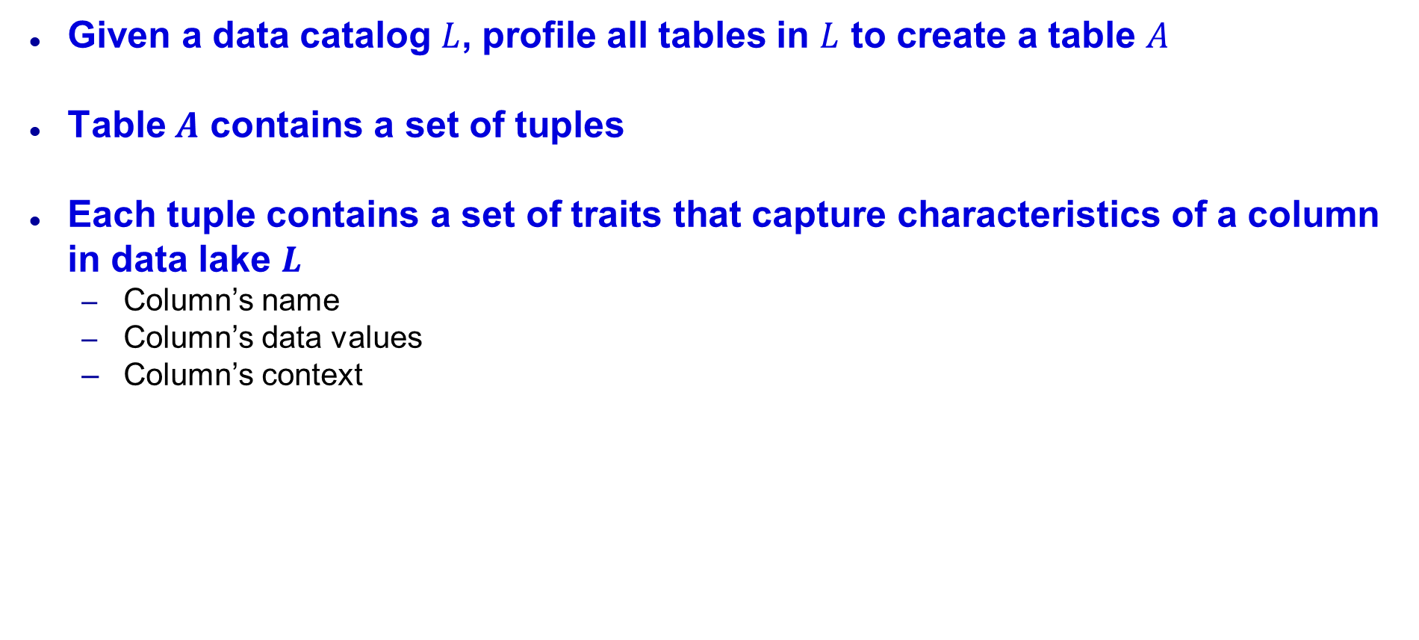
Profiling
Given a data catalog $L$, profile all tables in $L$ to create a table $A$
Table $A$ contains a set of tuples
Each tuple contains a set of traits that capture characteristics of a column in data lake $L$
Column’s name
Column’s data values
Column’s context

Slide 7
Set of Traits
Column name
Data types
String: Default type
Numeric: Pandas Series’ assigned dtype of the column is int64 or float64
Datetime: All data values of the column match one of the two date regexes
r’\d{4}-\d{2}-\d{2}’
r’\d{1,2}/\d{1,2}/\d{4}’
Textual: Data values of the column have an average character length greater than 30
Categorical: Unique number of data values is less than 5
Mean and median values
For Numeric columns only

Slide 8
Set of Traits
Top n most common words
For non-Numeric and non-Datetime columns only
A word is a lowercased word token (tokenized from the column’s data values using a whitespace tokenizer) that is not a stop word
Word frequencies
For Textual columns only
A word frequency is a lowercased word token (tokenized from the column’s data values using a whitespace tokenizer) with its count
Average character length
Average number of string characters in the data values of the column
Number of unique data values

Slide 9
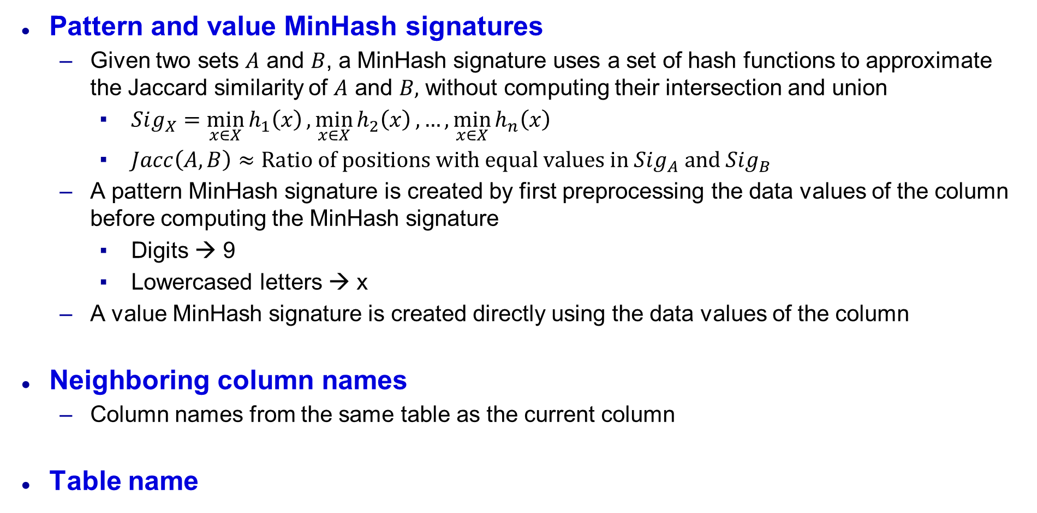
Set of Traits
Pattern and value MinHash signatures
Given two sets $A$ and $B$, a MinHash signature uses a set of hash functions to approximate the Jaccard similarity of $A$ and $B,$ without computing their intersection and union
$Sig_{X}=\min_{x∈X}{h_{1}\left(x\right)},\min_{x∈X}{h_{2}\left(x\right)}, …,\min_{x∈X}{h_{n}\left(x\right)}$
$Jacc\left(A, B\right)≈\text{Ratio} \text{of} \text{positions} \text{with} \text{equal} \text{values} \text{in} Sig_{A} \text{and} Sig_{B}$
A pattern MinHash signature is created by first preprocessing the data values of the column before computing the MinHash signature
Digits → 9
Lowercased letters → x
A value MinHash signature is created directly using the data values of the column
Neighboring column names
Column names from the same table as the current column
Table name

Slide 10
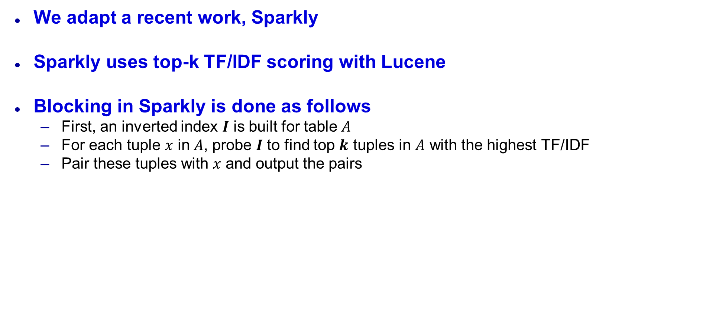
Blocking
We adapt a recent work, Sparkly
Sparkly uses top-k TF/IDF scoring with Lucene
Blocking in Sparkly is done as follows
First, an inverted index $I$ is built for table $A$
For each tuple $x$ in $A$, probe $I$ to find top $k$ tuples in $A$ with the highest TF/IDF
Pair these tuples with $x$ and output the pairs

Slide 11
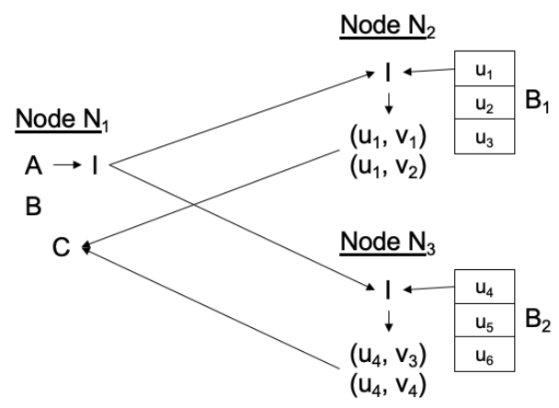
Sparkly’s execution on a Spark cluster

Slide 12
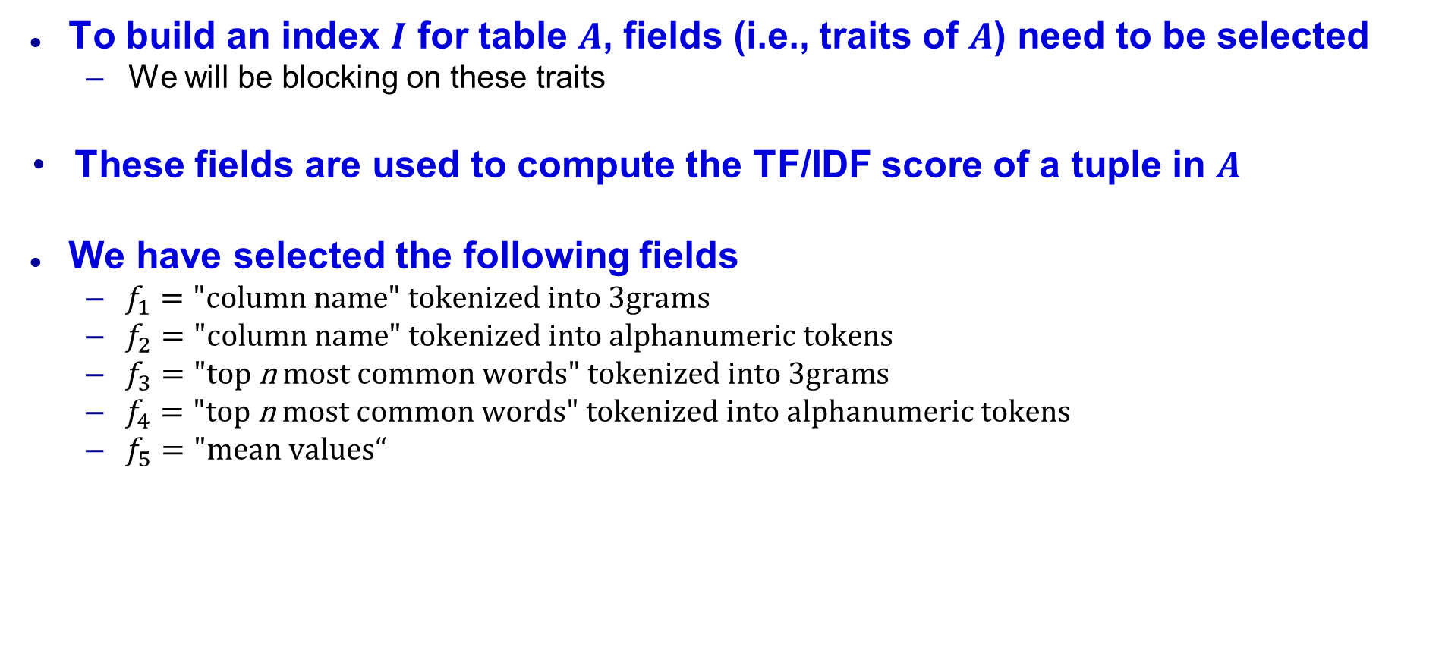
Sparkly’s Configuration
To build an index $I$ for table $A$, fields (i.e., traits of $A$) need to be selected
We will be blocking on these traits
These fields are used to compute the TF/IDF score of a tuple in $A$
We have selected the following fields
$f_{1}=\text{"}\text{column} \text{name}\text{" }\text{tokenized} \text{into}\text{ 3}\text{grams}$
$f_{2}=\text{"}\text{column} \text{name}\text{" }\text{tokenized} \text{into} alphanumeric tokens$
$f_{3}=\text{"}\text{top} \text{n} \text{most} \text{common} \text{words}\text{" }\text{tokenized} \text{into} 3grams$
$f_{4}=\text{"}\text{top} \text{n} \text{most} \text{common} \text{words}\text{" }\text{tokenized} \text{into} alphanumeric tokens$
$f_{5}=\text{"}mean values“$

Slide 13
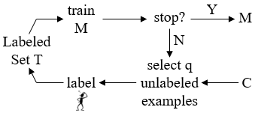

Matching
We adapt the CloudMatcher EM solution to train a matcher using active learning
We then apply the matcher to set $C$ of candidate tuple pairs to predict match/no match

Slide 14

Featurization
Before active learning can start, the candidate set $C$ needs to be converted into a set of feature vectors
We have 3 different types of features, with a total of 15 features
Name-based: Features calculated using column names
Content-based: Features calculated column data values
Context-based: Features calculated using column contexts

Slide 15
Set of Features
Name-based
Jaccard over 3gram
Levenshtein
Needleman-Wunsch
Generalized Jaccard over uppercase tokens
Overlap coefficient over uppercase tokens
Content-based
Difference in average character length
Jaccard of pattern MinHash signatures
Jaccard of value MinHash signatures
Jaccard of word frequencies

Slide 16
Set of Features
Content-based (cont.)
Same data types (4 features)
If both columns are of the same data types or not
One feature for each data type (Numeric, Categorical, Textual, Datetime)
Context-based
Jaccard over uppercase tokens in table names
Generalized Jaccard over word tokens in table names

Slide 17
Comparing Camel to Existing SM Solutions
State-of-the-art SM solutions: COMA, Cupid, Similarity Flooding (SF), and Distribution-based (DB)
System Name | Schema-based | Instance-based | Context-based
COMA | Yes | Yes | Yes
Cupid | Yes |  | Yes
SF | Yes |  | Yes
DB |  | Yes

Slide 18
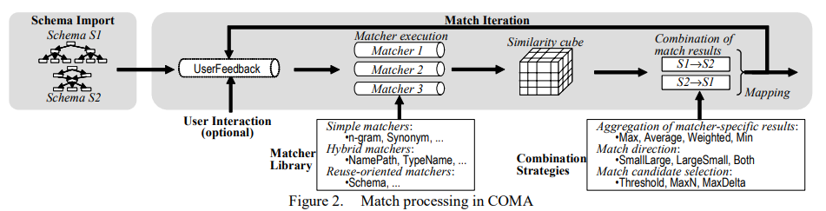
COMA

Slide 19
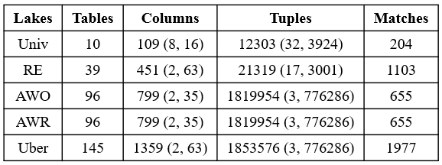
Data Lakes Used in Evaluation

Slide 20
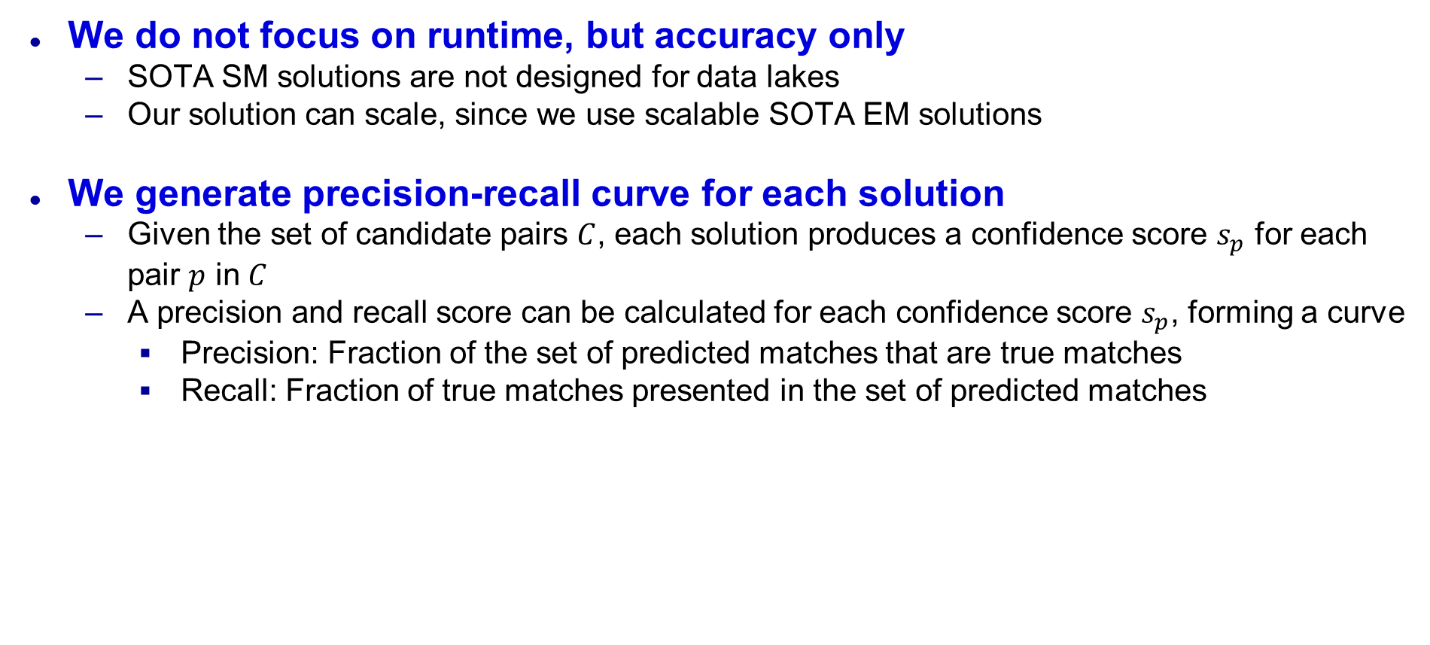
Evaluation Metrics
We do not focus on runtime, but accuracy only
SOTA SM solutions are not designed for data lakes
Our solution can scale, since we use scalable SOTA EM solutions
We generate precision-recall curve for each solution
Given the set of candidate pairs $C$, each solution produces a confidence score $s_{p}$ for each pair $p$ in $C$
A precision and recall score can be calculated for each confidence score $s_{p}$, forming a curve
Precision: Fraction of the set of predicted matches that are true matches
Recall: Fraction of true matches presented in the set of predicted matches

Slide 21
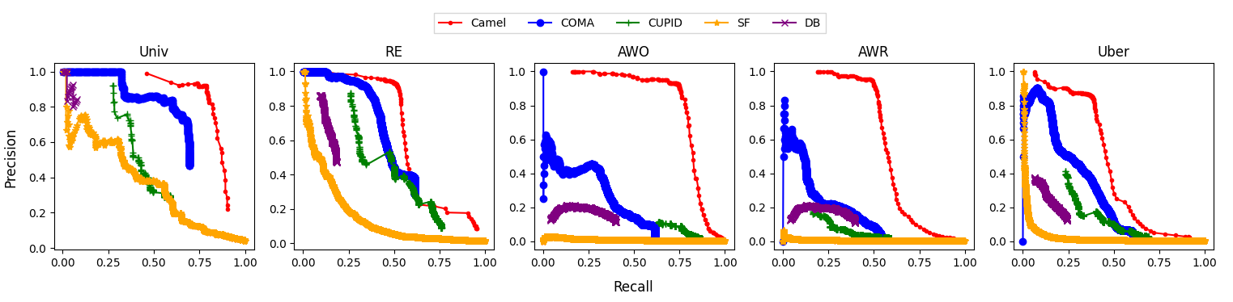
Comparing Camel to Existing SM Solutions
Camel does much better than all SOTA SM solutions
Among SOTA SM solutions, COMA does best, and SF does worst
Plenty of rooms for improvement for Camel

Slide 22
Improving Camel
We have shown that “vanilla” Camel outperforms SOTA SM solutions
“Vanilla” Camel is a relatively straightforward adaptation of SOTA EM solutions
We next show that Camel can be improved further
Using rules in blocking
Handling cryptic column names in matching
Exploiting synonym dictionaries when available

Slide 23
Using Rules in Blocking
TF/IDF blocking is highly promising, but we can create rules for blocking
We have a fixed schema for table A
Rules capture similarities (i.e. name, data) between two columns and keep pairs that are similar
We create two rule-based blocker
Manual blocker: Rules manually written
Learned blocker: Rules learned via machine learning
We also create a third blocker that takes the union of the outputs of TF/IDF and manual blockers

Slide 24
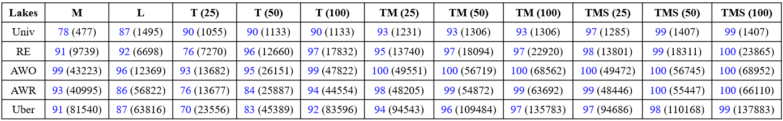
Performance of Different Blockers
M = manual blocker, L = learned blocker, T(k) = top-k TF/IDF Blocker
TM(k) = top-k TF/IDF Blocker union with manual blocker
Each cell is the blocking recall and the size of the set of candidate pairs
Blocking recall: Fraction of gold matches in the set of candidate pairs

Slide 25
Performance of Different Blockers
TF/IDF blocker outperforms both manual and learned blocker
For k=100 in top-k TF/IDF blocking
Union of TF/IDF and manual blockers achieves the best results
We will use TM(50) for the next experiments

Slide 26
Handling Cryptic Column Names in Matching
Cryptic column names are difficult to match
FN vs FNAME
TIMEPS vs TIME_PRODUCT_SHIPPING
We address this by adding 2 sequence-based features to active learning
Affine gap distance: Match two column names with “gaps” inserted
TIME_SHIPPING vs TIME_PROD_SHIPPING
Smith-Waterman distance: Match two columns names that share a long substring
PROD_SHIPPING_TIME vs DATE_PROD_SHIPPING
We also add a third feature to handle abbreviations
Abbreviated Jaccard: Match two columns with abbreviations
TIMEPS vs TIME_PRODUCT_SHIPPING

Slide 27
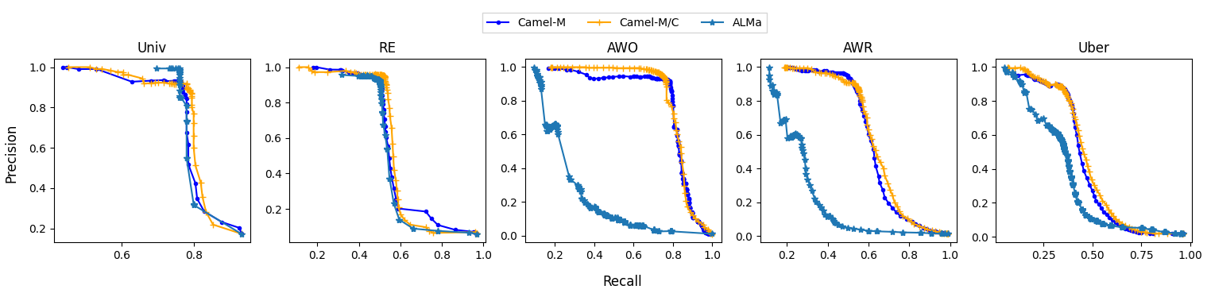
Effect of Handling Cryptic Column Names
Camel-M = Camel with TF/IDF + manual blocker
Camel-M/C = Camel with TF/IDF + manual blocker + features to handle cryptic column names in matching

Slide 28
Effect of Handling Cryptic Column Names
Using three features to handle cryptic column names does improve accuracy, but not by much
Univ and AWO do not have many matches with cryptic names
RE and AWR have many matches AND non-matches with cryptic names
Saddress vs street_address is not a match
Need to extend Camel to exploit context

Slide 29
Exploiting Synonym Dictionaries
Many matches cannot be found because of synonyms
StrAddress vs StreetLocation
Use a manually or semi-manually created dictionary of synonyms
Apply dictionaries in both blocking and matching
In blocking, Lucene (used by Sparkly) has a functionality to exploit such dictionaries when an index is being created
In matching, we can make name-based similarity functions “synonym-aware” by rewriting tokens in column names with different synonyms, then calculating the specific similarity scores

Slide 30
Effect of Exploiting Synonyms in Blocking
TMS(k) = top-k TF/IDF Blocker union with manual blocker, while exploiting a synonym dictionary
Exploiting synonyms produce substantial improvement
Especially for Univ, RE, Uber

Slide 31
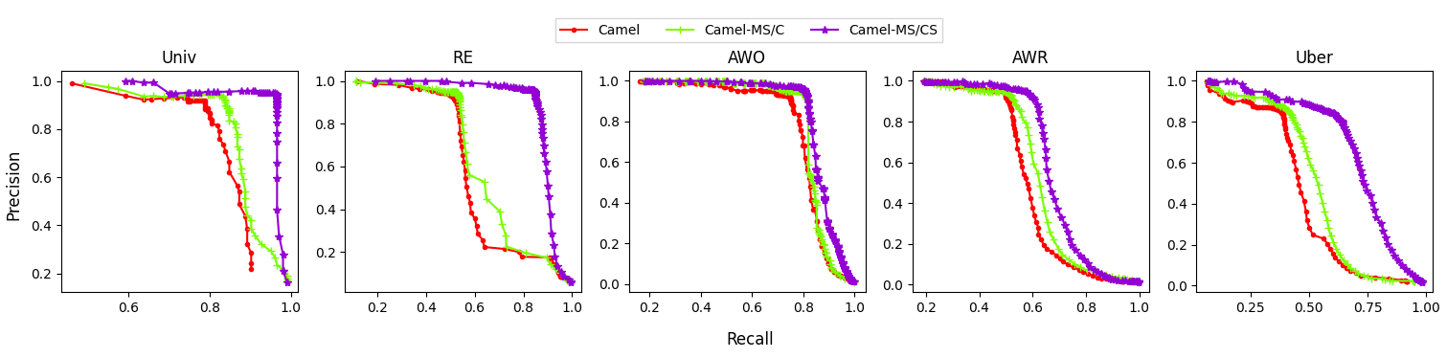
Effect of Exploiting Synonyms in Matching
Camel-MS/C = Exploits synonyms in blocking only
Camel-MS/CS = Exploits synonyms in blocking and matching
Camel = “Vanilla” Camel

Slide 32
Effect of Exploiting Synonyms in Matching
Exploiting synonyms in matching significantly improve accuracy
Substantial for Univ, RE, Uber
Very little for AWO and AWR
AWO and AWR contain many contradicting column pairs
Haddress vs house_location is a match
Saddress vs street_location is not a match

