Slide 1
File Organization and Indexing
Lecture 7
Notes:
1
The slides for this text are organized into chapters. This lecture covers Chapter 8, which introduces and compares several file and index organizations.
This chapter has been completely rewritten in the 3rd edition of the book., with the goal of being a self-contained discussion of the central concepts of files, B trees, and hash indexes, and how to use them effectively in physical database design. It provides a quantitative comparison of the file storage and indexing alternatives, and how they support efficient evaluation of queries, including the concept of “index-only” evaluation plans.
This chapter can be followed by a more in-depth discussion of B-trees, query evaluation, etc. Alternatively, it gives a concise overview of these topics from the perspective of a potential user, and can be used stand-alone in a course that emphasizes building applications over database system architecture. It covers the essential concepts in sufficient detail to support a discussion of physical database design and tuning in Chapter 20.

Slide 2
Motivation
Frequent operations
  scan (go over all tuples)
  sort, equality search, range search
  insert tuple, delete tuple (modify tuple?)
Need to speed up these operations
  using certain file organizations and indexes
File organizations
  heap
  sorted
  hash
  B+

Slide 3
Heap File Implemented as a List
Data
Page
Data
Page
Data
Page
Full Pages
Header
Page
Data
Page
Data
Page
Data
Page
Pages with
Free Space
The header page id and Heap file name must be stored someplace.
Each page contains 2 `pointers’ plus data.
Notes:
15

Slide 4
Heap File Using a Page Directory
Data
Page 1
Header
Page
Data
Page 2
Data
Page N
DIRECTORY
The entry for a page can include the number of free bytes on the page.
The directory is a collection of pages; linked list implementation is just one alternative.
Notes:
16

Slide 5
Hash Files
n buckets
Each bucket = linked list of pages
Hash each tuple into a bucket

Slide 6
Sorted Files
Sort on a single attribute
Or on a combination of attributes
These are called “search keys” or just “keys”
  not to be confused with keys of an entity set or table

Slide 7
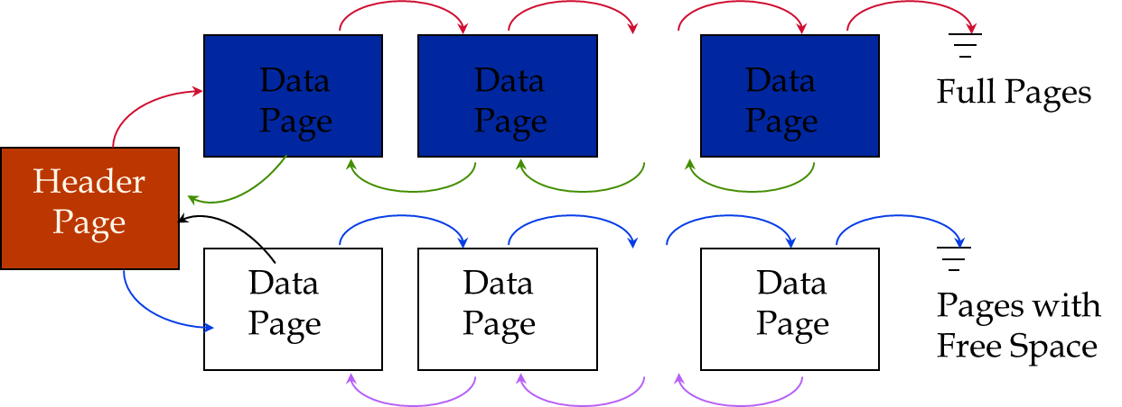
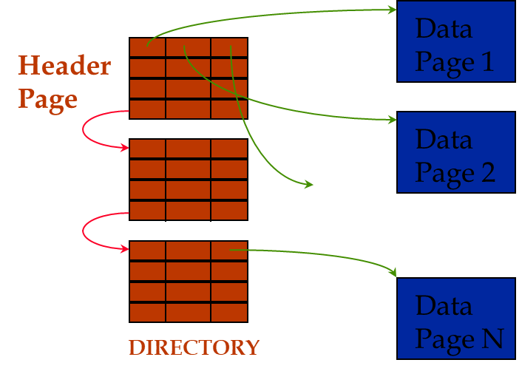
Sorted Files

Slide 8
Sorted Files
Rid = (i,N)
Page i
Rid = (i,2)
Rid = (i,1)
20
16
24
N
Pointer
to start
of free
space
N . . . 2 1
# slots
SLOT DIRECTORY

Slide 9
B+ Tree Files
Sorted file with a lot of pointers on top to direct search
Root
17
5
13
27
30
2*
3*
5*
7*
8*
14*
16*
22*
24*
27*
29*
33*
34*
38*
39*

Slide 10
Discussion
Frequent operations
  scan
  sort
  equality / range search
  insert / delete tuples

Slide 11
Motivation for Indexes
Frequent operations
  search by person name
  search by age, sal, or (age, sal)
11,80
11
12,10
12
12,20
name
age
sal
12
13,75
bob
12
10
13
<age, sal>
cal
11
80
<age>
joe
12
20
sue
13
75
10
Data records
sorted by name
20
75
80
<sal>
Notes:
13

Slide 12
Types of Indexes
Clustered vs unclustered indexes
Primary vs secondary indexes

Slide 13
B+ Tree Index
Notes:
1
The slides for this text are organized into chapters. This lecture covers Chapter 10, and discusses tree-structured indexing in depth. B+ trees are the most widely used database index structure, and this material is of great practical value to serious users of a DBMS.
It should be covered after Chapter 8, which provides an overview of storage and indexing. At the instructor’s discretion, it can also be omitted without loss of continuity in other parts of the text. (In particular, Chapter 20 can be covered without covering this chapter, though covering this chapter will certainly provide a stronger foundation.)

Slide 14
B+ Tree: Most Widely Used Index
Insert/delete at log _{F} N cost; keep tree height-balanced. (F = fanout, N = # leaf pages)
Minimum 50% occupancy (except for root). Each node contains d <= m <= 2d entries. The parameter d is called the order of the tree.
Supports equality and range-searches efficiently.
Index Entries
(Direct search)
Data Entries
("Sequence set")
Notes:
9

Slide 15
Example B+ Tree
d = 2, each entry is a number
Root
17
5
13
27
30
2*
3*
5*
7*
8*
14*
16*
22*
24*
27*
29*
33*
34*
38*
39*

Slide 16
Example B+ Tree
Search begins at root, and key comparisons direct it to a leaf
Search for 5*, 15*, all data entries >= 24* ...
Root
13
17
24
30
2*
3*
5*
7*
14*
16*
19*
20*
22*
24*
27*
29*
33*
34*
38*
39*
Based on the search for 15*, we know it is not in the tree!
Notes:
10

Slide 17
B+ Trees in Practice
Typical order: 100. Typical fill-factor: 67%.
  average fanout = 133
Typical capacities:
  Height 4: 133⁴ = 312,900,700 records
  Height 3: 133³ = 2,352,637 records
Can often hold top levels in buffer pool:
  Level 1 = 1 page = 8 Kbytes
  Level 2 = 133 pages = 1 Mbyte
  Level 3 = 17,689 pages = 133 MBytes

Slide 18
Inserting a Data Entry into a B+ Tree
Find correct leaf L.
Put data entry onto L.
  If L has enough space, done!
  Else, must split L (into L and a new node L2)
    Redistribute entries evenly, copy up middle key.
    Insert index entry pointing to L2 into parent of L.
This can happen recursively
  To split index node, redistribute entries evenly, but push up middle key. (Contrast with leaf splits.)
Splits “grow” tree; root split increases height.
  Tree growth: gets wider or one level taller at top.
Notes:
6

Slide 19
Important Tip to Get This Done Right
on the exam
focus on creating the pages, get them right
don’t worry about the pointers
once you have the pages right, you can easily create the pointers

Slide 20
Example: Insert 8*
Root
13
17
24
30
2*
3*
5*
7*
14*
16*
19*
20*
22*
24*
27*
29*
33*
34*
38*
39*
13
17
24
30
14*
16*
19*
20*
22*
24*
27*
29*
33*
34*
38*
39*
2*
3*
5*
7*
8*

Slide 21
13
17
24
30
14*
16*
19*
20*
22*
24*
27*
29*
33*
34*
38*
39*
2*
3*
5*
7*
8*
Copy up key 5
So page will have
5, 13, 17, 24, 30
5 13 17 24 30
14*
16*
19*
20*
22*
24*
27*
29*
33*
34*
38*
39*
2*
3*
5*
7*
8*

Slide 22
5 13 17 24 30
14*
16*
19*
20*
22*
24*
27*
29*
33*
34*
38*
39*
2*
3*
5*
7*
8*
Need to split the root page into two pages
and push up the middle key into another page
17
5 13
24 30
14*
16*
19*
20*
22*
24*
27*
29*
33*
34*
38*
39*
2*
3*
5*
7*
8*

Slide 23
Example B+ Tree After Inserting 8*
Root
17
5
13
24
30
2*
3*
5*
7*
8*
14*
16*
19*
20*
22*
24*
27*
29*
33*
34*
38*
39*
Notice that root was split, leading to increase in height.
Notes:
13

Slide 24
Inserting 8* into Example B+ Tree
Observe how minimum occupancy is guaranteed in both leaf and index pg splits.
Note difference between copy-up and push-up; be sure you understand the reasons for this.
Entry to be inserted in parent node.
5
(Note that 5 is
s copied up and
continues to appear in the leaf.)
2*
3*
5*
7*
8*
Entry to be inserted in parent node.
17
(Note that 17 is pushed up and only
appears once in the index. Contrast
this with a leaf split.)
5
13
24
30
Notes:
12

Slide 25
Deleting a Data Entry from a B+ Tree
Start at root, find leaf L where entry belongs.
Remove the entry.
  If L is at least half-full, done!
  If L has only d-1 entries,
    Try to re-distribute, borrowing from sibling (adjacent node with same parent as L).
    If re-distribution fails, merge L and sibling.
If merge occurred, must delete entry (pointing to L or sibling) from parent of L.
Merge could propagate to root, decreasing height.
Notes:
14

Slide 26
Example Tree After (Inserting 8*, Then) Deleting 19* and 20* ...
Root
17
5
13
27
30
2*
3*
5*
7*
8*
14*
16*
22*
24*
27*
29*
33*
34*
38*
39*
Deleting 19* is easy.
Deleting 20* is done with re-distribution. Notice how middle key is copied up.
Notes:
15

Slide 27
... And Then Deleting 24*
Must merge.
Observe `toss’ of index entry (on right), and `pull down’ of index entry (below).
30
22*
27*
29*
33*
34*
38*
39*
Root
5
13
17
30
2*
3*
5*
7*
8*
14*
16*
22*
27*
29*
33*
34*
38*
39*
Notes:
16

