Slide 1
Relational Algebra

Slide 2
Motivation
Employees(eid, ename, city, state)
Departments(did, dname, mid)
Select E.ename
From Employees E, Departments D
Where E.eid = D.mid and E.city = ‘Madison’
How to execute this query?
  create possible plans
  estimate their runtimes
  select and execute the fastest plan

Slide 3
Five Basic RA Operations
+ union
+ set difference
+ selection
+ projection
+ Cartesian product

Slide 4
Set Operations: Union
Union: all tuples in R1 or R2
Notation: R1 U R2
R1, R2 must have the same schema
R1 U R2 has the same schema as R1, R2
Example:
  ActiveEmployees U RetiredEmployees

Slide 5
Set Operations: Difference
Difference: all tuples in R1 and not in R2
Notation: R1 – R2
R1, R2 must have the same schema
R1 - R2 has the same schema as R1, R2
Example
  AllEmployees - RetiredEmployees

Slide 6
Selection
Returns all tuples which satisfy a condition
Notation: σ_{c}(R)
c is a condition: =, <, >, and, or, not
Output schema: same as input schema
Find all employees with salary more than $40,000:
  σ_{Salary > 40000} (Employee)

Slide 7
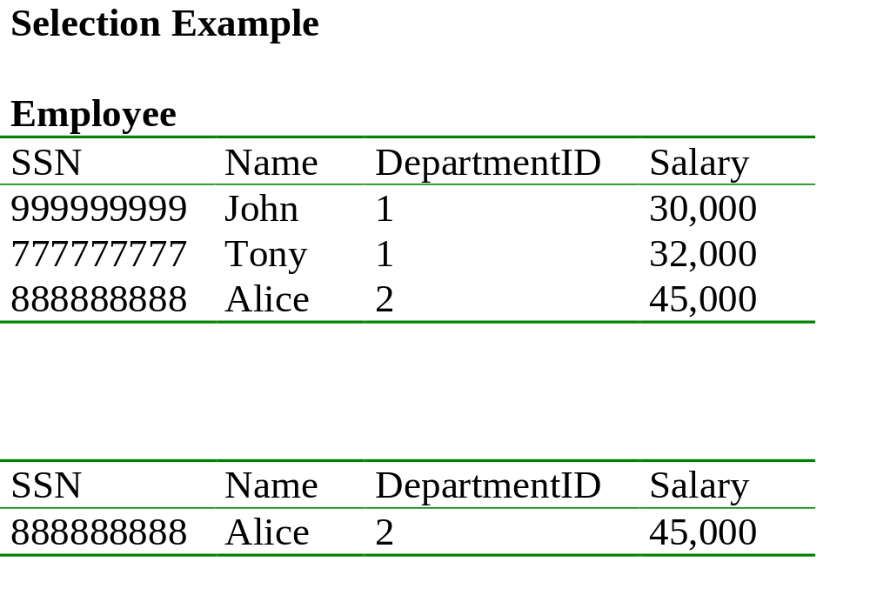
Find all employees with salary more than $40,000.
σ _{Salary > 40000} (Employee)

Slide 8
Example
Relation Sells:
bar beer price
Joe’s Bud 2.50
Joe’s Miller 2.75
Sue’s Bud 2.50
Sue’s Miller 3.00
JoeMenu := SELECT_{bar=“Joe’s”}(Sells):
bar beer price
Joe’s Bud 2.50
Joe’s Miller 2.75

Slide 9

Projection
Returns certain columns
Eliminates duplicate tuples!
Notation: Π _{A1,…,An} (R)
Input schema R(B1,…,Bm)
Condition: {A1, …, An} {B1, …, Bm}
Output schema S(A1,…,An)
Example: project social-security number and names:
  Π _{SSN, Name} (Employee)

Slide 10
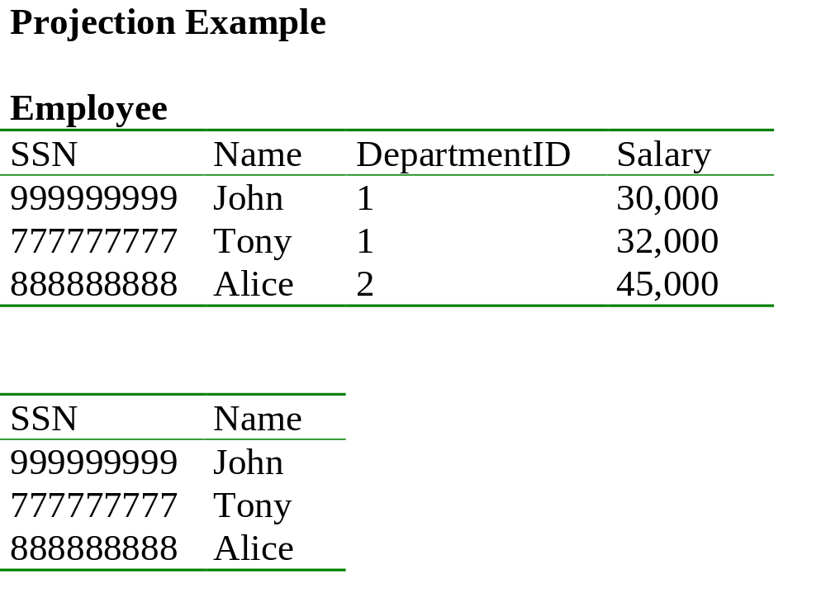
Π _{SSN, Name} (Employee)

Slide 11
Example
Relation Sells:
bar beer price
Joe’s Bud 2.50
Joe’s Miller 2.75
Sue’s Bud 2.50
Sue’s Miller 3.00
Prices := PROJ_{beer,price}(Sells):
beer price
Bud 2.50
Miller 2.75
Miller 3.00

Slide 12

Cartesian Product
Each tuple in R1 with each tuple in R2
Notation: R1 x R2
Input schemas R1(A1,…,An), R2(B1,…,Bm)
Condition: {A1,…,An} {B1,…Bm} = Φ
Output schema is S(A1, …, An, B1, …, Bm)
Notation: R1 x R2
Example: Employee x Dependents
Very rare in practice; but joins are very common

Slide 13
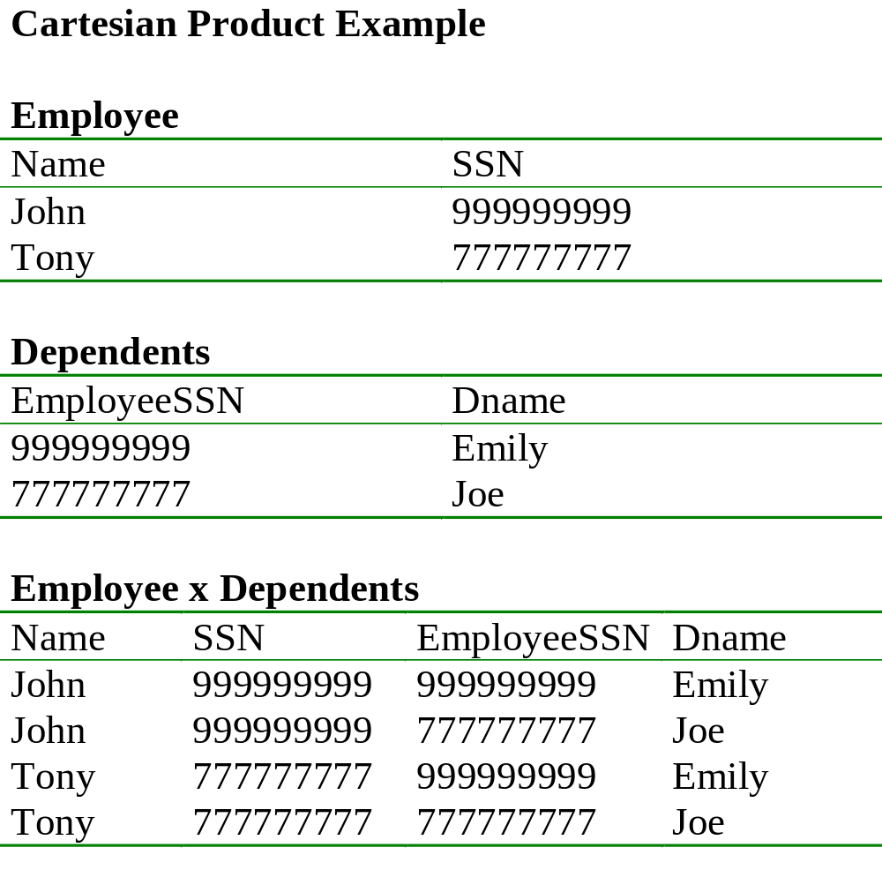

Slide 14
Example: R3 := R1 * R2
R1( A, B )
1 2
3 4
R2( B, C )
5 6
7 8
9 10
R3( A, R1.B, R2.B, C )
1 2 5 6
1 2 7 8
1 2 9 10
3 4 5 6
3 4 7 8
3 4 9 10

Slide 15
Renaming
Does not change the relational instance
Changes the relational schema only
Notation: ρ _{B1,…,Bn} (R)
Input schema: R(A1, …, An)
Output schema: S(B1, …, Bn)
Example:
    _{LastName, SocSocNo} (Employee)

Slide 16
Renaming Example
Employee
Name
SSN
John
999999999
Tony
777777777
    _{LastName, SocSocNo} (Employee)
LastName
SocSocNo
John
999999999
Tony
777777777

Slide 17
Derived RA Operations
1) Intersection
2) Most importantly: Join

Slide 18
Set Operations: Intersection
All tuples both in R1 and in R2
Notation: R1 R2
R1, R2 must have the same schema
R1 R2 has the same schema as R1, R2
Example
  UnionizedEmployees RetiredEmployees
Intersection is derived:
  R1 R2 = R1 – (R1 – R2) why ?

Slide 19
Joins
Theta join
Natural join
Equi-join
Semi-join
Inner join
Outer join
etc.

Slide 20

Theta Join
A join that involves a predicate
Notation: R1 _{θ} R2 where θ is a condition
Input schemas: R1(A1,…,An), R2(B1,…,Bm)
{A1,…An} {B1,…,Bm} = φ
Output schema: S(A1,…,An,B1,…,Bm)
Derived operator:
R1 _{θ} R2 = σ _{θ} (R1 x R2)

Slide 21
Example
Sells( bar, beer, price ) Bars( name, addr )
Joe’s Bud 2.50 Joe’s Maple St.
Joe’s Miller 2.75 Sue’s River Rd.
Sue’s Bud 2.50
Sue’s Coors 3.00
BarInfo := Sells JOIN _{Sells.bar = Bars.name} Bars
BarInfo( bar, beer, price, name, addr )
Joe’s Bud 2.50 Joe’s Maple St.
Joe’s Miller 2.75 Joe’s Maple St.
Sue’s Bud 2.50 Sue’s River Rd.
Sue’s Coors 3.00 Sue’s River Rd.

Slide 22
Natural Join
Notation: R1 R2
Input Schema: R1(A1, …, An), R2(B1, …, Bm)
Output Schema: S(C1,…,Cp)
  Where {C1, …, Cp} = {A1, …, An} U {B1, …, Bm}
Meaning: combine all pairs of tuples in R1 and R2 that agree on the attributes:
  {A1,…,An} {B1,…, Bm} (called the join attributes)
Equivalent to a cross product followed by selection
Example Employee Dependents

Slide 23
Natural Join Example
Employee
Name
SSN
John
999999999
Tony
777777777
Dependents
SSN
Dname
999999999
Emily
777777777
Joe
Employee Dependents =
Π_{Name, SSN, Dname}(σ _{SSN=SSN2}(Employee x ρ_{SSN2, Dname}(Dependents))
Name
SSN
Dname
John
999999999
Emily
Tony
777777777
Joe

Slide 24
Natural Join
R= S=
R S =
A | B
X | Y
X | Z
Y | Z
Z | V
B | C
Z | U
V | W
Z | V
A | B | C
X | Z | U
X | Z | V
Y | Z | U
Y | Z | V
Z | V | W

Slide 25
Natural Join
Given the schemas R(A, B, C, D), S(A, C, E), what is the schema of R S ?
Given R(A, B, C), S(D, E), what is R S ?
Given R(A, B), S(A, B), what is R S ?

Slide 26
Example
Sells( bar, beer, price ) Bars( bar, addr )
Joe’s Bud 2.50 Joe’s Maple St.
Joe’s Miller 2.75 Sue’s River Rd.
Sue’s Bud 2.50
Sue’s Coors 3.00
BarInfo := Sells JOIN Bars
Note Bars.name has become Bars.bar to make the natural
join “work.”
BarInfo( bar, beer, price, addr )
Joe’s Bud 2.50 Maple St.
Joe’s Milller 2.75 Maple St.
Sue’s Bud 2.50 River Rd.
Sue’s Coors 3.00 River Rd.

Slide 27
Equi-join
Most frequently used in practice:
R1 _{Α=Β} R2
Natural join is a particular case of equi-join
A lot of research on how to do it efficiently

Slide 28
Relational Algebra
Five basic operators, many derived
Combine operators in order to construct queries: relational algebra expressions, usually shown as trees

Slide 29
Building Complex Expressions
Algebras allow us to express sequences of operations in a natural way.
Example
  in arithmetic algebra: (x + 4)*(y - 3)
Relational algebra allows the same.
Three notations, just as in arithmetic:
    Sequences of assignment statements.
    Expressions with several operators.
    Expression trees.

Slide 30
Sequences of Assignments
Create temporary relation names.
Renaming can be implied by giving relations a list of attributes.
Example: R3 := R1 JOIN_{C} R2 can be written:
  R4 := R1 * R2
  R3 := SELECT_{C} (R4)

Slide 31
Expressions with Several Operators
Example: the theta-join R3 := R1 JOIN_{C} R2 can be written: R3 := SELECT_{C} (R1 * R2)
Precedence of relational operators:
    Unary operators --- select, project, rename --- have highest precedence, bind first.
    Then come products and joins.
    Then intersection.
    Finally, union and set difference bind last.
But you can always insert parentheses to force the order you desire.

Slide 32
Expression Trees
Leaves are operands --- either variables standing for relations or particular, constant relations.
Interior nodes are operators, applied to their child or children.

Slide 33
Example
Using the relations Bars(name, addr) and Sells(bar, beer, price), find the names of all the bars that are either on Maple St. or sell Bud for less than $3.

Slide 34
As a Tree:
Using the relations Bars(name, addr) and Sells(bar, beer, price), find the names of all the bars that are either on Maple St. or sell Bud for less than $3.
UNION
RENAME_{R(name)}
PROJECT_{name}
PROJECT_{bar}
SELECT_{addr = “Maple St.”}
SELECT _{price<3 AND beer=“Bud”}
Bars
Sells

Slide 35
Example
Using Sells(bar, beer, price), find the bars that sell two different beers at the same price.
Strategy: by renaming, define a copy of Sells, called S(bar, beer1, price). The natural join of Sells and S consists of quadruples (bar, beer, beer1, price) such that the bar sells both beers at this price.

Slide 36
The Tree
PROJECT_{bar}
SELECT_{beer != beer1}
JOIN
RENAME_{S(bar, beer1, price)}
Sells
Sells

Slide 37
Complex Queries
Product ( pid, name, price, category, maker-cid)
Purchase (buyer-ssn, seller-ssn, store, pid)
Company (cid, name, stock price, country)
Person(ssn, name, phone number, city)
Note:
in Purchase: buyer-ssn, seller-ssn are foreign keys in Person, pid is foreign key in Product;
in Product maker-cid is a foreign key in Company
Find phone numbers of people who bought gizmos from Fred.
Find telephony products that somebody bought

Slide 38
Expression Tree
Π _{name}
buyer-ssn=ssn
pid=pid
seller-ssn=ssn
Π _{ssn}
Π _{pid}
σ_{name=fred}
σ_{name=gizmo}
Person Purchase Person Product

Slide 39
Exercises
Product ( pid, name, price, category, maker-cid)
Purchase (buyer-ssn, seller-ssn, store, pid)
Company (cid, name, stock price, country)
Person(ssn, name, phone number, city)
Ex #1: Find people who bought telephony products.
Ex #2: Find names of people who bought American products

Slide 40
Exercises
Product ( pid, name, price, category, maker-cid)
Purchase (buyer-ssn, seller-ssn, store, pid)
Company (cid, name, stock price, country)
Person(ssn, name, phone number, city)
Ex #3: Find names of people who bought American products and did
not buy French products
Ex #4: Find names of people who bought American products and they
live in Champaign.

Slide 41
Exercises
Product ( pid, name, price, category, maker-cid)
Purchase (buyer-ssn, seller-ssn, store, pid)
Company (cid, name, stock price, country)
Person(ssn, name, phone number, city)
Ex #5: Find people who bought stuff from Joe or bought products
from a company whose stock prices is more than $50.

Slide 42
Operations on Bags
(and why we care)
Union: {a,b,b,c} U {a,b,b,b,e,f,f} = {a,a,b,b,b,b,b,c,e,f,f}
  add the number of occurrences
Difference: {a,b,b,b,c,c} – {b,c,c,c,d} = {a,b,b,d}
  subtract the number of occurrences
Intersection: {a,b,b,b,c,c} {b,b,c,c,c,c,d} = {b,b,c,c}
  minimum of the two numbers of occurrences
Selection: preserve the number of occurrences
Projection: preserve the number of occurrences (no duplicate elimination)
Cartesian product, join: no duplicate elimination
Read the book for more detail

Slide 43
Summary of Relational Algebra
Why bother ? Can write any RA expression directly in C++/Java, seems easy.
Two reasons:
  Each operator admits sophisticated implementations (think of , σ _{C})
  Expressions in relational algebra can be rewritten: optimized

Slide 44
Glimpse Ahead: Efficient Implementations of Operators
σ_{(age >= 30 AND age <= 35)}(Employees)
  Method 1: scan the file, test each employee
  Method 2: use an index on age
  Which one is better ? Depends a lot…
Employees Relatives
  Iterate over Employees, then over Relatives
  Iterate over Relatives, then over Employees
  Sort Employees, Relatives, do “merge-join”
  “hash-join”
  etc

Slide 45
Glimpse Ahead: Optimizations
Product ( pid, name, price, category, maker-cid)
Purchase (buyer-ssn, seller-ssn, store, pid)
Person(ssn, name, phone number, city)
Which is better:
  σ_{price>100}(Product) (Purchase σ_{city=sea}Person)
  (σ_{price>100}(Product) Purchase) σ_{city=sea}Person
Depends ! This is the optimizer’s job…

Slide 46
Finally: RA has Limitations !
Cannot compute “transitive closure”
Find all direct and indirect relatives of Fred
Cannot express in RA !!! Need to write C program
Name1 | Name2 | Relationship
Fred | Mary | Father
Mary | Joe | Cousin
Mary | Bill | Spouse
Nancy | Lou | Sister

