Slide 1
Evaluation of Relational Operations
Chapter 14, Part A (Joins)
Notes:
1
The slides for this text are organized into chapters. This lecture covers the first part of Chapter 14, focusing on algorithms for evaluating the join operation. The set of slides labeled “Chapter 14, Part B” covers the remainder of Chapter 14.
This chapter should be covered after Chapter 8, which provides an overview of storage and indexing. At the instructor’s discretion, it can also be omitted without loss of continuity in other parts of the text. (In particular, Chapter 20 can be covered without covering this chapter, though this material gives more insight into the workings of a DBMS.)
This chapter is most appropriate for a course with an implementation emphasis, and is a candidate for omission in a course with an applications emphasis.

Slide 2
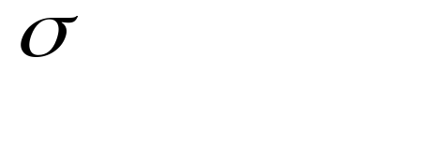
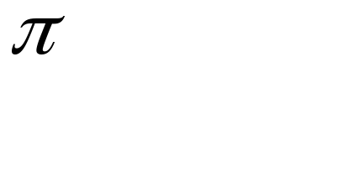



Relational Operations
We will consider how to implement:
  Selection ( ) Selects a subset of rows from relation.
  Projection ( ) Deletes unwanted columns from relation.
  Join ( ) Allows us to combine two relations.
  Set-difference ( ) Tuples in reln. 1, but not in reln. 2.
  Union ( ) Tuples in reln. 1 and in reln. 2.
  Aggregation (SUM, MIN, etc.) and GROUP BY
Notes:
3

Slide 3
Schema for Examples
Sailors (sid: integer, sname: string, rating: integer, age: real)
Reserves (sid: integer, bid: integer, day: dates, rname: string)
Reserves:
  Each tuple is 40 bytes long, 100 tuples per page, 1000 pages.
Sailors:
  Each tuple is 50 bytes long, 80 tuples per page, 500 pages.
Notes:
4

Slide 4


Equality Joins With One Join Column
SELECT *
FROM Reserves R1, Sailors S1
WHERE R1.sid=S1.sid
In algebra: R S. Common! Must be carefully optimized. R S is large; so, R S followed by a selection is inefficient.
Assume: M pages for R, p_{R} tuples per page, N pages for S, p_{S} tuples per page.
  In our examples, R is Reserves and S is Sailors.
Cost metric: # of I/Os. We will ignore output costs.
Notes:
5

Slide 5
Join Algorithms to Consider
Nested loop join
Sort-merge join
Hash join
Index nested loop join

Slide 6
Simple Nested Loops Join
foreach tuple r in R do
foreach tuple s in S do
if r_{i} == s_{j} then add <r, s> to result
Tuple-oriented NLJ: For each tuple in the outer relation R, we scan the entire inner relation S.
  Cost: M + p_{R} * M * N = 1000 + 100*1000*500 I/Os.
Page-oriented NLJ: For each page of R, get each page of S, and write out matching pairs of tuples <r, s>, where r is in R-page and S is in S-page.
  Cost: M + M*N = 1000 + 1000*500
  If smaller relation (S) is outer, cost = 500 + 500*1000
Notes:
6

Slide 7
Block Nested Loops Join
Use one page as an input buffer for scanning the inner S, one page as the output buffer, and use all remaining pages to hold ``block’’ of outer R.
  For each matching tuple r in R-block, s in S-page, add <r, s> to result. Then read next R-block, scan S, etc.
R & S
Join Result
block of R
. . .
. . .
. . .
Input buffer for S
Output buffer
Notes:
9

Slide 8
Block Nested Loops Join
R is scanned once, cost = M pages
Each block has size B-2 (B is # of buffer pages), so need to read S a total of ceiling(M/[B-2]) times
Total cost: M + N * ceiling(M/[B-2])
R & S
Join Result
block of R
. . .
. . .
. . .
Input buffer for S
Output buffer
Notes:
9

Slide 9
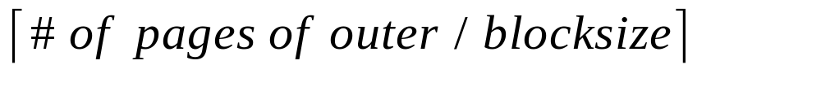
Examples of Block Nested Loops
Cost: Scan of outer + #outer blocks * scan of inner
  #outer blocks =
With Reserves (R) as outer, and 100 pages of R:
  Cost of scanning R is 1000 I/Os; a total of 10 blocks.
  Per block of R, we scan Sailors (S); 10*500 I/Os.
  If space for just 90 pages of R, we would scan S 12 times.
With 100-page block of Sailors as outer:
  Cost of scanning S is 500 I/Os; a total of 5 blocks.
  Per block of S, we scan Reserves; 5*1000 I/Os.

Slide 10

Sort-Merge Join (R S)
i=j
Sort R and S on the join column, then scan them to do a ``merge’’ (on join col.), and output result tuples.
  Advance scan of R until current R-tuple >= current S tuple, then advance scan of S until current S-tuple >= current R tuple; do this until current R tuple = current S tuple.
  At this point, all R tuples with same value in Ri (current R group) and all S tuples with same value in Sj (current S group) match; output <r, s> for all pairs of such tuples.
  Then resume scanning R and S.
R is scanned once; each S group is scanned once per matching R tuple. (Multiple scans of an S group are likely to find needed pages in buffer.)
Notes:
11

Slide 11
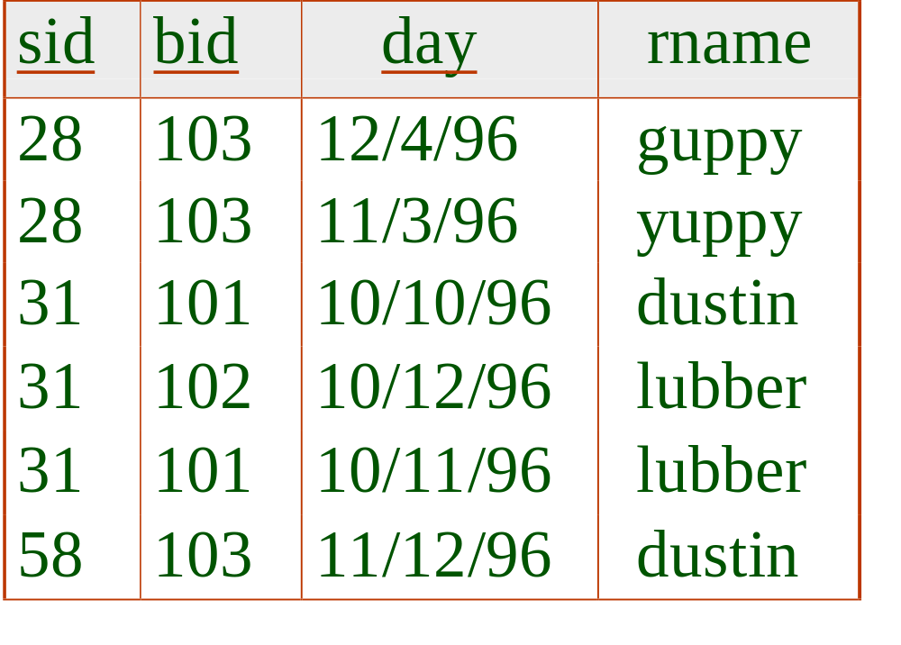
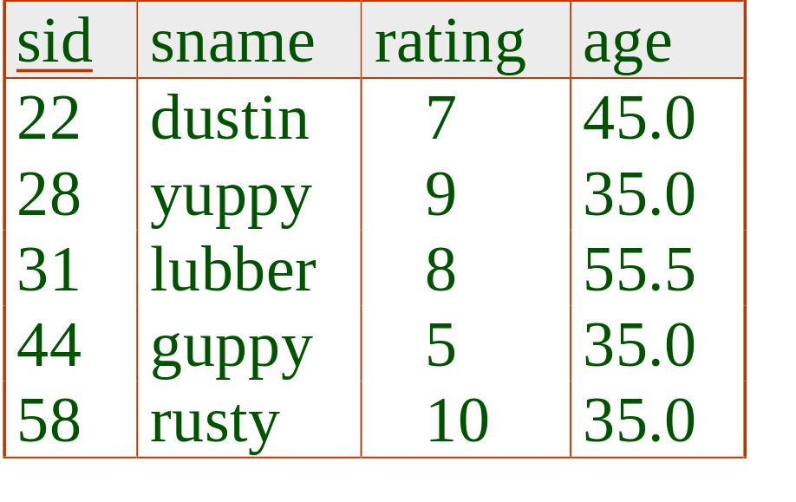
Example of Sort-Merge Join
Notes:
12

Slide 12
Example of Sort-Merge Join
Cost: M log M + N log N + (M+N) [this is incorrect!]
  The cost of scanning, M+N, could be M*N (very unlikely!)
Notes:
12

Slide 13
Cost of Sort-Merge Join
Start by sorting both R and S on the join attribute:
  Assumption: M <= B², N <= B²
  Cost: 4M + 4N
Read both relations in sorted order, match tuples
  Typical cost: M + N (but can be as high as M*N)
Difficulty: many tuples in R may match many in S
  If at least one set of tuples fits in memory, we are OK
  Otherwise need nested loop, higher cost
Total cost: 5M + 5N

Slide 14
Hash-Join
Original
Relation
OUTPUT
Partitions
1
Partition both relations using hash fn h: R tuples in partition i will only match S tuples in partition i.
1
INPUT
2
hash
function
h
2
. . .
B-1
B-1
Disk
B main memory buffers
Disk
Partitions
of R & S
Join Result
Read in a partition of R, hash it using h2 (<> h!). Scan matching partition of S, search for matches.
Hash table for partition
Ri (k < B-1 pages)
hash
fn
h2
h2
Input buffer
for Si
Output
buffer
Disk
B main memory buffers
Disk
Notes:
14

Slide 15
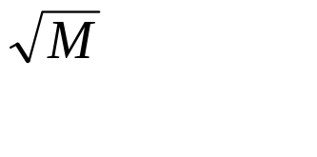
Observations on Hash-Join
#partitions k < B-1 (why?), and B-2 > size of largest partition to be held in memory. Assuming uniformly sized partitions, and maximizing k, we get:
  k= B-1, and M/(B-1) < B-2, i.e., B must be >
If we build an in-memory hash table to speed up the matching of tuples, a little more memory is needed.
If the hash function does not partition uniformly, one or more R partitions may not fit in memory. Can apply hash-join technique recursively to do the join of this R-partition with corresponding S-partition.
Notes:
15

Slide 16
Cost of Hash-Join
In partitioning phase, read+write both relns; 2(M+N). In matching phase, read both relns; M+N I/Os.
In our running example, this is a total of 4500 I/Os.
Notes:
16

Slide 17
Index Nested Loops Join
foreach tuple r in R do
foreach tuple s in S where r_{i} == s_{j} do
add <r, s> to result
If there is an index on the join column of one relation (say S), can make it the inner and exploit the index.
  Cost: M + ( (M*p_{R}) * cost of finding matching S tuples)
For each R tuple, cost of probing S index is about 1.2 for hash index, 2-4 for B+ tree.

Slide 18
General Join Conditions [See Textbook]
Equalities over several attributes (e.g., R.sid=S.sid AND R.rname=S.sname):
  For Index NL, build index on <sid, sname> (if S is inner); or use existing indexes on sid or sname.
  For Sort-Merge and Hash Join, sort/partition on combination of the two join columns.
Inequality conditions (e.g., R.rname < S.sname):
  For Index NL, need (clustered!) B+ tree index.
    Range probes on inner; # matches likely to be much higher than for equality joins.
  Hash Join, Sort Merge Join not applicable.
  Block NL quite likely to be the best join method here.

Slide 19
Key Things to Remember
Joins are very common, and very expensive
Need to bring similar tuples together
Can do this in a few ways
  sort
  hash
  using an index
  or just enumerate all pairs (nested loop joins)

