Slide 1
External Sorting
Notes:
1
The slides for this text are organized into chapters. This lecture covers Chapter 13, and discusses external sorting. Sorting is one of the most frequent database operations, and is optimized for I/O costs, leading to some interesting differences with in-memory sorting.
It should be covered after Chapter 8, which provides an overview of storage and indexing. At the instructor’s discretion, it can also be omitted without loss of continuity in other parts of the text. (In particular, Chapter 20 can be covered without covering this chapter.)
This chapter is most appropriate for a course with an implementation emphasis, and we suggest omitting it in a course with an applications emphasis.

Slide 2
Why Sort?
A classic problem in computer science!
Data requested in sorted order
  e.g., find students in increasing gpa order
Sorting is first step in bulk loading B+ tree index.
Sorting useful for eliminating duplicate copies in a collection of records (Why?)
Sort-merge join algorithm involves sorting.
Problem: sort 1Gb of data with 1Mb of RAM.
  why not virtual memory?
Notes:
4

Slide 3
2-Way Sort: Requires 3 Buffers
Pass 1: Read a page, sort it, write it.
  only one buffer page is used
Pass 2, 3, …, etc.:
  three buffer pages used.
INPUT 1
OUTPUT
INPUT 2
Main memory buffers
Disk
Disk
Notes:
5

Slide 4
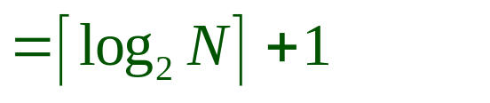
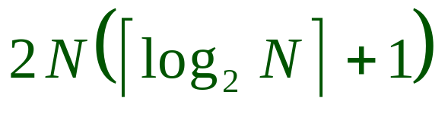
Two-Way External Merge Sort
Each pass we read + write each page in file.
N pages in the file => the number of passes
So toal cost is:
Idea: Divide and conquer: sort subfiles and merge
3,4
6,2
9,4
8,7
5,6
3,1
2
Input file
PASS 0
3,4
2,6
4,9
7,8
5,6
1,3
2
1-page runs
PASS 1
2,3
4,7
1,3
2-page runs
4,6
8,9
5,6
2
PASS 2
2,3
4,4
1,2
4-page runs
6,7
3,5
8,9
6
PASS 3
1,2
2,3
3,4
8-page runs
4,5
6,6
7,8
9
Notes:
6

Slide 5
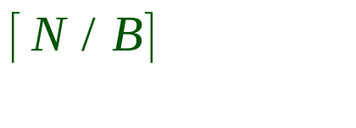
General External Merge Sort
More than 3 buffer pages. How can we utilize them?
To sort a file with N pages using B buffer pages:
  Pass 0: use B buffer pages. Produce sorted runs of B pages each.
  Pass 2, …, etc.: merge B-1 runs.
INPUT 1
. . .
INPUT 2
. . .
. . .
OUTPUT
INPUT B-1
Disk
Disk
B Main memory buffers
Notes:
7

Slide 6
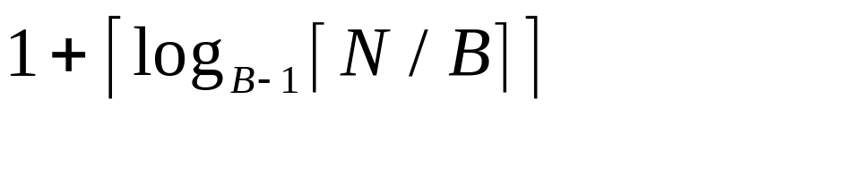
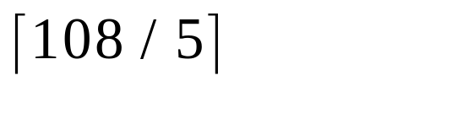
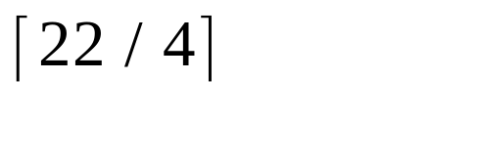
Cost of External Merge Sort
Number of passes:
Cost = 2N * (# of passes)
E.g., with 5 buffer pages, to sort 108 page file:
  Pass 0: = 22 sorted runs of 5 pages each (last run is only 3 pages)
  Pass 1: = 6 sorted runs of 20 pages each (last run is only 8 pages)
  Pass 2: 2 sorted runs, 80 pages and 28 pages
  Pass 3: Sorted file of 108 pages
Notes:
8

Slide 7
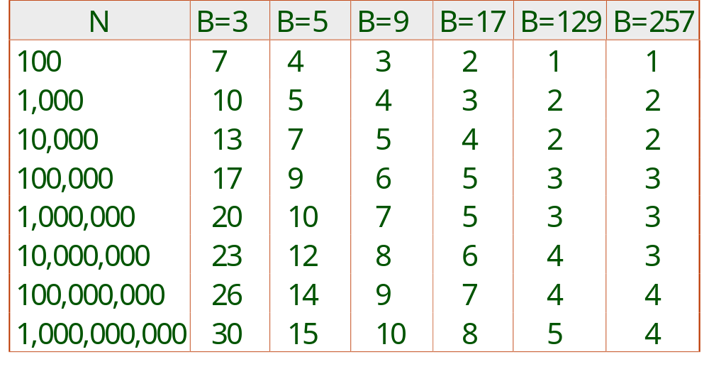
Number of Passes of External Sort
Notes:
9

Slide 8
A Typical Case
If have B memory pages, a file of M pages, and M < B*B
  then cost of sort is 4M
Pass 0: create runs of B pages long
Pass 1: create runs of B*(B-1) pages long
  if M < B*B, then we are done
Cost of Pass 0: 2M
Cost of Pass 1: 2M

