Slide 1

Knowledge Graphs, 360s, MDM, Reference Data
AnHai Doan
Notes:
Let me start this talk by telling you how I got to social media. For that, I need to go back to the year 2001.

Slide 2
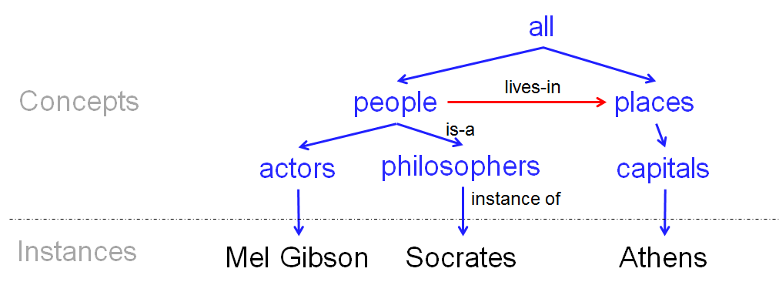
What is a KG?
Set of concepts
Set of relations
a special relation is “is-a”
can use this to organize concepts into a taxonomy
Each concept may have a set of instances
Each instance has several attributes

Slide 3
CS Dept. US
all products
electronics clothes toys
TVs PCs …
Entity
Undergrad
Courses
Grad
Courses
People
Faculty
Staff
Assistant
Professor
Associate
Professor
Professor
name: Mike Burns
degree: Ph.D.

Slide 4
all
places
people
Twitter users
FB users
actors
@melgibson @dsmith …
mel-gibson davesmith …
Angelia Jolie
Mel Gibson
the-same-as
tweet-about

Slide 5
Difference between KG and Ontology
Discuss an example regarding CS department
raw data
ontology
knowledge graph

Slide 6
Examples of Using KGs
Google knowledge panels
Walmart product KG
Discovery from biomedical literature
Understanding social media

Slide 7

Understanding Social Media
capital-of
Egypt
Cairo
located-in
condiments
movies
Tahrir
uprising
related-to
salt
Salt
tweeted-about
mention-of
@far213
Angelina
Jolie
CIA
tweet-of
@far213: salt is awesome. angelina rocks. I think I’m gonna join the cia
@far213: Tahrir is packed!

Slide 8
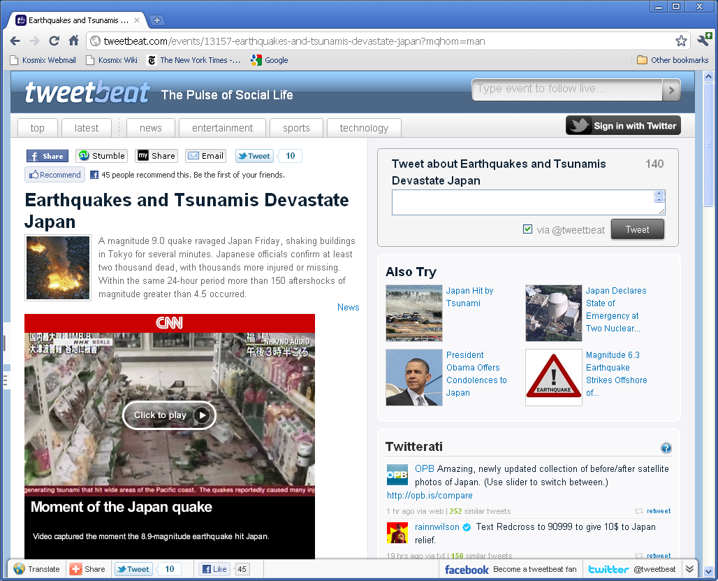
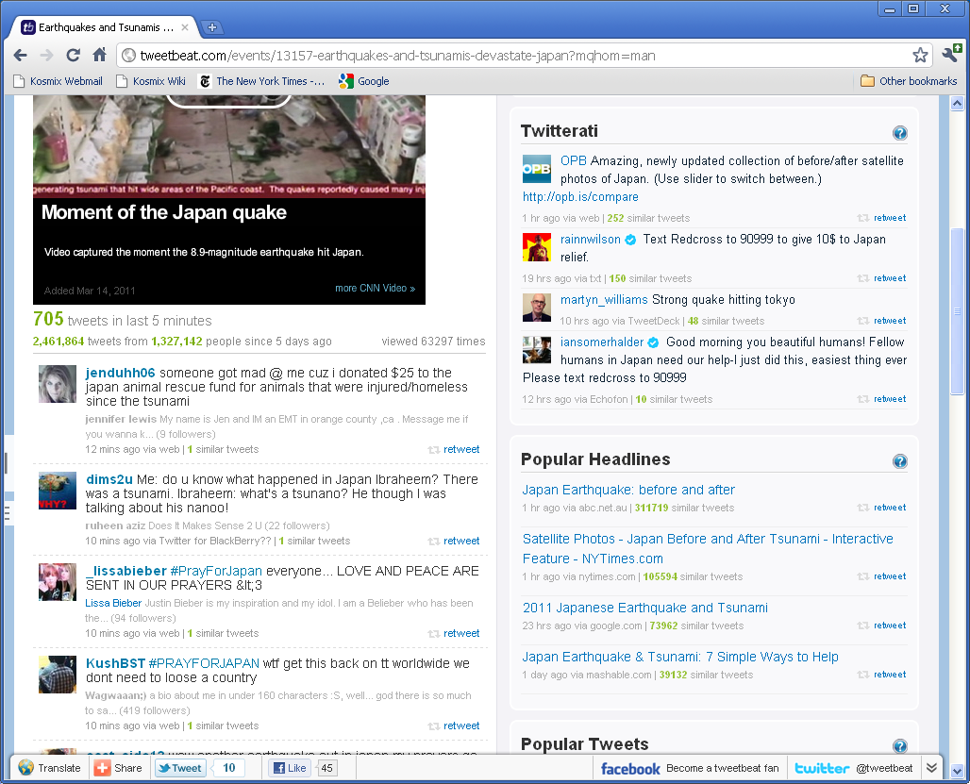
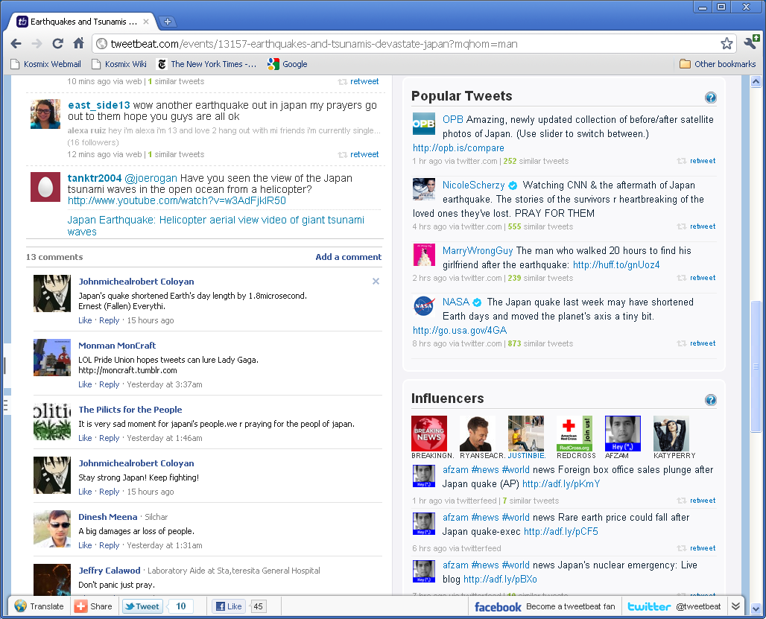
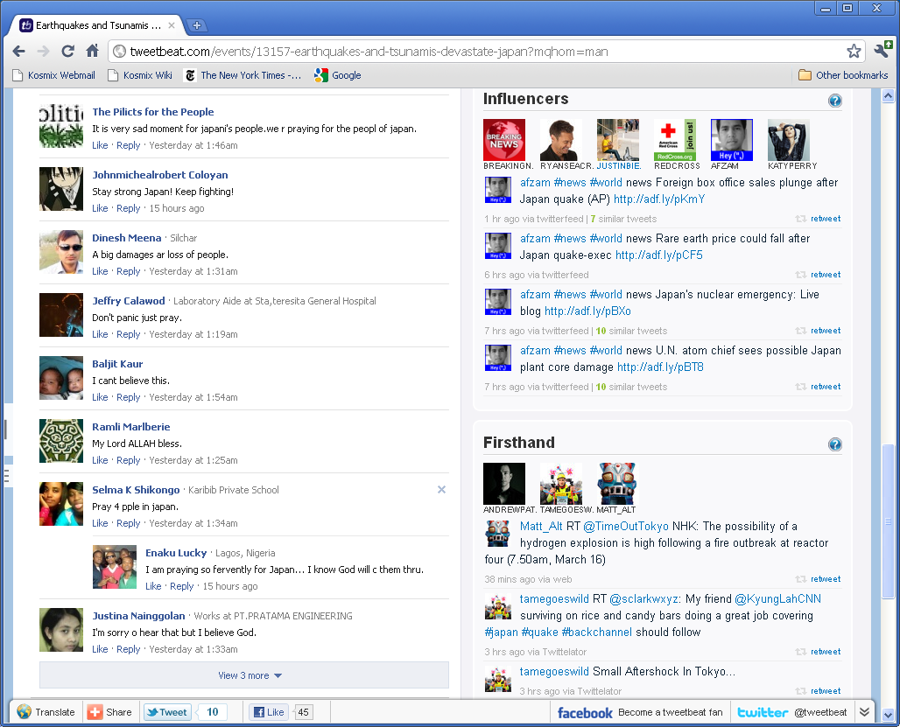

Slide 9
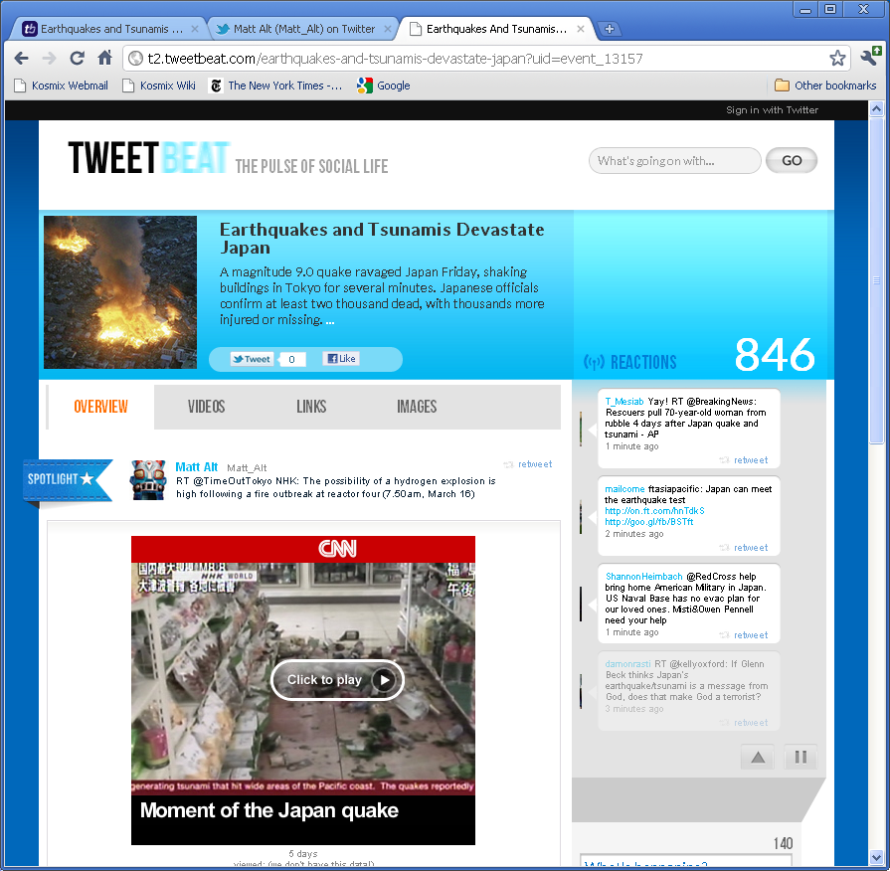
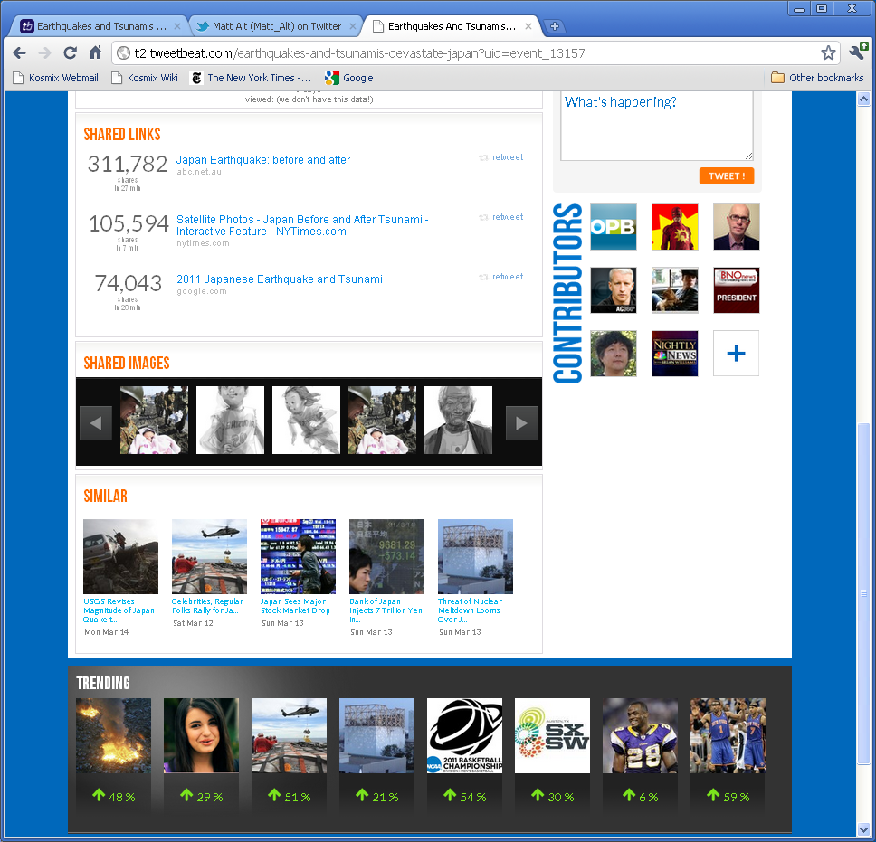

Slide 10
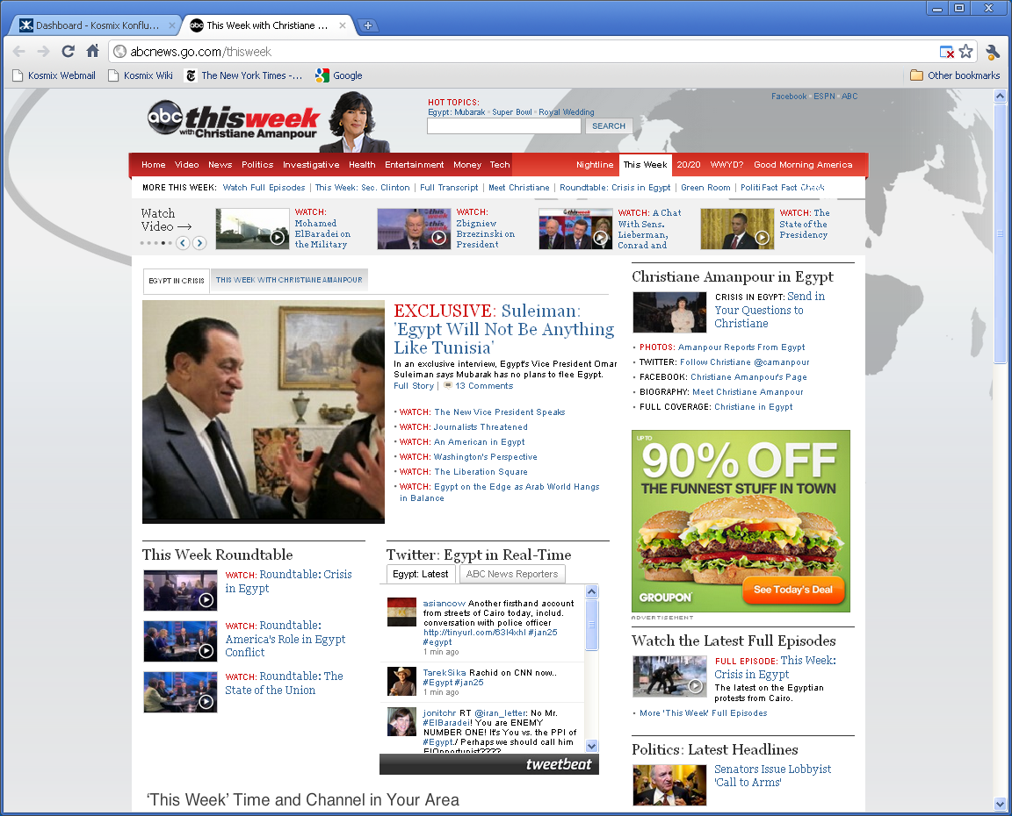
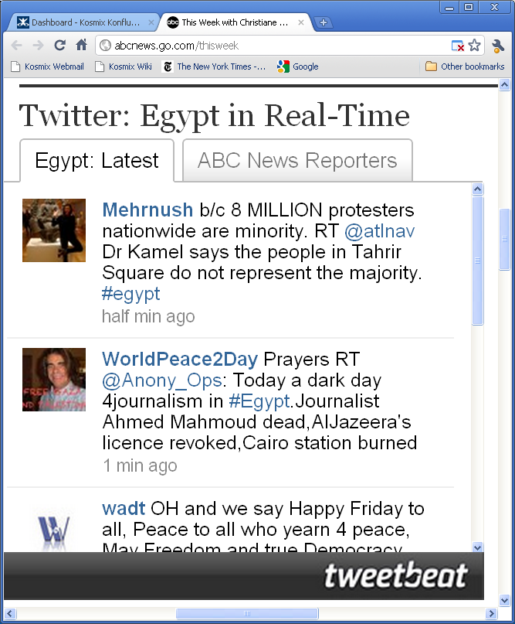

Slide 11
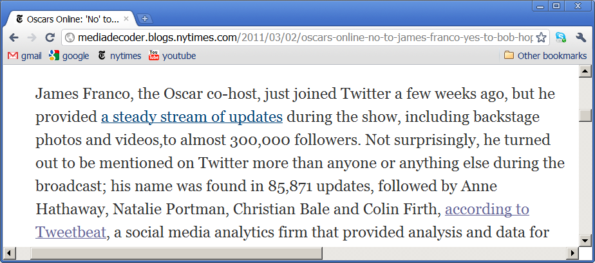
Social Analytics

Slide 12
How to Create a KG?
Discover concept taxonomy
Get entities
Get relationships

Slide 13
Overall Software Architecture
Crowd sourcing
internal analysts, users, Mechanical Turks, others
Build Social Genome
build base taxonomy
add social media
users, mappings
events, topics,
social context
tweets, updates
Use Social Genome
querying w/ MQL
app1, app2, app3
(Tweetbeat, RightHealth)
Data
sources
Social
genome
Tools
extractor
categorizer
event detector
event monitor
stat producer
Highly scalable real-time infrastructure
File system Hadoop Muppet
Slates Stream servers

Slide 14
Use Web Data to Build Seed Taxonomy
Human edits
all
Information extraction
Clustering
Entity matching
Information integration
places
people
over 10M
nodes
IMDB Musicbrainz
Wikipedia
…
actors
Angelia Jolie
Mel Gibson
Incrementally maintain over time as sources change
Ensure very low latencies
The backbone of the knowledge base.
Critical for understanding social media.
Took years to develop. Like learning a foreign language. Can’t shortcut.

Slide 15
Add Low-Hanging-Fruit Structured Data from Social Media
all
places
people
Twitter users
FB users
actors
@melgibson @dsmith …
mel-gibson davesmith …
Angelia Jolie
Mel Gibson
the-same-as

Slide 16
Add More Structured Data from Social Media
all
places
people
Twitter users
FB users
actors
@melgibson @dsmith …
mel-gibson davesmith …
Angelia Jolie
Mel Gibson
the-same-as
tweet-about
Twitter
4square
Facebook
Myspace
Flickr
…
events
Event detection
sports
celebrities
politics …
Gibson car crash
Egyptian uprising
Manually create important event nodes

Slide 17
Add Social Context
all
places
people
Twitter users
FB users
actors
@melgibson @dsmith …
mel-gibson davesmith …
Angelia Jolie
Mel Gibson
events
sports
celebrities
politics …
Long-term, Web context:
actor, movie, Oscar, Hollywood
Gibson car crash
Egyptian uprising
Actor Mel Gibson’s next movie is …
But Hollywood’s reaction has been rather lukewarm …
Short-term, social context:
crash, car, Maserati
@dsmith: Mel crashed. Maserati is gone.

Slide 18
Business Glossary: Poor Man’s KG
Use business terms to tag datasets

Slide 19
360s
KGs for most “horse” companies, not “elephants”
Customer 360
Product 360
Supplier 360
A particular example of doing this in Customer 360
on matching and merging

Slide 20
MDMs and Reference Data
Explain the key concepts

