Slide 1

Data Catalog Data Governance Data Mesh and Others
AnHai Doan
Notes:
Let me start this talk by telling you how I got to social media. For that, I need to go back to the year 2001.

Slide 2
Data Catalog

Slide 3
Motivation
In the past, an organization did not have that much data
Now it has way too much, drowned in data
relational db-s, files, emails, pptx, csv, images, videos, audios, etc.
Hard to have a global view of all of these
where are all the data?
what kinds of data are available, where?
what are in the data?
how to find some desired data?
Data catalog was invented to answer such questions
primary goal is to help find relevant data
but later is also being used for other purposes, such as data governance

Slide 4
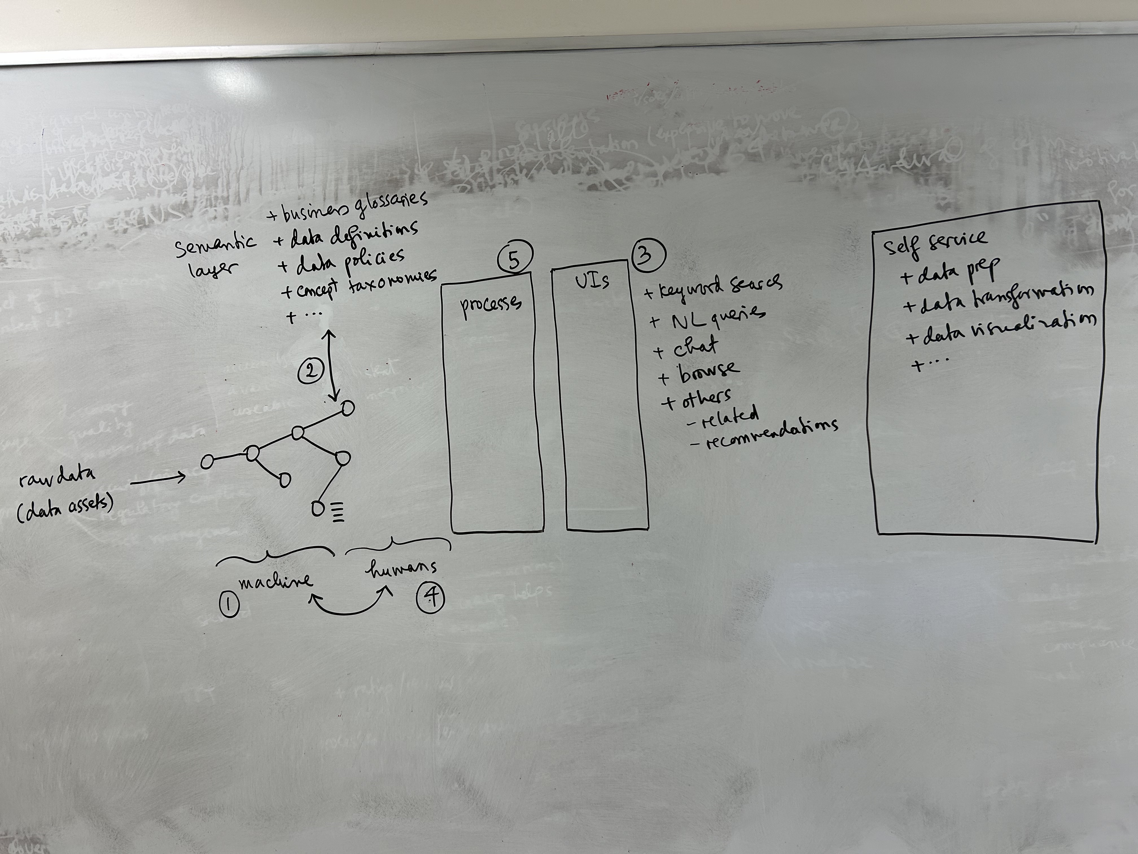

Slide 5
Data Assets
tables
files
databases
mappings
dictionaries
etc.

Slide 6
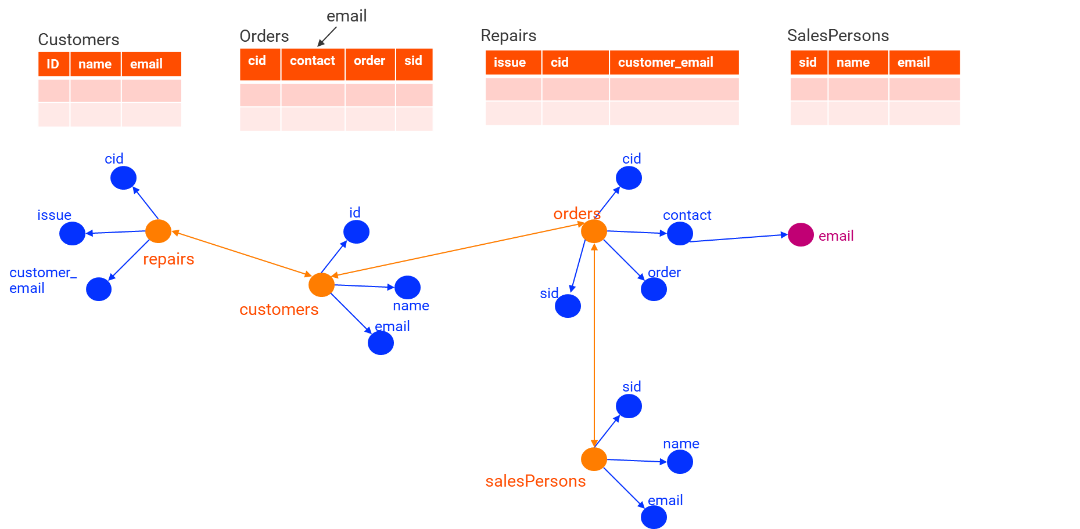
Creating the Catalog Graph
Often stored in a graph database

Slide 7
1. Using Automatic Solutions (aka Machine)
Extract, sample, profile from raw data sources
Enrich the nodes
statistics (from profiling)
English descriptions
how to access this asset?
quality (accuracy, completeness, etc.)
Enrich the edges
joinable
unionable
lineage

Slide 8
2. Mapping into the Semantic Layer
Within an organization, we can distinguish technical vs business stuff
technical stuff: tables, files, databases, catalog graph, etc.
business stuff
business glossary (having multiple terms)
data definitions
data policies
tags defined by users
concept taxonomies (to organize data assets into)
and more
The business stuff forms the semantic layer
In this step, we use automatic solutions to link the nodes and edges in the catalog graph into elements in the semantic layer
tag tables and columns with terms in a business glossary
classify columns, organize assets into taxonomies, link assets to KGs, etc.

Slide 9
3. Building the UIs
keyword search
NL queries
chat
browse
others
related
recommendation based on usage

Slide 10
4. Human Activities
Users can do the same thing that machine does
enrich nodes, enrich edges, link to semantic layer, etc.
in general, user can manually input something, correct something, flag something as incorrect
users can also rate/review, chat with each other, endorse an asset, etc.
Interesting interplay between users and machine
users can accept or reject machine actions
machine can learn from users’ activities (even if users just use the catalog)

Slide 11
5. Processes/Rules/Policies
Examples
how to get an asset
how to process a comment
how to endorse an asset

Slide 12
Other Issues
Schema matching
How to incrementally update the catalog

Slide 13
Data Governance

Slide 14
Motivation
In the past 20 years, companies have recognized that data is a major asset
asset types for companies: human asset, financial asset, technical asset, etc.
now they have data to be a major asset
if you have an asset, you deal with two key questions: how to best use and protect it?
So how best to use and protect data?
data governance deals with these two questions
it really takes off in the past ten years
since GDPR was released in 2016 (general data protection regulation)
CCPA (California Consumer Privacy Act), 2018
Data governance focuses on maximal usage and maximal protection of data
these two goals conflict

Slide 15
Two Goals of Governance
To facilitate maximal usage of data
discovery: make sure data is easily discoverable
quality: make sure data is high quality (accurate, comprehensive, consistent, etc.)
master/reference data: make sure these important data types are used properly
To facilitate maximal protection of data
security/privacy: make sure data is secure and private data remains private
regulatory compliance: comply with gdpr, ccpa, etc. or face big fines
risk management: know what the risks are and mitigate those

Slide 16
Example Questions
What data we have as an organization?
How does this data get into (or generated within) the organization?
Who is overseeing this data? Is this data classified according to our Information Security standards?
Is that data of good quality?
What are the regulatory requirements of this data?
What are the commercial requirements of this data? What do we do with this data? Do we pay for this data?
What are the ethical requirements of this data? Does any of this is considered PII (Personally Identifiable Information; Customer sensitive data) (e.g., in some cases EU considers IP address as personal data)
Who should have access to this data?
Is this data leaving our organization? If so, why?
If a regulator calls and says “we found out X data is being misused in your organization” what will you do first? Who will you call?

Slide 17
How Data Governance Accomplishes Those Goals
Data governance accomplish the above two goals using
best practices
eg how best to enter data to ensure high quality (say always match address against an internal list)
policies
processes
people
tools: eg data catalog

Slide 18
Example Activities
a) Catalog
Datasets your customers use through your IT and Business Processes
Datasets used by Business and IT internally for applications, analytics, and insights
b) Establish Supply Chain
Document flow of data
Document ownership and point of contact (Steward, Custodian, Owner)

Slide 19
Example Activities
c) Demand Known Quality
Measure the quality of data
Measure the business impact of the data quality (this is much harder than we assume) & Continuously monitor
d) Embrace (lightweight) Data Policy Writing
Document who has access to data and why?
Classify data and align to data classification supported by Information Security best practices
Empower business with data policy writing (approval process for the need to use)
Ask for regular attestation

Slide 20
Data Mesh & Data Fabric

