Slide 1

Data Lakes, Lake Houses, and Others
AnHai Doan
Notes:
Let me start this talk by telling you how I got to social media. For that, I need to go back to the year 2001.

Slide 2
Motivation

Slide 3
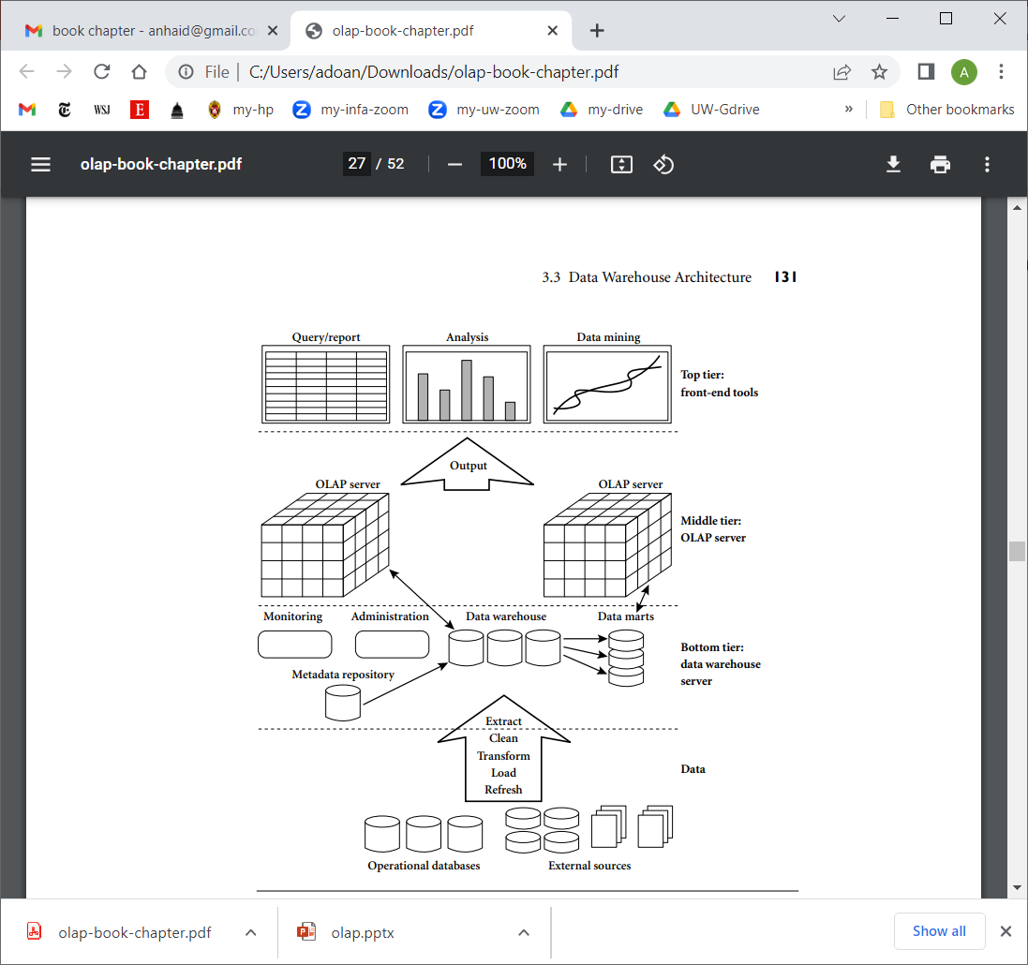
Data Warehouses

Slide 4
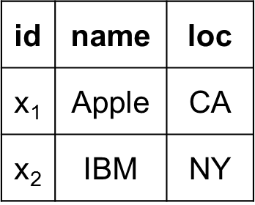
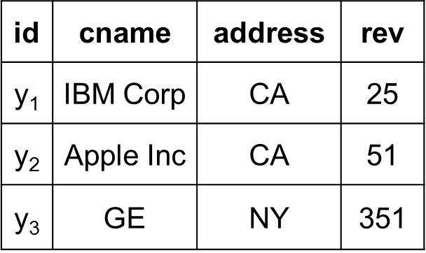
X
Y
news articles
data extraction

Slide 5
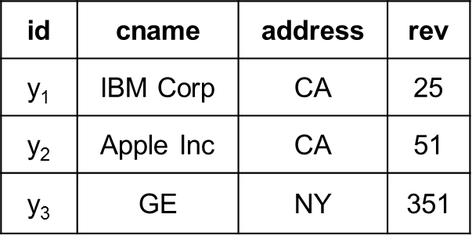
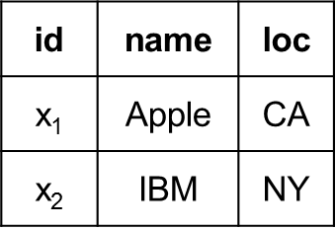
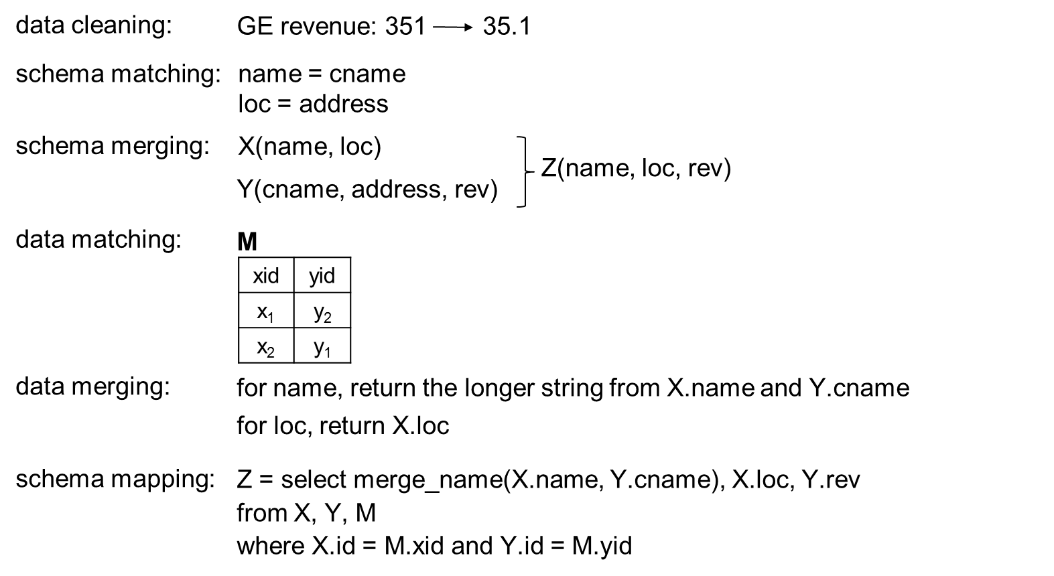
Y
X

Slide 6
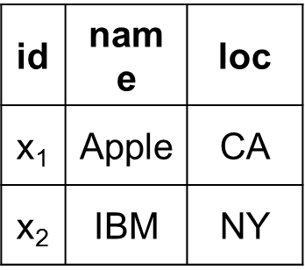
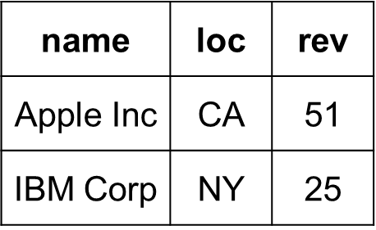
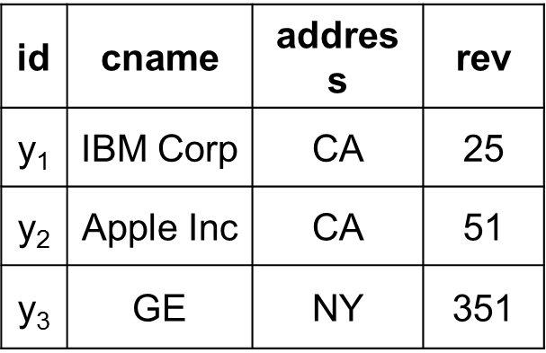
X
Z
Y

Slide 7
The ETL Process
Typically very tedious and time consuming to set up the ETL pipeline
Need to rerun it periodically, maintain it over time
Building a data warehouse can take years
This was okay in the 1990s and early 2000s
not too many people want to use the data warehouse
a small portion of business users
they can ask IT, and IT then uses the data warehouse to find answers
not too much data, mostly relational

Slide 8
Things Changed in Early 2000s
A lot more data is generated, captured, and analyzed by organizations
World becomes data driven
Decisions now are often made in a data driven fashion
This is when Big Data and Data Science become hot phrases
So suddenly a lot more business users want to use data to make decisions
A lot more data is generated, lot of non-relational data, data also changes fast
Data warehouse can’t keep up with this
Ad-hoc solution
business user identifies datasets to be used, goes talk to data owners, asks them to create an ETL pipeline to get the data
too expensive, does not scale

Slide 9
Data Lakes
Term introduced in 2010
Solution to the above problem
“Here are all the datasets, now go help yourself and leave us alone”
self service for business users
over time, other types of users also use the data lake
but initially, it was created to help business users process data using self services (because IT just can’t keep up)

Slide 10
Challenges and Architecture

Slide 11
Key Question
If we are to build a data lake for business users, how do we do it?

Slide 12
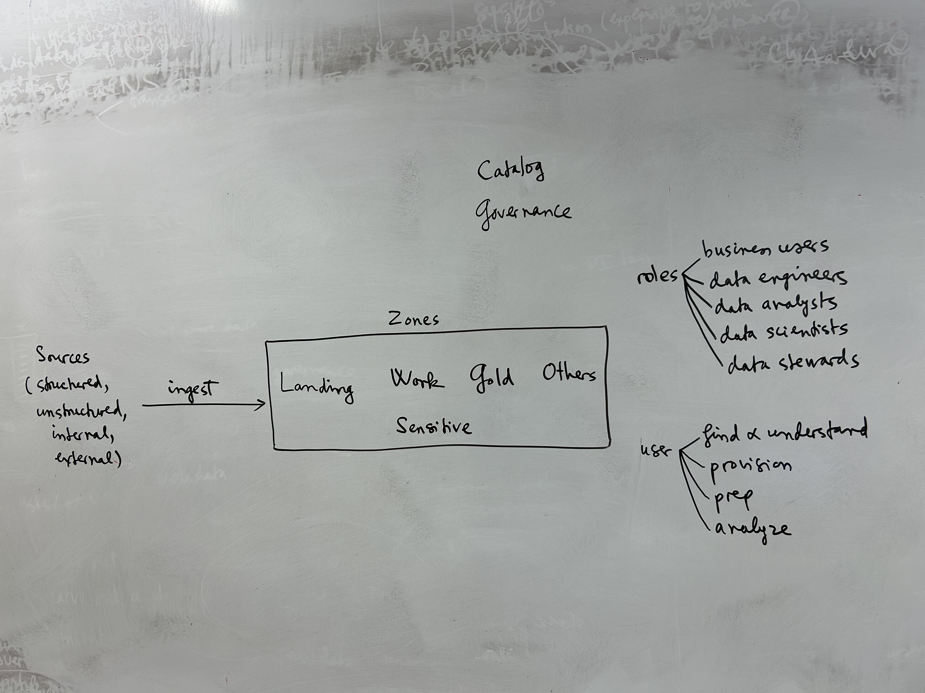

Slide 13
Challenges
Ingestion
hard to do on a large scale, need to capture changes
Catalog
this is so that users know what data sets are available and how to find them
need to capture information about each data set
name, description, date acquired, owner, size, type, etc.
can build a keyword search engine on top of these
but this won’t be enough to help users find relevant data sets
discover joinable data sets, unionable data sets
also define business glossary, then tag datasets with glossary terms (BTA problem)
manual tagging, automatic tagging
also profile data sets to understand them, apply data quality rules
results are captured in the catalog
others: have users rate and provide descriptions for data sets

Slide 14
Challenges
Ultimately, something similar to Amazon Search is used to help users find and understand data sets
Next, user needs to obtain data set
either read permission, or a copy is made say in the work zone
Prep (aka curation)
this happens in the work zone
Analyze
visualization tools, reporting tools
The above four steps (find, provision, prep, analyze) should be self service as much as possible for business users
Certain data sets will be put in the gold zone
business users often just consume data in this zone

Slide 15
Challenges
Governance
increasingly critical due to several reasons
regulations
data quality
data description / understanding

Slide 16
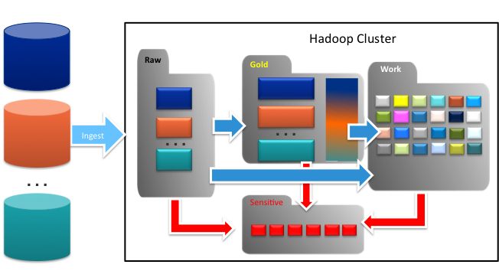
Organize Data Lake into Zones
Organize the lake

Slide 17
Multi-modal IT – Different Governance Levels for Different Zones
Minimal Governance
Make sure there is no sensitive data
Heavy governance
Restricted access
Raw/Landing
Sensitive
Data Stewards
Data Engineers
Data Scientists
Work
Gold/Curated
Business Analysts
Minimal Governance
Make sure there is no sensitive data
Heavy Governance
Trusted, curated data
Lineage, Data Quality
Data Scientists
Multi-modal IT with different governance levels in different zones

Slide 18
Lakehouses

Slide 19
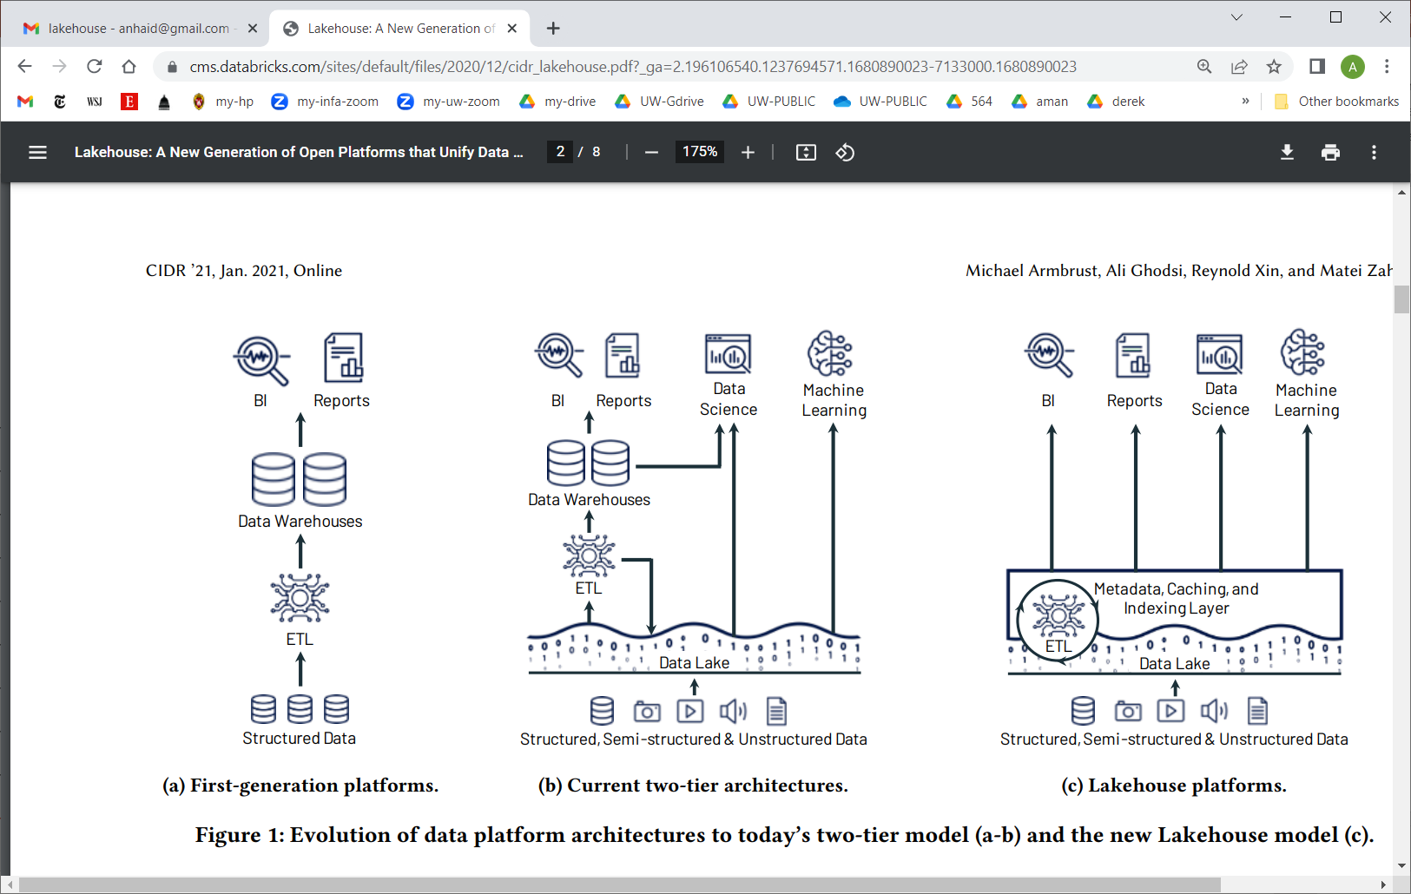

Slide 20
