Slide 1

Overview of Data Management at Organizations
AnHai Doan
Notes:
Let me start this talk by telling you how I got to social media. For that, I need to go back to the year 2001.

Slide 2
Overview of Data Management at Organizations
Organizations
companies, non-profit organizations (including UW), government agencies, militaries
others: big research groups, etc.
An organization has
employees, products, customers, suppliers
even UW fits this template, it offers courses to students
Business needs of organizations
bookkeeping, logistics (eg keep track of employees, customers, products, suppliers, etc.)
managing business processes/transactions/workflows
eg how a customer purchases a product, travel requests/approvals, payroll
data analysis (historical analytics, predictive analytics)
gathering more information
eg find all information about a customer, for marketing/customer service
eg find weather/crime related information for building security purposes

Slide 3
How Data Management Evolves as an Organization Grows
Let’s take a look at the evolution of an organization X, from small to big
and how the data management needs/solutions grow along the way
When X is very small, e.g., startup
need some bookkeeping/logistics
eg GreenBay, a data integration company (using AI/ML)
Need a Website
payroll using Gusto on cloud

Slide 4
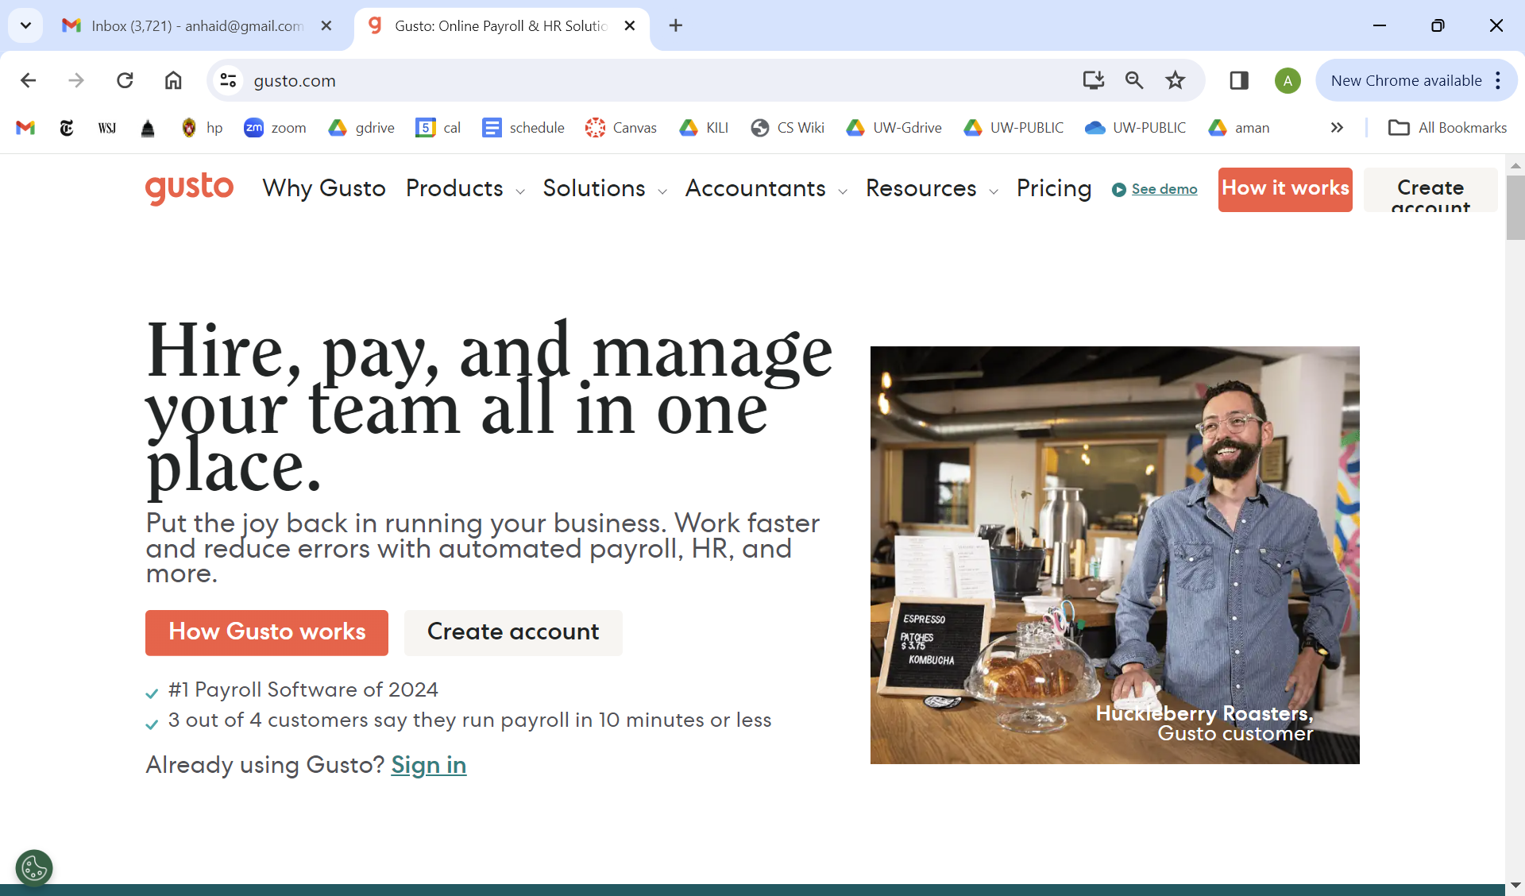

Slide 5
How Data Management Evolves as an Organization Grows
When X becomes bigger (medium-size organizations)
hundreds of employees, tens of products, hundreds to thousands of customers
need RDBMSs to keep track of employees/products/customers/suppliers/etc.
a lot more need for business processes/workflows/transactions (= business functions)
CRM: customer relationship management
ERP: enterprise resource planning
communication: Zoom, Teams/Slack, Outlook/Gmail
customer facing: Web page, social media, email, chat, phone call logs, etc.
and a lot more (see “Business software” on Wikipedia)
All these software generate a lot of data
must have backup (to handle crash and recovery)
capture and store data somewhere
Raises the need for analytics, three main goals
infer insights to do better business: eg sell more cheese in Arizona
infer insights to improve internal business processes
infer stuff for security, intrusion detection, hacking prevention, etc.

Slide 6
How Data Management Evolves as an Organization Grows
Two different kinds of analytics
Historical analytics
find patterns in existing (aka historical) data
eg people in Arizona consume a lot more cheese than people in Wisconsin in 2023
eg cluster customers who have obtained a loan from a bank to detect interesting patterns
maybe the biggest cluster is college students from Ohio in 2022
Predictive analytics
develop a MODEL to predict what can happen next
eg predict the amount of cheese people in Arizona will consume next winter
eg predict if a given potential customer will repay a loan or not
Since X has a lot of analytic needs, may create certain kinds of data warehouses to help with these
data warehouse, data lake, lakehouse, etc.
X may also want more information about certain topics
e.g., customers, products, so build Customer 360s, Product 360s

Slide 7
How Data Management Evolves as an Organization Grows
When X becomes really big (the largest organizations today)
eg GreenBay now become national, spanning multiple states, acquiring other startups
eg Informatica, insurance companies, hospital chain, Google, Microsoft, Walmart, etc.
Now there is a lot more to worry about
lot of need to move data efficiently: replicate, synchronize, transform (eg split, merge, etc.)
may need to process some data very fast, eg process log to detect intrusion
data quality, profiling
data security, privacy, logging
data catalog
data governance, compliance
meta-data
business terms, reference tables, knowledge graphs, etc.
acquiring external data

Slide 8
Summary of Needs
Needs | Solutions
Bookkeeping, logistics + RDBMSs Business functions + aka processes/transactions/workflows + CRM, ERP, Zoom, Teams, etc. Analytics & report + historical, predictive Find more information about … + customers, products, etc. Move data efficiently + replicate, synchronize, transform (split, merge, …) Process fast data Data quality, profiling Security, privacy, logging Data catalog Data governance, compliance Meta data (business terms, ref tables, KGs, …) Acquiring external data

Slide 9
Solutions
Needs | Solutions
Bookkeeping, logistics + RDBMSs Business functions + aka processes/transactions/workflows + CRM, ERP, Zoom, etc. Analytics & report + historical, predictive Find more information about … + customers, products, etc. Move data efficiently + replicate, synchronize, transform (split, merge, …) Process fast data Data quality, profiling Security, privacy, logging Data catalog Data governance, compliance Meta data (business terms, ref tables, KGs, …) Acquiring external data | Hardware, machines, cloud infrastructure Software, data artifacts + RDBMSs + business software: CRM, ERP, Gusto, etc. + logging + data warehouse, lake, lakehouse, etc. + analytics software + Customer 360s, Product 360s, etc. + software to manage and create data catalog data governance meta data (business terms, ref tables, KGs) Hire people to manage all of these + software engineers + data engineers, data scientists + data stewards, subject matter experts (SME) + business users/analysts + and more
Notes:
Meta data often also includes business term, ref tables (also called reference data), KGs, master data (from MDM)
Data governance often also includes quality, security/privacy, compliance
Moving data: replicating, backup, synchronizing, transformation, often called ETL For moving data, there is ONE SHOT and also MASS, eg mass replication

Slide 10
Solutions
Organizations increasingly maintain multiple hardware infrastructures
on-prem, cloud
Software split into on-prem and cloud software
but things are increasingly being moved to cloud: both data and software
More on people
many different roles, and a person may play multiple roles
roles are often also called “personas”
Main categories for role
general software roles: backend, frontend, full-stack
data related roles: data scientists, data engineers, data quality experts, etc.
data stewards, data owners
business related roles: subject matter experts (SMEs), business analysts/users
ML/AI related roles: ML engineers, MLOps engineers, etc.
data acquisition roles: to buy data from outside
crowdsourcing roles: to manage crowdsourcing tasks, eg label data for ML
Another split: business users vs technical users

Slide 11
Recent Trends
On prem vs cloud, mobile
Self service
AI/ML
Data streams

Slide 12
Levels of Data Maturity
8 | Drive Innovation | Using data analytics to spark innovations that differentiate the organization in a competitive market.
7 | Drive Organizational Learning | Using data science, artificial intelligence, and machine learning to adapt to changing business conditions, recommend and/or automate decisions and actions, and increase efficiencies and competencies.
6 | Look into the Future | Using data mining and predictive analytics to understand probable future conditions and events, and to inform and guide the strategies and tactics that shape the organization’s future.
5 | Understand Cause & Effect | Using data for causal analysis, to understand why things happen, and to identify leverage points to effect change—knowing how to create more of desired outcomes and to reduce or eliminate the undesirable.
4 | Understand Patterns & Trends | Using data for analysis and visualization to understand correlations and connections among business variables, and to see behavior over time of various business metrics.
3 | Know What Has Happened | Using data for descriptive and retrospective analysis of business outcomes (know what has happened), to quantify the outcomes (know how much), and to see the outcome historically (know when).
2 | Reporting | Using data to produce reports about business entities, events, and results—from internal reference and management reporting to external corporate, compliance, and enterprise reporting.
1 | Record Keeping | The most basic level of data management uses data simply as a digital record of business transactions and events.
Google for “seven core responsibilities of a chief data officer eckerson”

Slide 13
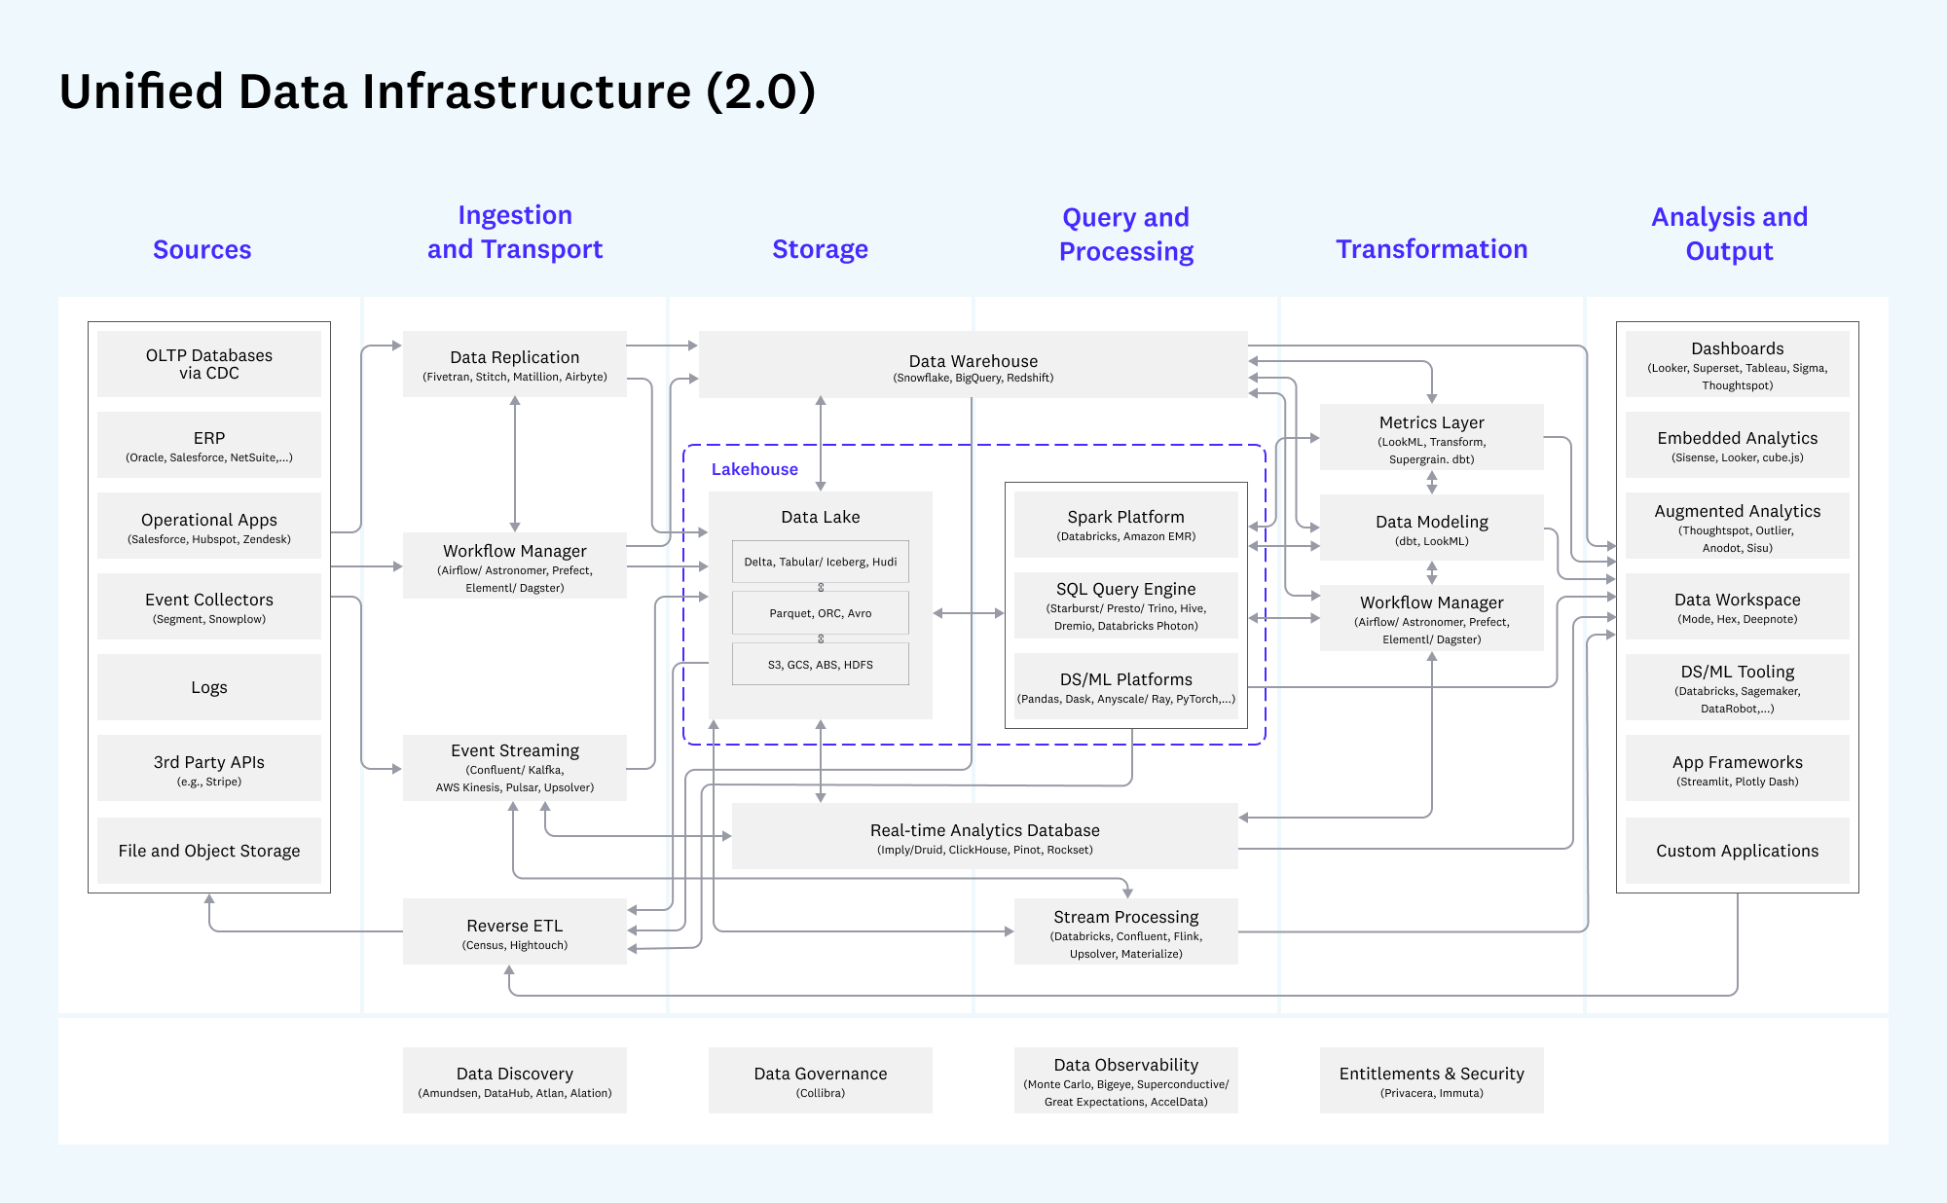
From the Web, google for “unified data infrastructure a16z”

Slide 14
Where Does DS and DI Fit?
Needs | Solutions
Bookkeeping, logistics + RDBMSs Business functions + aka processes/transactions/workflows + CRM, ERP, Zoom, etc. Analytics + historical, predictive Find more information about … + customers, products, etc. Move data efficiently + replicate, synchronize, transform (split, merge, …) Data quality, profiling Security, privacy, logging Data catalog Data governance, compliance Meta data (business terms, ref tables, KGs, …) Acquiring external data | Hardware, machines, cloud infrastructure Software, data artifacts + RDBMSs + business software: CRM, ERP, etc. + logging + data warehouse, lake, lakehouse, etc. + Customer 360s, Product 360s, etc. + software to manage and create data catalog data governance meta data (business terms, ref tables, KGs) Hire people to manage all of these + software engineers + data engineers, data scientists + data stewards, subject matter experts (SME) + business users/analysts + and more

Slide 15
Where Does DS and DI Fit?
A big part of DS is to do analysis, or build data artifacts to help do analysis
a major function as organizations get bigger
To do DS, need to work with a lot of data
internally, externally
Data comes in all kinds of format, uses different vocabularies, often is hard to understand and dirty
need data exploration, cleaning, integration
Big Data
volume
velocity
variety
veracity
we focus on the last two

