Slide 1
Storing Data: Disks and Files
Lecture #6
Notes:
1
The slides for this text are organized into chapters. This lecture covers Chapter 9, and discusses how data is stored on external storage media, such as disks. It includes a discussion of disk architectures, including RAID, buffer management, how data is organized into files or records, how files are treated as collections of physical pages, and how records are laid out on a page.
Chapter 8 provides an overview of storage and indexing, but is not a pre-requisite for this chapter. In implementation-oriented courses with course projects (e.g., based on the Minibase system) this chapter can be covered very early to facilitate programming assignments on heap files, record layout, and buffer management. One possibility is to cover this chapter immediately after Chapter 1, then return to Chapter 2 and the rest of the Foundations chapters. Chapters 8, 10, and 11 would then be covered later in the course. (This sequence is the one followed by Ramakrishnan in the implementation-oriented senior level introductory database course at Wisconsin.)
At the instructor’s discretion, this chapter can also be omitted without loss of continuity in other parts of the text. (In particular, Chapter 20 can be covered without covering this chapter.)

Slide 2
Motivation
User asks query
Select eid, ename
From Employees
Where salary > 100K
System scans through table Employees
  considers each tuple
  if salary > 100K, then return eid, ename
How does this happen in the backend?

Slide 3
Motivation
Table is stored as a file on disk
File has multiple pages
Each page has multiple tuples
The system (RDBMS) works on a page at a time
  in memory (the buffer)

Slide 4
Motivation
These layers
must consider
concurrency
control and
recovery
A typical DBMS has a layered architecture.
The figure does not show the concurrency control and recovery components.
This is one of several possible architectures; each system has its own variations.
Query Optimization
and Execution
Relational Operators
Files and Access Methods
Buffer Management
Disk Space Management
DB
Notes:
22

Slide 5
An Example
Select eid, ename
From Employees
Where salary > 100K
Query Optimization
and Execution
Relational Operators
Files and Access Methods
Buffer Management
Disk Space Management
DB
Notes:
22

Slide 6
Disks
Secondary storage device of choice.
random access vs. sequential.
Data is stored and retrieved in units called disk blocks or pages.
Notes:
20

Slide 7
Components of a Disk
Spindle
Disk head
Tracks
The platters spin (say, 90rps).
The arm assembly is moved in or out to position a head on a desired track. Tracks under heads make a cylinder (imaginary!).
Sector
Arm movement
Platters
Only one head reads/writes at any one time.
Arm assembly
Block size is a multiple of sector size (which is fixed).
Notes:
21

Slide 8
Accessing a Disk Page
Time to access (read/write) a disk block:
  seek time (moving arms to position disk head on track)
  rotational delay (waiting for block to rotate under head)
  transfer time (actually moving data to/from disk surface)
Seek time and rotational delay dominate.
  Seek time varies from about 1 to 20msec
  Rotational delay varies from 0 to 10msec
  Transfer rate is about 1msec per 4KB page
Key to lower I/O cost: reduce seek/rotation delays!
Notes:
22

Slide 9
Key Things to Remember
Notion of pages on disk
Reading pages from disk, wring to pages on disk
  very expensive
  try to minimize this if we can

Slide 10
Disk Space Management
Lowest layer of DBMS software manages space on disk.
Higher levels call upon this layer to:
  allocate/delete a page
  read/write a page
Notes:
24

Slide 11
Buffer Management in a DBMS
Page Requests from Higher Levels
BUFFER POOL
disk page
free frame
MAIN MEMORY
DISK
choice of frame dictated
by replacement policy
DB
Data must be in RAM for DBMS to operate on it!
Table of <frame#, pageid> pairs is maintained.
Notes:
4

Slide 12
When a Page is Requested ...
If requested page is not in pool:
  Choose a frame for replacement
  If frame is dirty, write it to disk
  Read requested page into chosen frame
Pin the page and return its address.
Notes:
5

Slide 13
More on Buffer Management
When done, requestor of page releases the page: must unpin it, and indicate whether page has been modified:
  dirty bit is used for this.
Page in pool may be requested many times,
  a pin count is used. A page is a candidate for replacement iff pin count = 0.
Notes:
6

Slide 14
Buffer Replacement Policy
Frame is chosen for replacement by a replacement policy:
  Least-recently-used (LRU), Clock, MRU etc.
Policy can have big impact on # of I/O’s; depends on the access pattern.
Sequential flooding: Nasty situation caused by LRU + repeated sequential scans.
  # buffer frames < # pages in file means each page request causes an I/O. MRU much better in this situation (but not in all situations, of course).
Notes:
7

Slide 15
Files of Records
Page or block is OK when doing I/O, but higher levels of DBMS operate on records, and files of records.
FILE: A collection of pages, each containing a collection of records. Must support:
  insert/delete/modify record
  read a particular record (specified using record id)
  scan all records (possibly with some conditions on the records to be retrieved)
Notes:
13

Slide 16
Unordered (Heap) Files
Simplest file structure contains records in no particular order.
As file grows and shrinks, disk pages are allocated and de-allocated.
To support record level operations, we must:
  keep track of the pages in a file
  keep track of free space on pages
  keep track of the records on a page
There are many alternatives for keeping track of this.
Notes:
14

Slide 17
Heap File Implemented as a List
Data
Page
Data
Page
Data
Page
Full Pages
Header
Page
Data
Page
Data
Page
Data
Page
Pages with
Free Space
The header page id and Heap file name must be stored someplace.
Each page contains 2 `pointers’ plus data.
Notes:
15

Slide 18
Heap File Using a Page Directory
Data
Page 1
Header
Page
Data
Page 2
Data
Page N
DIRECTORY
The entry for a page can include the number of free bytes on the page.
The directory is a collection of pages; linked list implementation is just one alternative.
  Much smaller than linked list of all HF pages!
Notes:
16

Slide 19
Page Formats: Fixed Length Records
Slot 1
Slot 1
Slot 2
Slot 2
. . .
Free
Space
. . .
Slot N
Slot N
Slot M
N
1
. . .
0
1
1
M
number
of records
M ... 3 2 1
number
of slots
PACKED
UNPACKED, BITMAP
Record id = <page id, slot #>. In first alternative, moving records for free space management changes rid; may not be acceptable.
Notes:
11

Slide 20
Page Formats: Variable Length Records
Rid = (i,N)
Page i
Rid = (i,2)
Rid = (i,1)
20
16
24
N
Pointer
to start
of free
space
N . . . 2 1
# slots
SLOT DIRECTORY
Can move records on page without changing rid; so, attractive for fixed-length records too.
Notes:
12

Slide 21
Record Formats: Fixed Length
F1
F2
F3
F4
L1
L2
L3
L4
Base address (B)
Address = B+L1+L2
Information about field types same for all records in a file; stored in system catalogs.
Finding i’th field does not require scan of record.
Notes:
9

Slide 22
Record Formats: Variable Length
Two alternative formats (# fields is fixed):
F1 F2 F3 F4
4
$
$
$
$
Fields Delimited by Special Symbols
Field
Count
F1 F2 F3 F4
Array of Field Offsets
Second offers direct access to i’th field, efficient storage
of nulls (special don’t know value); small directory overhead.
Notes:
10

Slide 23
System Catalogs
For each index:
  structure (e.g., B+ tree) and search key fields
For each relation:
  name, file name, file structure (e.g., Heap file)
  attribute name and type, for each attribute
  index name, for each index
  integrity constraints
For each view:
  view name and definition
Plus statistics, authorization, buffer pool size, etc.
Catalogs are themselves stored as relations!
Notes:
18

Slide 24
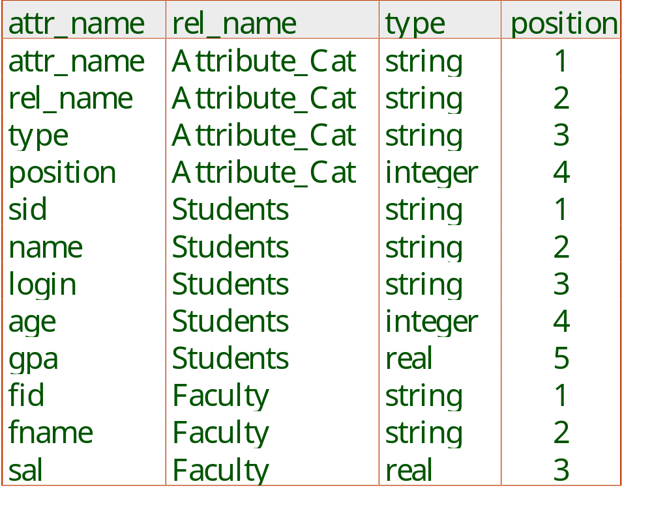
Attr_Cat(attr_name, rel_name, type, position)
Notes:
19

