Slide 1
Normalization

Slide 2
Motivation
We have designed ER diagram, and translated it into a relational db schema R = set of R1, R2, ...
Now what?
We can do the following
  specify all relevant constraints over R
  implement R in SQL
  start using it, making sure the constraints always remain valid
However, R may not be well-designed, thus causing us a lot of problems

Slide 3
Example of Bad Design
Persons with several phones:
Name SSN Phone Number
Fred 123-321-99 (201) 555-1234
Fred 123-321-99 (206) 572-4312
Joe 909-438-44 (908) 464-0028
Joe 909-438-44 (212) 555-4000
Problems (also called "Anomalies"):
Redundancy = repetition of data
update anomalies = update one item and forget others
= inconsistencies
deletion anomalies = delete many items,
delete one item, loose other information
insertion anomalies = can't insert one item without inserting others

Slide 4
Better Designs Exist
Break the relation into two:
SSN Name
123-321-99 Fred
909-438-44 Joe
SSN Phone Number
123-321-99 (201) 555-1234
123-321-99 (206) 572-4312
909-438-44 (908) 464-0028
909-438-44 (212) 555-4000

Slide 5
How do We Obtain a Good Design?
Start with the original db schema R
Transform it until we get a good design R*
Desirable properties for R*
  must preserve the information of R
  must have minimal amount of redundancy
  must be dependency-preserving
    if R is associated with a set of constraints C, then it should be easy to also check C over R*
  (must also give good query performance)

Slide 6
OK, But ...
How do we recognize a good design R*?
How do we transform R into R*?
Answers: use normal forms

Slide 7
Normal Forms
DB gurus have developed many normal forms
Most important ones
  Boyce-Codd, 3rd, and 4th normal forms
If R* is in one of these forms, then R* is guaranteed to achieve certain good properties
  e.g., if R* is in Boyce-Codd NF, it is guaranteed to not have certain types of redundancy
DB gurus have also developed algorithms to transform R into R* that is in some of these normal forms

Slide 8
Normal Forms (cont.)
DB gurus have also discussed trade-offs among normal forms
Thus, all we have to do is
  learn these forms
  transform R into R* in one of these forms
  carefully evaluate the trade-offs
Many of these normal forms are defined based on various constraints
  functional dependencies and keys

Slide 9
Functional Dependencies and Keys

Slide 10
Functional Dependencies
A form of constraint (hence, part of the schema)
Finding them is part of the database design
Used heavily in schema refinement
Definition:
If two tuples agree on the attributes
A , A , … A
1
2
n
then they must also agree on the attributes
B , B , … B
1
2
m
Formally:
A , A , … A
B , B , … B
1
2
n
1
2
m

Slide 11
Examples
EmpID Name, Phone, Position
Position Phone
but Phone Position
EmpID
Name
Phone
Position
E0045
Smith
1234
Clerk
E1847
John
9876
Salesrep
E1111
Smith
9876
Salesrep
E9999
Mary
1234
Lawyer

Slide 12
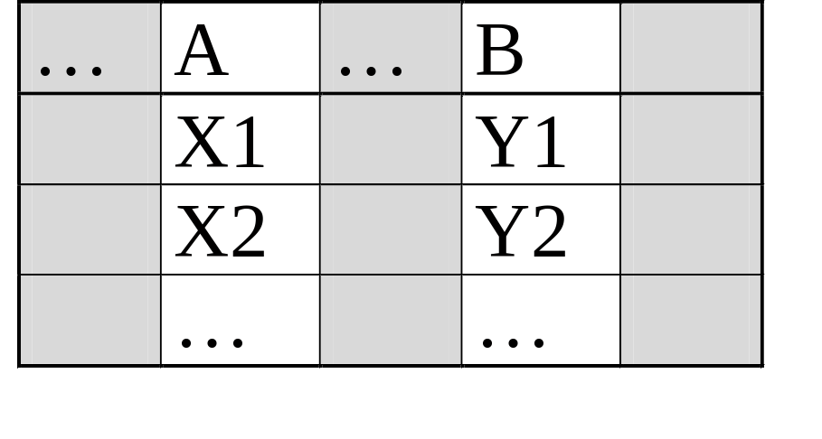
In General
To check A B, erase all other columns
check if the remaining relation is many-one (called functional in mathematics)

Slide 13
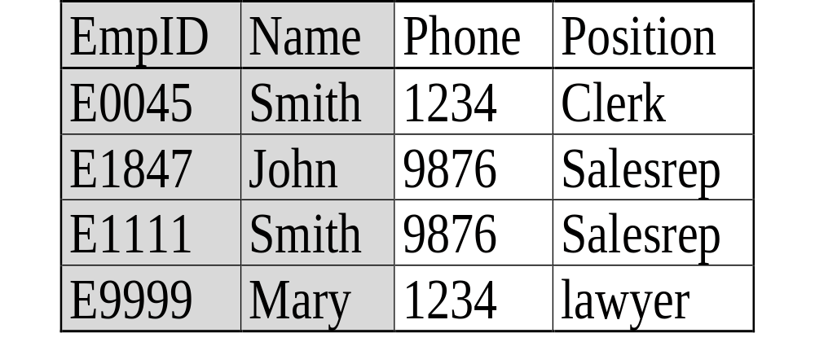
Example
More examples:
Product: name price, manufacturer
Person: ssn name, age
Company: name stock price, president

Slide 14
More about FDs
A ➔ B, we say “A functionally determines B”
When creating a DB schema, we should list all FDs we believe are valid
These FDs should be valid on ALL DB database instances conforming to our schema
  can’t just be valid on one database instance
  and not valid on another database instance

Slide 15
Relation Keys
Key of a relation R is a set of attributes that
  functionally determines all attributes of R
    this creates a FD A ➔ B
  none of its subsets determines all attributes of R
Superkey
  a set of attributes that contains a key
  so a key is also a superkey

Slide 16
Finding the Keys of a Relation
Given a relation constructed from an E/R diagram, what is its key?
Rules:
1. If the relation comes from an entity set,
the key of the relation is the set of attributes which is the
key of the entity set.
Person
Person(address, name, ssn)
address
name
ssn

Slide 17
Finding the Keys
Rules:
2. If the relation comes from a many-many relationship,
the key of the relation is the set of all attribute keys in the
relations corresponding to the entity sets
name
buys
Product
Person
price
name
ssn
date
buys(name, ssn, date)

Slide 18
Finding the Keys
More rules:
Many-one, one-many, one-one relationships
Multi-way relationships
Weak entity sets
Note that if you say the set of attributes A is a key, you are basically saying certain FDs are true.

Slide 19
Reasoning with FDs
1) closure of FD sets
2) closure of attribute sets

Slide 20
Closure of FD sets
Given a relation schema R & a set S of FDs
  is the FD f logically implied by S?
Example
  R = {A,B,C,G,H,I}
  S = A ➔B, A ➔C, CG ➔ H, CG ➔ I, B ➔ H
  would A ➔ H be logically implied?
  yes (you can prove this, using the definition of FD)
Closure of S: S+ = all FDs logically implied by S
How to compute S+?
  we can use Armstrong's axioms

Slide 21
Armstrong's Axioms
Reflexivity rule
  A1A2...An ➔ a subset of A1A2...An
Augmentation rule
  A1A2...An ➔ B1B2...Bm, then
  A1A2...An C1C2..Ck ➔ B1B2...Bm C1C2...Ck
Transitivity rule
  A1A2...An ➔ B1B2...Bm and
  B1B2...Bm ➔ C1C2...Ck, then
  A1A2...An ➔ C1C2...Ck

Slide 22
Inferring S+ using Armstrong's Axioms
S+ = S
Loop
  for each f in S, apply reflexivity and augment. rules
  add the new FDs to S+
  for each pair of FDs in S, apply the transitivity rule
  add the new FD to S+
Until S+ does not change any further

Slide 23
Additional Rules
Union rule
  X ➔ Y and X ➔ Z, then X ➔ YZ
  (X, Y, Z are sets of attributes)
Decomposition rule
  X ➔ YZ, then X ➔ Y and X ➔ Z
Pseudo-transitivity rule
  X ➔ Y and YZ ➔ U, then XZ ➔ U
These rules can be inferred from Armstrong's axioms

Slide 24
Closure of a Set of Attributes
Given a set of attributes {A1, …, An} and a set of FDs S.
Problem: find all attributes B such that:
any relation which satisfies S also satisfies:
A1, …, An B
The closure of {A1, …, An}, denoted {A1, …, An}+,
is the set of all such attributes B
➔ basically all attributes that are functionally determined
by A1, …, An
We will discuss the motivations for attribute closures soon
+

Slide 25
Algorithm to Compute Closure
Start with X={A1, …, An}.
Repeat until X doesn’t change do:
if is in S, and
C is not in X
then
add C to X.
B , B , … B
C
1
2
n
B , B , … B
are all in X, and
1
2
n

Slide 26
Example
A B C
A D E
B D
A F B
Closure of {A,B}: X = {A, B, C, D, E}
Closure of {A, F}: X = {A, F, B, D, C, E}

Slide 27
Usage for Attribute Closure
Test if X is a superkey
  compute X+, and check if X+ contains all attrs of R
Check if X ➔ Y holds
  by checking if Y is contained in X+
Another way to compute closure S+ of FDs
  for each subset of attributes X in relation R, compute X+
  for each subset of attributes Y in X+, output the FD
  X ➔ Y

Slide 28
Desirable Properties of
Schema Refinement
1) minimize redundancy
2) avoid info loss
3) preserve dependency
4) ensure good query performance

Slide 29
Relational Schema Design
(or Logical Design)
Conceptual Model:
name
buys
Product
Person
price
name
ssn
Relational Model:
- create tables
- specify FD’s
- find keys
Normalization
- use FDs to
decompose tables
to achieve better design

Slide 30
Recall: Relation Decomposition
The original relation schema
Name SSN Phone Number
Fred 123-321-99 (201) 555-1234
Fred 123-321-99 (206) 572-4312
Joe 909-438-44 (908) 464-0028
Joe 909-438-44 (212) 555-4000

Slide 31
Relation Decomposition (cont.)
Break the relation into two:
SSN Name
123-321-99 Fred
909-438-44 Joe
SSN Phone Number
123-321-99 (201) 555-1234
123-321-99 (206) 572-4312
909-438-44 (908) 464-0028
909-438-44 (212) 555-4000
Desirable Property #1: Minimize redundancy

Slide 32
Decompositions in General
Let R be a relation with attributes
A , A , … A
1
2
n
Create two relations R1 and R2 with attributes
B , B , … B
C , C , … C
1
2
m
1
2
l
Such that:
B , B , … B
∪
C , C , … C
=
A , A , … A
1
2
m
1
2
l
1
2
n
And
-- R1 is the projection of R on
-- R2 is the projection of R on
B , B , … B
1
2
m
C , C , … C
1
2
l

Slide 33
Certain Decomposition May Cause Problems
Name | Price | Category
Gizmo | 19.99 | Gadget
OneClick | 24.99 | Camera
DoubleClick | 29.99 | Camera
Decompose on : Name, Category and Price, Category
Name | Category
Gizmo | Gadget
OneClick | Camera
DoubleClick | Camera
Price | Category
19.99 | Gadget
24.99 | Camera
29.99 | Camera
Name | Price | Category
Gizmo | 19.99 | Gadget
OneClick | 24.99 | Camera
OneClick | 29.99 | Camera
DoubleClick | 24.99 | Camera
DoubleClick | 29.99 | Camera
When we put it back:
Cannot recover information

Slide 34
Lossless Decompositions
A decomposition is lossless if we can recover:
R(A,B,C)
R1(A,B) R2(A,C)
R’(A,B,C) should be the same as
R(A,B,C)
Decompose
Recover
R’ is in general larger than R. Must ensure R’ = R
Desirable Property #2: Lossless decomposition

Slide 35
Put Another Way: "Lossless" Joins
The main idea: if you decompose a relation schema, then join the parts of an instance via a natural join, you might get more rows than you started with, i.e., spurious tuples
  This is bad!
  Called a "lossy join".
Goal: decompositions which produce only "lossless" joins
  "non-additive" join is more descriptive

Slide 36
Dependency Preserving
Given a relation R and a set of FDs S
Suppose we decompose R into R1 and R2
Suppose
  R1 has a set of FDs S1
  R2 has a set of FDs S2
  S1 and S2 are computed from S
We say the decomposition is dependency preserving if by enforcing S1 over R1 and S2 over R2, we can enforce S over R

Slide 37
An Example
Unit Company Product
FD’s: Unit → Company; Company, Product → Unit
So, there is a BCNF violation, and we decompose.
Unit Company
Unit → Company
Unit Product
No FDs

Slide 38
So What’s the Problem?
Unit Company
Unit Product
Galaga99 UI Galaga99 databases
Bingo UI Bingo databases
No problem so far. All local FD’s are satisfied.
Let’s put all the data back into a single table again:
Unit Company Product
Galaga99 UW databases
Bingo UW databases
Violates the dependency: company, product -> unit!

Slide 39
Preserving FDs
What if, when a relation is decomposed, the X of an X→Y ends up only in one of the new relations and the Y ends up only in another?
Such a decomposition is not “dependency-preserving.”
Desirable Property #3: always have FD-preserving decompositions
We will talk about "Desirable Property #4: Ensure Good Query Performance" later

Slide 40
Review
When decomposing a relation R, we want to decomposition to
  minimize redundancy
  avoid info loss
  preserve dependencies (i.e., constraints)
  ensure good query performance
These objectives can be conflicting
Various normal forms achieve parts of the objectives

Slide 41
Normal Forms
First Normal Form = all attributes are atomic
Second Normal Form (2NF) = old and obsolete
Boyce Codd Normal Form (BCNF)
Third Normal Form (3NF)
Fourth Normal Form (4NF)
Others...

Slide 42
Recall: What We Want to Do with Normal Forms
Take a relation schema…
Test it against a normalization criterion…
If it passes, fine!
  Maybe test again with a higher criterion
If it fails, decompose into smaller relations
  Each of them will pass the test
  Each can then be tested with a higher criterion

Slide 43
Boyce-Codd Normal Form
A simple condition for removing anomalies from relations:
A relation R is in BCNF if and only if:
Whenever there is a nontrivial FD
for R , it is the case that { }
is a super-key for R.
A , A , … A
B
1
2
n
A , A , … A
1
2
n
In English (though a bit vague):
Whenever a set of attributes of R is determining another attribute,
it is a super-key, and thus should determine all attributes of R. (A key
is also a super-key)

Slide 44
Example
Name SSN Phone Number
Fred 123-321-99 (201) 555-1234
Fred 123-321-99 (206) 572-4312
Joe 909-438-44 (908) 464-0028
Joe 909-438-44 (212) 555-4000
What are the FDs?
SSN Name
Does this FD satisfy the BCNF condition?
Is the relation in BCNF?

Slide 45
Decompose it into BCNF
SSN Name
123-321-99 Fred
909-438-44 Joe
SSN Name
SSN Phone Number
123-321-99 (201) 555-1234
123-321-99 (206) 572-4312
909-438-44 (908) 464-0028
909-438-44 (212) 555-4000

Slide 46
What About This?
Name Price Category
Gizmo $19.99 gadgets
OneClick $24.99 camera
Name Price, Category

Slide 47
BCNF Decomposition
Find a dependency that violates the BCNF condition:
A , A , … A
B , B , … B
1
2
n
1
2
m
Heuristics: choose B , B , … B “as large as possible”
1
2
m
Decompose:
Continue until
there are no
BCNF violations
left.
Others
A’s
B’s
Any
2-attribute
relation is
in BCNF.
R1
R2

Slide 48
Example Decomposition
Person:
Name SSN Age EyeColor PhoneNumber
Functional dependencies:
SSN Name, Age, Eye Color
BNCF: Person1(SSN, Name, Age, EyeColor),
Person2(SSN, PhoneNumber)
What if we also had an attribute Draft-worthy, and the FD:
Age Draft-worthy

Slide 49
Thus,
BCNF removes certain types of redundancy
For examples of redundancy that it cannot remove, see "multivalued redundancy"
BCNF avoids info loss

Slide 50
Recall: Lossless Decompositions
A decomposition is lossless if we can recover:
R(A,B,C)
{ R1(A,B) , R2(A,C) }
R’(A,B,C) = R(A,B,C)
Decompose
Recover
R’ is in general larger than R. Must ensure R’ = R

Slide 51
Decomposition Based on BCNF is Necessarily Lossless
R(A, B, C), A → C
BCNF: R1(A,B), R2(A,C)
Some tuple (a,b,c) in R (a,b’,c’) also in R
decomposes into (a,b) in R1 (a,b’) also in R1
and (a,c) in R2 (a,c’) also in R2
Recover tuples in R: (a,b,c), (a,b,c’), (a,b’,c), (a,b’,c’) also in R ?
Can (a,b,c’) be a bogus tuple? What about (a,b’,c’) ?

Slide 52
However,
BCNF is not always dependency preserving
In fact, some times we cannot find a BCNF decomposition that is dependency preserving
Can handle this situation using 3NF
Not covered in this course, see book for examples

