Slide 1

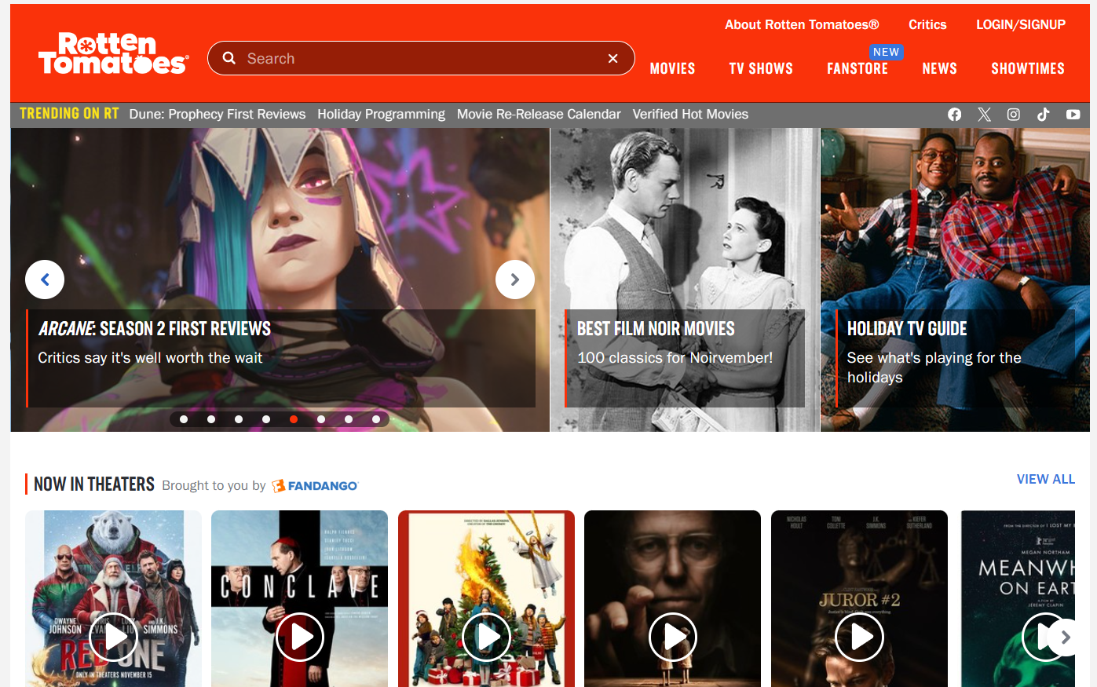
Meaning of RottenTomatoes Crawling
world famous
General audience
Professional film critics
Notes:
Rotten Tomatoes is a world-renowned film review aggregator that contains ratings and reviews of movies by fans and critics, data that is perfect for analysing user preferences.
Rotten Tomatoes not only contains ratings from general audiences, but also reviews from professional film critics. This data can be used to compare the differences in film ratings between critics and general audiences, helping to understand the relationship between professional reviews and mass acceptance, and thus choosing the right media strategy for film promotion.

Slide 2

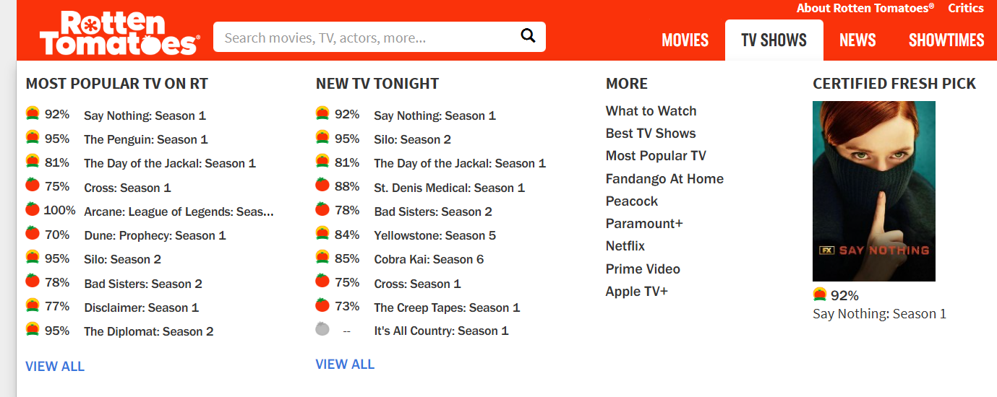
RottenTomatoes Crawling Process
Select the target webpage
Reasonable download delay
Selenium automation tool
CSV format
Notes:
Next up is the crawling process
Select the target webpage of Rotten Tomatoes, set the content to be extracted, set a reasonable download delay as well as randomise the request interval to simulate irregular user access patterns, use Selenium automation tool to simulate the browser to load the webpage and extract the dynamic content, and save the crawled data in CSV format as needed.

Slide 3

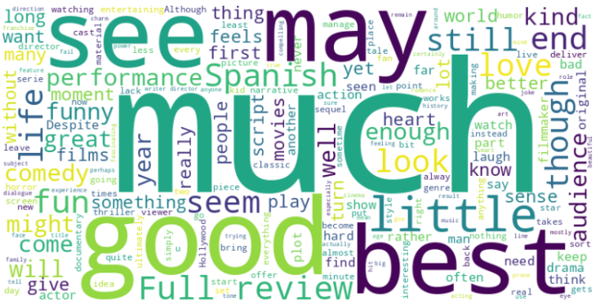
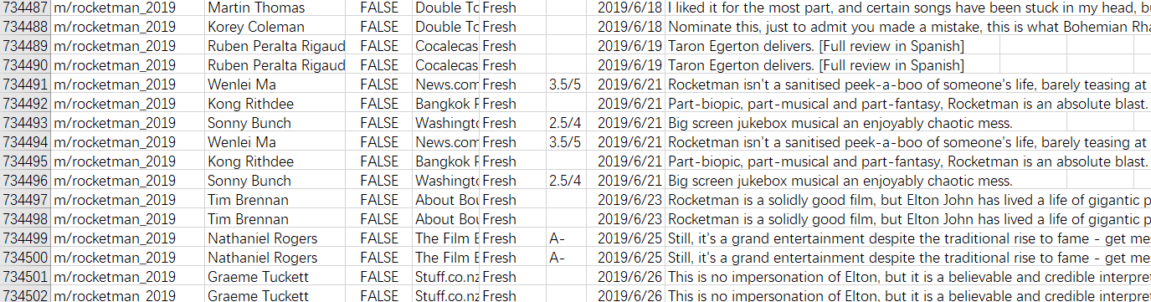
Data Cleaning
Remove missing values
Remove duplicate comments
Fill in the missing values of ratings
Use word cloud
Notes:
After that data cleaning is performed.
1. Remove missing values (remove rows with missing comment content) respectively.
2. Remove duplicate comments.
3. Fill in the missing values of ratings, for example, you can replace the missing ratings with a default value, such as 0.
4. Use word cloud to determine whether there are a large number of non-informative words (e.g. ‘movie’, ‘film’) in the data and to eliminate them for more accurate analysis.

