Slide 1
Analysis Goal
Goal:
To gather user review data on a wide range of books from Amazon, collecting reviews for each book to make a multi-dimensional analysis.
Key analysis factors:
Sentiment Analysis: Understand whether reviews are positive, negative, or neutral.
Rating Trends: Track how ratings change over time.
Reputation and Credibility: Help potential buyers make informed decisions.

Slide 2
Amazon Books Data Collection
We collect essential information, including book ID, book title, along with review details like reviewer name, rating, review time, helpfulness, the full review text and so on.
Storage: Data stored in a CSV file, ensuring compatibility with analysis tools like Python and Excel.
Overcome anti-scraping: We simulated real user behavior to reduce the risk of detection and blocking.
Use multiple User-Agent strings
Add random delays between requests

Slide 3
Amazon Books Data Cleaning
Data Cleaning Process:
Remove Unnecessary Columns
Handle Missing Values: Remove incomplete rows.
Convert Timestamps: Convert Unix timestamps to readable dates.
Save Cleaned Data in another CSV file.
The cleaned data is now ready for deeper analysis, like sentiment tracking, trend analysis and so on.

Slide 4
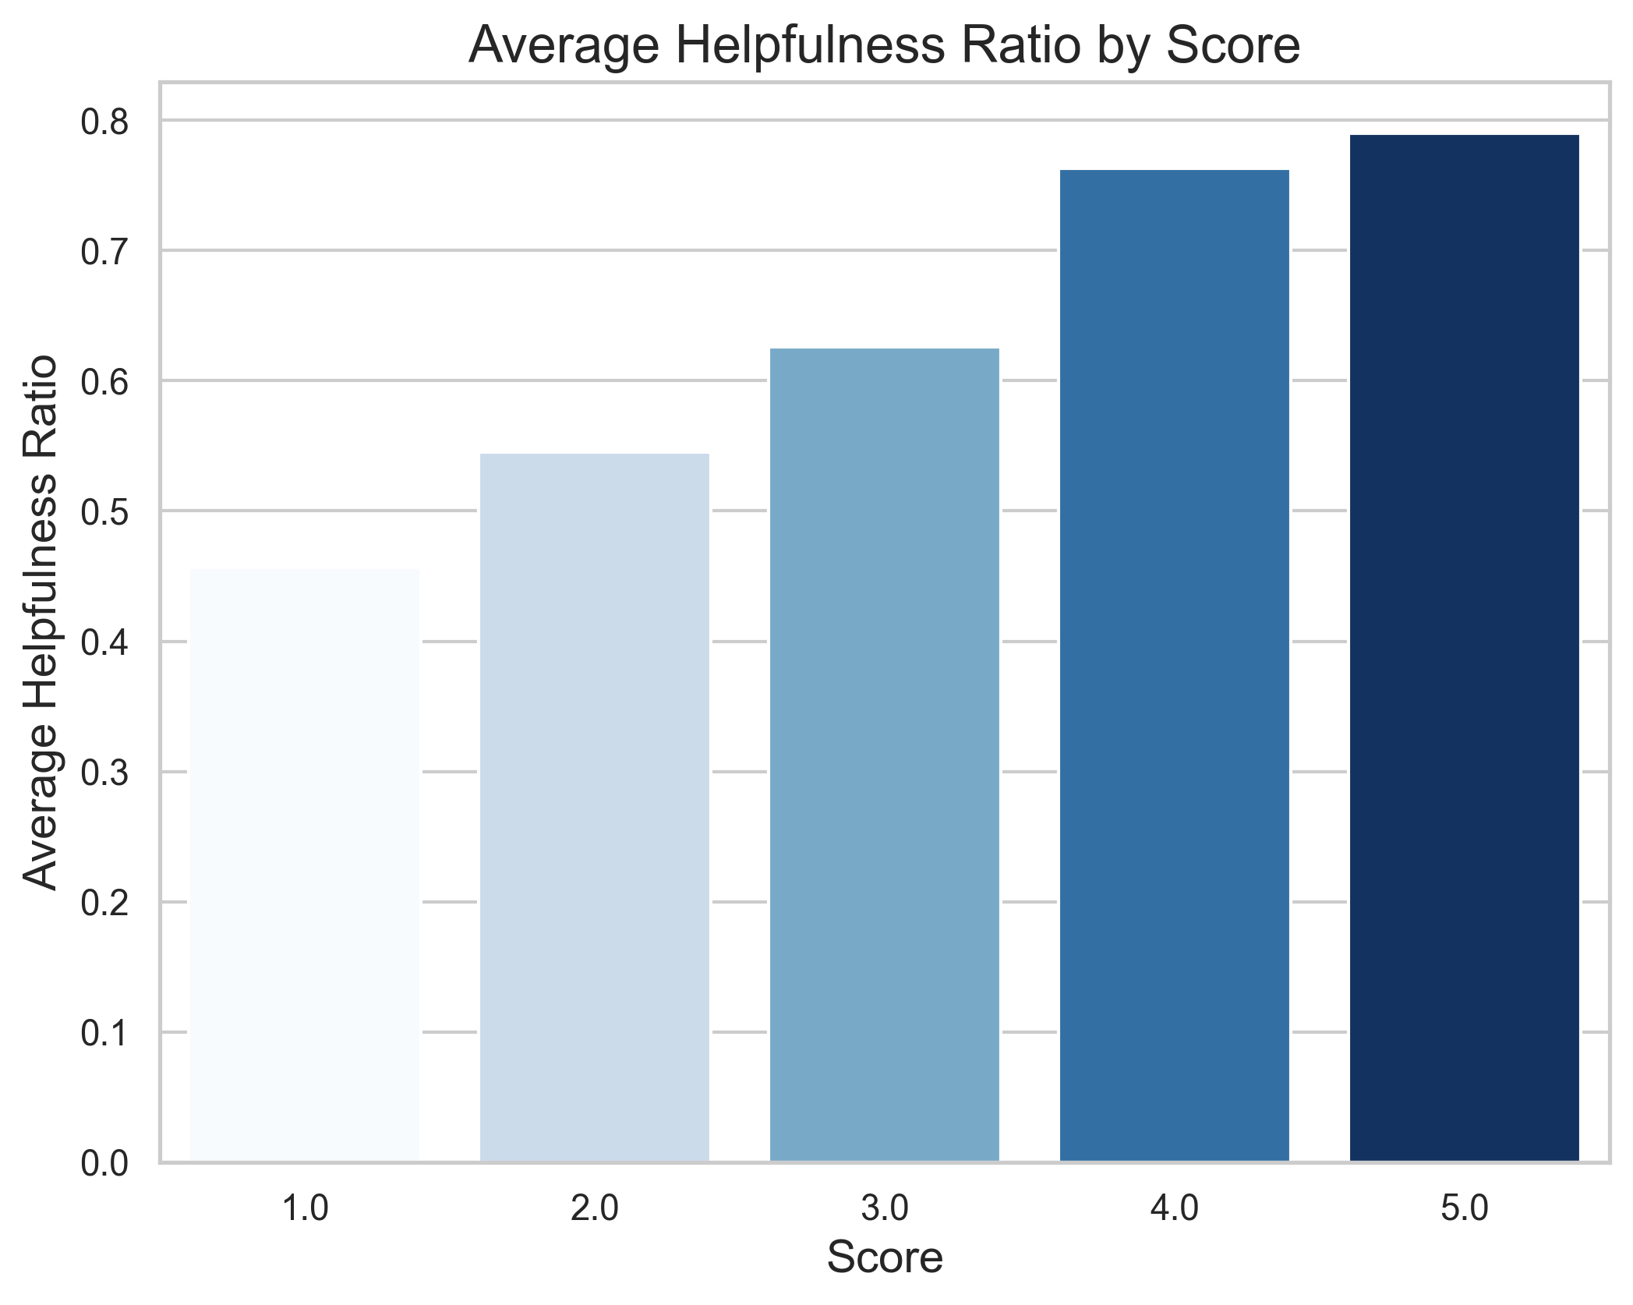
Data Analysis Example
This bar chart shows the average helpfulness ratio of book reviews across different ratings.
High star ratings: high average helpfulness ratio, indicating that users generally find positive reviews more helpful or reliable.
Low star ratings: low helpfulness ratio, meaning that negative feedback may be viewed as less constructive or subjective.

