Slide 1
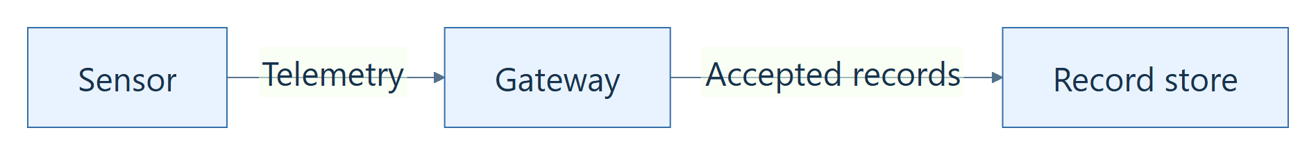
Editing SDDs
with Quarto
Document content, references, and diagrams
Quarto format
Easy and advanced editing
Positron workflow
Mermaid diagrams
TELEMETRY GATEWAY EXAMPLE
Fictional SDD used throughout this session
Introduction
01
Notes:
Slide 1 • 1 minute
Introduce the Telemetry Gateway SDD as a fictional teaching example. Point out the table, image, and diagram on the sample document page. Explain that the session follows one document from readable source to formatted output. The session consists of explanations and presenter demonstrations. The behaviors in the example are illustrative rather than approved requirements.

Slide 2
What Quarto does
MAINTAINED CONTENT
FORMATTED OUTPUT
# Overview
The gateway validates
telemetry before storage.
Overview
The gateway validates telemetry
before storage.
Supporting file | Role
_quarto.yml | Output settings
assets/ | Source images
reference.docx | Word styles
Edit the QMD source, then rebuild HTML or Word.
Introduction
02
Notes:
Slide 2 • 2 minutes
Connect a source sentence to the same sentence in the formatted output. A QMD file carries the content the team maintains. Quarto reads the source and output configuration, while the reference document supplies Word styles and HTML uses its own styling. When content changes, save the source and rebuild the intended outputs. Changes made only in generated output will be replaced by a later build.
Sources:
Quarto authoring overview: https://quarto.org/docs/get-started/authoring/

Slide 3
Anatomy of a Quarto document
QMD SOURCE
DOCUMENT STRUCTURE
---
title: "Telemetry Gateway SDD"
---
# Overview
The gateway validates telemetry.
## Design constraints
- Reject invalid messages.
YAML header
Document settings
Markdown body
Headings, prose, and lists
Shared settings can live in _quarto.yml.
Introduction
03
Notes:
Slide 3 • 2 minutes
Identify the YAML header between the two --- boundaries. Then identify the first heading, its paragraph, the second-level heading, and the list. YAML indentation matters. Blank lines separate document blocks. Preserve the existing project settings while changing content. Executable cells and more specialized blocks appear later in the session.
Sources:
Quarto front matter: https://quarto.org/docs/authoring/front-matter.html
Copy-ready source example:
---
title: "Telemetry Gateway SDD"
---
# Overview
The gateway validates incoming telemetry before storage.
## Design constraints
- Reject messages with an invalid schema.

Slide 4
The SDD project structure
PROJECT FILES
WHAT EACH FILE DOES
quarto-training-demo/
SDD.qmd
sections/
assets/
_quarto.yml
reference.docx
review.css
output/
SDD.qmd and sections/ contain the text.
assets/ keeps the source images.
Configuration and reference styles shape output.
output/ holds the generated files.
Keep the complete design folder together.
Introduction
04
Notes:
Slide 4 • 2 minutes
Walk through the actual training folder. The main QMD is the build target. Section fragments can be edited individually. Keep the assets and configuration with the content when moving a project. The reference document contains Word styles and page settings. A project may use another main filename. Rebuilding replaces generated output, so maintain content edits in QMD.
Sources:
existing toolkit workflow: C:/Users/KEFEI/Documents/sdd/quarto-docx-toolkit/README.md
Copy-ready source:
SDD.qmd
sections/
assets/
_quarto.yml
reference.docx
output/

Slide 5
Text, paragraphs, and headings
QMD SOURCE
RENDERED RESULT
## Message validation
The gateway **validates**
every incoming message.
Invalid messages receive
an *error response*.
### Configuration
Use `schema_version`.
Message validation
The gateway validates every
incoming message.
Invalid messages receive
an error response.
Configuration
Use schema_version.
Use heading levels for structure and blank lines for paragraphs.
Easy editing
05
Notes:
Slide 5 • 3 minutes
Read the source and point to each matching element in the rendered result. Demonstrate revising the first sentence and adding a separate paragraph. Use heading levels to describe structure and let the project handle any configured numbering. A line wrap in source is usually part of the same paragraph unless a blank line or another block marker separates it.
Sources:
Markdown text and heading syntax: https://quarto.org/docs/authoring/markdown-basics.html
Copy-ready source example:
## Message validation
The gateway **validates** every incoming message.
Invalid messages receive an *error response*.
### Configuration
The `schema_version` field selects the message schema.

Slide 6
Lists, links, and code examples
QMD SOURCE
RENDERED RESULT
- Validate the schema.
- Store accepted records.
1. Load the configuration.
2. Start the receiver.
[Quarto guide](https://quarto.org)
Validate the schema.
Store accepted records.
1. Load the configuration.
2. Start the receiver.
Quarto guide
Language-tagged code fences display configuration examples.
Easy editing
06
Notes:
Slide 6 • 2 minutes
Show bullet and ordered list markers, consistent indentation for nested items, and the bracket/parenthesis link pattern. Point out matching backtick fences around the JSON example. An ordinary language-tagged block displays source code. A later {mermaid} cell renders a diagram. Keep the JSON example as an alternate view if the main source becomes too crowded.
Sources:
Quarto guide: https://quarto.org/docs/guide/
Pandoc lists, links, and code blocks: https://pandoc.org/MANUAL.html
Copy-ready source example:
- Validate the message schema.
- Store accepted records.
1. Load the active configuration.
2. Start the receiver.
See the [Quarto guide](https://quarto.org/docs/guide/).
Alternate examples:
```json
{"schema_version": "v1", "enabled": true}
```

Slide 7
Attributes, IDs, and captions
Syntax | Purpose | Example
#id | Identify an element | #fig-gateway-context
.class | Assign a class | .callout-note
key="value" | Supply an option | width="5in"
Caption | Describe the object | Gateway context
@id | Refer to the object | @fig-gateway-context
Attribute order: ID, classes, then key-value options
An ID, a caption, and a reference have different jobs.
Advanced editing
07
Notes:
Slide 7 • 2 minutes
Use the terminology table to distinguish an identifier, a class, an option, a caption, and a reference. A generic ID identifies content, while fig- and tbl- prefixes identify numbered reference types. Captions supply visible descriptions. Use descriptive lowercase IDs. Where an element combines attribute types, follow the documented order: ID, classes, then key-value options.
Sources:
Quarto attributes: https://quarto.org/docs/authoring/markdown-basics.html#divs-and-spans
cross-reference labels: https://quarto.org/docs/authoring/cross-references.html

Slide 8
Fenced divs
QMD SOURCE
BLOCK STRUCTURE
::: {.callout-note}
## Validation rule
The gateway stores a message
only after validation succeeds.
:::
Opening fence + attributes
Enclosed content
Closing fence
RENDERED NOTE
Advanced editing
08
Notes:
Slide 8 • 3 minutes
Walk through the opening fence, content, and closing fence. At least three colons form a div fence. Explain that the note is a built-in callout, while an arbitrary class needs supporting styling or a filter. A missing closing fence can change the structure of later content. Nested blocks are possible; different fence lengths can make their structure easier to read.
Sources:
fenced divs: https://quarto.org/docs/authoring/markdown-basics.html#divs-and-spans
callout blocks: https://quarto.org/docs/authoring/callouts.html
Copy-ready source example:
::: {.callout-note}
## Validation rule
The gateway stores a message only after validation succeeds.
:::

Slide 9
Fenced divs and SDD styles
QMD SOURCE
WORD STYLE
::: {custom-style="Body Text Indent"}
The gateway retains its last
accepted configuration.
:::
Body Text Indent
The gateway retains its last
accepted configuration.
The named style comes from
reference.docx.
Word styles control Word output. HTML uses its own styling.
Advanced editing
09
Notes:
Slide 9 • 2 minutes
Connect the exact Body Text Indent style name to the selected style in the reference document and the indented Word paragraph. The gateway paragraph is a fictional example. Ordinary paragraphs use the normal body style and need no wrapper. A Word style does not guarantee matching HTML appearance. Use a named style already approved for the SDD.
Sources:
applying Word custom styles: https://quarto.org/docs/output-formats/ms-word-templates.html#applying-custom-styles
Copy-ready source example:
::: {custom-style="Body Text Indent"}
The gateway retains the last accepted configuration locally.
:::

Slide 10
Markdown pipe tables
MARKDOWN PIPE SOURCE
RENDERED TABLE
| ID | Interface | Direction |
|:---|:----------|:----------|
| IF-01 | Telemetry | Inbound |
| IF-02 | Record store | Outbound |
ID | Interface | Direction
IF-01 | Telemetry | Inbound
IF-02 | Record store | Outbound
Header and separator row
Easy row and column edits
Simple text and inline formatting
Pipe tables are the everyday choice for simple SDD data.
Advanced editing / Table formats
10
Notes:
Slide 10 • 3 minutes
Identify the header, separator, and body rows. Add one row in the prepared example. Explain :---, ---:, and :---: for left, right, and center alignment. Padding the source helps readability but strict vertical alignment is unnecessary. IF-01 is an interface value, not the Quarto table ID. Pipe cells support inline content, but not block paragraphs, block lists, or merged cells. Output styling determines the visible Word borders.
Sources:
Quarto Markdown tables: https://quarto.org/docs/authoring/tables.html#markdown-tables
Pandoc pipe tables: https://pandoc.org/MANUAL.html#extension-pipe_tables
Copy-ready source example:
| ID | Interface | Direction |
|:------|:-------------|:----------|
| IF-01 | Telemetry | Inbound |
| IF-02 | Record store | Outbound |

Slide 11
Pandoc grid tables
PANDOC GRID SOURCE
SAME RENDERED DATA
+-------+--------------+-----------+
| ID | Interface | Direction |
+=======+==============+===========+
| IF-01 | Telemetry | Inbound |
+-------+--------------+-----------+
| IF-02 | Record store | Outbound |
+-------+--------------+-----------+
ID | Interface | Direction
IF-01 | Telemetry | Inbound
IF-02 | Record store | Outbound
Cells can hold multiple paragraphs,
lists, or other block content.
+ intersections | boundaries = header separator
Keep every grid boundary aligned in a monospaced editor.
Advanced editing / Table formats
11
Notes:
Slide 11 • 3 minutes
Name the bordered syntax a Pandoc grid table. Keep every vertical boundary aligned in a monospaced editor. An extra source line can continue a cell rather than create a new row. A blank content line separates paragraphs inside a cell. When widening a column, update the corresponding boundary positions consistently. Show the two-paragraph Description cell as the alternate example. Grid boundaries define structure, while output styling controls visible borders. Quarto shortcodes are unsupported inside grid cells.
Sources:
Pandoc grid tables: https://pandoc.org/MANUAL.html#extension-grid_tables
Quarto grid tables: https://quarto.org/docs/authoring/tables.html#grid-tables
Copy-ready source example:
+-------+--------------+-----------+
| ID | Interface | Direction |
+=======+==============+===========+
| IF-01 | Telemetry | Inbound |
+-------+--------------+-----------+
| IF-02 | Record store | Outbound |
+-------+--------------+-----------+
Alternate examples:
+-----------+-----------------------+
| Interface | Description |
+===========+=======================+
| IF-01 | Receives telemetry. |
| | |
| | Rejects invalid data. |
+-----------+-----------------------+

Slide 12
HTML tables
HTML SOURCE IN A QMD FILE
```{=html}
<table>
<tr><th>ID</th><th>Interface</th><th>Direction</th></tr>
<tr><td>IF-01</td><td>Telemetry</td><td>Inbound</td></tr>
<tr><td>IF-02</td><td>Record store</td><td>Outbound</td></tr>
</table>
```
ID | Interface | Direction
IF-01 | Telemetry | Inbound
IF-02 | Record store | Outbound
Explicit tags and cell spans
Check the intended output
Quarto can process HTML tables across formats. Verify the Word build.
Advanced editing / Table formats
12
Notes:
Slide 12 • 3 minutes
Identify the same two interface records used in the pipe and grid examples. Change one td value and show the HTML preview. Mention thead, tbody, and caption, then explain colspan and rowspan as extensions for merged cells. With processing enabled, Quarto can translate supported HTML tables for multiple output formats. Browser CSS appearance does not automatically transfer to Word. Keep this example separate from the toolkit Word build: the current wrapper preflight may count zero raw HTML tables before Quarto converts one, causing its exact Word table count check to disagree. Use pipe or grid tables in the demonstrated approved Word output until the HTML path is verified.
Sources:
Quarto HTML tables and table processing: https://quarto.org/docs/authoring/tables.html#html-tables
HTML table elements and cell spans: https://developer.mozilla.org/en-US/docs/Web/HTML/Reference/Elements/table
Copy-ready source example:
```{=html}
<table>
<thead><tr><th>ID</th><th>Interface</th><th>Direction</th></tr></thead>
<tbody>
<tr><td>IF-01</td><td>Telemetry</td><td>Inbound</td></tr>
<tr><td>IF-02</td><td>Record store</td><td>Outbound</td></tr>
</tbody>
</table>
```

Slide 13
Table IDs and references
CAPTION AND REFERENCE
: Gateway interfaces {#tbl-interfaces}
See @tbl-interfaces.
RENDERED RESULT
Table 1: Gateway interfaces
See Table 1.
ID | Interface | Direction
IF-01 | Telemetry | Inbound
IF-02 | Record store | Outbound
Insert an earlier table:
the number updates.
The ID stays the same.
Keep IDs stable and let Quarto supply the table number.
Advanced editing
13
Notes:
Slide 13 • 3 minutes
Identify the caption, the table ID, and its reference. Keep a blank line before the caption. The caption can be placed above the rendered table by output settings even though it follows the table in source. Insert an earlier table and show the number and reference updating together. Avoid typing manual numbers into captions. Avoid an extra Table before the reference when the configured reference already supplies that label.
Sources:
table labels and references: https://quarto.org/docs/authoring/tables.html#cross-references
Copy-ready source example:
| ID | Interface | Direction |
|:------|:----------|:----------|
| IF-01 | Telemetry | Inbound |
: Gateway interfaces {#tbl-interfaces}
See @tbl-interfaces for the interface summary.

Slide 14
Adding and replacing images
IMAGE SOURCE
![Gateway context](assets/gateway-context.png){width="5in"}
SOURCE IMAGE IN assets/
Caption: Gateway context
Path: assets/gateway-context.png
fig-alt supplies an accessible description.
Inspect the image size in Word.
Advanced editing
14
Notes:
Slide 14 • 3 minutes
Connect the image filename in the assets folder to the path in the QMD. Place the captioned image in its own paragraph. Change the width, then replace the file with the revised version and rebuild. Explain the fig-alt attribute as an alternative description distinct from the visible caption. HTML preview does not determine Word page fit. Inspect the image and caption in the intended output.
Sources:
Gateway context: assets/gateway-context.png
Quarto figures and alternative text: https://quarto.org/docs/authoring/figures.html
Copy-ready source example:
![Gateway context](assets/gateway-context.png){width="5in"}

Slide 15
Image IDs and references
FIGURE ID
![Gateway context](assets/gateway-context.png){#fig-gateway-context}
See @fig-gateway-context for the external connections.
Figure 1: Gateway context
See Figure 1 for the external connections.
Replacing the same conceptual figure can retain its existing ID.
Advanced editing
15
Notes:
Slide 15 • 3 minutes
Add the figure ID to the image example and identify the generated caption number and prose reference. Insert an earlier figure to show numbering update. The ID is independent of the image filename. Preserve it when replacing the same conceptual figure. An unrelated figure should receive an appropriate ID. Every ID must be unique across the assembled document, including included fragments.
Sources:
Gateway context: assets/gateway-context.png
figure cross-references: https://quarto.org/docs/authoring/figures.html#cross-references
Copy-ready source example:
![Gateway context](assets/gateway-context.png){#fig-gateway-context width="5in"}
See @fig-gateway-context for the external connections.

Slide 16
Including other QMD files
MAIN FILE: SDD.qmd
{{< include sections/_architecture.qmd >}}
{{< include sections/_interfaces.qmd >}}
INCLUDED FILE
ASSEMBLED DOCUMENT
# Architecture
The gateway validates
telemetry before storage.
Architecture
The gateway validates telemetry
before storage.
Render the main document. Keep paths relative to that document.
Advanced editing
16
Notes:
Slide 16 • 3 minutes
Identify the main SDD file and its two prose fragments. Show the architecture fragment, revise a sentence, and inspect the rebuilt main output. Put each include on its own line with surrounding blank lines. Keep metadata in the main file or project configuration, and omit YAML from fragments. Asset paths resolve from the main document directory. IDs are unique across the assembled document. Use prose-only fragments in this toolkit demonstration because its preflight counts main-source tables before include expansion.
Sources:
Quarto includes: https://quarto.org/docs/authoring/includes.html
Copy-ready source example:
{{< include sections/_architecture.qmd >}}
{{< include sections/_interfaces.qmd >}}
Alternate examples:
# Architecture {#sec-architecture}
The gateway validates incoming telemetry before storage.

Slide 17
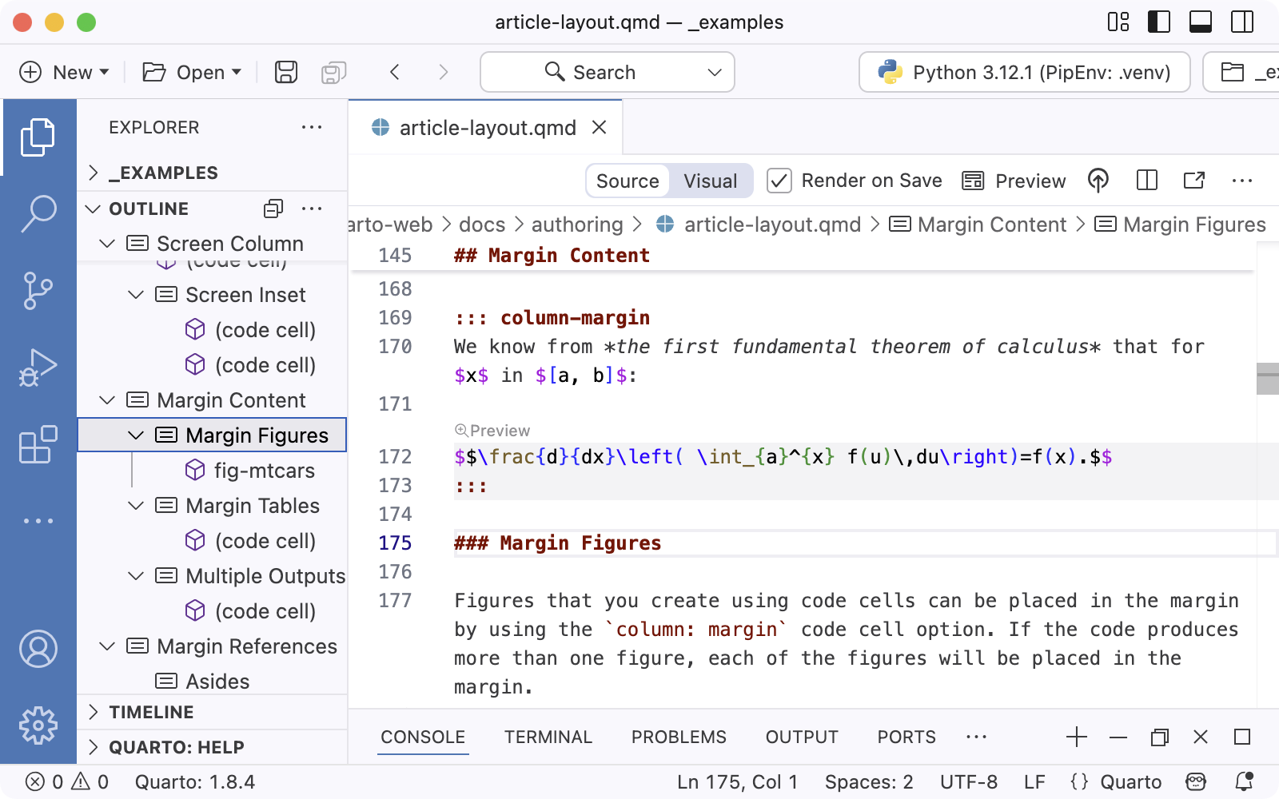
Opening an SDD project in Positron
EXPLORER AND OUTLINE
SOURCE, VISUAL, AND PREVIEW
Open the project folder and select SDD.qmd.
Use the outline to navigate headings.
TERMINAL
The Viewer opens with HTML preview (slide 19).
Official Quarto documentation screenshot
Positron
17
Notes:
Slide 17 • 2 minutes
Open the training project, expand sections and assets, and open SDD.qmd. Navigate to the interface section using the outline. Explain that fragments are edited as separate files while the main QMD remains the rendering entry point. Orient the team in the actual installed Positron version: Explorer, editor, outline, Viewer, and terminal.
Sources:
Quarto in Positron: https://quarto.org/docs/tools/positron/
Screenshot credit: Quarto documentation / Posit. Official documentation screenshot with macOS reference UI. Positron version unspecified. Controls may differ from the installed Windows version.
Source: https://quarto.org/docs/tools/positron/
Image: https://quarto.org/docs/tools/images/positron-outline.png

Slide 18
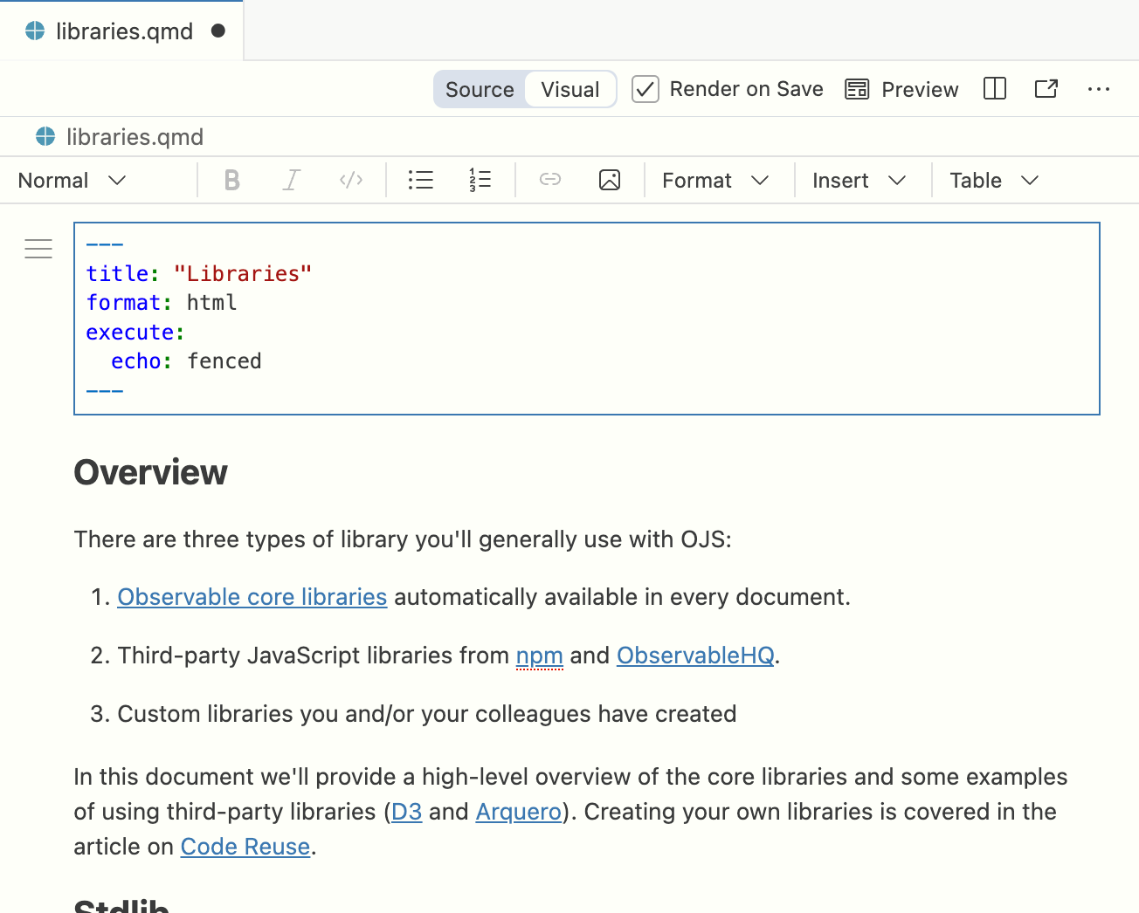
Source and visual editing in Positron
SOURCE MODE
VISUAL MODE
## Message validation
The gateway **validates**
every incoming message.
::: {.callout-note}
Preserve IDs and attributes.
:::
Precise syntax, includes,
attributes, and Mermaid
Formatted prose and document editing
Visual-mode image: official Quarto documentation example
Positron
18
Notes:
Slide 18 • 3 minutes
Edit a sentence in Visual mode, switch to Source mode, and point to the corresponding Markdown. Show where figure or table attributes appear. Use Edit in Visual Mode and Edit in Source Mode, or Open With in Explorer, as supported by the installed version. Visual editing may normalize source formatting, so review specialized imported markup and retain IDs and attributes. The rendered output remains the final behavior check.
Sources:
Positron visual editing: https://quarto.org/docs/tools/positron/visual-editor.html
Screenshot credit: Quarto documentation / Posit. Official documentation screenshot with macOS reference UI. Positron version unspecified. Controls may differ from the installed Windows version.
Source: https://quarto.org/docs/tools/positron/visual-editor.html
Image: https://quarto.org/docs/tools/images/positron-visual-editor.png
The source excerpt is the training SDD, while the official Visual-mode screenshot shows a different example document. Use the screenshot to identify the editing controls. Do not imply that it is a capture of this SDD.

Slide 19
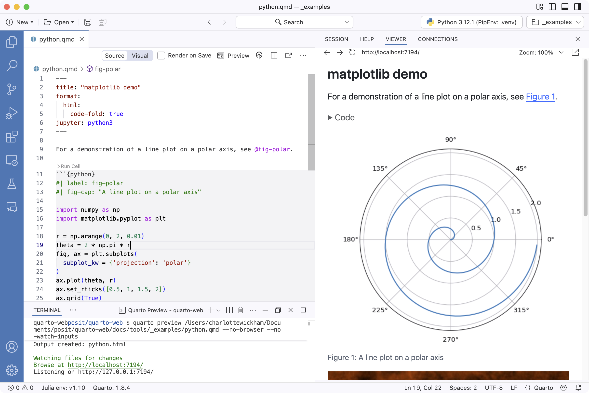
Previewing and building the document
HTML REVIEW IN POSITRON
1. Save all edited files.
2. Preview Format: HTML.
3. Run the toolkit Word build.
4. Open Word and refresh fields.
Word: Ctrl+A, then F9
Official Quarto documentation screenshot
Positron
19
Notes:
Slide 19 • 4 minutes
Save all changed files, select the main QMD, run Quarto: Preview Format, and choose HTML explicitly. Quarto: Preview continues with the selected format. Review a paragraph and reference in the Viewer. Close the previous generated Word output before running the toolkit Word build in the integrated terminal. Open output/SDD.docx externally in Word. Use Ctrl+A, F9 and repeat F9 if a reference before its target needs another refresh. Inspect figures, captions, tables, and page fit. Positron preview and a direct Quarto render do not perform the toolkit Word post-processing. Saving alone is not proof of a completed build.
Sources:
Positron rendering and preview: https://quarto.org/docs/tools/positron/
toolkit build instructions: C:/Users/KEFEI/Documents/sdd/quarto-docx-toolkit/README.md
Copy-ready source example:
$toolkitBuild = 'C:\Users\KEFEI\Documents\sdd\quarto-docx-toolkit\scripts\build.bat'
$sddProject = 'C:\Users\KEFEI\Documents\sdd\quarto-training-demo'
& $toolkitBuild --project $sddProject --input-file SDD.qmd --format html
& $toolkitBuild --project $sddProject --input-file SDD.qmd --format docx
Copy-ready source:
$toolkitBuild = 'C:\Users\KEFEI\Documents\sdd\quarto-docx-toolkit\scripts\build.bat'
$sddProject = 'C:\Users\KEFEI\Documents\sdd\quarto-training-demo'
& $toolkitBuild --project $sddProject --input-file SDD.qmd --format html
& $toolkitBuild --project $sddProject --input-file SDD.qmd --format docx
Screenshot credit: Quarto documentation / Posit. Official documentation screenshot with macOS reference UI. Positron version unspecified. Controls may differ from the installed Windows version.
Source: https://quarto.org/docs/tools/positron/
Image: https://quarto.org/docs/tools/images/positron-render.png

Slide 20
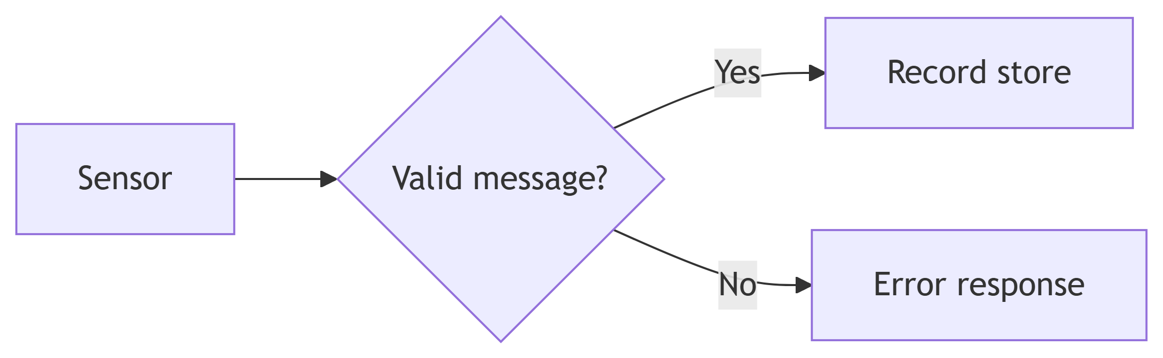
Mermaid diagrams inside Quarto
MERMAID SOURCE
```{mermaid}
flowchart LR
S[Sensor] --> V{Valid message?}
V -->|Yes| D[Record store]
V -->|No| E[Error response]
```
Node ID: S
Visible label: Sensor
Connection: -->
RENDERED DIAGRAM
Mermaid
20
Notes:
Slide 20 • 3 minutes
Show the small telemetry validation flowchart. Identify Sensor, the validation decision, the accepted path to Record store, and the rejected path to Error response. Edit the store label in Positron and show its updated preview. Then show a prepared added node or connection. Stable node IDs such as D are different from labels inside brackets. A sequence diagram is another useful way to document request/response behavior.
Sources:
Quarto Mermaid diagrams: https://quarto.org/docs/authoring/diagrams.html
Copy-ready source example:
```{mermaid}
flowchart LR
S[Sensor] --> V{Valid message?}
V -->|Yes| D[Record store]
V -->|No| E[Error response]
```

Slide 21
Diagram captions, IDs, and export
OPTIONS DIRECTLY BELOW {mermaid}
REFERENCE IN PROSE
%%| label: fig-processing-flow
%%| fig-cap: "Telemetry processing flow"
See @fig-processing-flow.
Figure 2: Telemetry processing flow
See Figure 2.
Mermaid
21
Notes:
Slide 21 • 3 minutes
Keep the validation flowchart body from slide 20 and add only the figure label and caption options directly below the opening fence. Rebuild and point to the generated figure number and prose reference. Diagrams share the figure reference system with images. HTML uses Mermaid JavaScript rendering, while Word receives a generated diagram image. Inspect label readability in Word. Browser-backed rendering must work for export, and a local diagram preview alone does not establish successful Word output.
Sources:
diagram options, references, and output formats: https://quarto.org/docs/authoring/diagrams.html
Copy-ready source example:
```{mermaid}
%%| label: fig-processing-flow
%%| fig-cap: "Telemetry processing flow"
flowchart LR
S[Sensor] --> V{Valid message?}
V -->|Yes| D[Record store]
V -->|No| E[Error response]
```
See @fig-processing-flow for the processing sequence.

Slide 22
Common errors, quick reference, and Q&A
SYNTAX REMINDER
BEFORE SHARING
## Interface design
::: {.callout-note}
...
:::
#tbl-interfaces
@tbl-interfaces
#fig-gateway-context
@fig-gateway-context
Save the QMD and included fragments.
Check assets, fences, and references.
Confirm the build completed.
Inspect Word layout and refresh fields.
Questions and discussion
Closing
22
Notes:
Slide 22 • 3 minutes
Summarize headings, fenced divs, pipe/grid/HTML tables, tbl- and fig- references, includes, and Mermaid option prefixes. Connect the common symptoms to first checks: unexpected formatting often means a missing fence, malformed tables may have bad separators or cell counts, missing assets often mean wrong main-relative paths, and references need matching unique IDs. Preview and Word layout can differ because of format-specific styling and pagination. A final Word failure can involve a file lock, an included table, or HTML-table compatibility. Rebuild successfully and refresh Word fields before delivery. Take questions.
Copy-ready source:
## Interface design
::: {.callout-note} ... :::
#tbl-interfaces / @tbl-interfaces
#fig-gateway-context / @fig-gateway-context
{{< include sections/_interfaces.qmd >}}
%%| label: fig-processing-flow

