Slide 1
Part 2: General Situation of the Planning Area
Kefyalew Sahle (MSc.)

Slide 2
2.0 General Situation of the Planning Area
Ownership, Legal Status, and Stakeholders
Personnel and Organisational Structure
Socio-economic Information
Geographical Information
Climate
Forest Types
Problems

Slide 3
2.1-Ownership, Legal Status, and Stakeholders
who owns the areas
the legal status of the ownership
the history of the enterprise/management unit

Slide 4
Other relevant information
status profile of the forest owner(s)
what capital
what asset
when they are established
who is the manager and
other characteristics relevant of the owner.
Notes:
The management plan report should show who owns the areas - the legal status of the ownership - the history of the enterprise/management unit and - other relevant information like status profile of the forest owner(s), what capital, what asset, when they are established, who is the manager and other characteristics relevant of the owner. - A table based on cadastral data should show which are the parcels that are included in the FMP

Slide 5
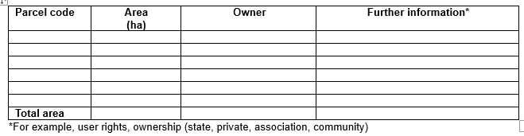
Table 2: Parcels of the planning area

Slide 6
2.1-Stakeholder Roles and Contributions
present the different stakes on the forest to be managed:
local community
government entities
environmental and
other NGOs deal
A stakeholder map showing
who has what interest, and
how and what they can contribute to the forest management plan
Notes:
A stakeholder map
showing who has what interest, and how and what they can contribute to the forest management plan should be developed.This is the base of concise consultation in the process to prepare the FMP (see chapter 4.).
Stakeholders vary in their role in forest management. Some are more vital or crucial than others, but understanding their individual and collective role is important for a successful preparation of FMPs.
The different stakes on the forest to be managed should be presented.
These may include local community, government entities, environmental and other NGOs dealing with land use, and the like.
A stakeholder map showing who has what interest, and how and what they can contribute to the forest management plan should be developed.
This is the base of concise consultation in the process to prepare the FMP (see chapter 4.).
Stakeholders vary in their role in forest management. Some are more vital or crucial than others, but understanding their individual and collective role is important for a successful preparation of FMPs.

Slide 7
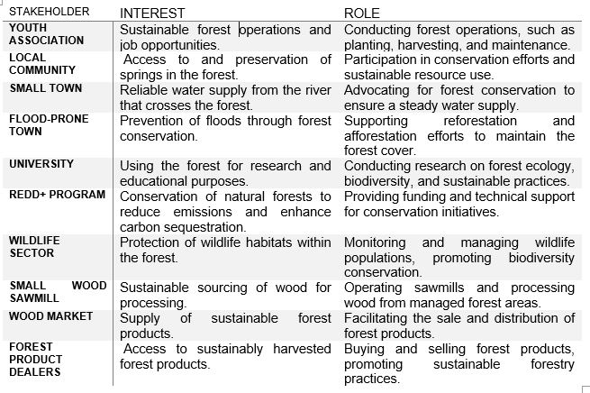
Sample - Stakeholder map

Slide 8
2.1 National policies and strategies
state national policies and strategies and
their relevance for the forest management planning

Slide 9
2.2-Personnel and Organisational Structure
Forest Management Unit
Human Resources
FMP Preparation and Approval

Slide 10
2.2-Forest Management Unit
Give a general description of the forest user who manages the area to be planned for.
Ethiopian Forestry Department
a forest enterprise
a community,
an association, or
a private enterprise.

Slide 11
2.2-Forest Management Unit
give a short discription of
the forest management unit
the organisational structure
infrastructure
the administrative framework
Notes:
This chapter of the FMP comprises a general description of the forest user who manages the area to be planned for.
This can be a unit of the Ethiopian Forestry Department, a forest enterprise, a community, an association, or a private enterprise.
A short description of the forest management unit, the organisational structure, infrastructure, and the administrative framework are to be given.

Slide 12
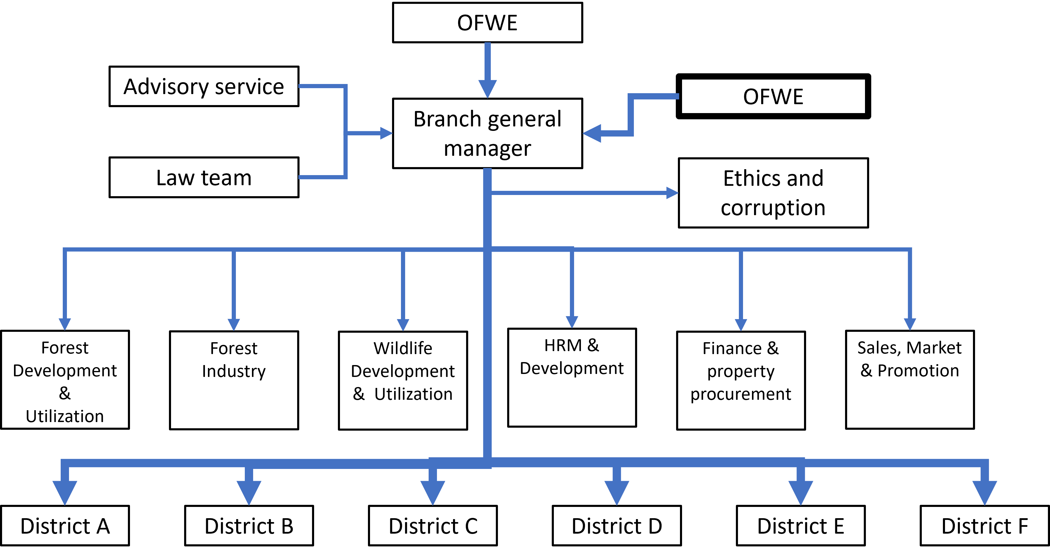
Sample Forest Management Unit

Slide 13
2.2-Human Resources
Gives an overview of
the human (administrative and technical staff) resources
that will be responsible for the preparation of the FMP and its implementation.
States
necessary logistics, financial and other resources
capacity development ( If there is the need )

Slide 14
2.2-FMP Preparation and Approval
states
who prepared the FMP
for example their own staff or an external consultant
who approves the plan

Slide 15
2.2-FMP Preparation and Approval
Regulation Art. 20 deals explicitly with forest management plans:
a forest management plan for large-scale forest developers
shall be only prepared by professionals having a certificate of professional competence.
Notes:
This chapter states who prepared the FMP, for example their own staff or an external consultant and who approves the plan.
This is stated in a regulation Art. 20 deals explicitly with forest management plans: Thus, Art. 20 stated that a forest management plan for large-scale forest developers of forest properties of ≥ 5 ha shall be only prepared by professionals having a certificate of professional competence.

Slide 16
2.3-Socio-economic information (1/2)
Demographic and social information\
from official statistics and documents
Information on land use patterns
Economic activities (main sources of income),
Infrastructure
Activities in the forests and other related activities

Slide 17
2.3-Socio-economic information (2/2)
The pressure on the forests
illegal cutting, encroachment, poaching and others
The relations to and cooperation with the forest managers and EFD
Agreements like Joint Forest Management
Obligations and benefits for both sides (in theory and practice)

Slide 18
2.4- Geographical Information
Location
Topography and Land Cover
Geology
Cadastral Information

Slide 19
2.4- Location
Description of
the forest area’s location
adjacent land users and their locations
Supported by map (GIS) showing
main and nearest towns
major roads
rivers

Slide 20
Location

Slide 21
2.4- Topography and Land Cover
Major land cover types and landscapes
Topography and drainage descriptions
Supported by maps and summary tables

Slide 22
Topography (elevation)

Slide 23
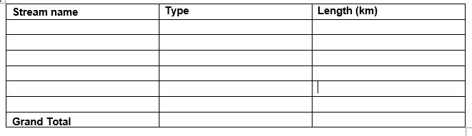
Drainage

Slide 24
2.4- Geology
Brief description based on geological maps (if available)

Slide 25
2.4- Cadastral Information
2nd level certification in many areas is completed.
In forests mostly 1st level certification exists.
The certified forest parcels and the parcels of the surrounding areas are the base of the planning area.
The boundaries of parcels with forests to non-forest parcels are the outer boundaries of the planning area.
Recent Orthophotos are available and should be made available by the Land Administration.
Trustful inter-institutional cooperation is essential.

Slide 26
2.5- Climate
Mean Rainfall
Mean, Minimum, Maximum, Pattern, Seasonality
Temperature
Mean, Minimum, Hottest, Driest, Wettest, Coldest Months
Adverse Effects
Frost, Wind, Drought

Slide 27
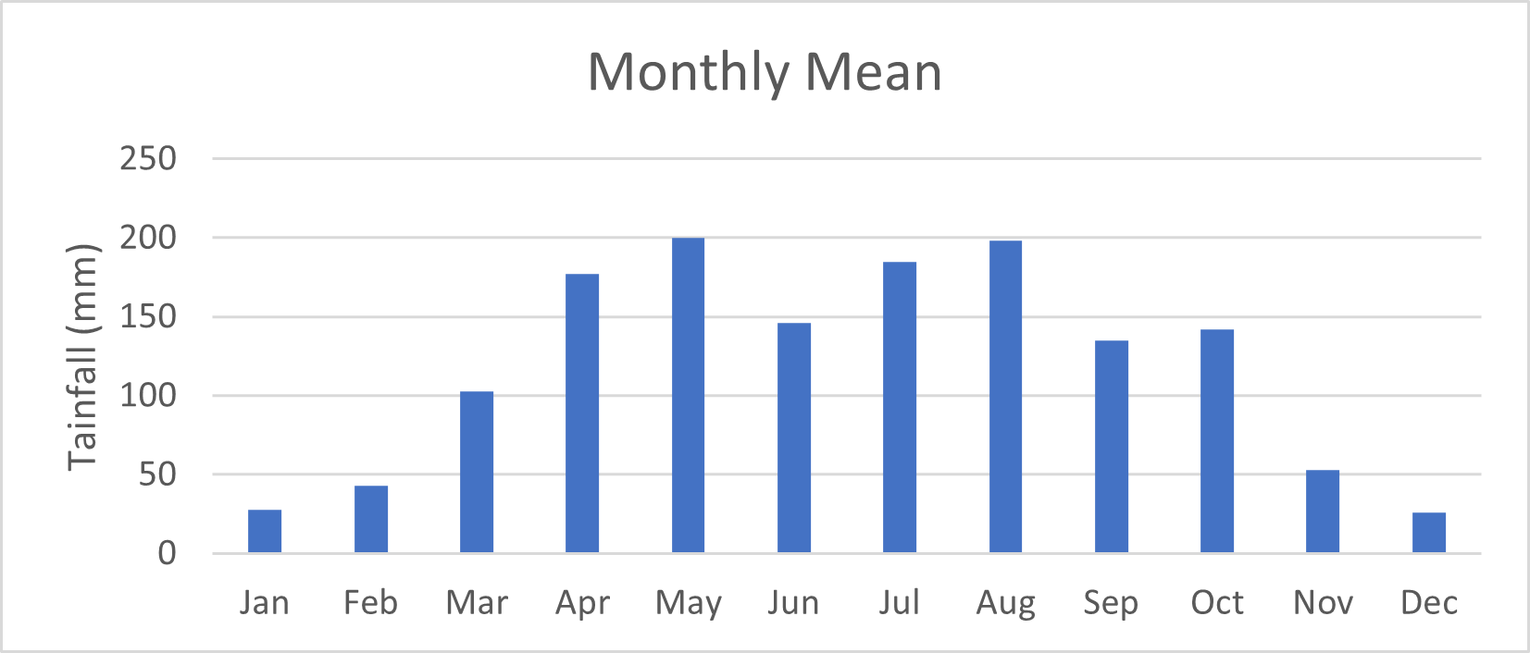
2.5- Climate

Slide 28
Agro-ecology
Use a map if the forest sites are located in different agro-ecological zones

Slide 29
Agro-ecology

Slide 30
2.6- Forest Types
Forest Type according to Legislation
Productive forest
Protected forest
Preserved forest
Ethiopian Forest Vegetation
Dry Afromontane
Moist Afromontane
Acacia-Commiphora
Combretum-Terminalia

Slide 31
2.6- Forest Types
Biological Diversity
Natural: Species richness, major tree species, disturbance status
Plantation: Rare species
Existing Forest Data:
Age & diameter distribution - Volume measures - Non-timber resources

Slide 32
2.7- Problems
Summary of Problems
Issues from the climate, forest types, and biodiversity described previously.
Additional Problems
Identified through preliminary work, Findings from team discussions, Insights from social surveys of surrounding villages.

