Slide 1
Microframeworks for Microservices
Vitalii Samolovskikh
Software Engineer at Scentbird inc.
@kefirfromperm
kefirfromperm@gmail.com

Slide 2
History
1998, Sun announced JPE
(Java Platform for the Enterprise)
1999, J2EE
2001, Hibernate
2004, Spring 1.0
There are only monoliths

Slide 3
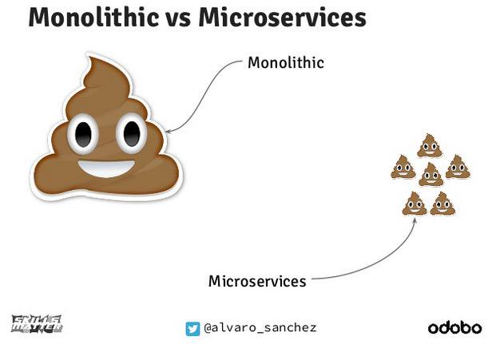

Slide 4

Spring Boot
Version 1.0 was released in 2014
Many Java-programmers use Spring Boot to develop microservices

Slide 5
The Problem
The simplest Hello World application created with Spring Boot allocates 300 MiB RAM

Slide 6

Microservices with Spring Boot

Slide 7
Looking for a new Hero
Allocate minimum RAM
Fast run
Minimum dependencies

Slide 8

“Play is based on a lightweight, stateless, web-friendly architecture.”
playframework.com

Slide 9
Play Framework has disadvantages
Developed by Scala
The simplest Hello World application builds during half an hour
And allocates 566 MiB RAM
NO WAY!

Slide 10





Slide 11
Microframeworks comparison
Framework | Allocated, MiB | Time to start, ms.
Spring Boot | 291 | 2290
Play | 566 | ?
Ninja | 151 | 1374
Spark | 43 | 368
Jooby | 99 | 639
Micronaut | ? | ?

Slide 12
Spark Demo
import static spark.Spark.*;
public class Application {
public static void main(String[] args) {
get("/hello", (req, res) -> "Hello Spark!");
}
}

Slide 13
Jooby Demo
import org.jooby.Jooby;
public class Application extends Jooby {
{
get("/", () -> "Hello Jooby!");
}
public static void main(final String[] args) {
run(Application::new, args);
}
}

Slide 14
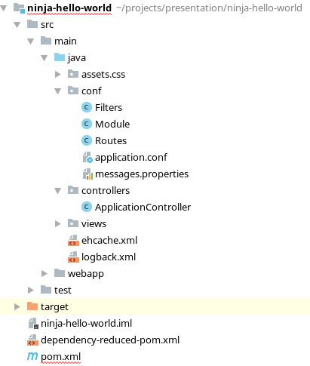
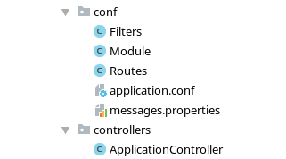
Ninja Project

Slide 15
Ninja Routes
public class Routes implements ApplicationRoutes {
@Override
public void init(Router router) {
router.GET().route("/").with(ApplicationController::index);
router.GET().route("/hello_world.json").with(ApplicationController::helloWorldJson);
///////////////////////////////////////////////////////////////////////
// Assets (pictures / javascript)
///////////////////////////////////////////////////////////////////////
router.GET().route("/assets/webjars/{fileName: .*}").with(AssetsController::serveWebJars);
router.GET().route("/assets/{fileName: .*}").with(AssetsController::serveStatic);
///////////////////////////////////////////////////////////////////////
// Index / Catchall shows index page
///////////////////////////////////////////////////////////////////////
router.GET().route("/.*").with(ApplicationController::index);
}
}

Slide 16
Ninja Controller
@Singleton
public class ApplicationController {
public Result index() {
return Results.html();
}
public Result helloWorldJson() {
SimplePojo simplePojo = new SimplePojo();
simplePojo.content = "Hello Ninja!";
return Results.json().render(simplePojo);
}
public static class SimplePojo {
public String content;
}
}

Slide 17

Micronaut
A modern, JVM-based, full-stack framework for building modular, easily testable microservice applications.
Developed by OCI, the home of Grails

Slide 18
Micronaut advantages
JAR file – 8MiB (Java) / 12 MiB (Groovy)
Heap size – 7MiB (Java) / 19MiB (Groovy)
Startup time ~1s

Slide 19
How is it possible?
Compile time dependency injection (No Spring!)
Lightweight Netty application server

Slide 20
When?
Coming soon
At the end of May on Gr8conf.eu

Slide 21
Questions?

