Slide 1
1000W DC Electronic Load
Market Analysis & Product Opportunity Report
May 2026 | Confidential
$4.0B
7.5%
17%
$800-$2k
2026 Global Market Size
Annual Growth Rate
1kW Segment Share
Target Price Range

Slide 2
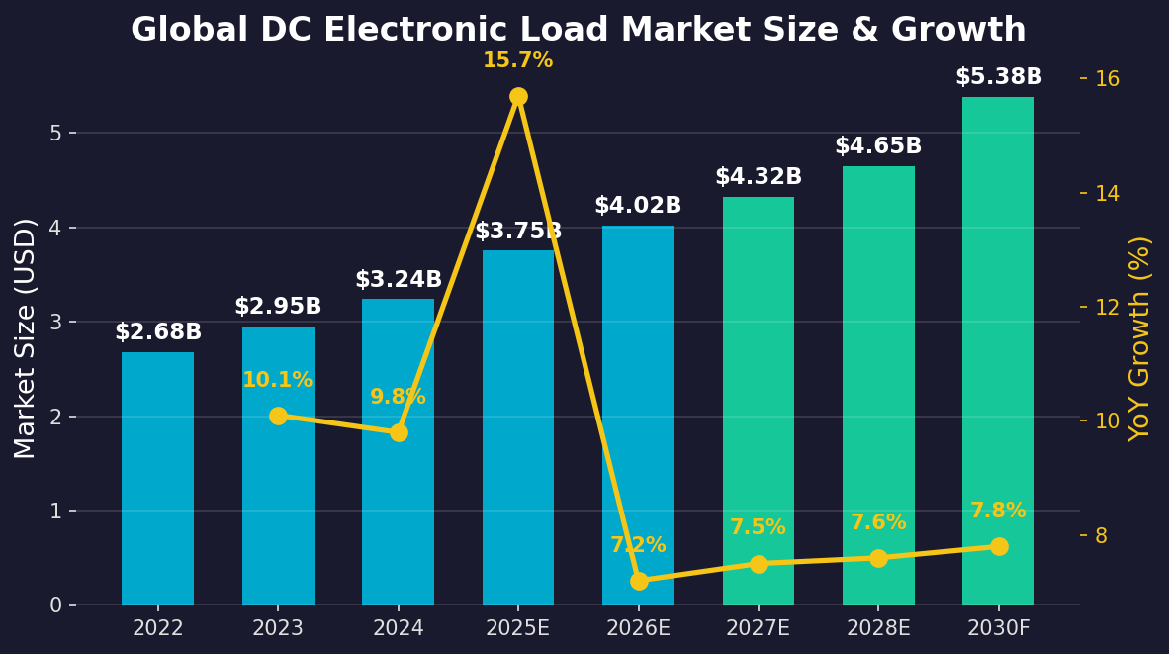
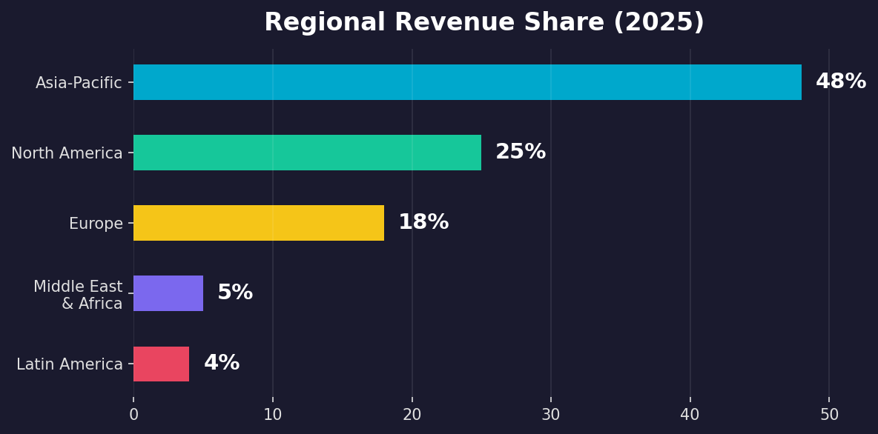
Global DC Electronic Load Market Size & Growth
Key Findings
Market Size (2025): $3.75B → Growing to $5.38B by 2030
CAGR: 6-11% depending on report source
DC loads dominate; AC+DC combined market tops $4.7B
1000W sits at the sweet spot between benchtop and modular systems
Asia-Pacific accounts for ~48% of global revenue

Slide 3
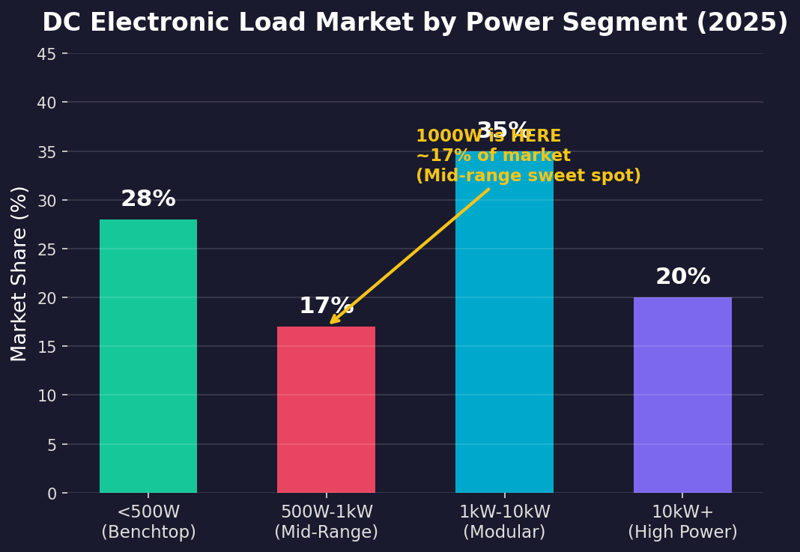
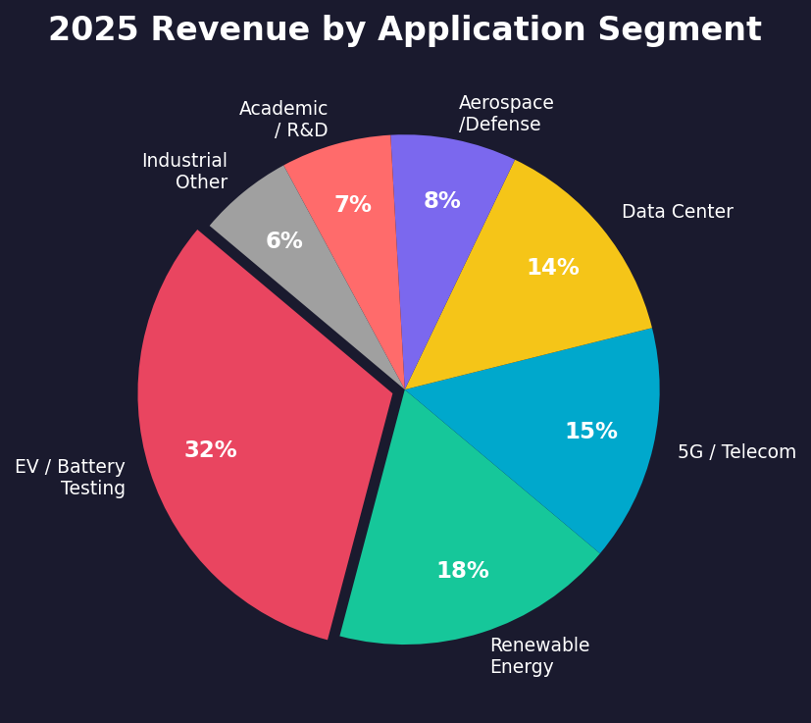
Market Segmentation: By Power & Application
1000W Segment Characteristics
Falls into 1kW-10kW "modular" segment (35% share)
Also overlaps with mid-range 500W-1kW (17% share)
Ideal for server PSU, EV module, solar inverter testing
3-5x more applications than 500W-class
Top Applications for 1000W Loads
EV battery module testing (up to 96V / 30A)
Server PSU validation (1kW ATX / redundant PSU)
Solar micro-inverter & charge controller testing
DC-DC converter efficiency measurement
Why 1000W > 500W
Addressable market ~3x larger than 500W
Fewer DIY competitors (complexity jumps at 1kW+)
Higher ASP = better margins at same volume
Professional users have bigger budgets

Slide 4
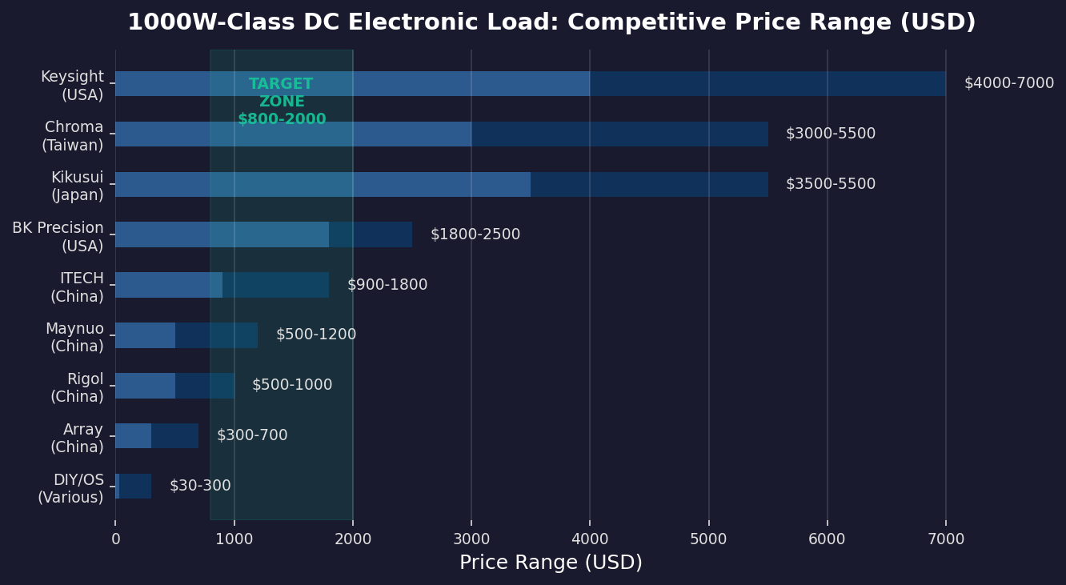
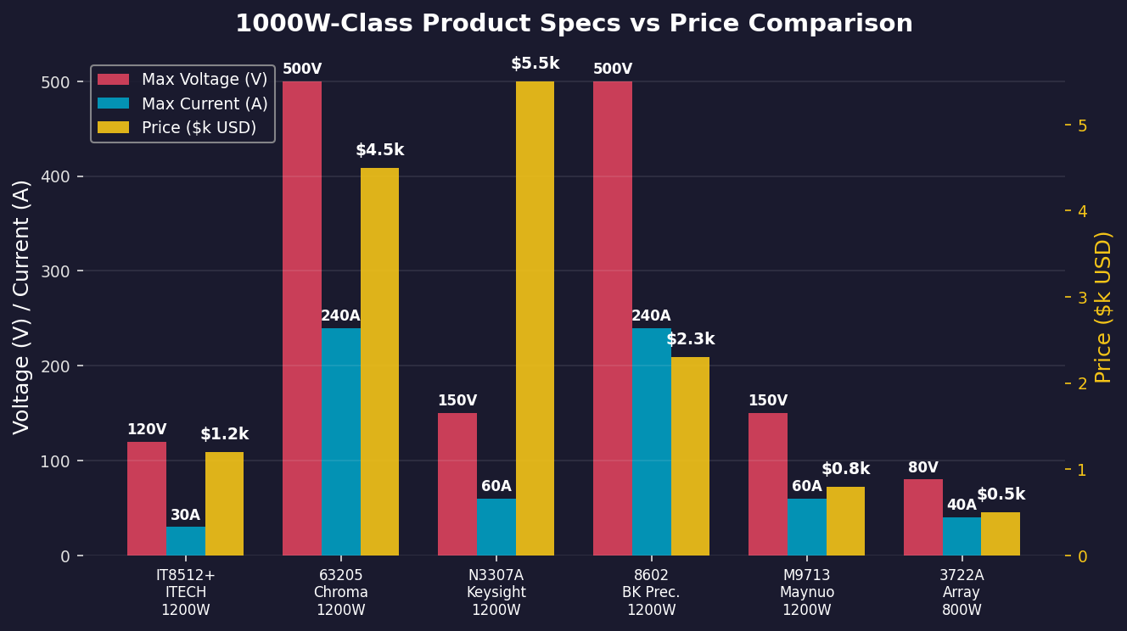
Competitive Landscape: 1000W-Class DC Electronic Loads
Tier 1: Premium ($3,000-7,000)
Keysight, Chroma, Kikusui
Accuracy <0.1%, extensive protocol support
Target: enterprise, defense, aerospace
Key weakness: terrible software UX, slow innovation
Tier 2: Mid-Market ($800-2,500)
ITECH (CN), BK Precision (US), Rigol (CN)
Good accuracy (0.1-0.5%), decent software
Target: R&D labs, testing houses
ITECH dominates China / BK Precision dominates US
Tier 3 & DIY ($30-1,200)
Maynuo, Array, unknown Taobao brands, Arduino+MOSFET
Low accuracy (>0.5%), minimal protection
Target: makers, students, budget-constrained labs
Open-source community wants a serious 1kW design

Slide 5
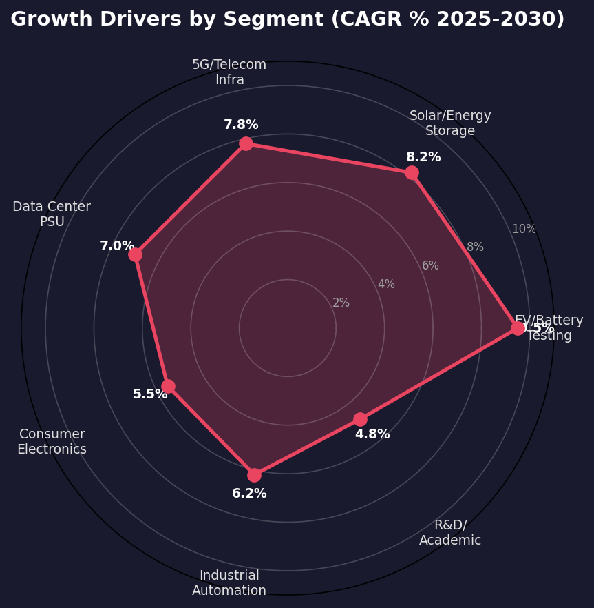
Growth Drivers & Technology Trends
Market Growth Catalysts
EV Battery Testing (CAGR 9.5%)
Global EV penetration rising from 18% to 35%+
Battery cell, module, and pack-level testing all need DC loads
Charging station compliance testing mandates grow
Solar + Energy Storage (CAGR 8.2%)
Residential storage boom: 100 GWh new installs expected by 2030
Micro-inverter and hybrid inverter testing requires 1kW range
5G Infrastructure (CAGR 7.8%)
5G base stations require 3x more power testing than 4G
Small-cell deployment driving volume demand
Tech Trend: Smart + Connected Test Equipment
Wi-Fi / BLE / LAN remote control becoming expected
Cloud data logging and AI-driven test automation emerging
Software-defined test instruments - update via firmware

Slide 6
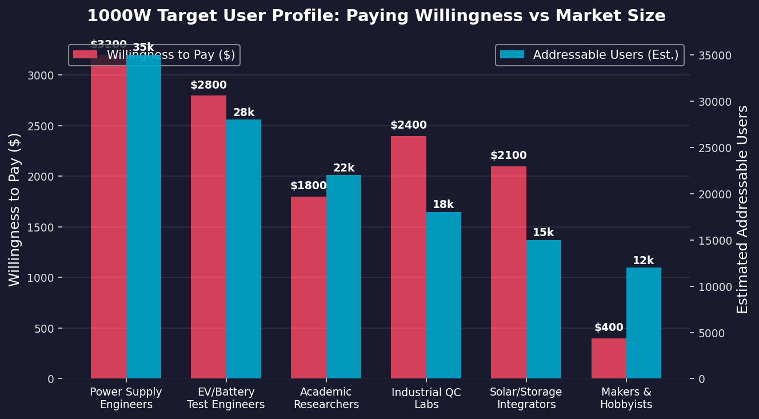
Target User Profile & Addressable Market
Primary: Power Supply Engineers (35k users)
Need: accurate, programmable, affordable 1kW load for PSU validation
Pain: Keysight budget rejected by management, ITECH not trusted
WTP: $1,500-3,500 | Total SAM: $80-120M
Secondary: EV/Battery Engineers (28k users)
Need: CC/CV/CP modes, battery discharge curves, data logging
Pain: Chroma too expensive for startup teams
WTP: $1,800-4,000 | Total SAM: $65-90M
Tertiary: Academic & Maker (34k users)
Need: affordable multi-channel loads for student labs
Pain: current options either junk or unaffordable
WTP: $400-1,500 | Total SAM: $20-35M

Slide 7
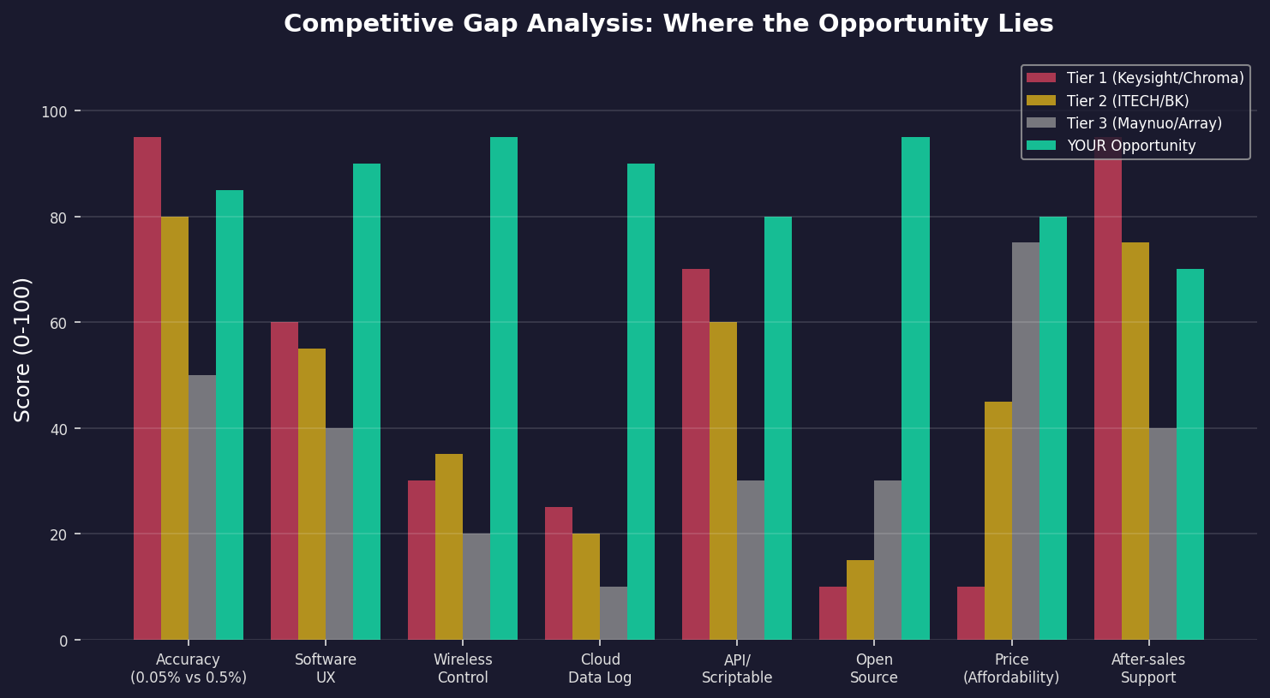
Opportunity Gap Analysis: Where to Compete
Conclusion: The biggest competitive window is in "Software UX + Connectivity + Price" — not trying to beat Keysight on raw accuracy.

Slide 8
Recommended Product Positioning
Positioning Statement
A 1000W programmable DC electronic load that delivers ITECH-grade accuracy at Maynuo-grade pricing,
with modern software (web UI, Wi-Fi, API-first) that makes Keysight s look 20 years old.
Target retail price: ¥3,999-5,999 (~$550-830) — undercutting ITECH by 30-40% with better software.
Hardware Spec Target
Power: 1000W continuous (1200W peak)
Voltage: 0-150V DC
Current: 0-60A DC
Accuracy: 0.1% ± 0.05% FS (on par with ITECH)
Modes: CC / CV / CP / CR + Battery Test
Protection: OTP / OVP / OCP / OPP / Reverse Polarity
Interface: USB-C + Wi-Fi 6 + BLE 5.0
Software Differentiators
Web-based control panel (no install needed)
REST API + Python SDK for automation
Cloud data logging & real-time dashboards
Firmware OTA updates via Wi-Fi
Multi-device synchronization (parallel loads)
Export data to CSV / JSON / Grafana
iOS / Android companion app
Go-to-Market Strategy
Phase 1: Open-source hardware design to build community
Phase 2: Crowdfunding (Kickstarter / zeczc) pre-sales
Phase 3: Direct e-commerce + AliExpress / Amazon
Phase 4: Distributor partnerships for B2B channels
Target: ship 500 units in first 12 months
Break-even at ~200 units at $699 ASP
Community = free QA, content, and word-of-mouth
Product Architecture Overview
MCU (STM32H7 / ESP32-S3) + FPGA (gate driver PWM) → MOSFET bank (8x IRFP250N parallel) → Active cooling
Isolated ADC (ADS1115) + shunt resistors → 16-bit current sensing → PID loop @ 10kHz → 0.1% accuracy target
Wi-Fi/BLE (ESP32-S3) + Web Server → REST API → Optional Cloud Sync → Companion App + CLI Tool

Slide 9
5-Year Financial Projection (Illustrative)
Year 1
Year 2
Year 3
Year 4
Year 5
Units Sold
200
500
1,200
2,500
5,000
Revenue (@$700 ASP)
$140K
$350K
$720K
$1.5M
$3.0M
COGS (@55% target)
$84K
$193K
$396K
$825K
$1.65M
Gross Margin (45%)
$56K
$157K
$324K
$675K
$1.35M
Investment Required
Hardware R&D (prototyping, PCB, BOM): $15,000-25,000
Software development (FW + web + app): $10,000-15,000
Certification (CE/FCC/3C): $5,000-10,000
Initial production run (200 units): $40,000-60,000
Total seed capital needed: ~$70,000-110,000
Break-even: ~200 units (within 12-18 months)
ROI & Exit Potential
Year 3 EBITDA: ~$250K (net after OpEx of ~$75K)
Valuation at Y3: 6-8x EBITDA = $1.5-2M (conservative)
Potential acquirers: ITECH, Rigol, Siglent (looking for SW talent)
Alternative: stay bootstrapped, 5-year cumulative margin >$2.5M
Kickstarter target: $50K (500 backers × $100 avg pledge)
China domestic market alone can support 5,000+ units/yr

Slide 10
Key Risks & Mitigations
1. Hardware Accuracy Claims
Risk: failing to deliver 0.1% accuracy kills credibility. Mitigation: partner with calibration lab during R&D; publish third-party accuracy reports; be transparent about limitations.
2. Thermal Management at 1kW
Risk: 1000W of heat dissipation is non-trivial. Mitigation: use actively cooled MOSFET bank with thermal feedback; over-engineer heatsink; auto-derating above 85C ambient.
3. Supply Chain / BOM Cost
Risk: component costs make $699 ASP impossible. Mitigation: use commodity MOSFETs (IRFP250N) in parallel; ESP32-S3 is $3; avoid exotic parts; design for manufacturability.
4. ITECH/Maynuo Price War
Risk: incumbents lower prices to crush you. Mitigation: compete on software & community, not just price; open-source creates stickiness; target niches they ignore (makers, startups).
5. Safety & Liability
Risk: 1kW DC load is dangerous if misused. Mitigation: multiple redundant protections (HW + SW); CE/FCC/3C certification; clear warning labels; liability insurance; open-source = shared responsibility.
6. Copycats (especially in China)
Risk: design gets cloned within 6 months. Mitigation: open-source IS the strategy — build the brand and community; clones validate the market; keep moving faster; software moat.

Slide 11
Next Steps: From Analysis to Action
Phase 1: Deep Dive (Weeks 1-2)
Phase 2: Architecture Design (Weeks 3-4)
Phase 3: Prototype (Weeks 5-8)
Phase 4: Crowdfunding Prep (Weeks 9-12)
Tear down 3 competitor products (IT8512+, M9713, 8602)
Benchmark accuracy, ripple, thermal performance
Interview 10 target users (engineers on Taobao, Zhihu, EEVblog)
Select MCU + MOSFET topology; run SPICE simulation
Draft schematics, BOM cost estimate, PCB outline
Write firmware architecture spec + web UI wireframes
Build 2 prototype units; test to destruction
Iterate on thermal design; validate accuracy claims
Publish open-source repo with design files and docs
Produce demo video with real-world testing scenarios
Set up supply chain for 200-unit production run
Launch Kickstarter / zeczc campaign
Questions? Next discussion: Product spec definition & architecture design
Thanks for reviewing. Let s build something that engineers actually want to use.

