Slide 1
EE523
Smart Alignment
Kevin Egedy

Slide 2
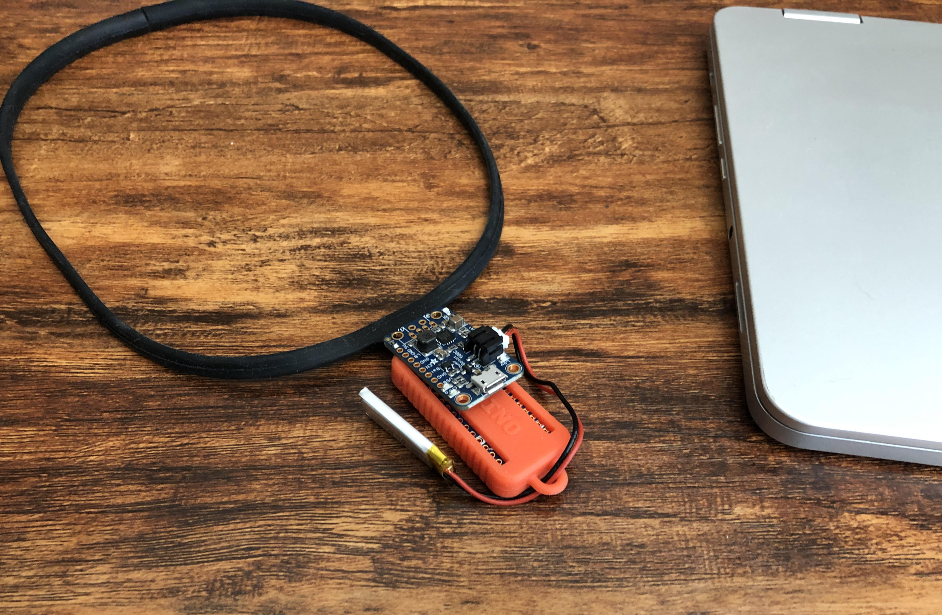
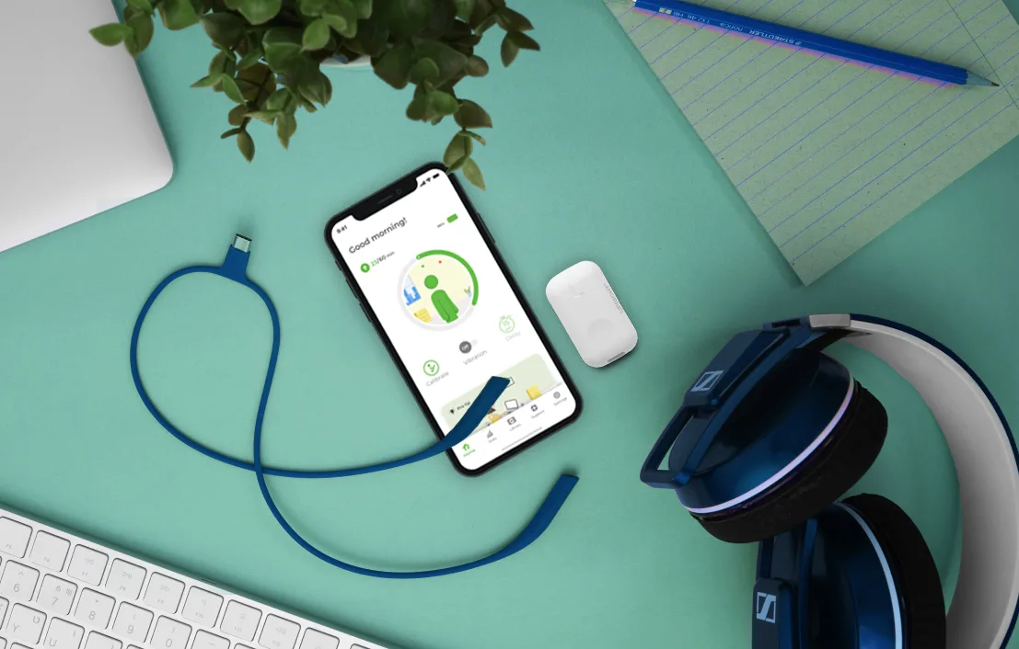

Smart Alignment
Smart alignment passively improves posture
by notifying the user’s spine curvature. This
product is based on existing uprightpose,
however it is composed of common devices
available through Arduino.
Smart Alignment
Upright

Slide 3
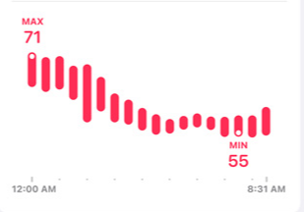
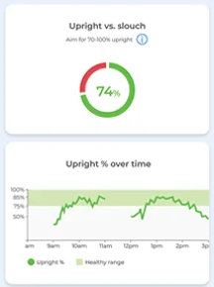
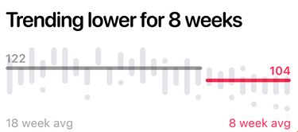
App Inspirations
Display health information to benefit the user.
Apple’s heart rate display
Pie chart comparing good vs bad posture
Apple
Upright

Slide 4
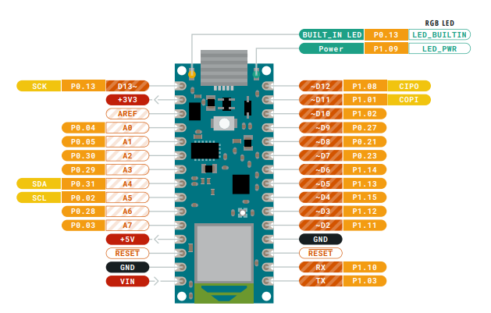
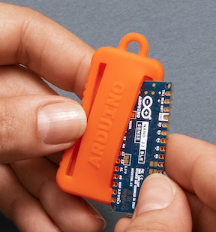
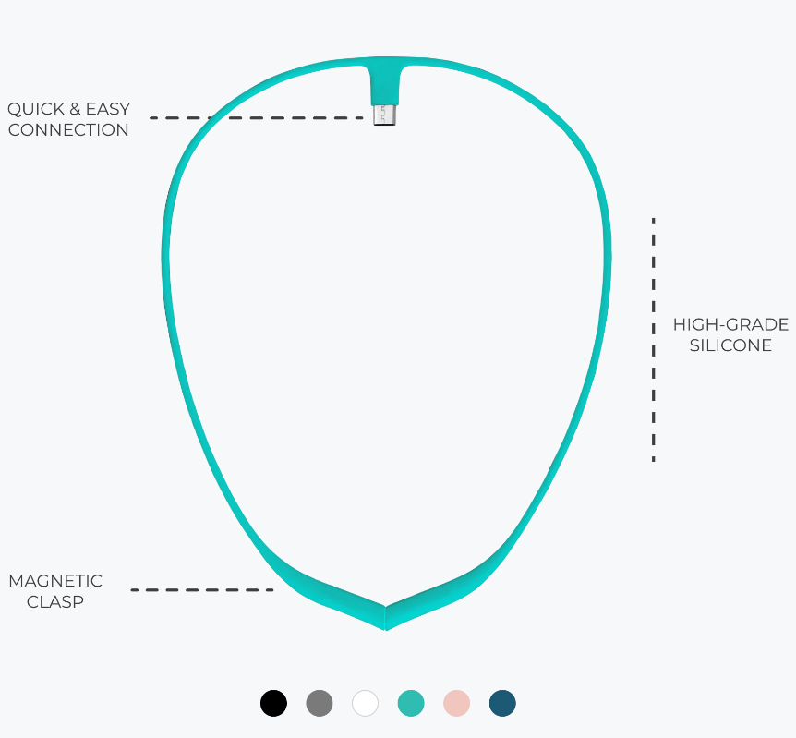
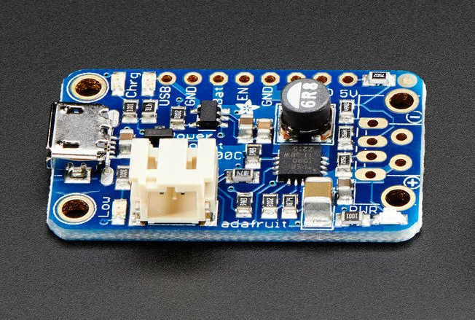
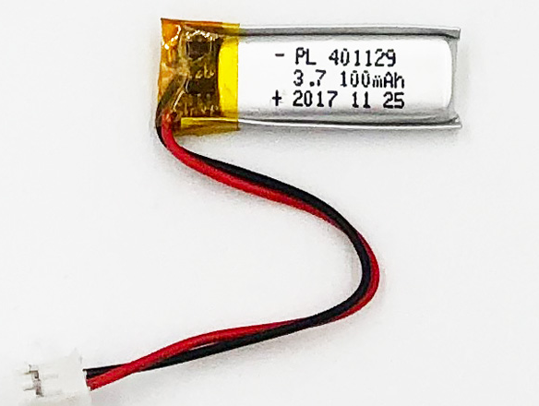
Components
Arduino Nano 33 BLE Pinout
Case
Necklace
5V Lipo Boost
100 mAh Lipo Bat
* INPUT-VIN: 4.5-21V

Slide 5
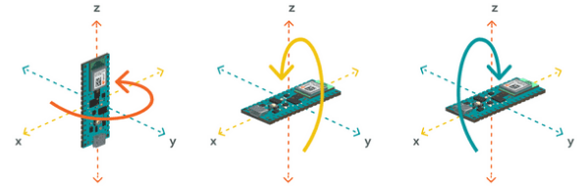
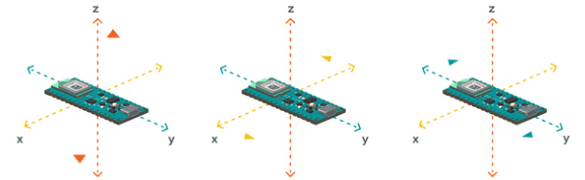
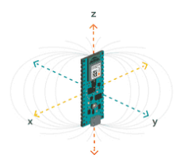
Sensors: 9-axis
Gyroscope
Accelerometer
Magnetometer

Slide 6
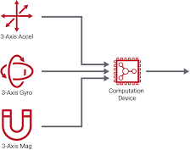
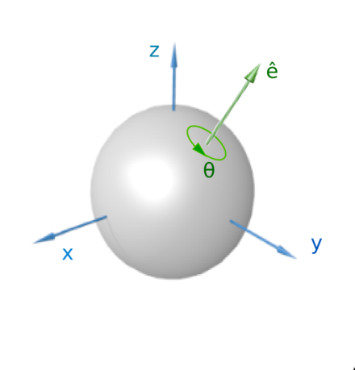
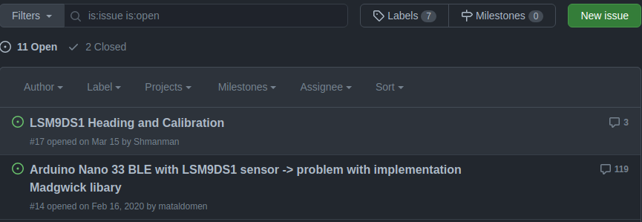
AHRS
Exact Orientation
AHRS (Altitude and Heading Reference System)
Determines orientation using
Mahony,
Madgwick,
NXP Fusion,
etc fusion filters.
Returns pitch, yaw, and roll
https://forum.arduino.cc/t/ble-sense-ahrs/636949
https://github.com/kriswiner/LSM9DS1/issues

Slide 7
Resources
Arduino Nano 33 BLE Pinout
Component | Library
 | Adafruit_SSD1306
Bluetooth Low Energy (BLE) | ArduinoBLE
 | LSM9DS1
 | AHRS
Android
https://github.com/android/connectivity-samples
https://punchthrough.com/android-ble-guide/

Slide 8
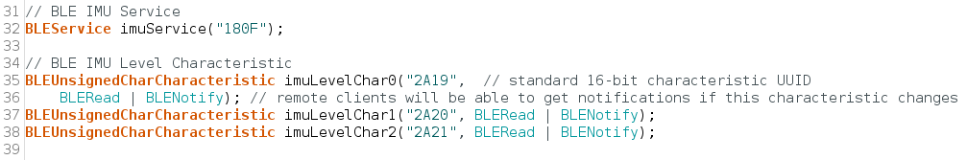
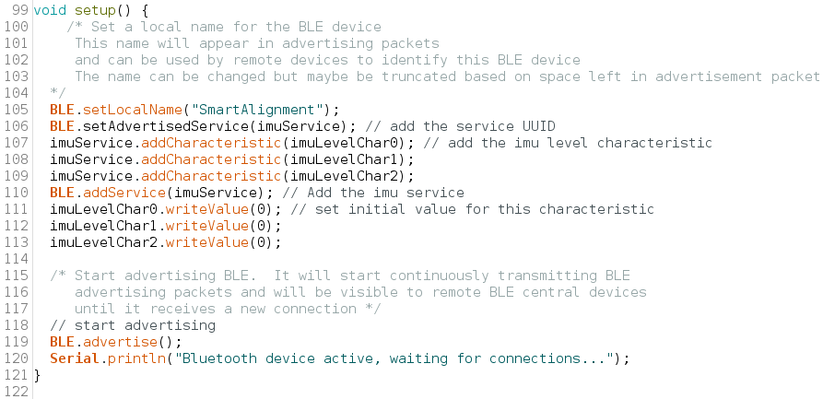
Demo: Arduino Nano 33 BLE

Slide 9
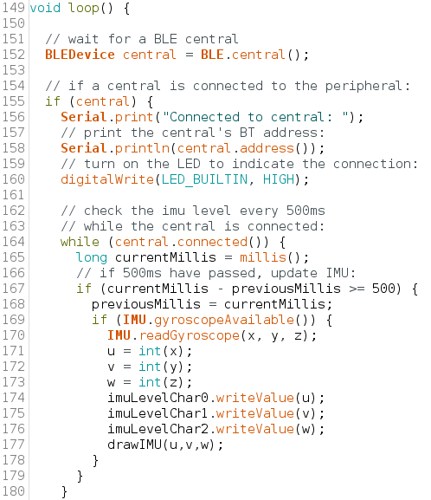
Demo: Arduino Nano 33 BLE
*Should not advertise indefinitely

Slide 10
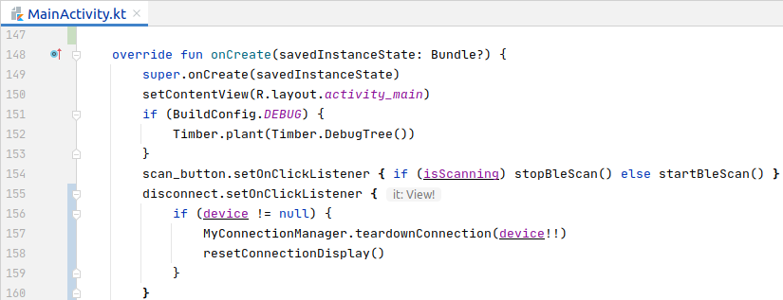
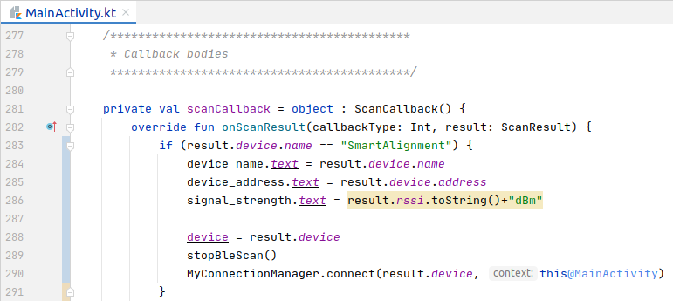
Demo: Android App
Button click listeners
scan_button: start/stop scanning
disconnect: end BLE connection to peripheral
Callback for BLE scan
Connect to gatt server

Slide 11
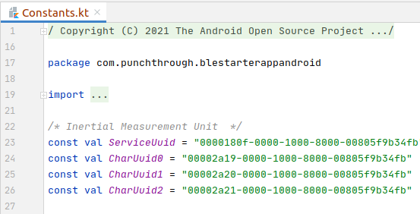
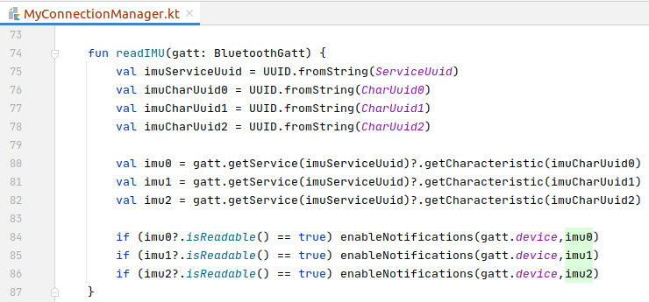
Demo: Android App

Slide 12
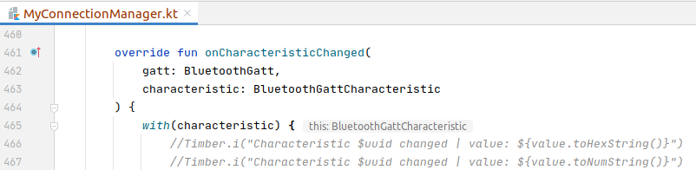
Demo: Android App
Callback for characteristic change
Update to sliding window and plot

Slide 13
Conclusion
Thank you!

