Slide 1
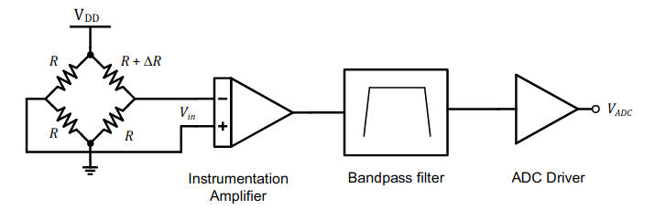
Strain-Gage Low Noise Signal Conditioning
Kevin Egedy
May 30, 2020

Slide 2
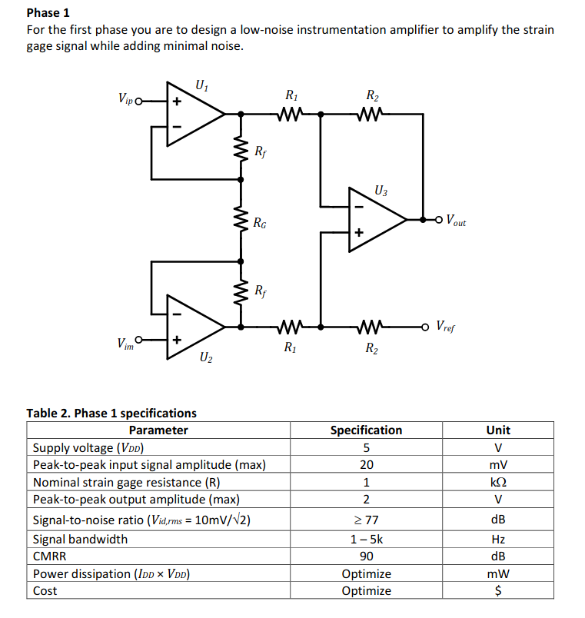
Instrumentation Amplifier Specs

Slide 3
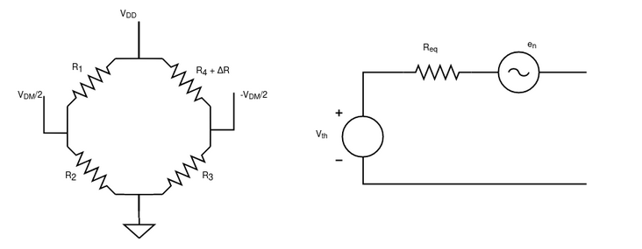
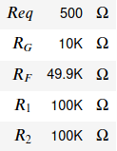
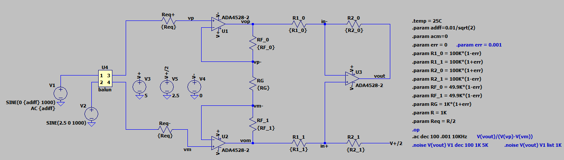
Strain-Gage Thevenin Eq. + Instrumentation Amp.
Strain-Gauge
Ideal Sources
5.0 V Single-ended power supply
2.5 V Single-ended power supply
Precision Amplifiers
ADA4528: e_{n} = 5.6nV, i_{n} = 0.7pA

Slide 4
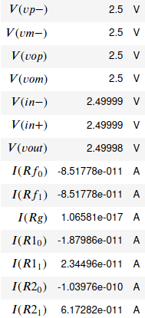
DC Operation: 192 Resistor Series (0.1% tolerance)

Slide 5
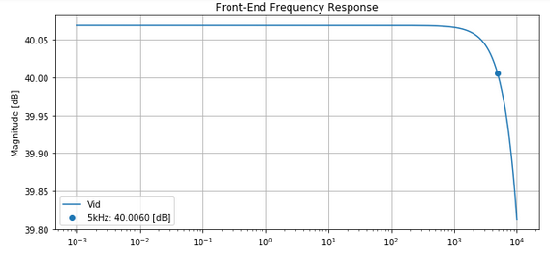

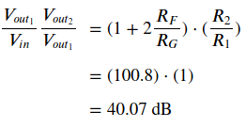
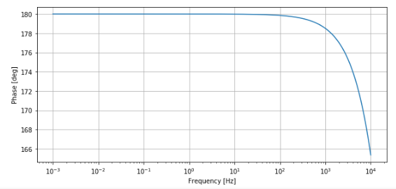
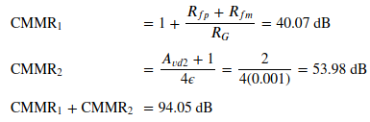
Front-End Frequency Response
Target
Actual
CMMR

Slide 6
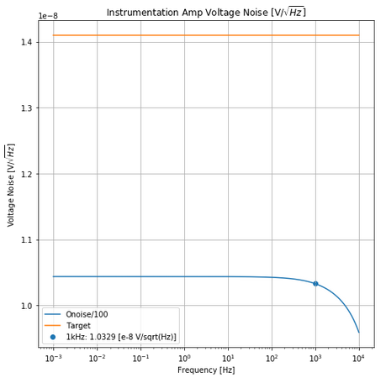
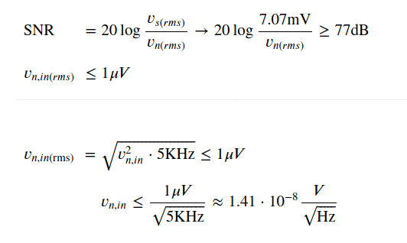
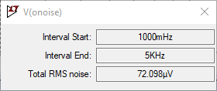
Input-Referred Noise Target
ADA4528: e_{n} = 5.6nV, i_{n} = 0.7pA
Integrated noise from 1Hz to 5kHz is 72.1 uV.

Slide 7
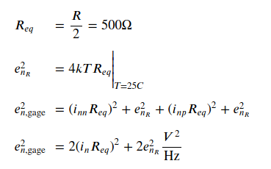

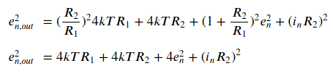

Noise Sources
ADA4528: e_{n} = 5.6nV, i_{n} = 0.7pA
Strain-Gage Noise: 1.67 * 10⁻¹⁷ V²/Hz
Gain Stage: 3.69 * 10⁻¹⁵ V²/Hz
Difference Amp Inverting: 8.32 * 10⁻¹⁵ V²/Hz
Difference Amp Non-Inverting: 8.23 * 10⁻¹⁵ V²/Hz

