Slide 1
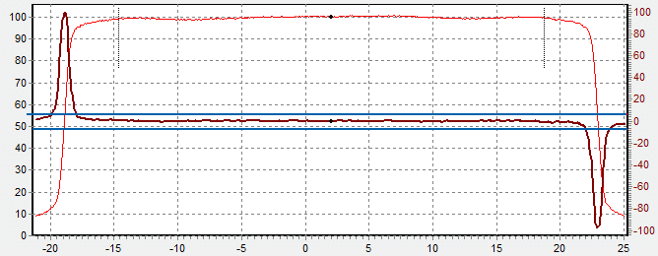
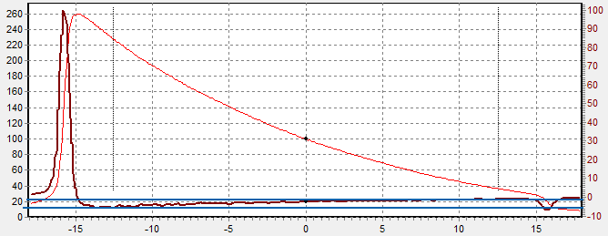
A general approach for field size detection
Take derivative
Calculate histogram
Define “dead band” around largest bin
Any maximum and minimum should be outside dead band and occur with only one crossing of the dead band.
Perform second order polynomial fit on peaks.
The position of maximum resp. minimum defines x_{edge}
Optionally: fit sigmoid function around found edge Note: the inflection point, found with both methods, generally does not represent x_{50%}
If x_{50%} differs “too much” from x_{edge} then use x_{edge}
The method is stable for wedged fields and wide FFF fields where the 50% position clearly is not representative.
Reliably rejects missing penumbra’s
No assumptions on field size needed
Using more data with a good model decreases uncertainty: incorporated data linear fit < peak fit < sigmoid fit

