Slide 1
Ontwikkelingen BistroMath
Theo van Soest, 15 oktober 2020
Notes:
Let op: dit is een project waar bijna alle collega’s mee of minder hun rol in hebben (gehad)

Slide 2
Status en toekomst
Tot en met versie 3.30.x geschreven in Borland Delphi7.
Delphi7 is verouderd, code daarom niet toekomstbestendig.
Alternatief: Lazarus, open source Pascal ontwikkelomgeving.
Conversie naar Lazarus duurt lang, besteedbare tijd beperkt.
Conversie analysemodule af in zomer 2019, bedieningsmodule moet opnieuw opgezet worden.
Dankzij Corona-crisis ineens veel tijd beschikbaar.
Status van BistroMath in QMS onzeker; consequenties groot.

Slide 3
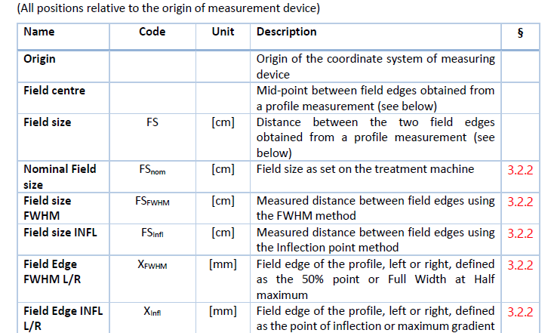
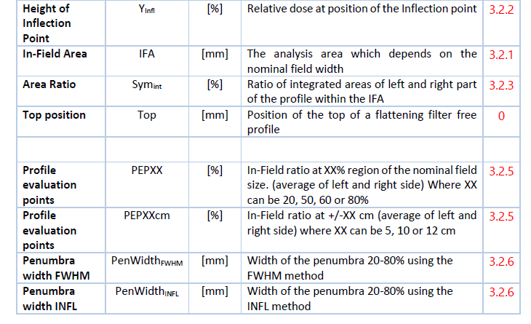
Prepublicatie NCS-33, juli 2020

Slide 4
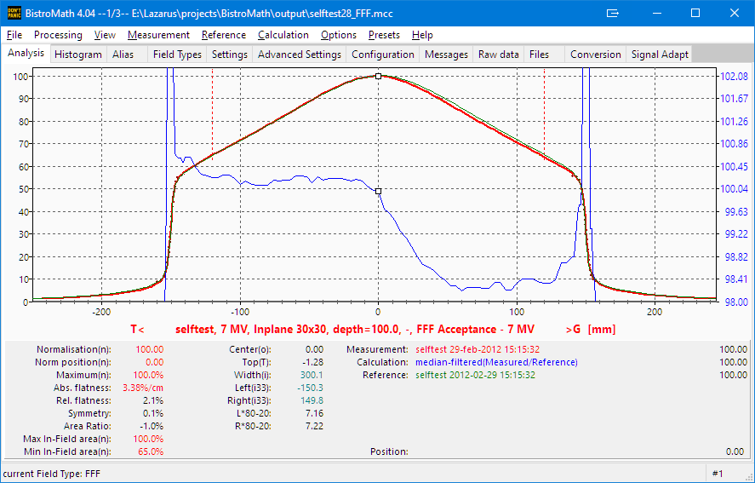
NCS-33 (juli 2020): inflectiepunt en penumbra
FFF: veldgrens m.b.v. inflectiepunt (D_{rel,infl}=33% in dit voorbeeld)
“80” = 80*33/50=52.8; “20” = 20*33/50=13.2)

Slide 5
Klinische versie 3.30.x
Ontwerp in Delphi bevroren op versie 3.30 (december 2018).
Reparaties en kleine toevoegingen in subversies.
Verbeteren en uitbreiden help-bestand.

Slide 6
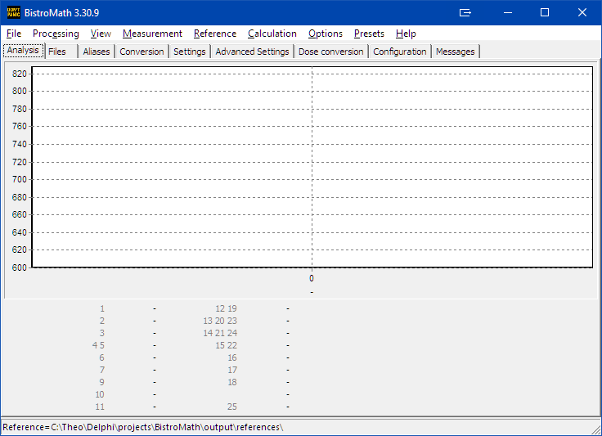
Datapresentatie configureerbaar (≥ v 3.20)
Locatie van alle presentatieregels

Slide 7
Presentatieregels (1): voorbeeld
Code bevat standaard-set.
Standaard-set kan geëxporteerd worden als configuratie.
Simple Mode (“cond:s”) niet in standaardregels (≥ v3.30.9).
[PanelElements] sep=, add=0 doc=v(build),id,curve sel,eval.type,multiplier,errorval,"label",deci,unit,col,row,mod,energy,
scan type[,cond:-][,annot:-][,color:-] 12=v623,12,-1,c,1,9e9,"Center",2,,1,0,XEPO,0,H,annot:!rzcCS 1=v650,1,-1,n,1,0,"Normalisation",2,,0,0,XEPO,0,A,annot:rcnS,cond:s 7=v607,7,-1,s,1,0,"Symmetry",1,%,0,5,XEPO,0,H,annot:rzs 20=v650,20,-1,P10,100,-1,"-",2,,1,1,XP,0,V,annot:!rfRS*,color:n

Slide 8
Presentatieregels (2): uitgebreide help
Rule list format
Each rule consists of a series of values separated by a delimiter. The default delimiter is a comma (","). This may be changed at any time and will be used for all following rules.
;changing the delimiter
sep=,
;adding to existing rules (1) or start from scratch (0)
add=1
Therefore the general format is:
unique_ident_string=item{delimiter}item[{delimiter}item]
As ident for each rule is the id-number taken, but it can be any text except "sep“, “add” and "doc". The current setup of a rule is given by the "doc" string.
doc=v{build},id,curve sel,eval.type,multiplier,errorval,"label",deci,unit,col,row,mod,energy,scan type[,cond:-][,annot:-][,color:-]

Slide 9
Presentatieregels (3): evaluation type
evaluation type
The currently supported evaluation data types are listed below. These are used in both Results panel rules and special modes. In the first route only a single parameter per position on the Results panel can be used. Special modes allow to combine these parameters. Each evaluation type is called with a case sensitive single letter.
EvaluationXtypes = ['a','b','c','d','D','e','F','f','G','i','L','l','M','m','N','n','p','q','P', ‘r',’R', 's','S', 'T','u','w','X','x','Y',#0];
Parameters with the exclamation symbol (!) have a left and right result. Therefore the left result is obtained as "-{evaluation type}" and the right results as "+{evaluation type}". When no sign is given the result will be the average of left and right value.
a Area ratio based on user's choices for center position
wSource[Xsource].twSymAreaRatio
! b Border position based on edges user choices
wSource[Xsource].twLevelPos[twUsedEdgeLevel].Penumbra[side].Calc;
c Center position as defined by user's choices
wSource[Xsource].twCenterPosCm as defined by choices
d Relative flatness
wSource[dsCalculated].twFlatness*100

Slide 10
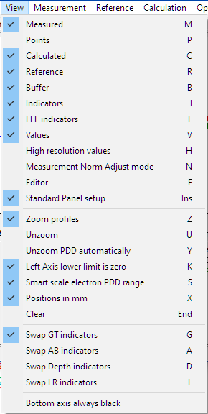
Presentatieregels (4): terug naar basis
Exporteer regels zonodig opnieuw.

Slide 11
Koppeling met meetformulier via prikbord (1)
Zet SpecialMode2 aan.
Configureer SpecialMode[2]-parameters.
Evaluatie-types gelijk aan presentatieregels.
BistroMath zal nu steeds een lange tekstregel op prikbord zetten.
Meetformulier bevat knoppen om zo’n regel van prikbord te pakken en te interpreteren.

Slide 12
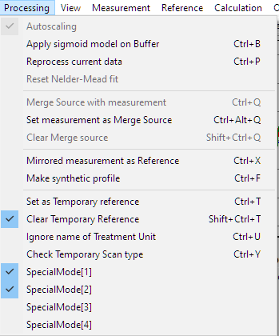
Koppeling met meetformulier via prikbord (2)
Configuratievoorbeeld
[AnalyseForm]
SpecialModeItem2=1
[SpecialModes]
;number of decimals
SpecialMode[2]Float[1]=4
;profiles, non-wedged
SpecialMode[2]String[1]=b,c,-b,+b,-i,+i,i,-e,+e,e,d,f,s,L,a,w,-p,+p
;wedge detection symmetry value
SpecialMode[2]Float[2]=1.1
;export to clipboard
SpecialMode[2]Float[3]=1
;wedged profiles
SpecialMode[2]String[2]=b,c,-b,+b,-E,+E,d,w,

Slide 13
Koppeling met meetformulier via prikbord (3)
Voorbeeld van uitvoer (als één lange tekstregel).
BistroMath,analysis-time=11-1-2020 13:14:44,date=20120301,time=14:33,file=default.txt, linac=selftest,modality=X,energy=6,wedge=0,scan=c:A->B,scale=mm,depth=50.0,field=400x400, b=20.1875,c=20.1875,-b=-189.1370,+b=229.5120,-i=-188.8177,+i=229.1287,i=20.1555, -e=-188.4922,+e=229.2276,e=20.3677,d=0.7056,f=2.0064,s=100.8511,L=0.5092,a=0.3855, w=418.6489,-p=7.3563,+p=7.3554,-u=-188.6448,+u=229.0097,u=20.1825
b: 50%-veldgrenzen
e: edge (maximumpositie eerste afgeleide)
i: sigmoïd-analyse (buigingspunt)
u: users dose-veldgrenzen (hier 53%)

Slide 14
Versie 3.30.20 (01/07/2020)
All these changes are also incorporated in the upcoming version 4.00.
New: An extra option is added to the file menu to save also the filtered version of a curve (if available).
New: In the Processing menu an option is added to apply the calculated sigmoid fit to a copy of the measurement in the Buffer curve. This might be convenient to observe the results of the sigmoid fit.
New: The clipboard observer now ignores text data which start with "BistroMath" or are less or equal the configurable value MinClipBoardBytes.
New: Clicking on values in the Results panel will copy the result to the clipboard.
Major design change: The separate editor window is replaced by a raw data tab.
Minor design change: Due to discontinued support for 80 bit floating point values on Windows10/64, in this version a discretisation is built in the way BistroMath decides which points to use for the quadratic filtering and first derivative. Although the calculation differences are far beyond clinical relevance, this effect can change on a random basis which points to include. It will have some influences on field borders, at most 0.03 mm in the supplied test data. This new discretisation will also be used in the upcoming version 4 and therefore will show exactly reproducible result compared with this version. [v17]

Slide 15
Versie 4.00, 28/08/2020 (1)
All changes, most of them initiated in the porting process, as published in v3.30 and subversions are ported to version 4.00.
Due to the deprecated support of the x87 math processor in Windows10/64bits exact reproduction with previous versions before 3.30.18 is not possible.
New: The sigmoid model may be used as alternative to calculate 50% border positions. Also the inflection point is more precise calculated as the derivative function which amplifies the noise by its nature.
New: The profile value at a position as percentage of the border to center of field (Profile Evaluation Point) is introduced as evaluation type "r" / "R" for the results panel and specialmode2.
New: In the viewing menu an Auto Unzoom item is added for FFF profiles.
New: The right axis can be linked to the grid.
New: A pdf print of the current window.
New: In the Result Panel rules two new conditions (N=Standard field type, S=Small field type, see below) and field size limits are introduced.
Changes in configuration file: a lot of elements were renamed. Backward compatibility is guaranteed with on-the-fly conversion. See configuration issues.

Slide 16
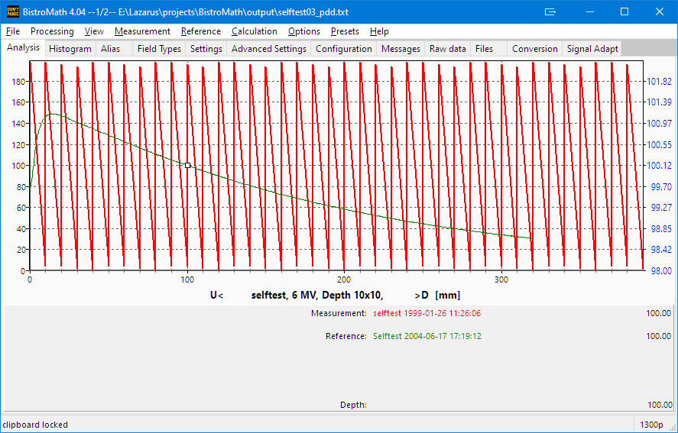
Versie 4.04,14/10/2020 (2)
Minor design change: The statusbar is now split in two parts. At the right side the confirmed scan number in a multi scan file is shown; for a single data set the number of measurement points.
Design change: Edge annotations which reflect the primary edge definition can be suppressed.
Design change: A new information type is introduced: the Field type. This replaces the (unnamed) default, Wedge and FFF characteristic with the new Field types Standard, FFF, Small, MR-linac and Wedge.
Introduction of inflection point based penumbra width.
Design change: The annotation for edge values based on the sigmoid inflection point is changed from s to inn, where nn is the actual dose level. A new 50%-level based on sigmoid analysis with annotation s is introduced. The evaluation types for these choices are 'i' and 'I' respectively. The sigmoid may also be used to find the position at user's level (evalution type 'U’).
A History List is introduced.
New: A Field Type Electrons is introduced.
New: Legacy support for oddly formatted numbers.

Slide 17
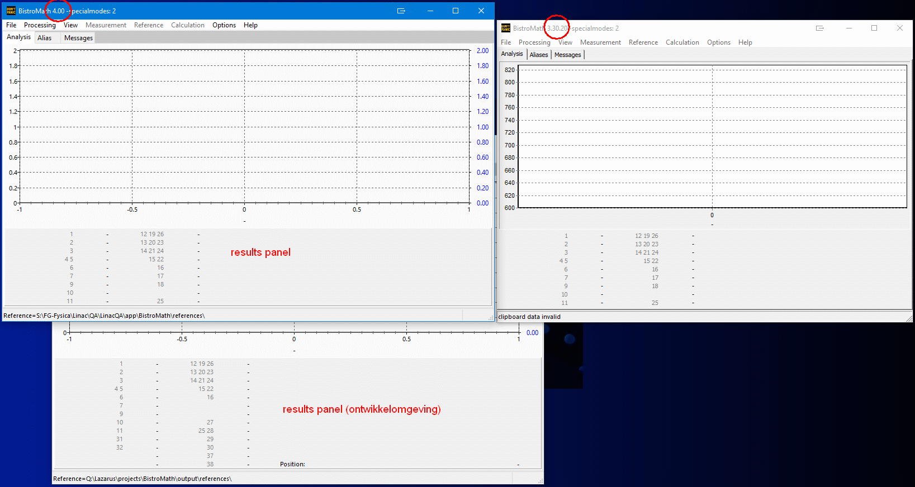
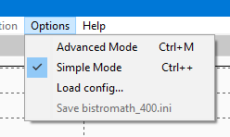
Advanced mode : uit
Simple Mode : aan

Slide 18
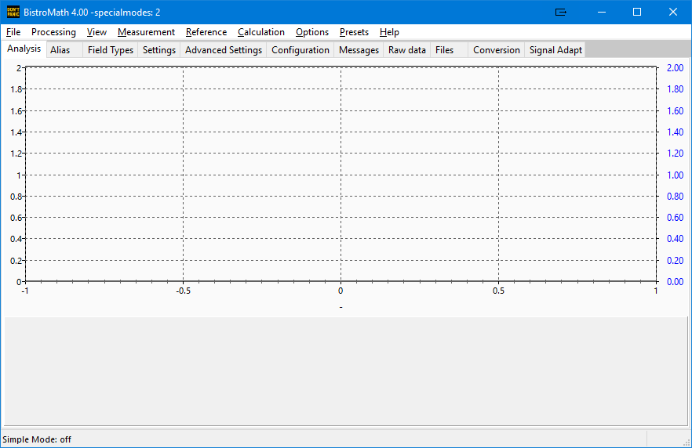
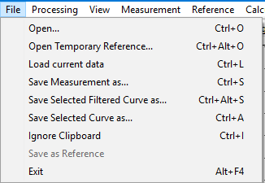
Advanced mode : aan
Simple Mode : uit

Slide 19
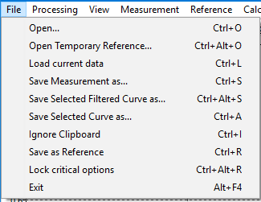
Advanced mode : aan
Simple Mode : uit

Slide 20
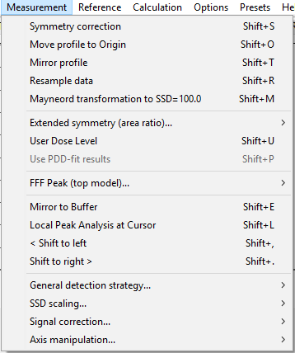
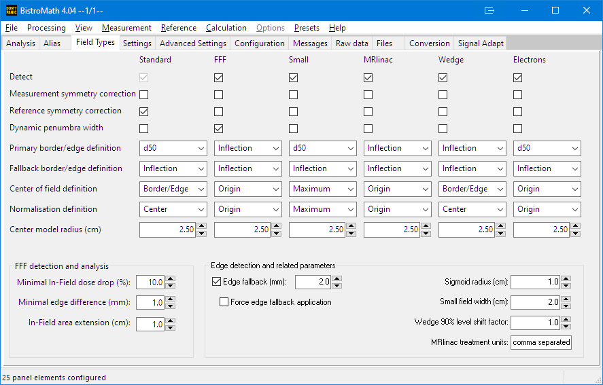
Measurement menu veel kleiner: Field Types tab

Slide 21
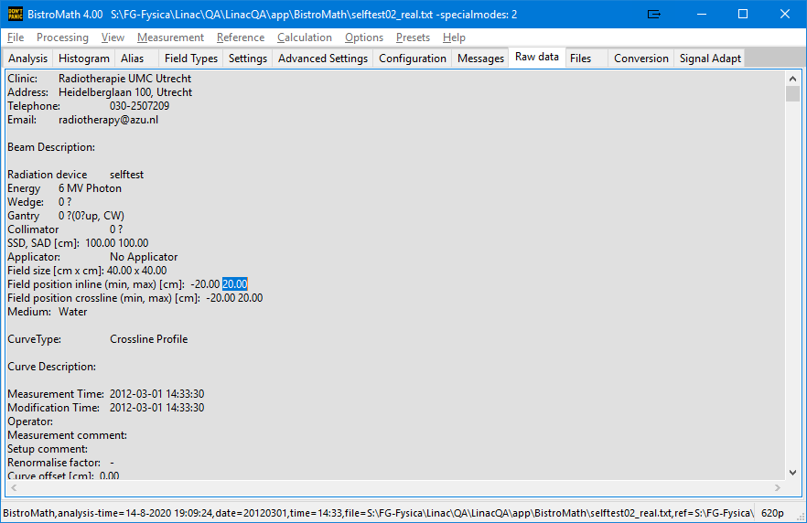
Tekst (en dus data) wijzigbaar

Slide 22
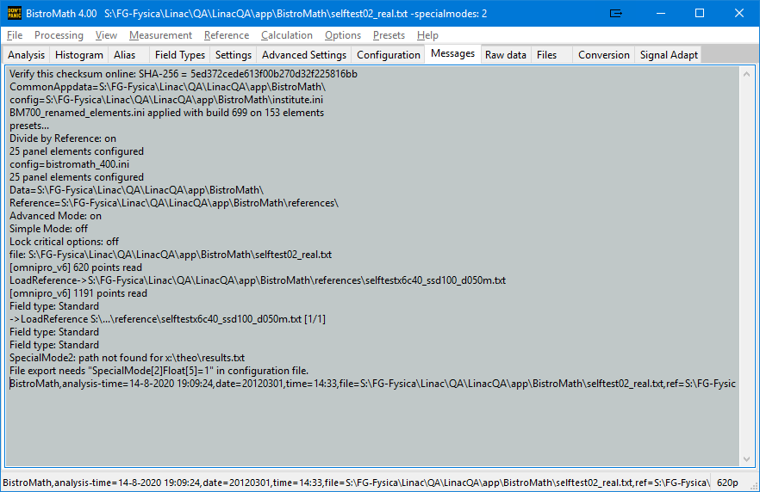
Wanneer een referentie niet laadt is hier meer informatie te vinden.

Slide 23
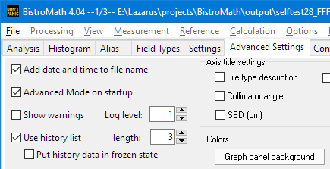
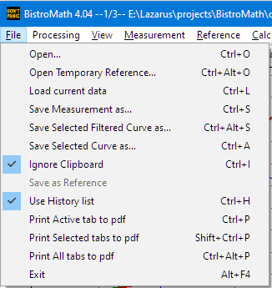
History List
Eigenschappen van lijst:
Lijst gedraagt zich cyclisch.
Meest recent geladen data heeft nummer “1/nn”; een hoger nummer geeft dus een grotere “afstand in tijd”. De oudste data worden als eerste vervangen (als de lijst vol is).
Bij bladeren door de lijst (<Ctrl>+<PageUp/Down>) wordt alles herberekend.
Een tijdelijke referentie wordt “meegenomen” tijdens het bladeren.
Bij bevroren data blijft alles in oorspronkelijke staat tijdens bladeren.
De bevroren-status kan op willekeurig moment in- of uitgeschakeld worden.
Elke dataset heeft zijn eigen analyse-object, inclusief ruwe data. Geheugengebruik mogelijk relevant.
gekoppeld

