Slide 1
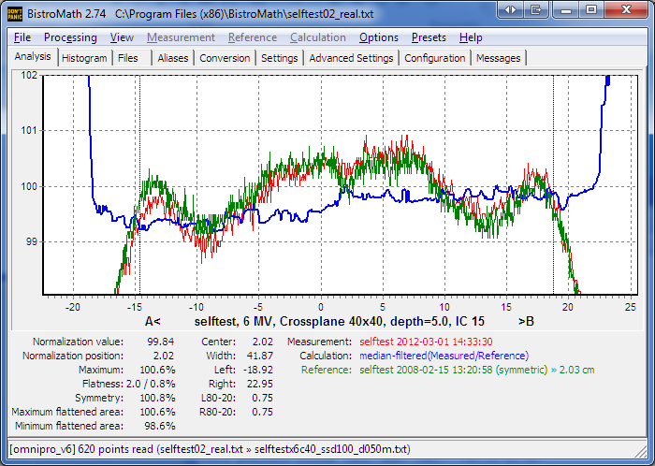
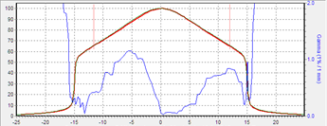
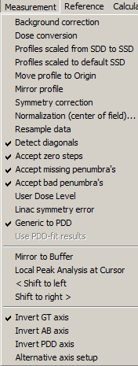
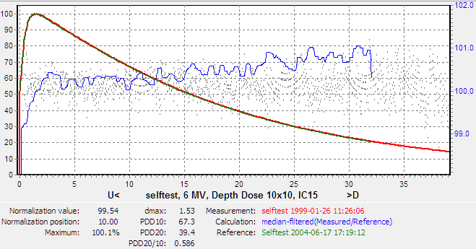
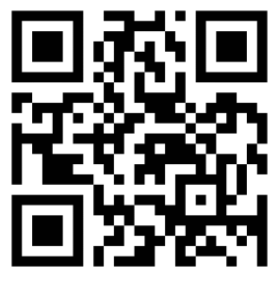

A general software tool for the analysis of profiles and depth dose curves
PO-0872
T.L. van Soest , J.W.H. Wolthaus
Objectives
For non-flattened beams, like FFF, QA-criteria need to be defined.
We explored methods for an easy evaluation of different beam criteria for water phantom data, using baseline reference profiles.
measurement
Is imported as file or
grabbed from clipboard.
normalisation
By default done on
calculated centre of field.
reference
Is automatically taken
from library.
ratio
Is calculated as
measurement/reference.
absolute and relative flatness
Based on flattened area
as derived from field borders, SSD and depth.
assymetry of reference
By default correction of
average slope.
reference
Shifted towards measurement
Currently reads 15 file formats from all major vendors.
works also for FFF beam
Measurement options
Flexible and configurable.
“bad” penumbra
Field position data in deviant color calculated from
first derivative as fallback method.
Error presented as gamma analysis
Optionally both data sets are used for a
gamma calculation.
Detailed insight in energy deviations from reference beam.
Residual noise of fit.
Separate and configurable
normalization for both graph and calculation. Can be made fully compliant with local dosimetry setup.
Conclusions
Based on a conventional approach new concepts are added, like relative flatness and relative depth dose (RDD) as alternative for PDD, using baseline references. This approach can also be used for 2D-arrays. Flexible configuration makes the tool compliant with institution policies.
BistroMath, (http://bistromath.nl) can handle beam data of all major vendors, automatically comparing these with stored reference data.
It is routinely used in the UMC Utrecht, freely available and not related to any commercial party.
T.L.vanSoest@umcutrecht.nl

