Slide 1


2019
Functions and Lambdas in Kotlin
logo

Slide 2
01
Functions
02
Lambdas
CONTENTS
03
Inline Functions

Slide 3
01
Functions

Slide 4
Function declaration
Declaration
Example
Parameter
Functions in Kotlin are declared using the “fun” keyword
fun getSum(x : Int, y : Int) : Int{
return x+y
}
Parameter ( name : type), Parameter are separated using commas. Each parameter must be explicitly typed

Slide 5
Function usage
Function can be called in 2 ways:
1. Positional
sum(1,2) // a = 1, b = 2
2. name argument
sum(a = 1, b = 2) // a = 1, b = 2
sum(b = 2, a = 3) // a = 3, b = 2
Note: when function is called with both ways, all the positional arguments should be placed before the first named one.
sum(1, b = 2) // ok print 3
sum(a = 2, 1) // error

Slide 6
Default argument
Default argument is default value of parameter, which are used when a corresponding argument is omitted.
fun getSum(a : Int = 0, b : Int = 0) : Int {
return a + b
}
Print( getSum(2,3)) // print 5
Print( getSum(3)) // a = 3, b =0 => print 3
Print( getSum(b=2)) // a = 0, b = 2 => print 2

Slide 7
Default argument
Default argument allow for a reduced number of overloads method compared to java.
Java:
public in getSum(int a, int b){ return a+b}
public int getSum(int a){ return a+10}
public int getSum(int b){ return b+10}
kotlin:
Fun getSum(a : Int = 10, b : Int = 10){
return a+b
}

Slide 8
Override method
Override methods always use the same default parameter values as the base method.when override a method with default parameter values, the default parameter values must be omitted from the signature:
open class A {
open fun getSum(a : Int = 0, b : Int = 0) : Int {
return a + b
}
}
class B : A {
Override fun getSum(a : Int, b : Int) : Int {
return a + b
}
}

Slide 9
Single-expression Function
Single-expression function is a function which return only 1 expression. The curly braces of this function can be omitted and the body is specified after a “=“ symbol :
fun getSum(x : Int = 0, y : Int = 0) : Int = x + y
Explicitly declaring the return type is optional :
fun getSum(x : Int = 0, y : Int = 0) = x + y // still ok

Slide 10
Variable number of argument ( Varargs)
A function’s parameter may be marked with varargs allowing a variable number of arguments to be passed to the function
fun getSum(vararg numbers: Int): Int {
var sum = 0
for (n in numbers) {
sum = sum + n
}
return sum
}
print(getSum(1,2,3)) // print 6
print(getSum(1,2,3,4,5)) // print 15
Inside function, numbers has type array<Int>

Slide 11
Variable number of argument ( Varargs)
In function, only 1 parameter may be marked as varargs
fun getSum(vararg numbers: Int, vararg strings: String): Int {// error
var sum = 0
for (n in numbers) {
sum = sum + n
}
return sum
}

Slide 12
Variable number of argument ( Varargs)
If a vararg parameter is not the last one, values for the following parameters can be passed using named argument syntax.
fun getSum(vararg numbers: Int, a :Int = 0, b : Int = 0): Int {
var sum = 0
for (n in numbers) {
sum = sum + n
}
return sum + a + b
}
print(getSum(1,2,3,4,a = 1, b = 1)) // print 1212
print(getSum(1,2,3,4,a = 1)) // print 11

Slide 13
Infix notation
Functions marked with the infix keyword can be called without the dot and the parentheses.
Infix functions must be satisfy the following requirements:
- Must be member function or extension functions
- Must have single parameter.
- Must not accept varargs and must have no default value
infix fun Int.isGreater(number : Int) : Boolean = this > number
Print(1 isGreater 2) // false
Print(2 isGreater 1) // true

Slide 14
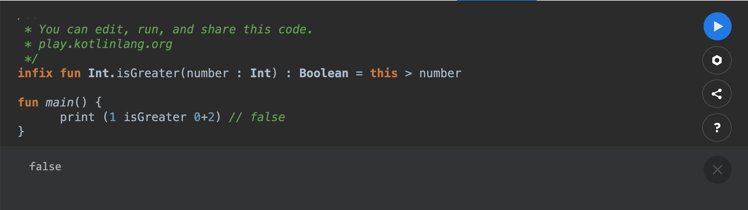
Infix notation
Infix functions have lower precedence than the arithmetic operator and type casts .
Arthmetic operator:

Slide 15
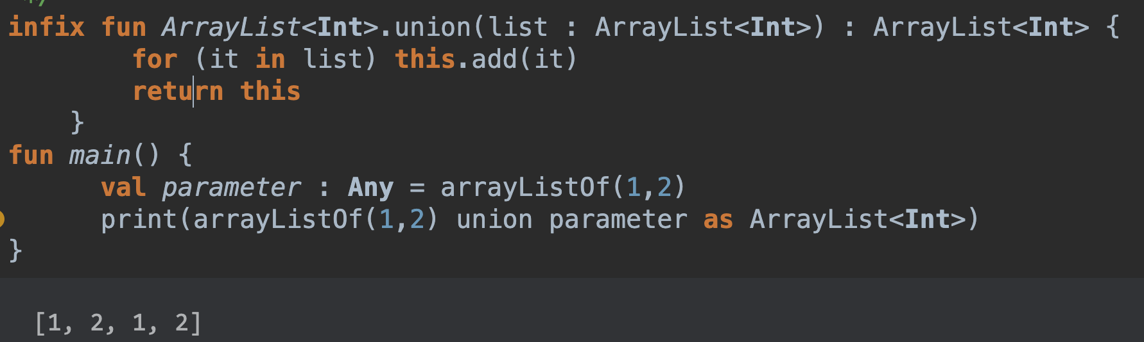
Infix notation
Infix functions have lower precedence than the arithmetic operator and type casts operator.
Type casts operator:

Slide 16
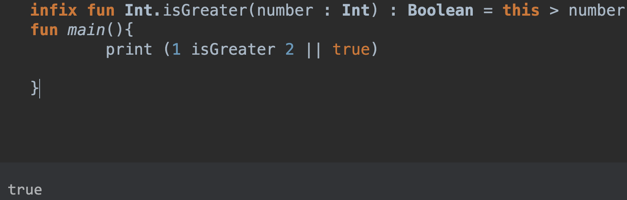
Infix notation
Infix functions have higher precedence than the boolean operator && and ||

Slide 17
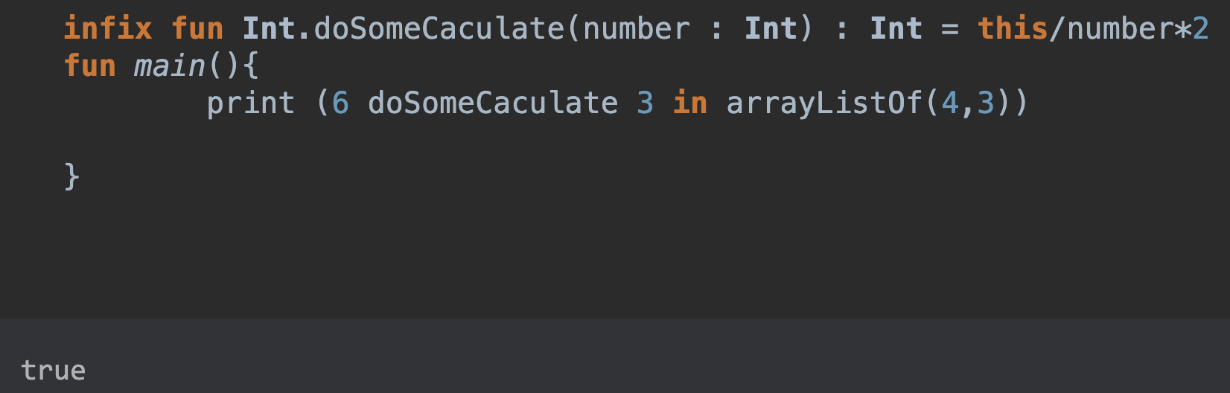
Infix notation
Infix functions have higher precedence than the boolean operator
Is, in

Slide 18
Functions
Local function
Member function
Generic function
Extension function
High-order function
Inline function

Slide 19
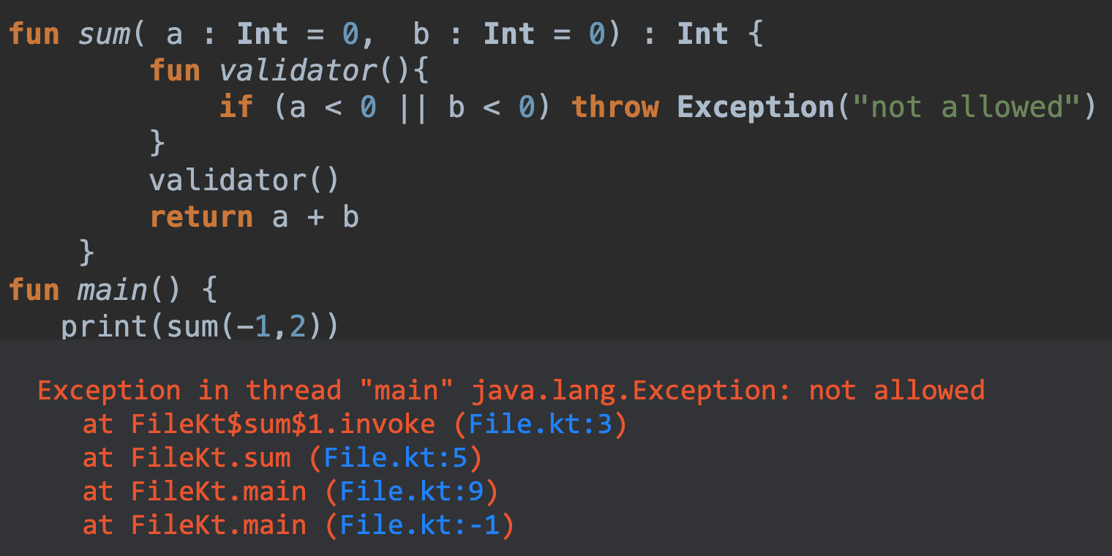
Local function
Local function is a function which declared inside other function, it can access local variable or parameter of outer function

Slide 20
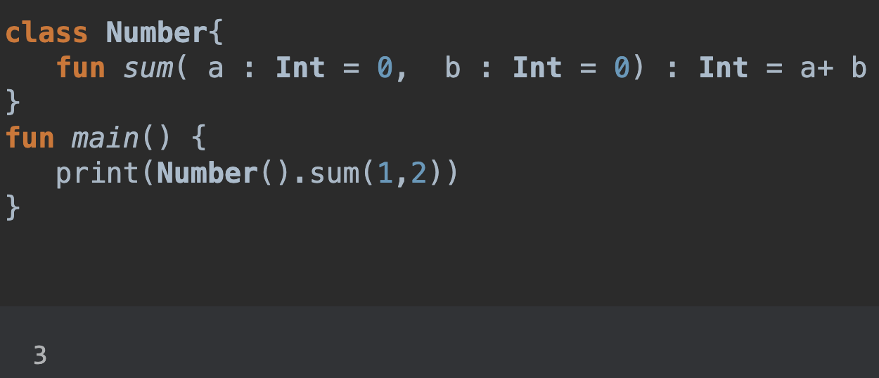
Member Function
Local function is a function which declared inside a class or object

Slide 21
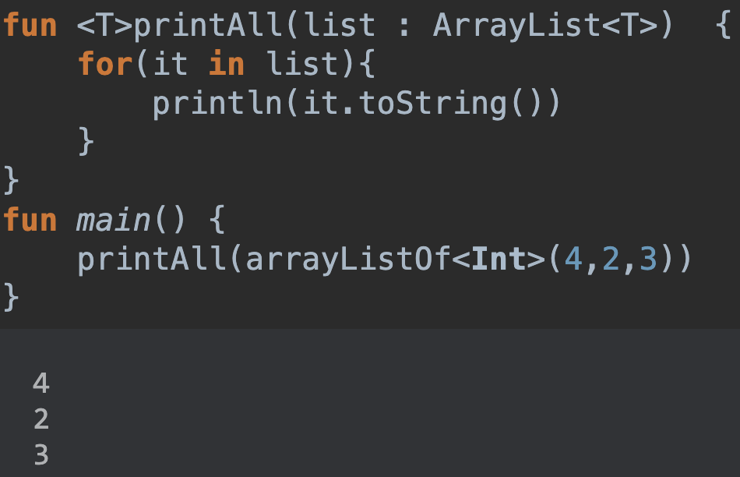
Generic Function
Function can have type parameters. Type parameters are declared before the name of the function.

Slide 22
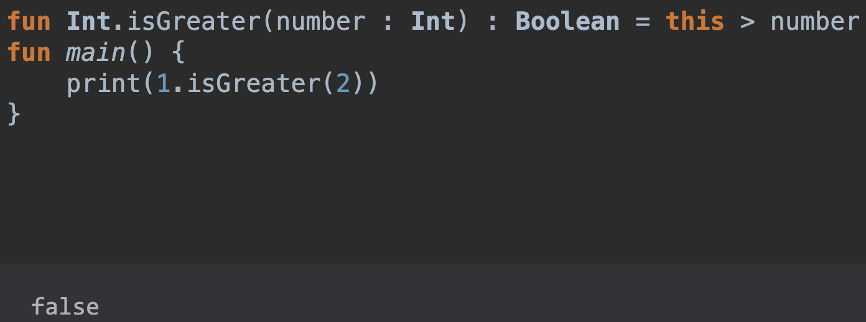
Extension Function
Kotlin provides the ability to extend a class with new functionality without having to inherit from the class or use any type of design pattern.

Slide 23
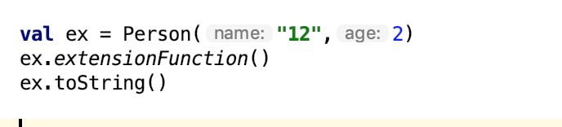

Extension Function
Extensions do not add a new member function into a class.

Slide 24
Extension Function
Extensions are resolved statically

Slide 25
02
Lambdas
Lambda function là các hàm không có tên. Chúng thường được sử dụng như các tham số để truyền vào 1 hàm khác . Lambda function còn có thể được biểu diễn dưới dạng các biến

Slide 26
Chúng ta sử dụng cú pháp sau để khai báo:
val lambdaName : Type = { argumentList -> codeBody }
val message = {
str:String->
println(str)c
println("End lambda function")
}
message(“sexy” ) //in ra : sexy
// End lambda functionaa

Slide 31

ADD YOUR TITLE
2014
2015
This PPT template for the rice husk designer pencil demo works, focusing on the production of
This PPT template for the rice husk designer pencil demo works, focusing on the production of
2016
2017
This PPT template for the rice husk designer pencil demo works, focusing on the production of
This PPT template for the rice husk designer pencil demo works, focusing on the production of

Slide 32

ADD YOUR TITLE
2020
This PPT template for the rice husk designer pencil demo works, focusing on the production of
2021
This PPT template for the rice husk designer pencil demo works, focusing on the production of
ADD YOUR TITLE
2022
This PPT template for the rice husk designer pencil demo works, focusing on the production of high-end design husk designer pencil demo works, focusing on
This PPT template for the rice husk designer pencil demo works, focusing on the production of
This PPT template for the rice husk designer pencil demo works, focusing on the production of high-end design husk designer pencil demo works, focusing on

Slide 33



ADD YOUR TITLE
Add Your Title
Add Your Title
Add Your Title
Add Your Title
This PPT template for the rice husk designer pencil demo works, focusing on the production of
This PPT template for the rice husk designer pencil demo works, focusing on the production of
This PPT template for the rice husk designer pencil demo works, focusing on the production of
This PPT template for the rice husk designer pencil demo works, focusing on the production of

Slide 34
03
Inline functions
Sử dụng higher-order functions sẽ gây tốn tài nguyên trong quá trình run-time.
Để tránh việc tiêu tốn bộ nhớ, ta có inline function

Slide 35
function được khai báo là inline thì thay vì tạọ 1 function object, toàn bộ code của function sẽ được thêm vào tại ngay nơi mà function được gọi
inline fun hehe(callback: (a: Int, b: Int) -> Int) {
callback(2, 3)
}
và call:
hehe() { a, b ->
a + b
}
compile ra java:
int $i$f$hehe = false;
int b = 3;
int a = 2;
int var7 = false;
int var8 = a + b;

Slide 36
Hạn chế
Một inline function không thể tự gọi lại chính nó một cách trực tiếp hoặc gọi gián tiếp thông qua một inline funciton khác.
Một public inline function được khai báo ở trong một class chỉ có thể truy cập vào các public function và public field của class đó
Số lượng dòng code sẽ tăng lên. Việc inline một function dài, phức tạp nhiều lần sẽ được compiler sinh ra code tương ứng

Slide 37
Noinline functions
Noinline được sử dụng khi ta muốn truyền các Noinline lambdas vào 1 inline function
inline fun hehe(noinline callback: (a: Int, b: Int) -> Int) {
callback(2, 3)
}
compile ra java:
Function2 callback$iv = (Function2)null.INSTANCE;
int $i$f$hehe = false;
callback$iv.invoke(2, 3);
Nếu 1 inline function không có 1 inline parameter nào thì complier sẽ warning

Slide 38
ADD YOUR TITLE
01
This PPT template for the rice husk designer pencil demo works, focusing on the production of high-end design husk designer pencil
2020
02
This PPT template for the rice husk designer pencil demo works, focusing on the production of high-end design husk designer pencil
03
This PPT template for the rice husk designer pencil demo works, focusing on the production of high-end design husk designer pencil
04
This PPT template for the rice husk designer pencil demo works, focusing on the production of high-end design husk designer pencil

Slide 39
ADD YOUR TITLE
2020
2022
This PPT template for the rice husk designer pencil demo works, focusing on the production of
This PPT template for the rice husk designer pencil demo works, focusing on the production of
This PPT template for the rice husk designer pencil demo works, focusing on the production of
This PPT template for the rice husk designer pencil demo works, focusing on the production of
2021
2023

Slide 40
04
ADD YOUR TITLE
This PPT template for the rice husk designer pencil demo works, focusing on the production of high-end design husk designer pencil demo works, focusing on

Slide 41
ADD YOUR TITLE
ADD YOUR TITLE
ADD YOUR TITLE
01
02
This PPT template for the rice husk designer pencil demo works, focusing on the production of
This PPT template for the rice husk designer pencil demo works, focusing on the production of
ADD YOUR TITLE
ADD YOUR TITLE
This PPT template for the rice husk designer pencil demo works, focusing on the production of
03
04
This PPT template for the rice husk designer pencil demo works, focusing on the production of

Slide 42
ADD YOUR TITLE
ADD YOUR TITLE
This PPT template for the rice husk designer pencil demo works, focusing on the production
ADD YOUR TITLE
This PPT template for the rice husk designer pencil demo works, focusing on the production
ADD YOUR TITLE
This PPT template for the rice husk designer pencil demo works, focusing on the production

Slide 43
THANK YOU

