Slide 1


2019
Functions and Lambdas in Kotlin
Nguyễn Chính Thọ
Đặng Quốc Việt

Slide 2
01
Functions
CONTENTS
02
Lambdas

Slide 3
01
Functions

Slide 4
Function declaration
Declaration
Example
Parameter
Functions in Kotlin are declared using the “fun” keyword
fun getSum(x : Int, y : Int) : Int{
return x+y
}
Parameter ( name : type), Parameter are separated using commas. Each parameter must be explicitly typed

Slide 5
Function usage
Function can be called in 2 ways:
1. Positional
sum(1,2) // a = 1, b = 2
2. name argument
sum(a = 1, b = 2) // a = 1, b = 2
sum(b = 2, a = 3) // a = 3, b = 2
Note: when function is called with both ways, all the positional arguments should be placed before the first named one.
sum(1, b = 2) // ok print 3
sum(a = 2, 1) // error

Slide 6
Default argument
Default argument is default value of parameter, which are used when a corresponding argument is omitted.
fun getSum(a : Int = 0, b : Int = 0) : Int {
return a + b
}
Print( getSum(2,3)) // print 5
Print( getSum(3)) // a = 3, b =0 => print 3
Print( getSum(b=2)) // a = 0, b = 2 => print 2

Slide 7
Default argument
Default argument allow for a reduced number of overloads method compared to java.
Java:
public in getSum(int a, int b){ return a+b}
public int getSum(int a){ return a+10}
public int getSum(int b){ return b+10}
Kotlin:
fun getSum(a : Int = 10, b : Int = 10){
return a+b
}

Slide 8
Override method
Override methods always use the same default parameter values as the base method.when override a method with default parameter values, the default parameter values must be omitted from the signature:
open class A {
open fun getSum(a : Int = 0, b : Int = 0) : Int {
return a + b
}
}
class B : A {
Override fun getSum(a : Int, b : Int) : Int {
return a + b
}
}

Slide 9
Single-expression Function
Single-expression function is a function which return only 1 expression. The curly braces of this function can be omitted and the body is specified after a “=“ symbol :
fun getSum(x : Int = 0, y : Int = 0) : Int = x + y
Explicitly declaring the return type is optional :
fun getSum(x : Int = 0, y : Int = 0) = x + y // still ok

Slide 10

Variable number of argument ( Varargs)
A function’s parameter may be marked with varargs allowing a variable number of arguments to be passed to the function
fun getSum(vararg numbers: Int): Int {
var sum = 0
for (n in numbers) {
sum = sum + n
}
return sum
}
print(getSum(1,2,3)) // print 6
print(getSum(1,2,3,4,5)) // print 15
Inside function, numbers has type array<Int>

Slide 11
Variable number of argument ( Varargs)
In function, only 1 parameter may be marked as varargs
fun getSum(vararg numbers: Int, vararg strings: String): Int {// error
var sum = 0
for (n in numbers) {
sum = sum + n
}
return sum
}

Slide 12
Variable number of argument ( Varargs)
If a vararg parameter is not the last one, values for the following parameters can be passed using named argument syntax.
fun getSum(vararg numbers: Int, a :Int = 0, b : Int = 0): Int {
var sum = 0
for (n in numbers) {
sum = sum + n
}
return sum + a + b
}
print(getSum(1,2,3,4,a = 1, b = 1)) // print 12
print(getSum(1,2,3,4,a = 1)) // print 11

Slide 13
Infix notation
Functions marked with the infix keyword can be called without the dot and the parentheses.
Infix functions must be satisfy the following requirements:
- Must be member function or extension functions
- Must have single parameter.
- Must not accept varargs and must have no default value
infix fun Int.isGreater(number : Int) : Boolean = this > number
Print(1 isGreater 2) // false
Print(2 isGreater 1) // true

Slide 14
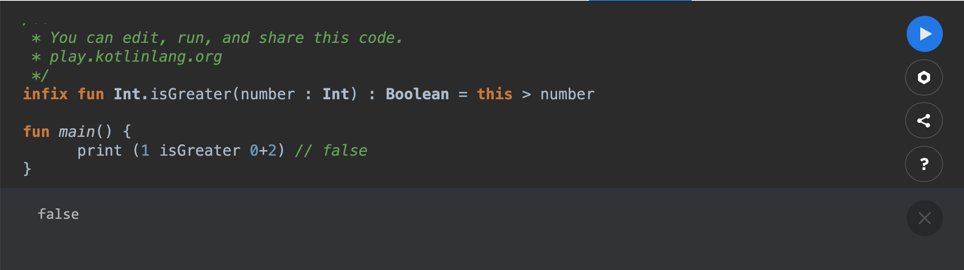
Infix notation
Infix functions have lower precedence than the arithmetic operator and type casts .
Arthmetic operator:

Slide 15
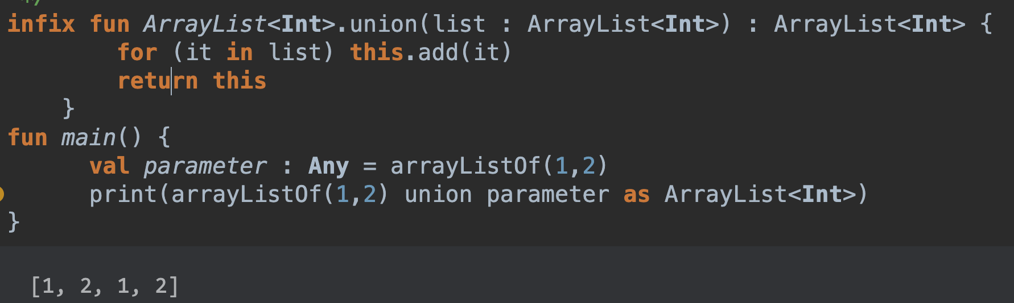
Infix notation
Infix functions have lower precedence than the arithmetic operator and type casts operator.
Type casts operator:

Slide 16
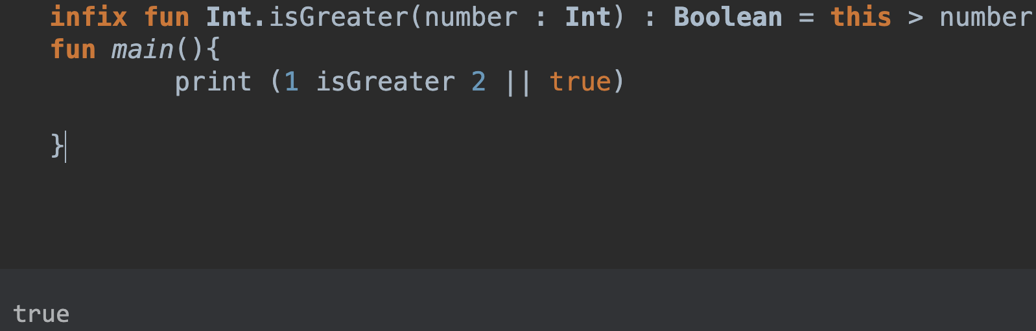
Infix notation
Infix functions have higher precedence than the boolean operator && and ||

Slide 17
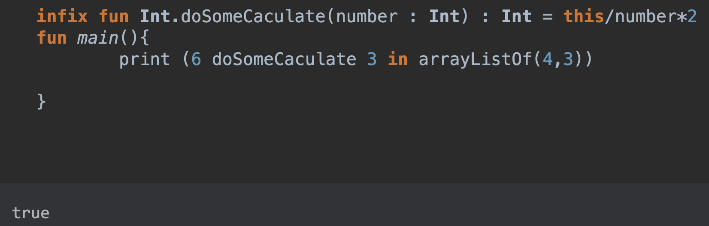
Infix notation
Infix functions have higher precedence than the boolean operator
Is, in

Slide 18
Functions
Local function
Member function
Generic function
Extension function
High-order function
Inline function

Slide 19
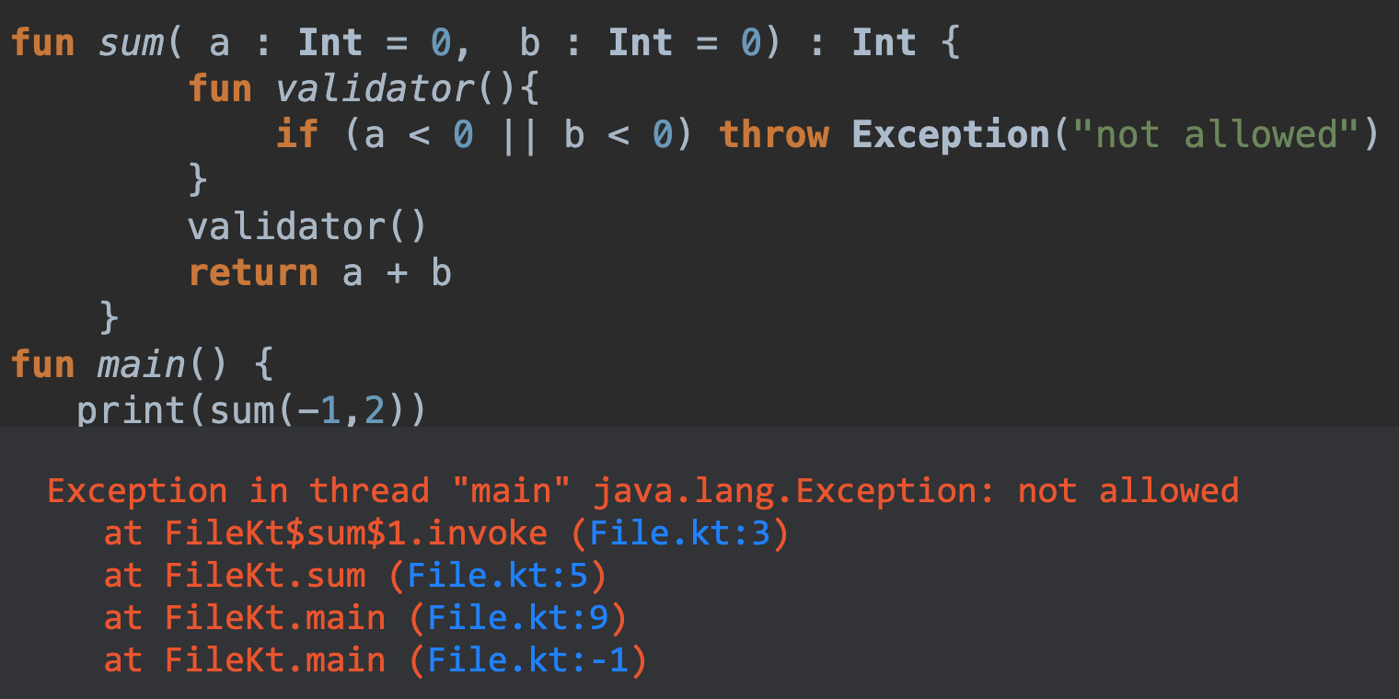
Local function
Local function is a function which declared inside other function, it can access local variable or parameter of outer function

Slide 20
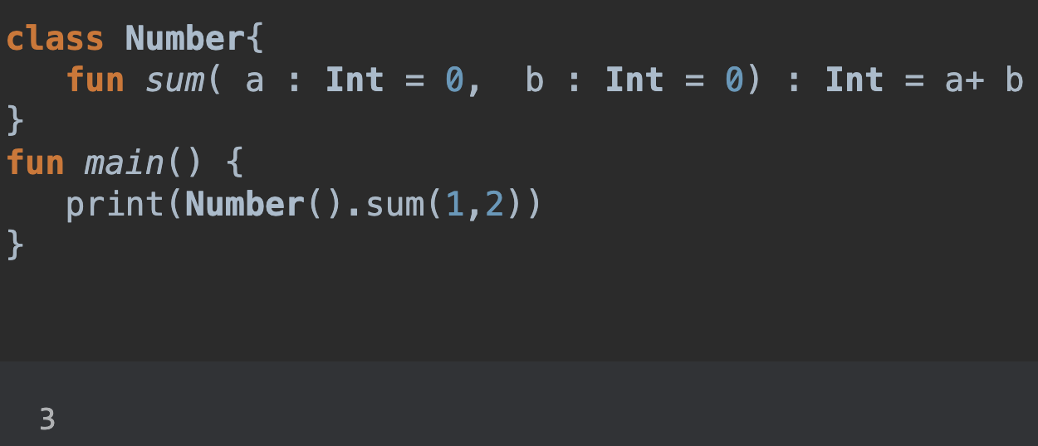
Member Function
Local function is a function which declared inside a class or object

Slide 21
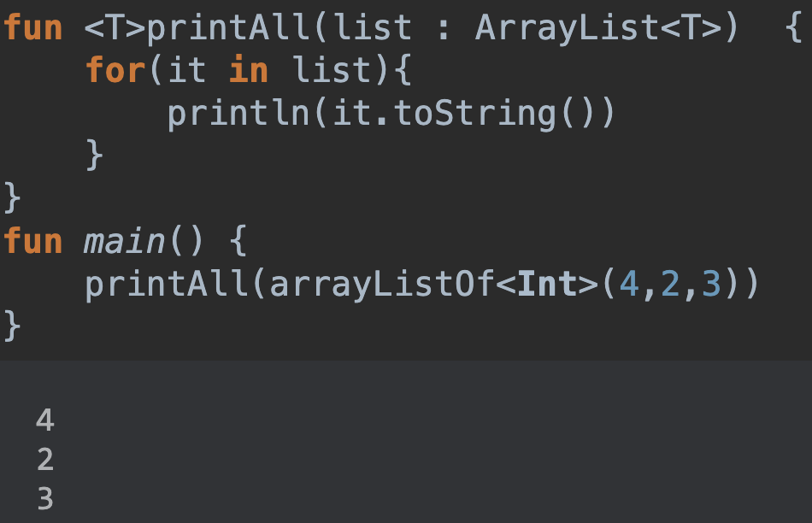
Generic Function
Function can have type parameters. Type parameters are declared before the name of the function.

Slide 22
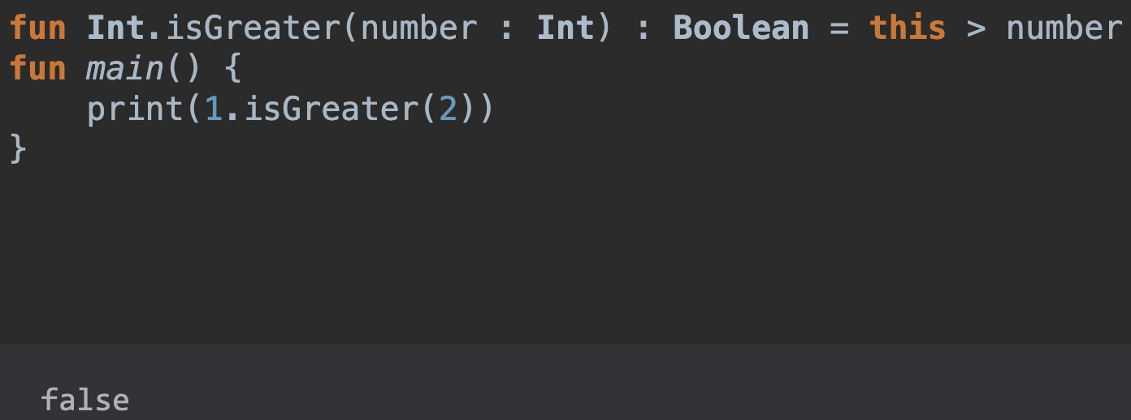
Extension Function
Kotlin provides the ability to extend a class with new functionality without having to inherit from the class or use any type of design pattern.

Slide 23
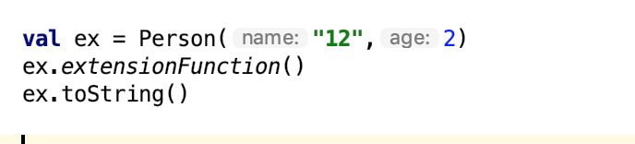

Extension Function
Extensions do not add a new member function into a class.

Slide 24
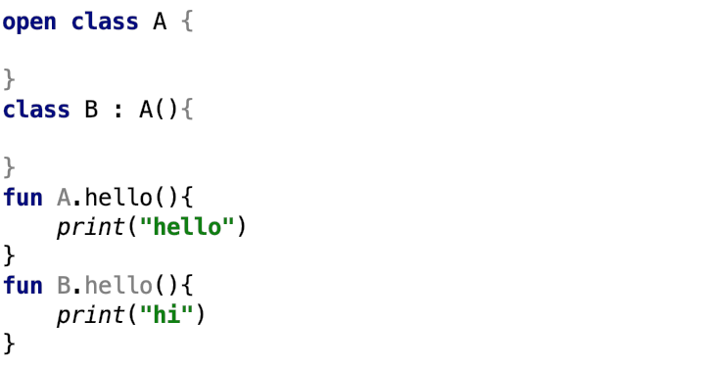

Extension Function
Extensions are resolved statically

Slide 25
Higher-order function
A higher-order function is a function that takes functions as parameter or return as a function.
fun fetchApi(callback: () -> Unit){
// do fetchApi
onSuccess(){
callback()
}
}
=> fetchApi({() -> //do some update UI })

Slide 26

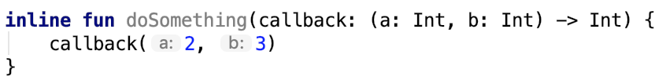
Inline function
Using higher-order functions impose certain runtime penalties: each function is an object, and it captures a closure, such as those variable, another function,…
Inline function is a function which put all code inside function to the place where it was called.Inline modifier affects both function itself and lambdas pass to it.
Inline may cause the generated code to grow.

Slide 27
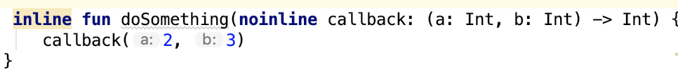
Noinline
Noinline would be used in case you want to pass a no-inline lambdas in a inline function.

Slide 28
02
Lambdas
Lambdas Expressions essentially anonymous functions that we can treat as values — we can, for example, pass them as arguments to methods, return them, or do any other thing we could do with a regular object

Slide 29
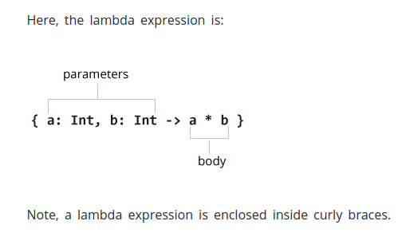



Slide 30
PARAMETER “IT”
This value represents any lone that argument we pass to the lambda function.
Longhand
array.forEach { item -> println(item * 4) }
val array = arrayOf(1, 2, 3, 4, 5, 6)
Shorthand
array.forEach { println(it * 4) }

Slide 31
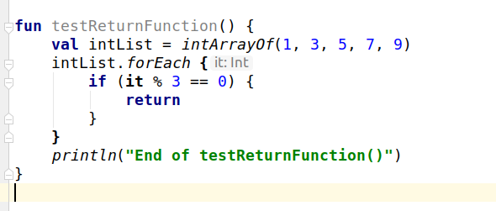
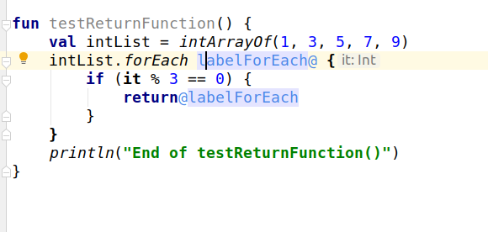
RETURN IN LAMBDA
Nothing
End of testRuturnFunction()

Slide 32
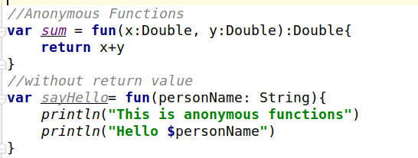
ANONYMOUS FUNCTIONS
An anonymous function looks very much like a regular function declaration, except that its name is omitted. Its body can be either an expression or a block:

Slide 33

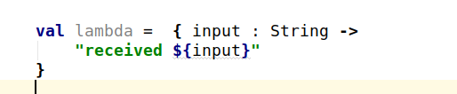


Why does Kotlin have two syntaxes for lambdas / anonymous functions?

Slide 34
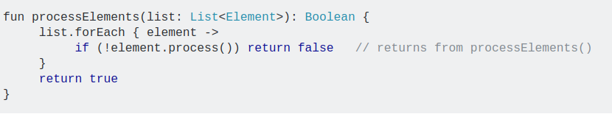

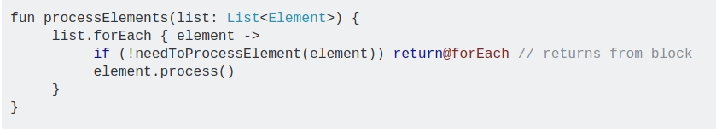
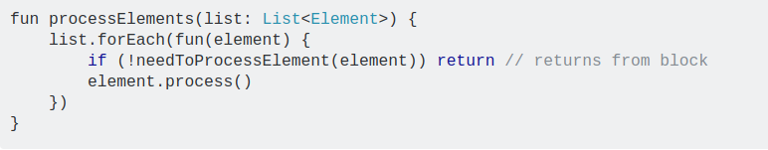

Slide 35
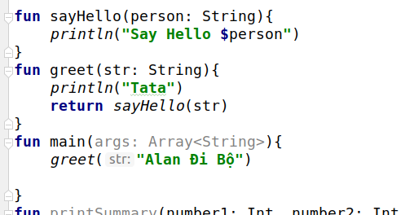
HIGHER-ODER FUNCTIONS
A higher-order function is a function that takes functions as parameters, or returns a function.
Tata
Say Hello Alan Đi Bộ

Slide 36
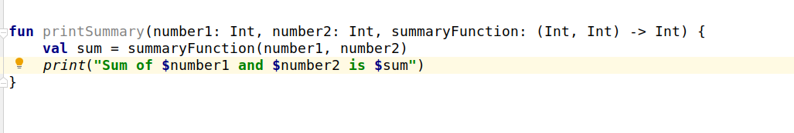
Sum of 10 and 10 is 20

Slide 37


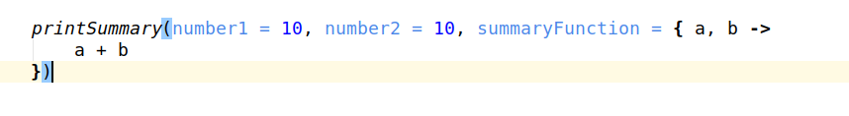
ATTENTION
Kotlin automatically assigns the type for the lambda function parameters to match the function declaration

Slide 38
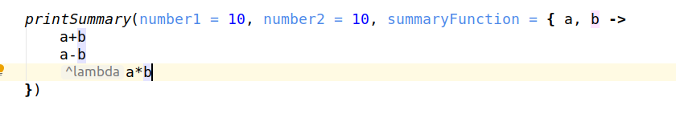
Can't use the return keyword
We can specify as many values as we want
Get the final value as the return value of the function
Sum of 10 and 10 is 100

Slide 39

If the lambda function is the last parameter of a function, we can write the content of the lambda function outside the pair ()

Slide 40
THANK YOU

Slide 41
ADD YOUR TITLE

Slide 42


ADD YOUR TITLE
This PPT template for the rice husk designer pencil demo works, focusing on the production of
ADD YOUR TITLE
ADD YOUR TITLE
This PPT template for the rice husk designer pencil demo works, focusing on the production
This PPT template for the rice husk designer pencil demo works, focusing on the production
PPT
PPT

Slide 43
ADD YOUR TITLE
2020
This PPT template for the rice husk designer pencil demo works, focusing on the production of
2021
This PPT template for the rice husk designer pencil demo works, focusing on the production of
ADD YOUR TITLE
2022
This PPT template for the rice husk designer pencil demo works, focusing on the production of high-end design husk designer pencil demo works, focusing on
This PPT template for the rice husk designer pencil demo works, focusing on the production of
This PPT template for the rice husk designer pencil demo works, focusing on the production of high-end design husk designer pencil demo works, focusing on

Slide 44


ADD YOUR TITLE
Add Your Title
Add Your Title
Add Your Title
Add Your Title
This PPT template for the rice husk designer pencil demo works, focusing on the production of
This PPT template for the rice husk designer pencil demo works, focusing on the production of
This PPT template for the rice husk designer pencil demo works, focusing on the production of
This PPT template for the rice husk designer pencil demo works, focusing on the production of

Slide 45
03
Inline functions
Sử dụng higher-order functions sẽ gây tốn tài nguyên trong quá trình run-time.
Để tránh việc tiêu tốn bộ nhớ, ta có inline function

Slide 46
Hạn chế
Một inline function không thể tự gọi lại chính nó một cách trực tiếp hoặc gọi gián tiếp thông qua một inline funciton khác.
Một public inline function được khai báo ở trong một class chỉ có thể truy cập vào các public function và public field của class đó
Số lượng dòng code sẽ tăng lên. Việc inline một function dài, phức tạp nhiều lần sẽ được compiler sinh ra code tương ứng

Slide 47
ADD YOUR TITLE
01
This PPT template for the rice husk designer pencil demo works, focusing on the production of high-end design husk designer pencil
2020
02
This PPT template for the rice husk designer pencil demo works, focusing on the production of high-end design husk designer pencil
03
This PPT template for the rice husk designer pencil demo works, focusing on the production of high-end design husk designer pencil
04
This PPT template for the rice husk designer pencil demo works, focusing on the production of high-end design husk designer pencil

Slide 48
ADD YOUR TITLE
2020
2022
This PPT template for the rice husk designer pencil demo works, focusing on the production of
This PPT template for the rice husk designer pencil demo works, focusing on the production of
This PPT template for the rice husk designer pencil demo works, focusing on the production of
This PPT template for the rice husk designer pencil demo works, focusing on the production of
2021
2023

Slide 49
04
ADD YOUR TITLE
This PPT template for the rice husk designer pencil demo works, focusing on the production of high-end design husk designer pencil demo works, focusing on

Slide 50
ADD YOUR TITLE
ADD YOUR TITLE
ADD YOUR TITLE
01
02
This PPT template for the rice husk designer pencil demo works, focusing on the production of
This PPT template for the rice husk designer pencil demo works, focusing on the production of
ADD YOUR TITLE
ADD YOUR TITLE
This PPT template for the rice husk designer pencil demo works, focusing on the production of
03
04
This PPT template for the rice husk designer pencil demo works, focusing on the production of

Slide 51
ADD YOUR TITLE
ADD YOUR TITLE
This PPT template for the rice husk designer pencil demo works, focusing on the production
ADD YOUR TITLE
This PPT template for the rice husk designer pencil demo works, focusing on the production
ADD YOUR TITLE
This PPT template for the rice husk designer pencil demo works, focusing on the production

