Slide 1
USER GUIDE TO INSTALL AUDELA
Install AudeLA with SVN
Compile AudeLA
Windows
Linux
Launching AudeLA
Alain KLOTZ (2018 July)

Slide 2

Installing AudeLA from the sourceforge SVN server
and compiling under Windows
1. Installation of Tortoise SVN
Download Tortoise SVN from http://tortoisesvn.tigris.org/
Install Tortoise SVN
2. Installation de Visual C++ 2008
Download the Visual C++ 2008:
http://download.microsoft.com/download/3/6/0/36027A58-BEEF-440C-B835C8A53EDD1D42/VS2008ExpressWithSP1FRAx1504731.iso
Unzip the ISO image with 7-Zip (or write a CDROM)
Launch Setup.hta
Select VisualC++ 2008 Express Edition
unvalid “Allow Visual studio to receive and display online RSS content”
unvalid "Microsoft SQL Server Express Edition”
install in C:\Program Files\Microsoft Visual Studio 9.0\ (by default)

Slide 3
Installing AudeLA from the sourceforge SVN server
and compiling under Windows
3. Download AudeLA (1/4)
Create an AudeLA folder. Example: C:\audela using the file manager:

Slide 4
Installing AudeLA from the sourceforge SVN server
and compiling under Windows
3. Download AudeLA (2/4)
Right click on the audela
folder and choice:
"SVN Checkout"
in the contextual menu.

Slide 5
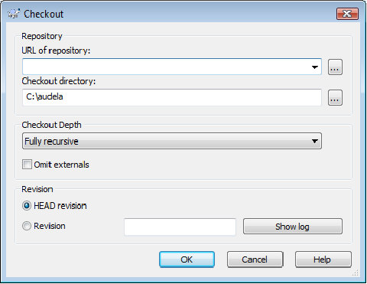
Installing AudeLA from the sourceforge SVN server
and compiling under Windows
3. Download AudeLA (3/4)
A window propose a form. One must complete the URL of repository:
https://svn.code.sf.net/p/audela/code/trunk/audela

Slide 6
Installing AudeLA from the sourceforge SVN server
and compiling under Windows
3. Download AudeLA (4/4)
Role of the folders:
.svn : hidden folder used for the SVN synchronisation. Do not delete and do not modify it.
bin : binary files (DLL and executable) of AudeLA.
doc : documentation about AudeLA extension for Tcl
gui : script files Tcl/Tk of graphical interfaces of AudeLA.
lib : files of Tcl extensions used by AudeLA.
images : some test images.
src : C/C++ source files of AudeLA.
The audela.exe file and the DLL extensions of AudeLA does not exist in the bin folder
downloaded by SVN because these files are created by the compilation.

Slide 7
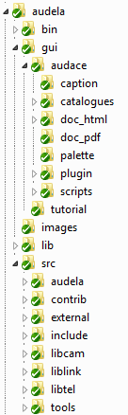
AudeLA architechture : AudeLA important folders (same Windows/Linux)
bin
Executables and libraries (.so, .dll)
Tcl/Tk codes for GUI definition
Tcl/Tk codes for “Plugin GUI tools”
Tcl libraries (FTP, plots, HTTP, SOAP, MySQL,...)
C/C++ source codes
C/C++ codes of Fitsio, Sextractor, DLL for drivers
Camera plugin C/C++ codes
Mount plugin C/C++ codes
Tcl
C
C++

Slide 8
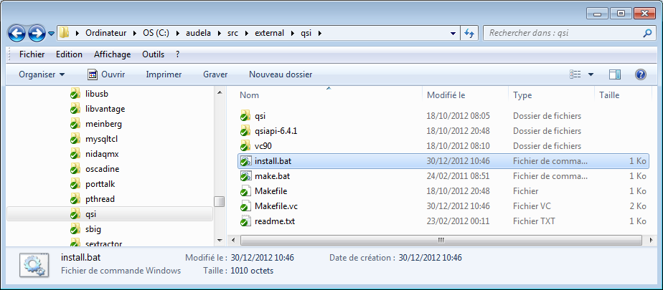

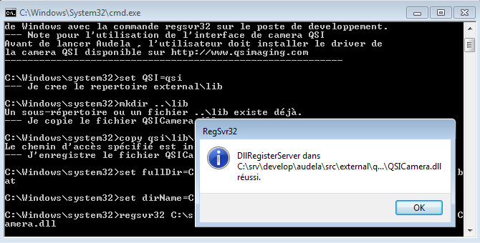
Installing AudeLA from the sourceforge SVN server
and compiling under Windows
4. Registry database updating before compiling AudeLA
(Seems valid only for Windows XP)
right click
Register install.bat
of the qsi camera library

Slide 9

Installing AudeLA from the sourceforge SVN server
and compiling under Windows
5. Compiling AudeLA
Open the audela/src folder and double-clic on the audela_VS2008.sln file.
Select Release
Menu Generate → Build Solution (F7)

Slide 10
Installing AudeLA from the sourceforge SVN server
and compiling under Windows
6.Updating AudeLA
Right click on the
audela folder and choice
"SVN Update"
After update
you must recompile
(see section 5).

Slide 11
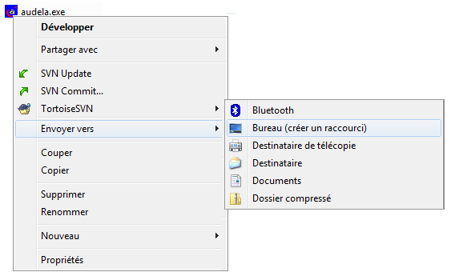
Installing AudeLA from the sourceforge SVN server
and compiling under Windows
7.Create a desktop shortcut
Open the audela\bin folder
Right click on the
audela.exe file
and choice
"Send"
Desktop (create a shortcut)

Slide 12
Installing AudeLA from the sourceforge SVN server
and compiling under Linux
1. Install packages
Switch your terminal to root using the command su
Suse : zypper install gcc gcc-c++ make gsl gsl-devel subversion tkimg xorg-x11-libX11-devel
Ubuntu : apt-get install libgsl0 libgsl0-dev subversion tkimg
Fedora : yum install gcc gcc-c++ subversion tkimg wget gsl gsl-devel
yum groupinstall "X Software Development"
Debian Raspberry :
apt-get install libgsl2 libgsl-dev libssl-dev
apt-get install make subversion
apt-get install tcl tk tcl-dev tk-dev tcl-thread tcl-tls
Optional packages (for some specific cameras):
libtiff-devel

Slide 13
Installing AudeLA from the sourceforge SVN server
and compiling under Linux
1b. Alternative install with Tcl/Tk compilation
If multithreading is needed for Tcl/Tk (use of cameras and telescopes),
then it is preferable to recompile Tcl/Tk from sources:
Download Tcl and Tk sources from sourceforge (version 8.6. Don‘t use another one)
wget http://prdownloads.sourceforge.net/tcl/tcl863-src.zip
unzip tcl863-src.zip
cd tcl8.6.3/unix
./configure --prefix /opt/tcl8.6
sudo make install
cd ../..
wget http://prdownloads.sourceforge.net/tcl/tk863-src.zip
unzip tk863-src.zip
cd tk8.6.3/unix
./configure --prefix /opt/tcl8.6
sudo make install
About TkImg, one must add a link. Switch your terminal to root using the command su):
cd /usr/local/lib
ln -s /usr/share/tcl/Img1.3

Slide 14
Installing AudeLA from the sourceforge SVN server
and compiling under Linux
2. Prepare the srv folder
root> mkdir /srv (only if needed)
root> chown -R USER.users /usr/local /srv (replace USER by your login)
cd /srv
mkdir develop
3. Download AudeLA from SVN
cd /srv/develop
svn co https://svn.code.sf.net/p/audela/code/trunk/audela audela

Slide 15
Installing AudeLA from the sourceforge SVN server
and compiling under Linux
4. Compile AudeLA (OS 32 bits)
cd /srv/develop/audela/src
chmod +x configure
./configure --with-tcl=/opt/tcl8.6/lib --with-tk=/opt/tcl8.6/lib
make external
make contrib
make
cd ../bin
chmod +x audela.sh
5. Set the library path for AudeLA (OS 32 bits)
root> cd /etc/ld.so.conf.d
root> touch audela.conf
root> vi audela.conf
write these lines and save
root> ldconfig
/srv/develop/audela/bin
/opt/tcl8.6/lib
/srv/develop/audela/lib
/usr/lib

Slide 16
Installing AudeLA from the sourceforge SVN server
and compiling under Linux
4. Compile AudeLA (OS 64 bits)
cd /srv/develop/audela/src
chmod +x configure
./configure --with-tcl=/opt/tcl8.6/lib --with-tk=/opt/tcl8.6/lib
make external
make contrib
make
cd ../bin
chmod +x audela.sh
5. Set the library path for AudeLA (OS 64 bits)
root> cd /etc/ld.so.conf.d
root> touch audela.conf
root> vi audela.conf
write these lines and save
root> ldconfig
/srv/develop/audela/bin
/opt/tcl8.6/lib
/srv/develop/audela/lib
/srv/develop/audela/lib64
/usr/lib

Slide 17
Installing AudeLA from the sourceforge SVN server
and compiling under Linux
6. Create a desktop shortcut
cd
cd Desktop
vi audela.desktop
In the editor window add the following lines and save the text file:
[Desktop Entry]
Name=AudeLA
Exec="/srv/develop/audela/bin/audela"
Icon=/srv/develop/audela/bin/audace32.png
Type=Application
Categories=Education;Application

Slide 18

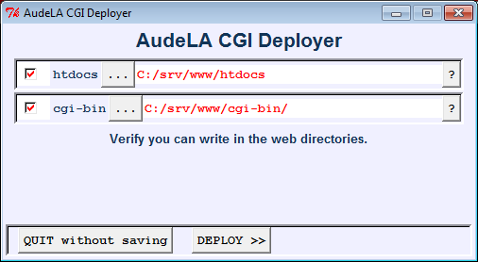
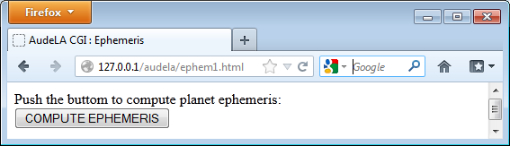
Many ways to launch AudeLA
1. Launch AudeLA and Aud'ACE graphical interface (standard)
Windows : Click on the audela.exe icon
Linux: Click on the AudeLA icon or use the command ./audela &
2. Launch AudeLA without Aud'ACE graphical interface (console mode)
Windows command: audela.exe --console
Linux command: ./audela --console
3. Launch AudeLA without Aud'ACE graphical interface and launch a script
Windows command: audela.exe --console --file c:\test\analysis.tcl
Linux : ./audela --console --file ~/test/analysis.tcl
4. Launch AudeLA without Aud'ACE graphical interface as a CGI script
Install Apache server before.
Install through the AudeLA terminal: source $audace(rep_install)/bin/cgi_install.tcl ; ::cgi_install::run

Slide 19
What appends when you launch AudeLA ?
Anatomy of the executable file audela.exe / audela
Entry point
main(int argc, char **argv)
Load the Tcl library
#include <tcl.h>
Declare a Tcl interpreter
void *interp
Launch the Tcl event loop
Tcl_Main(argc, argv, init)
Define the init of the interpreter
    int init(Tcl_Interp *interp) {
      Tcl_Init(interp);
      return TCL_OK;
    }
Load
libaudela
libmc
etc...
Load
libaudelatk
etc...
Launch a starting Tcl script
source audela/bin/audela.tcl (default)

Slide 20
Migration from old to new sourceforge SVN server (since 2013 March 26th)
URL address for anonymous checkout and update only:
https://svn.code.sf.net/p/audela/code/trunk/audela
URL address for sourceforge identified users (xxx) that commit (ask to denis.marchais@free.fr to have an id):
https://xxx@svn.code.sf.net/p/audela/code/trunk/audela
Windows (Tortoise SVN):
AudeLA folder, right mouse button "TortoiseSVN > Relocate"
Type one of the two above URL until /code (replace xxx by our sourceforge id if necessary)
Password asked for identified users
Message when the conversion is done
Linux
New SVN versions, only one command:
svn relocate https://svn.code.sf.net/p/audela/code/trunk/audela
or, if you are identified
svn relocate https://xxx@svn.code.sf.net/p/audela/code (sometimes add /trunk/audela)
Old SVN version, only one command:
svn switch --relocate https://audela.svn.sourceforge.net/svnroot/audela https://svn.code.sf.net/p/audela/code/trunk/audela
or, if you are identified
svn switch --relocate https://audela.svn.sourceforge.net/svnroot/audela https://xxx@svn.code.sf.net/p/audela/code/trunk/audela

Slide 21
New sourceforge SVN server (since 2013 March 26th)
Pour eviter d avoir a retaper systematiquement le mdp a chaque commit,
il faut "echanger" les cles ssh entre le server sourceforge et la machine locale.
sur la machine locale
sous linux se mettre dans le repertoire ~/.ssh
taper la commande :
> ssh-keygen -t dsa -C "USERNAME@shell.sf.net"
en remplacant USERNAME par votre login sourceforge
ceci cree 2 fichiers :
id_dsa : la clé privée
id_dsa.pub : la clé publique
aller sur le site : https://sourceforge.net/account/services
puis Edit SSH Keys for Shell/CVS
copier le contenu du fichier id_dsa.pub (en faisant bien attention qu il n y ait pas de retour chariot dans la ligne)
puis cliquer sur update.
retour a la page : https://sourceforge.net/account/services
verifier qu il y a bien au moins 1 clé prise en compte

Slide 22
New sourceforge SVN server (since 2013 March 26th)
Pour eviter d avoir a retaper systematiquement le mdp a chaque commit,
il faut "echanger" les cles ssh entre le server sourceforge et la machine locale.
1. generer la clef :
mauclaire@atlantis:~$ ssh-keygen -t dsa "mon_login@shell.sf.net"
Generating public/private dsa key pair.
Enter file in which to save the key (/home/mauclaire/.ssh/id_dsa):
/home/mauclaire/.ssh/id_dsa already exists.
Overwrite (y/n)? y
Enter passphrase (empty for no passphrase):
Enter same passphrase again:
Your identification has been saved in /home/mauclaire/.ssh/id_dsa.
Your public key has been saved in /home/mauclaire/.ssh/id_dsa.pub.
The key fingerprint is:
06:**************************************************************:df mon_login@shell.sf.net
2. Aller dans Services, Edit SSH Keys et copier le contenu de la clef public sur sourceforge.net :
mauclaire@atlantis:~$ less ~/.ssh/id_dsa.pub
3. effacer les retours chariot dans le cadre de sourceforge
en laissant le ssh-dss au debut, le login a la fin et les +.
-------

