Slide 1

HEATWATCH
Heatwave
Monitoring
An interactive website for exploring
heat conditions and practical precautions
TEAM MEMBERS
Vedant Chawda
Eshan Desai
Kehan Desai
Notes:
Introduce Heatwatch as an offline browser-based heatwave monitoring demonstration. The team members are Vedant Chawda, Eshan Desai and Kehan Desai. All current conditions are labelled samples or manual entries. Visual: an AI-generated illustrative skyline created for the Heatwatch website, not a photograph of a documented heatwave.

Slide 2

Problem statement
Weather values need context
Temperature, humidity and forecast values can be difficult to compare when shown separately.
Users need a clear risk category, relevant precautions and a layout that works on small screens.
Notes:
Explain the interface problem: raw weather numbers do not automatically communicate the meaning of the simplified rules. The aim is to make inputs, the calculated category and related advice easy to understand. This is a design motivation, not a measured usability study. Visual: original AI-generated shade image used in Heatwatch.

Slide 3
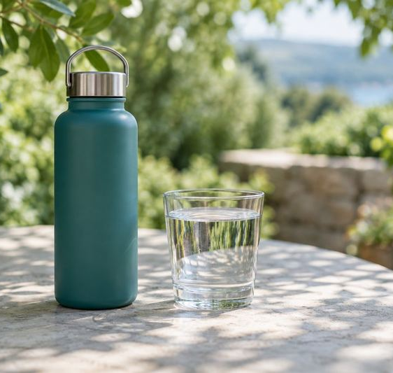
Objectives
01
Show clear risk levels
Classify conditions into five understandable states.
02
Accept reliable inputs
Check weather values and explain invalid entries.
03
Compare temperature readings
Show trends, averages and threshold counts.
04
Keep the site easy to use
Support keyboard access, mobile layouts and offline use.
Notes:
The completed features match these objectives. Point out the five risk categories, field-level errors, the readings analysis and responsive offline behavior. Visual: original AI-generated water image used in Heatwatch.

Slide 4
Methodology & technologies
01
Input
HTML5
Choose a sample location or enter weather values.
Semantic sections, forms, tables and media
02
Validate
Check required fields, formats, ranges and dates.
CSS3 + Bootstrap grid
Responsive layout, focus styles and visual effects
03
Calculate
Apply risk rules and analyze the readings array.
Vanilla JavaScript
04
Update
Objects, arrays, regular expressions and events
Refresh the dashboard, advice and table through the DOM.
All processing runs in the browser. No API key or server is required.
Notes:
Source: the completed index.html, style.css and script.js. The Bootstrap 5.3.8 grid subset is embedded locally with its license. The site needs no build tool, CDN or backend. One shared climate object supplies the dashboard and report, while events trigger validation and rendering.

Slide 5
Heat-risk decision logic
Rules run from top to bottom. The first matching condition sets the category.
Order | Risk level | Condition
1 | Severe | Current temperature ≥ 40°C
2 | High | Current temperature ≥ 38°C and humidity ≥ 60%
3 | Early warning | Next-day forecast ≥ 40°C
4 | Moderate | Current temperature ≥ 35°C
5 | Normal | None of the conditions above applies
The configurable threshold is tracked separately from the risk category.
Simplified demonstration rules. Actual warnings depend on official local criteria.
Notes:
Source: script.js determineRisk() and the on-page risk explanation. Severe takes priority over high, then an early forecast warning takes priority over moderate. Dry current temperatures of 38–39.9°C remain moderate unless the forecast reaches 40°C. Threshold status uses temperature >= threshold. These rules demonstrate the supplied course material and do not constitute an official warning system.

Slide 6
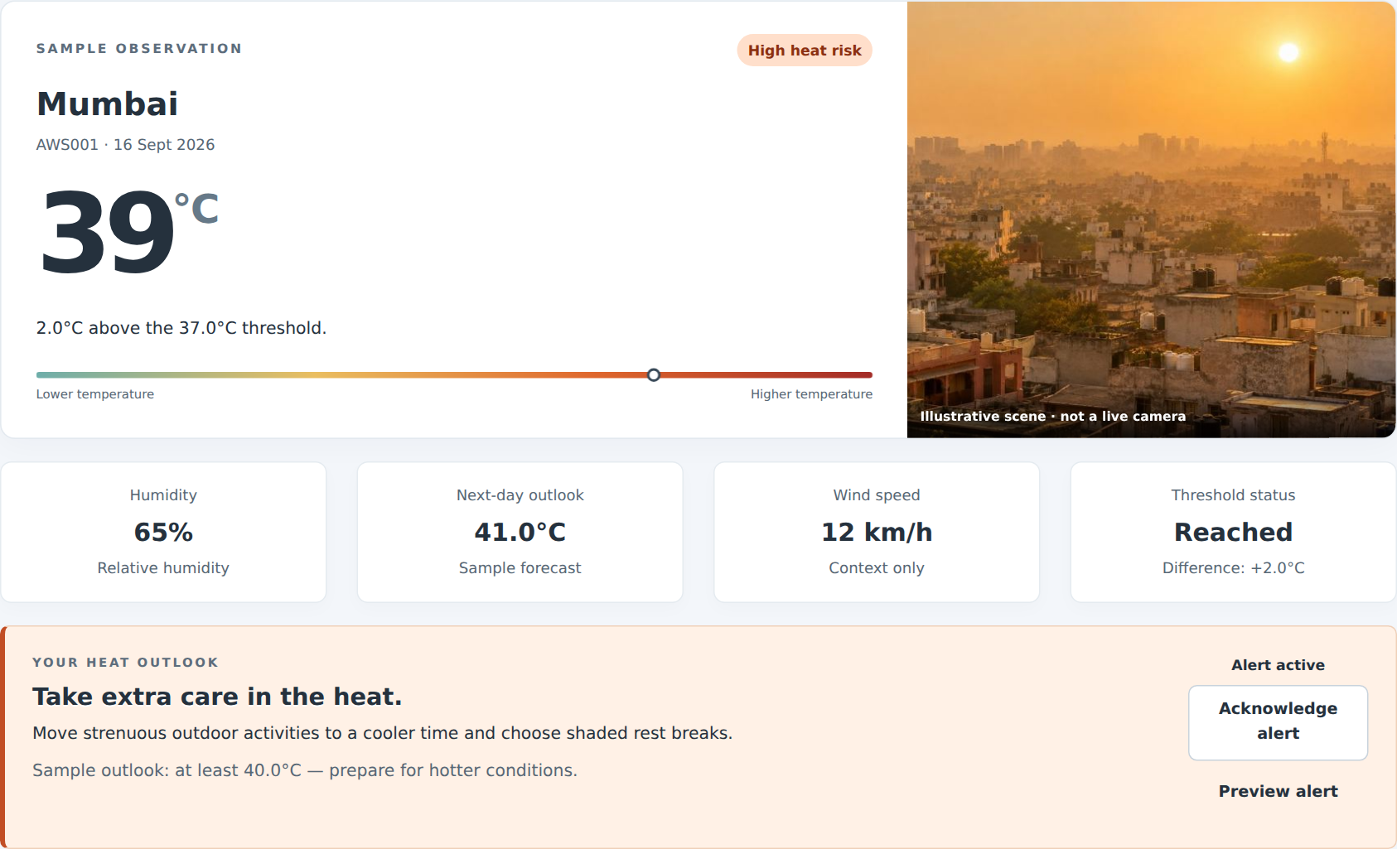
Implementation: heat-risk dashboard
39°C
Mumbai sample
65% humidity
41°C next-day outlook
High heat risk
Advice and alert controls
update with the conditions.
Notes:
Source: actual screenshot of the completed Heatwatch website using the original Mumbai preset. Show the current temperature, humidity, next-day forecast, threshold difference, calculated risk and alert controls. The screenshot displays a sample observation and no live sensor feed.

Slide 7
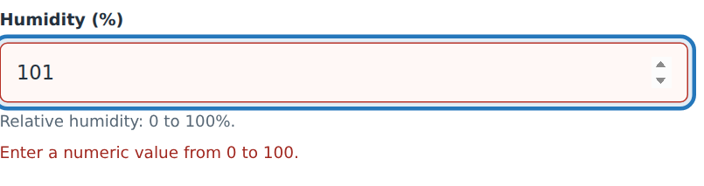
Demo: change, validate and reset
01
Choose a scenario
Field-level feedback
Cycle through the five sample locations.
02
Try an invalid value
Enter 101% humidity and show the field error.
03
Apply valid conditions
Correct the value, update the dashboard, then reset.
Invalid inputs keep the current dashboard unchanged.
Notes:
Suggested live demo: open heatwave_monitoring.html. From the initial Mumbai sample, use Try next scenario to show Pune (moderate), Nagpur (severe), Delhi (early warning) and Shimla (normal). Enter humidity 101 and submit to show the range error. Correct it to 65, apply the form, then use Reset demo. If time permits, show Celsius/Fahrenheit and CSV download/import. Source: actual form screenshot and tested controls in script.js.

Slide 8
Results & outcome
Ten sample temperature readings
38.1°C
Average temperature
6 / 10
Strictly above 37°C
3 readings at or above 40°C
Both file versions work offline. Checks covered Chromium, Firefox, input validation and layouts from 320–1440px.
Notes:
Source: the supplied sample array reproduced in script.js: [34,36,38,39,41,40,37,35,39,42]. Sum 381°C across 10 readings gives mean 38.1°C. Minimum 34°C and maximum 42°C. Six readings exceed 37°C. Three readings reach or exceed 40°C: 41, 40 and 42. These are illustrative readings, not live measurements. Outcome statements refer to the actual browser verification of the finished files. They do not imply a real-world health benefit or field deployment.

Slide 9
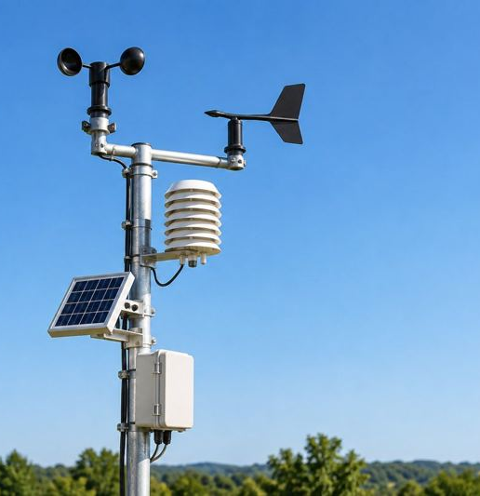
Conclusion & future scope
A complete offline experience
Heatwatch combines understandable risk categories, validated inputs and temperature analysis in one responsive website.
Future scope
Connect a verified weather API or sensor feed.
Store historical observations for trend analysis.
Add location-specific official alert criteria.
GITHUB LINK:-
https://github.com/kehandesai/WDL-Mini-Project
Notes:
Conclude with what already works: the offline dashboard, manual inputs, risk explanations and array analysis. Future items are proposed enhancements and are not implemented. A real deployment would need verified data sources and location-specific official rules. Visual: original AI-generated weather-station image used in Heatwatch.

