Slide 1
Capital One Project
# Overview
This repository contains various Jupyter Notebooks and files related to a project focused on analyzing capital one transactions data.
The link to the dataset: https://github.com/CapitalOneRecruiting/DS
The project involves data preprocessing, visualization, wrangling and modeling. Below is a brief description of the files and directories present:
## Files and Directories
- `01_main.ipynb`:
This notebook serves as the main entry point for the project, I unzip and check column with null and empty strings.
Also saved as pickle for faster loading
`02_preprocessing.ipynb`:
This notebook is dedicated to data preprocessing tasks, such as cleaning, transforming, statistical information and preparing the data for analysis.
Empty column was drop and the remaining was saved as an updated clean dataset
`03_plots.ipynb`:
This notebook contains code for generating transactional plots based on the clean data.
Information about outliers was also visualize and hypothesis testing was done for distribution testing

Slide 2
`04_wrangling.ipynb`:
This notebook focuses on data wrangling tasks, which may involve checking for reversal and multi-swipe transaction.
Information about reversal and multi-swipe transaction was provided
`05_model.ipynb`:
These notebooks pertain to modeling tasks, such as building machine learning models or statistical analyses.
`utils.py`:
This Python file contains utility functions or helper code used across the project.
`requirements.txt`:
This file lists the Python dependencies required to run the project.
`data/`:
Directory containing the raw data or intermediate datasets used in the project.
`venv/`:
Directory containing a virtual environment for Python dependencies.
## Usage
To use this project, ensure you have Python installed along with the dependencies listed in `requirements.txt`. You can explore the notebooks in Jupyter environment.

Slide 3
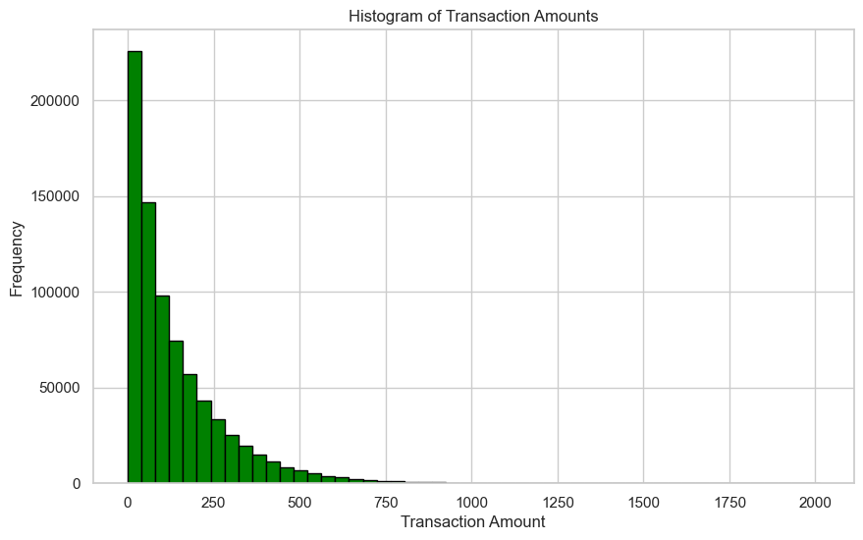
Transaction Amount Hypotheses
* The distribution is right-skewed.
* Most transaction amounts fall between 0 and 250, suggesting that the majority indeed comprise smaller amounts.
* There exists a tail of transactions with higher amounts, possibly indicating outliers on the higher end of the transaction spectrum.
* The mean of transaction amounts exceeds the median. This is likely due to the sensitivity of the mean to extreme values, pulling it towards the higher end due to the right skew.
* The distribution of transaction amounts does not adhere to a normal distribution.
* Overall, the behavior of the distribution is satisfactory.

Slide 4
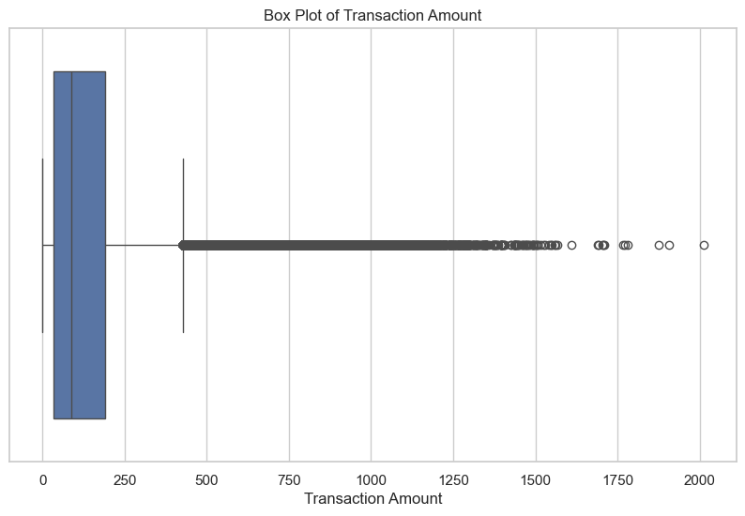
The box plot displays the number of outliers and the range of the data.
Additionally, it indicates that 75% of transactions are less than $250, providing insight into the distribution of transaction amounts.

Slide 5
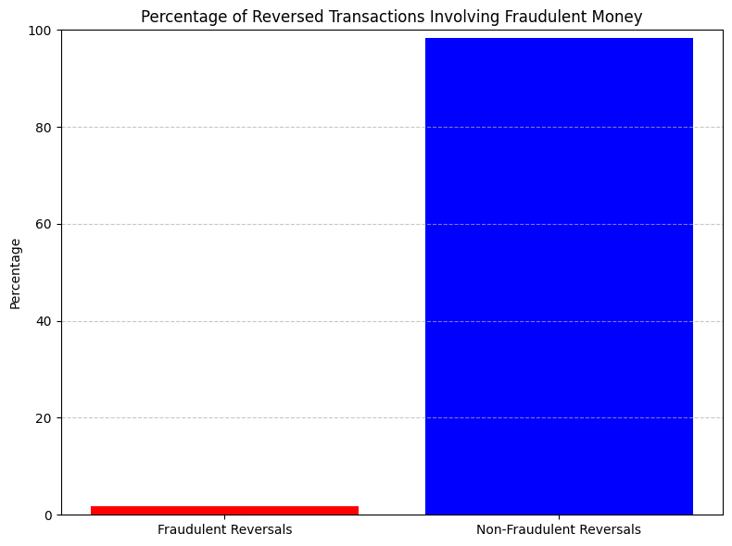
The majority of reversal transactions are not fraudulent.
Out of 17,999 reversed transactions, only 309 (1.72%) involve fraudulent activity. This indicates that a vast majority of reversals are legitimate.
Further investigation may be necessary to uncover patterns or trends associated with fraudulent reversals..

Slide 6
### Reversed Transaction Estimates
* Number of reversed transactions: 17,999 transactions
Total dollar estimate for reversed transactions: 2,701,311.87 US dollars
Doing this “please consider the first transaction to be "normal" and exclude it from the number of transaction and dollar amount counts” would result in:
Total number of reversed count: 17,999 - 1 = 17,998
Total number of reversed transactions: $2,701,311.87 - 215.13 = 2,701,096.74 US dollars
#QUESTION:
why are we excluding the first transaction?
It is the first purchase or reversal?
what do the question mean by "normal"?
should I do that for reversal and multi-swipe
The above question need to be answered
### Multi-swipe Estimates
* Number of multi-swipe transactions: 65,796 transactions
* Total dollar estimate for multi-swipe transactions: $3,679,356.2

Slide 7
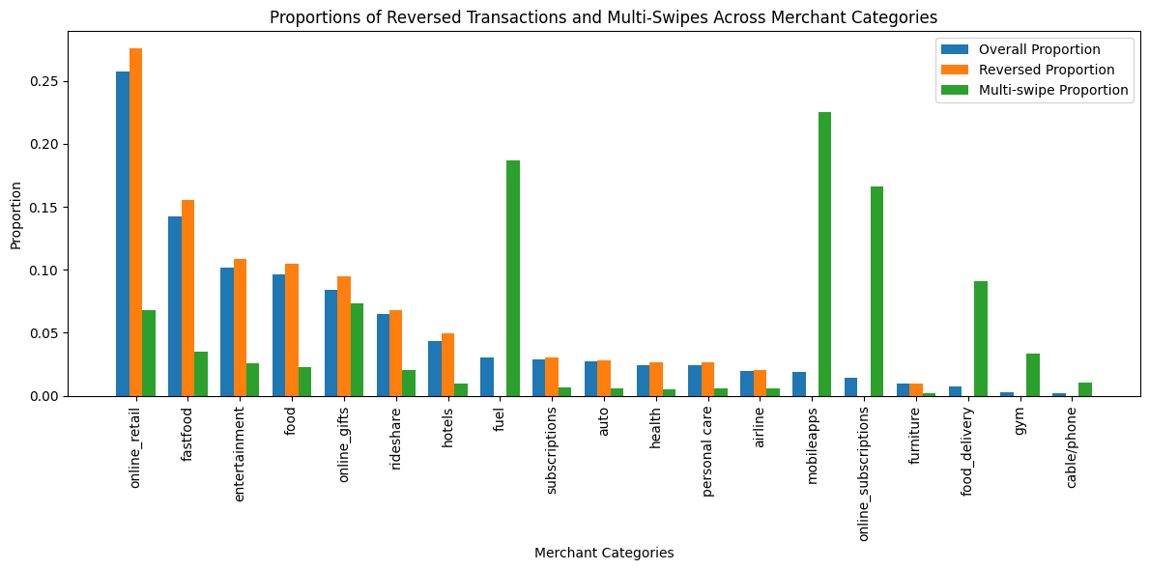
Certain merchant categories, such as mobile apps, online subscriptions, and fuel, exhibit high proportions of multi-swipes, indicating a greater likelihood of duplicate transactions within these categories.
However, other categories, such as online retail and fast food, also show significant proportions of reversed transactions.

Slide 8
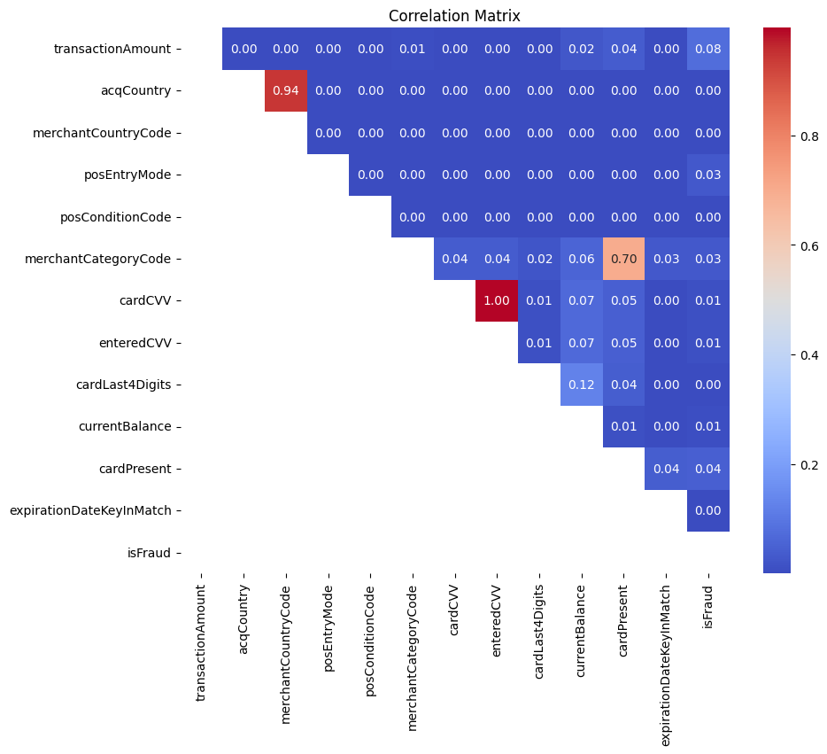
Correlation matrix showing information about relationship between various categories before building model

Slide 9
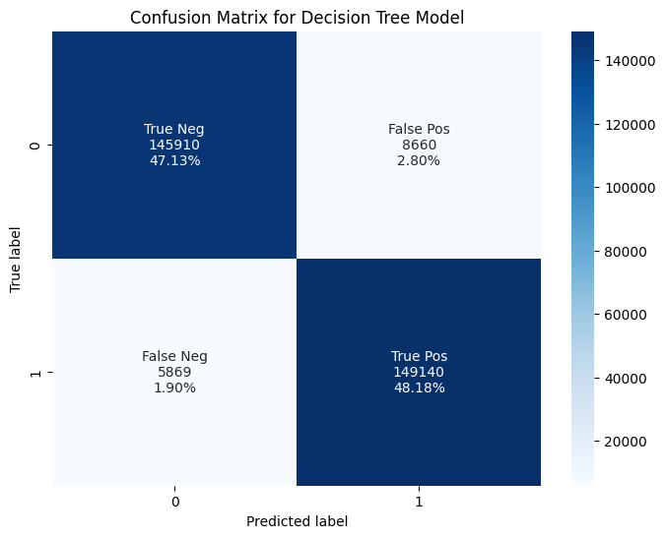
Decision Tree Classifier
Accuracy: 0.9531
Precision: 0.9451
Recall: 0.9621
F1 Score: 0.9536

Slide 10
With an accuracy of 0.9531, the model demonstrates a high level of overall correctness in its predictions. This indicates that nearly 95.31% of the instances were correctly classified by the model.
Furthermore, the precision of 0.9451 suggests that when the model predicts a positive outcome, it is correct approximately 94.51% of the time. This metric is crucial, especially in scenarios where the cost of false positives is high.
The recall score of 0.9621 indicates that the model effectively captures a significant portion of the actual positive instances in the dataset, achieving a recall rate of approximately 96.21%. This is particularly important in scenarios where it's vital to identify as many positive cases as possible.
The F1 Score, which takes into account both precision and recall, provides a balanced measure of the model's performance. With an F1 Score of 0.9536, our model achieves a good balance between precision and recall, indicating robust performance across both metrics.

Slide 11
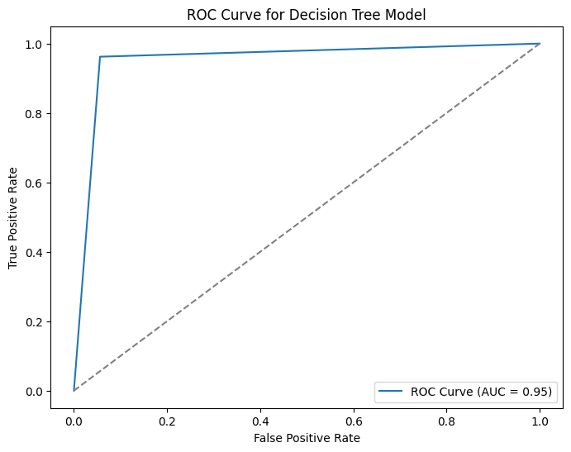
ROC Curve
I referenced the following link for our ROC Curve analysis: https://glassboxmedicine.com/2019/02/23/measuring-performance-auc-auroc/
Our model demonstrates a very good ROC Curve with an AUC of 0.95.

Slide 12
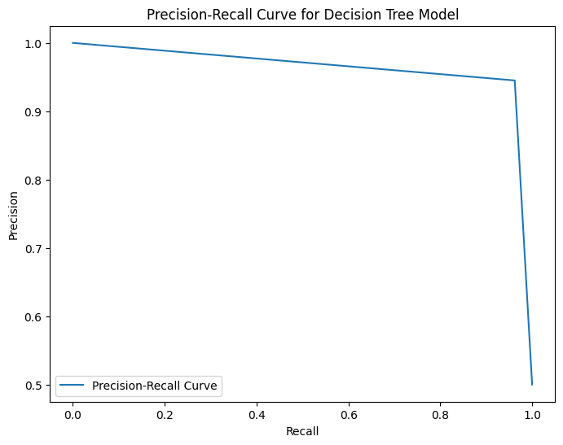
Precision-Recall Curve
I used the reference link for our Precision-Recall Curve analysis: https://analyticsindiamag.com/complete-guide-to-understanding-precision-and-recall-curves/
It's evident that our model exhibits a very good Precision-Recall Curve.

Slide 13
Given sufficient time:
I would proceed to test various column attributes to construct different Decision Tree models and assess their performance. Additionally, I would visualize the workings of the Decision Tree method to gain insights into its functioning.
I trained the model using Logistic Regression, and it yielded poor performance.
Furthermore, I would explore other methods outlined in this link: https://sqream.com/blog/fraud-detection-machine-learning/

