Slide 1
Code Warriors Hospital Booking System.

Slide 2
INTRODUCTION.
The provision of quality, accessible and affordable healthcare remains a serious problem and due to this fact, Nigeria was ranked to be low in health care delivery by international organizations ( Oba,2008).
Research on outpatient clinics shows that waiting times are patients’ main dissatisfaction with hospital services ( Huang, 1994).

Slide 3
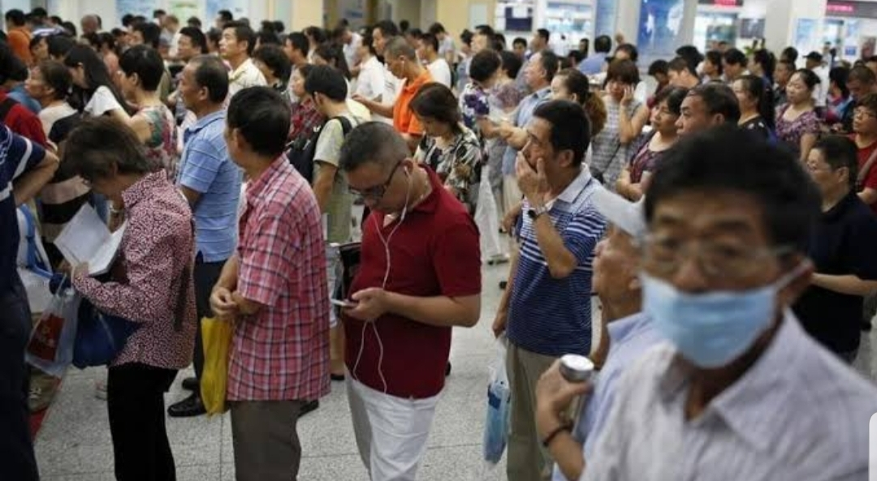
Problem Statement
The numbers of missed appointments and unnecessary waste of patient’s appointment time have caused an impending problem for healthcare institutions, thus ,there is need for an appointment booking system to intervene and provide platform for outpatients to have access to care in recorded time.

Slide 4
Solution
Code Warriors Hospital Booking System

Slide 5
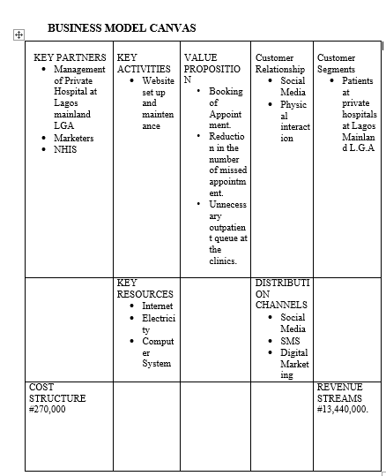

Slide 6
Competitors
NHIS.
Some Top Notch Hospitals.

Slide 7
Value Proposition
Booking of Appointment.
Reduction in the number of missed appointment.
Unnecessary outpatient queue at the clinics.

Slide 8
Pricing
#30,000
Unlimited Access
100 Hospitals
1 hour Appointment Extension.
#10,000
Limited Access
25 Hospitals
1 Hour Appointment Extension.
#5,000
Limited Access
10 Hospitals
30 Minutes Appointment Extension.

Slide 9
Marketing and Sales Strategies
Social Media.
Digital Marketing.
Word of Mouth.

Slide 10
Projected Initial Investment
Item | Description | Qty | Unit Rate (NGN) | Total (NGN)
Equipment/Construction
Internet modem | For Internet Access | 10 | 15,000.00 | 150,000.00
Advertisement | Mini Digital Post | 1 | 30,000.00 | 30,000.00
Working Capital
Transportation | Cost of transportation | 1 | 50,000.00 | 50,000.00
Subscription | Internet Subscription | 10 | 3,000.00 | 30,000.00
Total 80,000.00
Others
Miscellaneous | Stationaries, etc. | 1 | 10,000.00 | 10,000.00
Total 10,000.00
Initial Investment 270,000.00

Slide 11

Projected Revenue
 |  | Year 1 |  | Year 2 |  | Year 3
Product1 | Price | #200 | #13,440,000.00 | #200 | #26,880,000.00 | #200 | #53,760,000.00
 | Units | 200 |  | 400 |  | 800
Total Revenue |  |  | 13,440,000.00 | 26,880,000.00 |  | 53,760,000.00

Slide 12
Projected Income Statement
 | Year 1 | Year 2 | Year 3
Sales of: Product 1 | 13,440,000.00 | 26,880,000.00 | 53,760,000.00
Total Revenue | 13,440,000.00 | 26,880,000.00 | 53,760,000.00
Commission Paid to Hospitals | 5,376,000.00 | 10,752,000.00 | 21,504,000.00
Gross Profit | 8,064,000.00 | 16,128,000.00 | 32,256,000.00
Gross Profit Margin (%) | 60 | 60 | 60
Salaries | 2,880,000.00 | 1,500,000.00 | 2,000,000.00
Marketing Cost | 50,000.00 | 50,000.00 | 50,000.00
Electricity | 30,000.00 | 30,000.00 | 30,000.00
Website Maintenance | 100,000.00 | 200,000.00 | 400,000.00
Maintenance (others) | 80,000.00 | 80,000.00 | 100,000.00
Expenses | 3,140,000.00 | 4,128,000.00 | 5,513,600.00
Pre-Tax Profit | 4,924,000.00 | 12,000,000.00 | 26,742,400.00

Slide 13
Timeline
We are a start-up business interested in easing the stress of the common man. In the next three years we hope to be a household platform that puts a smile on peoples faces after rendering our service.

Slide 14
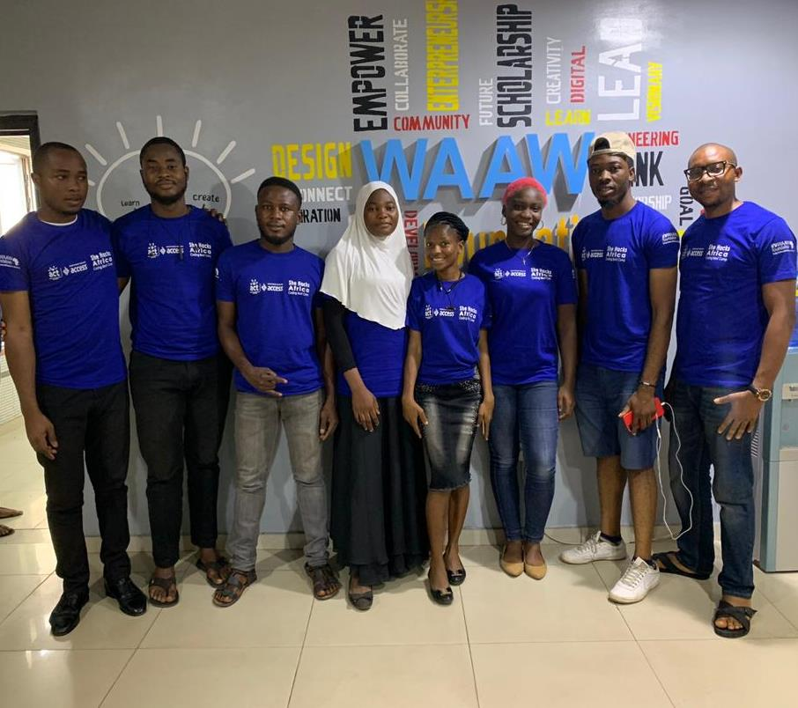
Code Warriors

Slide 15
References
Oba, J. O. (2008). Nigeria: Yar’Adua and the Resuscitation of Health Sector. Online available at: http://allatrica.com/stories/200806021431.html. Retrieved October 3, 2009.
Huang (1994). A study of queues and appointment systems in hospital outpatient departments, with special reference to waiting times. Journal of the Royal Statistical Society, A14, 185-199.

Slide 16
THANKS FOR LISTENING.

