Slide 1

Cafeteria
Malte
Daniel
Niels
Jonathan
Architecture
Prototype

Slide 2
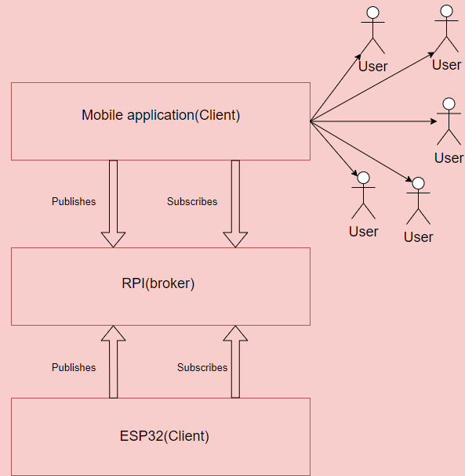
Overview
ESP publishes door open to broker
Mobile app subscribes to broker. Is door open?
If user wants to make coffee mobile app publishes it to broker
ESP subscribes to broker to know whether to make coffee

Slide 3
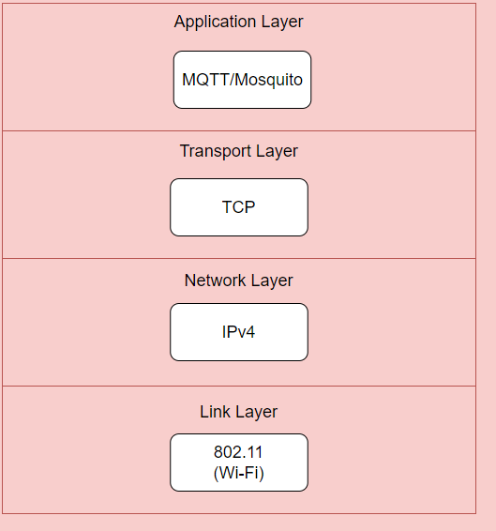
IoT Protocol stack

Slide 4
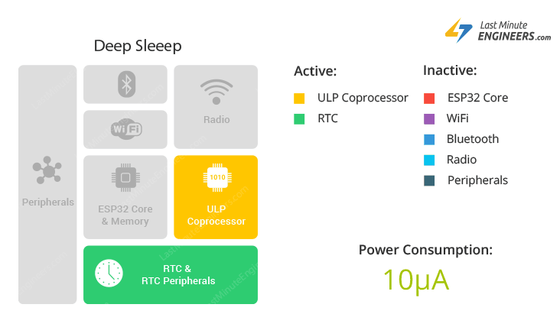
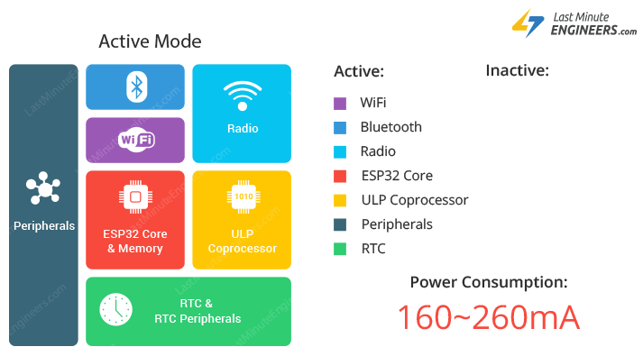
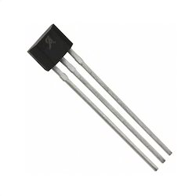
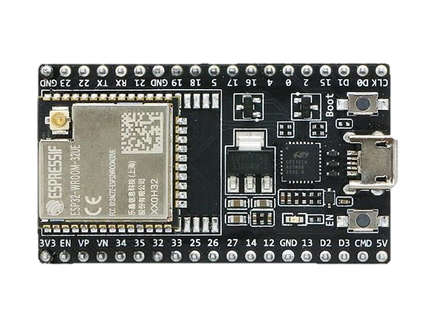
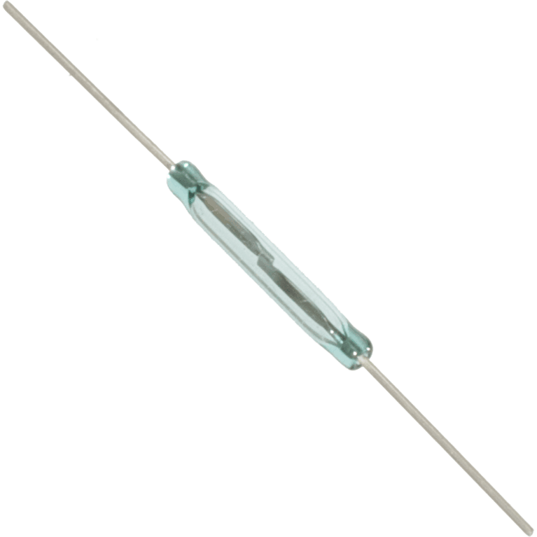
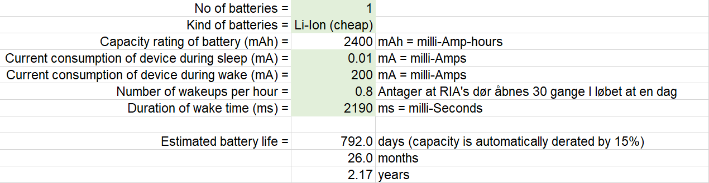
Prototype

Slide 5
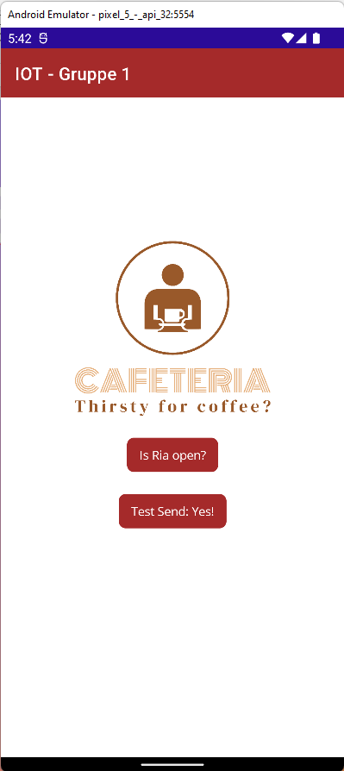

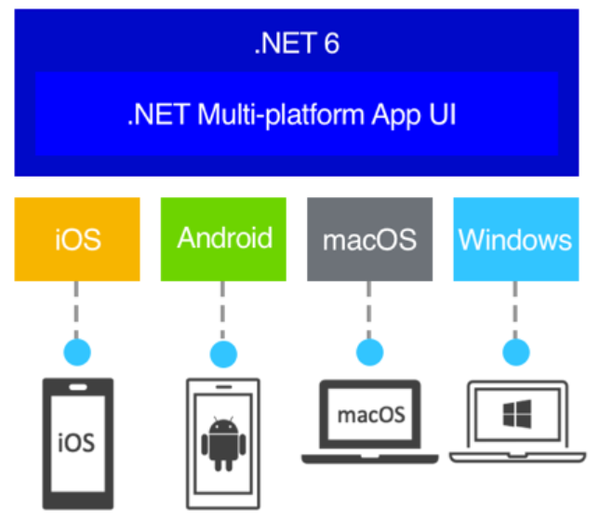
Prototype
Yes!

