Slide 1
Bcmap - Efficient linked-read barcode mapping without read alignment
Richard Lüpken
ISMB/ECCB 2021

Slide 2
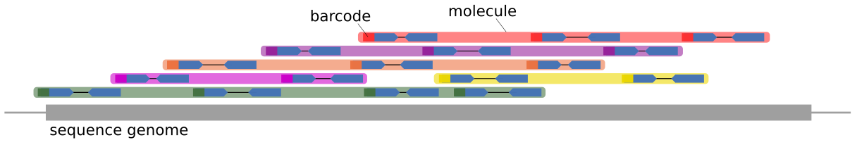
Linked-read data
Reads from same large molecule marked with same barcode
Multiple molecules can have same barcode
Low read coverage per molecule

Slide 3
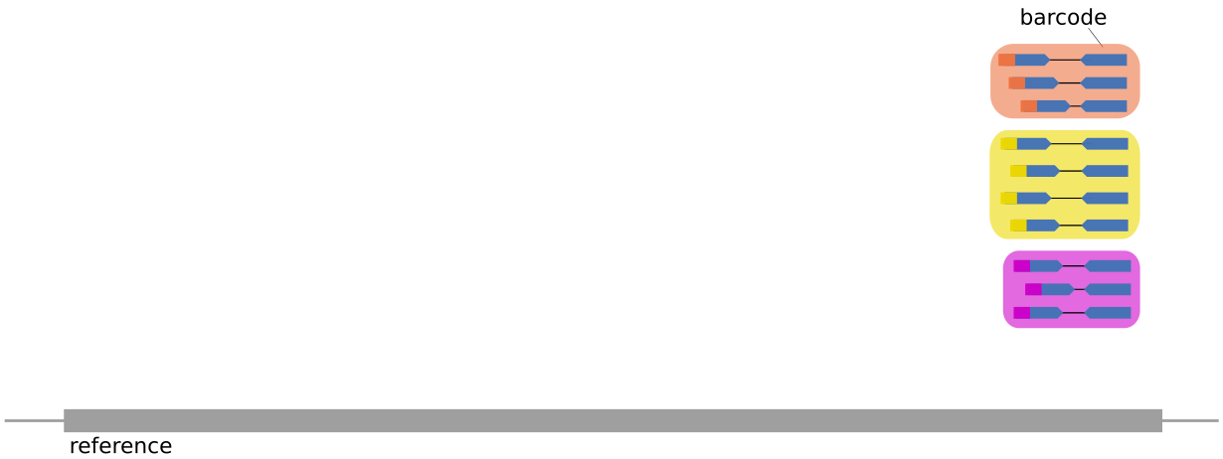
Bcmap
Input
(10xGenomics) paired-end linked-read data
Barcodes extracted (and corrected)
FastQ sorted by barcode

Slide 4
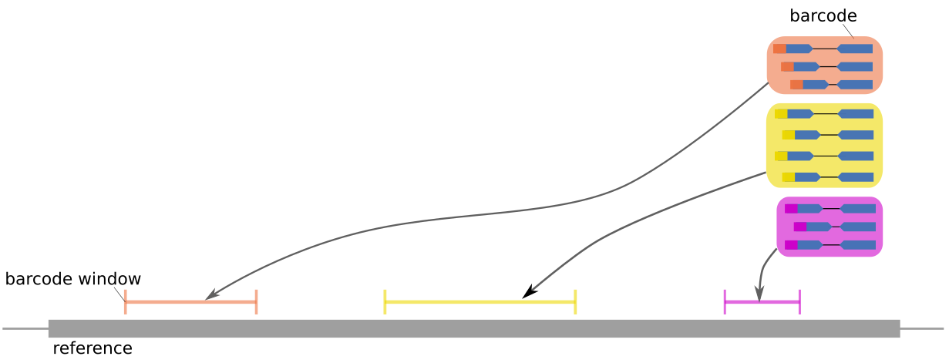
Bcmap
Workflow
Building an open adressing k-mer index for the reference
Mapping barcodes from barcode sorted read files
Construction of barcode index

Slide 5
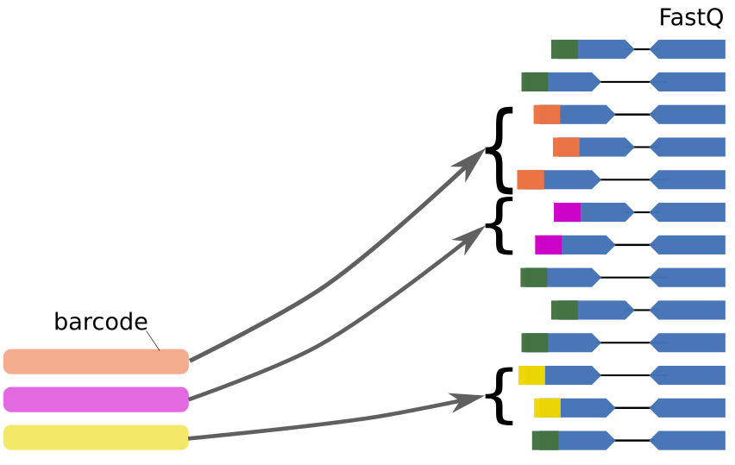
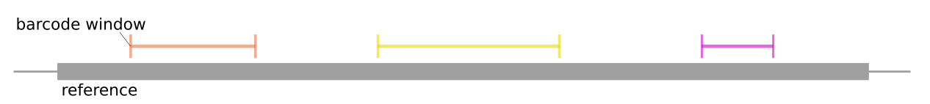
Bcmap
Output
Bed-file containing best mappings for every barcode:
chromosome startposition endposition barcode mapping_score
Barcode index for fast retrieval of reads

Slide 6
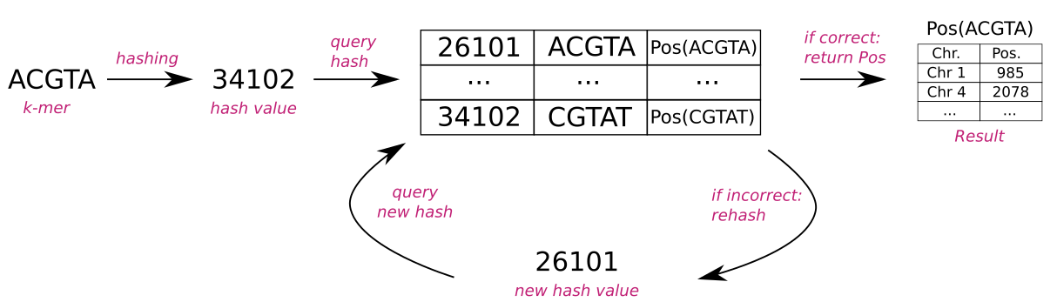
Open adressing k-mer index
Hashing for fast lookups
Ambiguous hashing to save memory

Slide 7
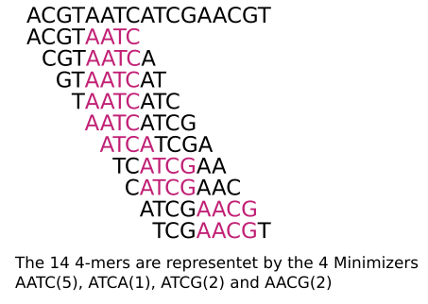
Minimizers
Representation of a k-mer
set by defined subset
Sequence split into windows of length w
Keep smallest k-mer of every window
The order of k-mers matters
Random order used throug xor with bitvector

Slide 8
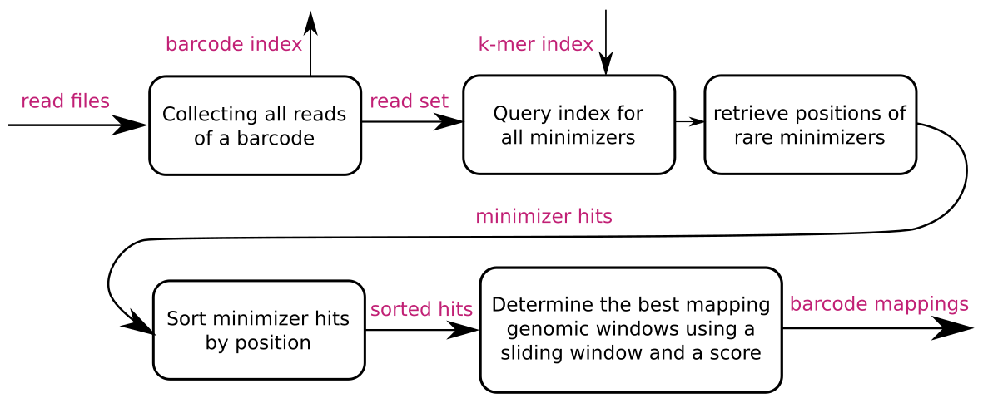
Barcode mapping - overview

Slide 9
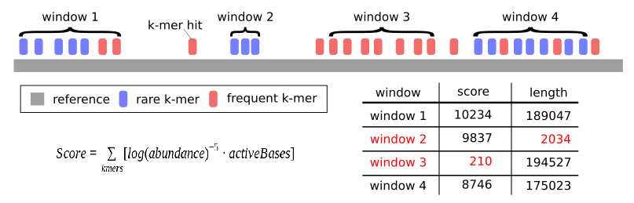
Barcode mapping – sliding window
D
Maximum gap size
Break Criteria
Maximum window size

Slide 10
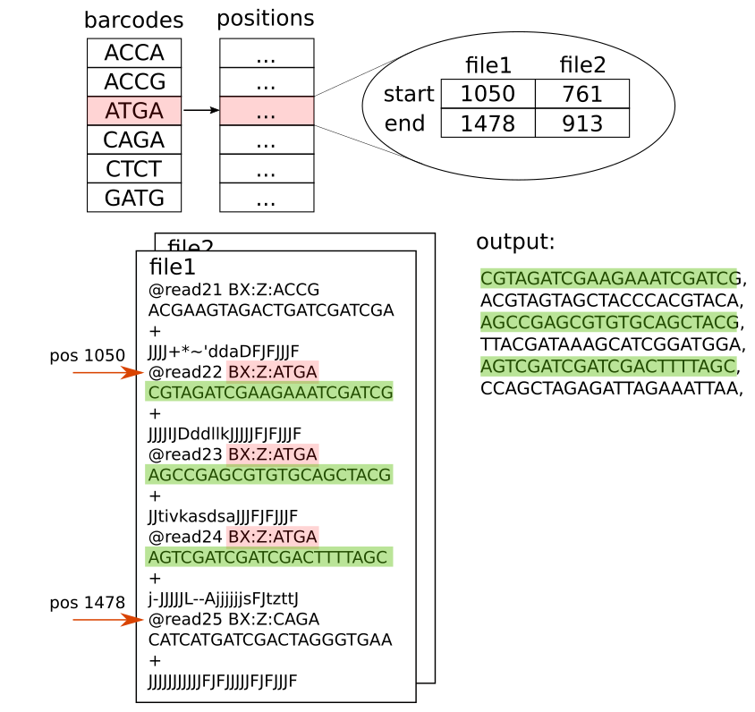
Barcode index
Start and end positions in the readfiles are saved for every barcode
The barcode index is constucted whilst mapping the barcodes
An index of n barcodes can be queried in log(n) time using binary search
All reads belonging to the barcode can be extracted from the readfile in linear time

Slide 11
Performance
Running time compared to BWA and Longranger align
NA12878 (281GB) mapped to hg38
Calculatoions performed on Intel Xeon E5-2650 v2 2.60Ghz cores
k=31, w=61
#cores | Bcmap index | Bcmap map | bwa | long-ranger
32 | 12:14 min | 9:00 min | 8:01 h | 22:34 h
16 | 13:28 min | 15:28 min | 15:45 h | -
1 | 32:26 min | 2:18 h | - | -

Slide 12
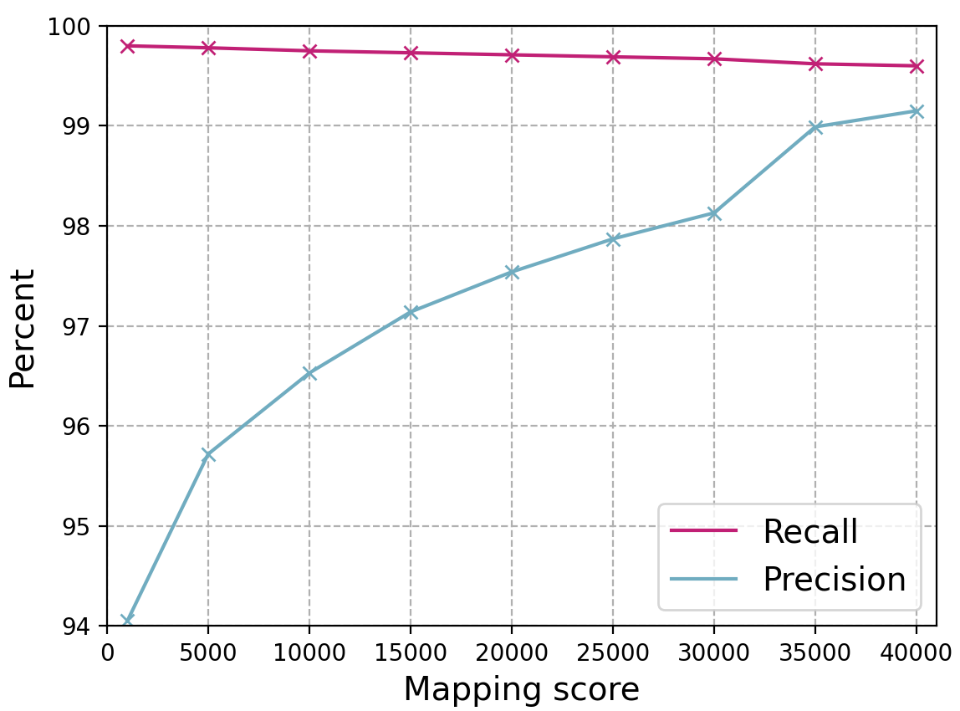
Accuracy – agreement with BWA
FN: No mapping where >10 bwa alignments cluster
TP: No alignment matches mapping
FP: alignment matches mapping

Slide 13

Summary
Fast barcode mapping allows efficient use of linked read information
Approximate barcode mapping substantially faster then read alignment
Results agree with processed BWA output
Fast access to barcoded reads provides starting point for ongoing analyzes
https://github.com/kehrlab/bcmap

Slide 14

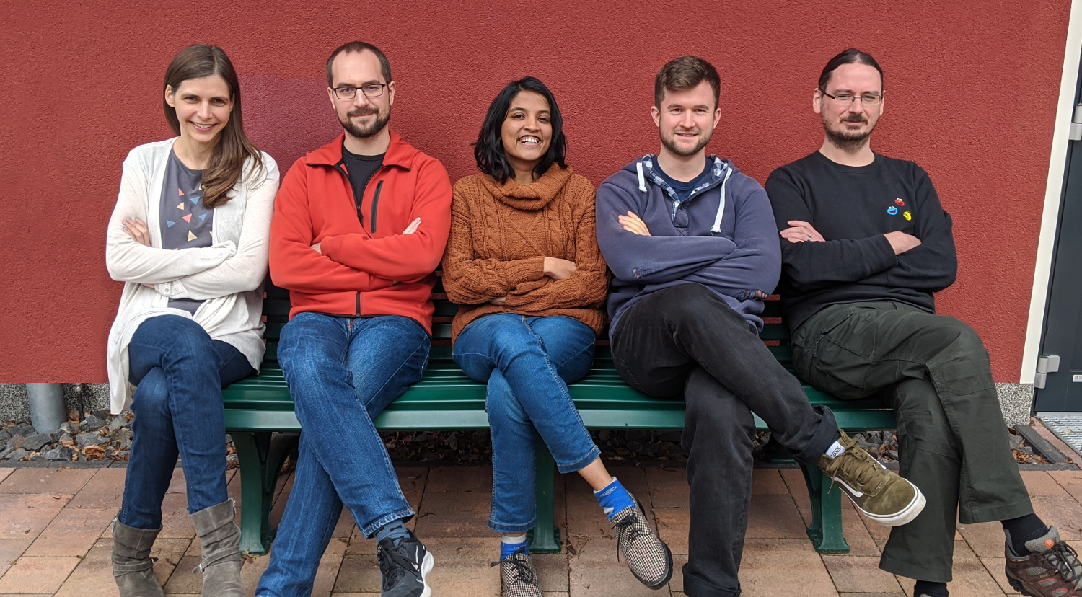


Thank you!
DFG funded research unit (FOR 2841 P03)
JRG Genome Informatics
HPC 4 Research cluster
Prof. Knut Reinert, SeqAn Team

