Slide 1
BUILT WITH CLAUDE · LIFE SCIENCES
Specimen
Casebook
ONE RECORD.
FIVE SOURCES.
ZERO SILENT GUESSES.
1907 ≠ 1909
Auditable data reconciliation
for biodiversity collections
Conflict preserved.
Science protected.
Specimen Casebook · Build Track
01

Slide 2
THE DATA-QUALITY RISK
A single wrong date can become
published biodiversity data.
ORIGINAL EVIDENCE
LEGACY DATABASE
The risk is not
slow transcription.
It is false certainty.
1907
→
1909
specimen label + field ledger
ready to publish as “fact”
Darwin Core is a standard for biodiversity data sharing · dwc.tdwg.org
02

Slide 3
A NAMED LIFE-SCIENCES USER
Built for a herbarium
collections data manager.
“Reconcile each field, preserve every conflict, and show me exactly where every value came from.”
Their job is to compare fragments that disagree—then publish one trustworthy record without losing the evidence behind it.
01
Specimen label
02
Field ledger
03
Legacy database
HERBARIUM COLLECTIONS
DATA MANAGER
04
Collector notebook
05
Taxonomy history
Build Track: start from a user in life sciences you can name · cerebralvalley.ai
03

Slide 4
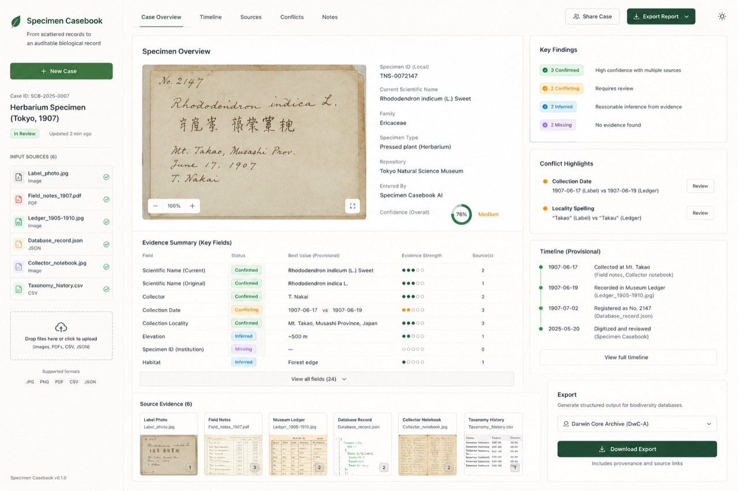
THE WORKING PRODUCT
Claude reconciles evidence
field by field.
1
Read every source
1
labels, ledgers, JSON and CSV
2
Compare claims
2
per field—not per document
3
Keep uncertainty
3
confirmed, inferred, conflicting, missing
Prototype walkthrough · Specimen Casebook
04

Slide 5
THE MOMENT THAT MATTERS
The disagreement stays visible—
so the mistake cannot ship.
SPECIMEN LABEL
FIELD LEDGER
LEGACY DATABASE
≠
≠
June 17, 1907
June 19, 1907
June 17, 1909
RECOMMENDED ACTION
CONFLICTING
Do not publish without human review.
Without Specimen Casebook, 1909 could be published as fact.
05

Slide 6
HOW CLAUDE IS USED
Claude proposes.
The policy layer decides what can ship.
SOURCE INGEST
CLAUDE
RECONCILIATION
HUMAN REVIEW
DARWIN CORE
Label · ledger
JSON · CSV
→
Extract field-level
claims + citations
→
Compare values
and preserve conflicts
→
Resolve only with
visible evidence
→
Publish with
provenance attached
Every exported value remains traceable to the source that supports it.
Output target: Darwin Core Archive with field-level provenance
06

Slide 7
EVALUATING SAFE AI
We measure restraint,
not just extraction.
0%
UNSUPPORTED RESOLUTION RATE
No conflict becomes one answer
without supporting evidence.
Conflict detection
Field-source accuracy
Did we find the disagreement?
Can every value point to evidence?
The goal is not to make uncertainty disappear.
The goal is to make it reviewable.
Review triage
Time saved
Did we surface the right records?
How much faster is human review?
Evaluation plan for intentionally seeded conflicts
07

Slide 8
SPECIMEN CASEBOOK
Trustworthy biodiversity records,
without silent certainty.
Auditable data reconciliation for the collections that science depends on.
RUN THE WORKING DEMO
SOURCE
Clone the repository · npm install · npm run dev
github.com/keigotak/
specimen-casebook
Conflict preserved. Science protected.
Built with Claude · Life Sciences · Build Track
08

