Slide 1
Visualizing logistic regression results for non-technical audiences
Abby Kaplan and Keiko Cawley
September 20, 2022

Slide 2
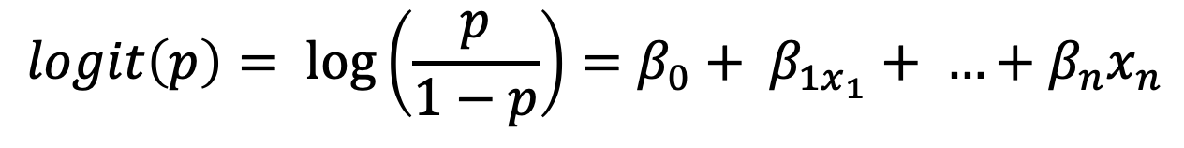
Logistic Regression Review
Use logistic regression to model a binary outcome
Examples:
Did the tutoring program increase pass rates, yes or no?
Does a tuition discount increase student enrollment, yes or no?
Do students who participate in clubs more likely to retain Fall to Fall, yes or no?
The logistic regression equation
$$logit\left(p\right)= \log\left(\frac{p}{1−p}\right)=β_{0}+ β_{1x_{1}}+ …+β_{n}x_{n}$$

Slide 3
What’s the problem?

Slide 4
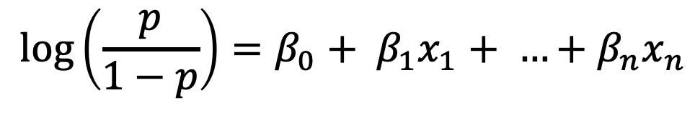
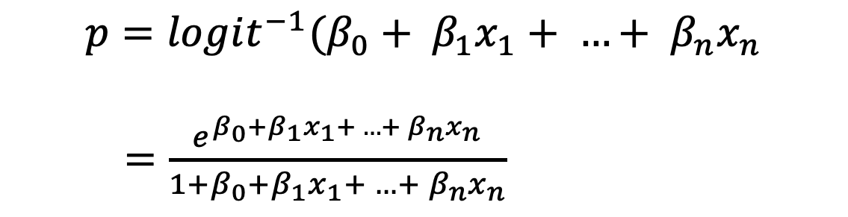
Just tell me “the” effect
Oftentimes stakeholders are interested in whether something has a positive or negative effect and if so, by how much.
The problem stems from:
We can solve for probability p :
$$\log\left(\frac{p}{1−p}\right)=β_{0}+ β_{1}x_{1}+ …+β_{n}x_{n}$$
$$p=logit^{−1}(β_{0}+ β_{1}x_{1}+ …+ β_{n}x_{n}$$
$=\frac{e^{β_{0}+β_{1}x_{1}+ …+ β_{n}x_{n}}}{1+β_{0}+β_{1}x_{1}+ …+ β_{n}x_{n}}$

Slide 5
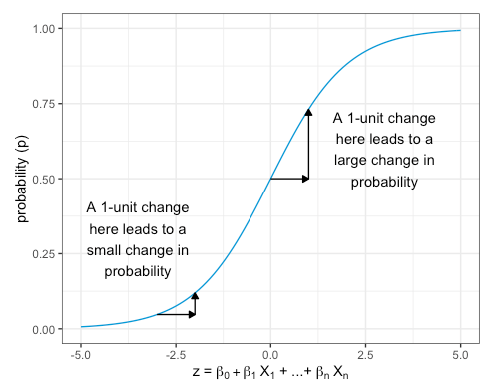

Just tell me “the” effect
$$p=\frac{e^{β_{0}+β_{1}x_{1}+ …+ β_{n}x_{n}}}{1+β_{0}+β_{1}x_{1}+ …+ β_{n}x_{n}}$$
An observation’s position on the curve is contingent on its properties, and the magnitude of effect in percentage points
varies in a non-linear way.

Slide 6
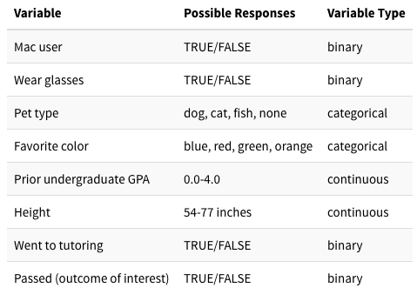
Sample dataset and model
Our simulated dataset describes students who took Balloon Animal-Making 201 at University Imaginary.
Built a logistic regression model to determine which variables are associated with a student passing Balloon Animal-Making.

Slide 7
Disclaimer: causality

Slide 8
Visualization Option 1
Presenting Model Coefficients

Slide 9

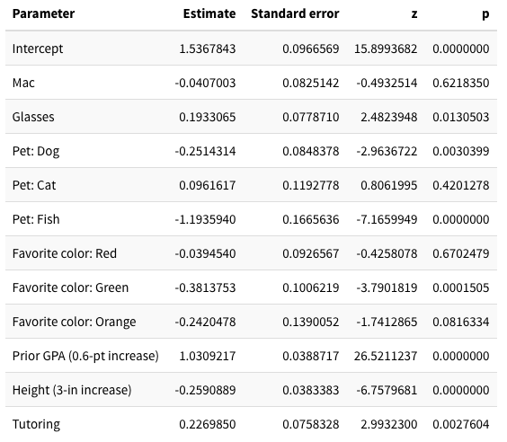
Table of coefficients

Slide 10
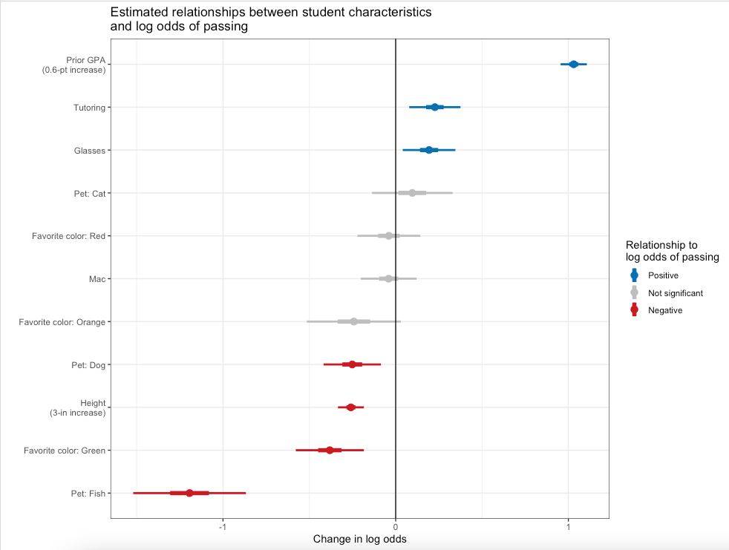
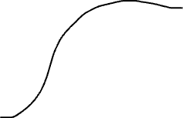

Change in the log-odds: Pros
Clearly catalogs which effects are positive and negative by color and order
The numerical values are in one place

Slide 11


Change in the log-odds: Cons
- What is a 0.4 change in the log-odds?
- Is a 0.4 to 0.8 change in the log-odds “big” or “small”?

Slide 12
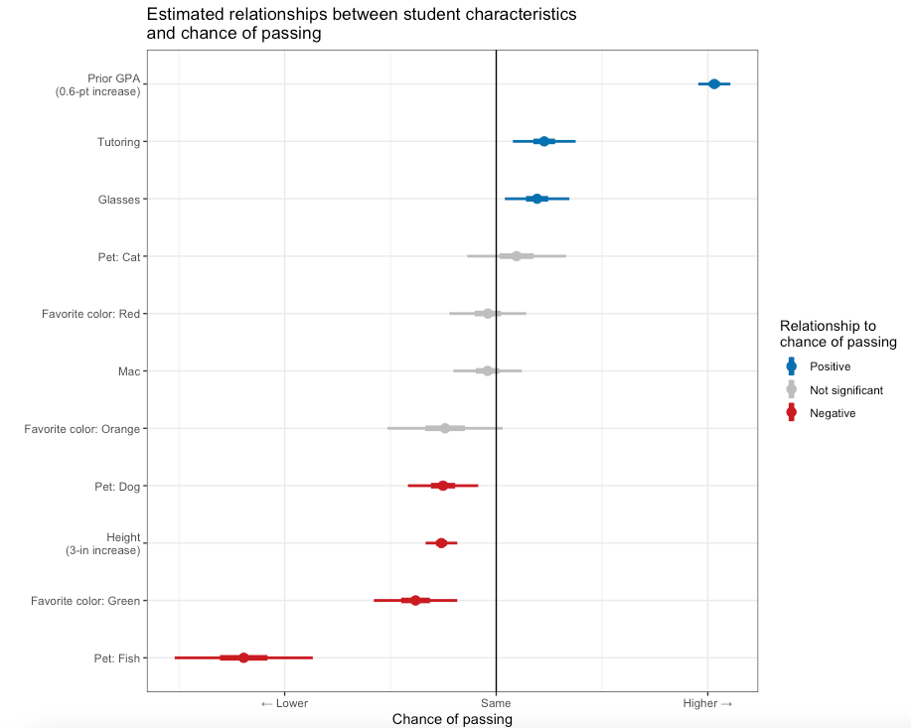
Secret log-odds

Slide 13
Secret log-odds
It’s a simple adjustment but…
No unit of measurement to describe absolute effect size
Non-technical audience member will still not get a sense of the overall magnitude of effect
Example

Slide 14
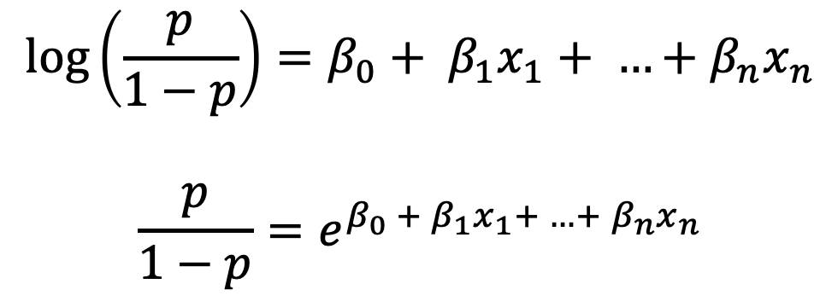
Odds Ratio
Your audience may be more familiar with the "odds" part of log-odds
$$\log\left(\frac{p}{1−p}\right)=β_{0}+ β_{1}x_{1}+ …+β_{n}x_{n}$$
$$\frac{p}{1−p}=e^{β_{0} +{ β}_{1}x_{1}+ …+ β_{n}x_{n}}$$

Slide 15
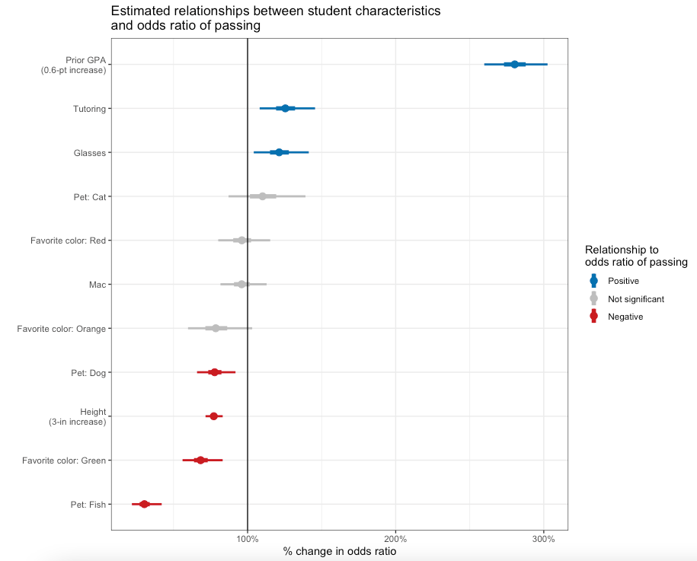
Odds Ratio

Slide 16
Odds Ratio
Changes in odds might be easier to describe than changes in log-odds
2 non-trivial obstacles:
Odds are expressed as integer ratios ("3-to-1" or "2-to-5") rather than "3" or "0.4”
Coefficients of your model don't represent odds directly; they represent changes in odds
Danger of this plot: the percent change in log odds might be misinterpreted as the absolute probability of the outcome (or the change in its probability)

Slide 17
Odds Ratio

Slide 18
Visualization Option 2
Presenting Probabilities

