Slide 1

An introduction to PorePy
CSD Winter School
March 2023

Slide 2
What is PorePy (not)?
PorePy is a research tool primarily intended to:
Develop mathematical models for multi-physics processes in fractured porous media
Develop numerical methods for solving the models
Study coupled physics in settings of relevance for subsurface applications
PorePy is a modular and flexible prototyping tool:
Models are easy to employ and modify
It should be easy to experiment with models and numerical methods
PorePy is not:
A framework for high-performance computing
A traditional reservoir simulator

Slide 3
Who can (should) use PorePy
PhD students and researchers
Other (commercial?) users
Requirements to harness the full power of PorePy:
Literacy in Python coding (need not be experts)
Ability to write code to set up simulations (no graphical user interface)
Ability to think in terms of equations
Requirements to follow these lectures:
Have followed the installation instructions (sent out last week)
Pay attention, try to solve the exercises, be curious
Notes:
Equations are more than number producers.

Slide 4
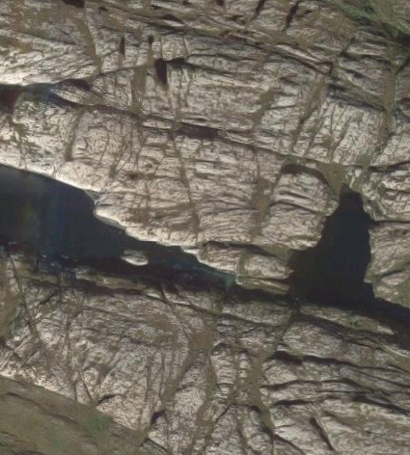
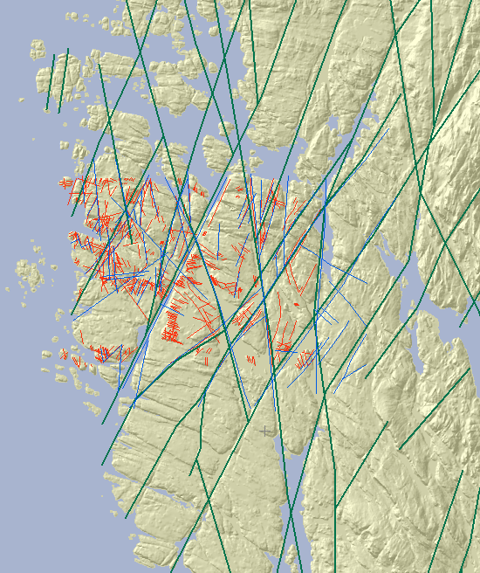
What is special about fractures?
Geometry:
Individual fractures have high aspect ratios
Fracture networks have complex geometries
Processes:
Non-linear multiphysics couplings
Heterogenous governing equations
Parameter heterogeneity
Strong interaction between geometry and processes
Notes:
Motivates

Slide 5
What are the ingredients of a PorePy simulation?
A continuous representation of the mixed-dimensional geometry
Construction of a mesh which resolves fractures and their intersections
Specification of governing equations
Discretization and solution approach
Notes:
The main focus here will be the first three points.

Slide 6
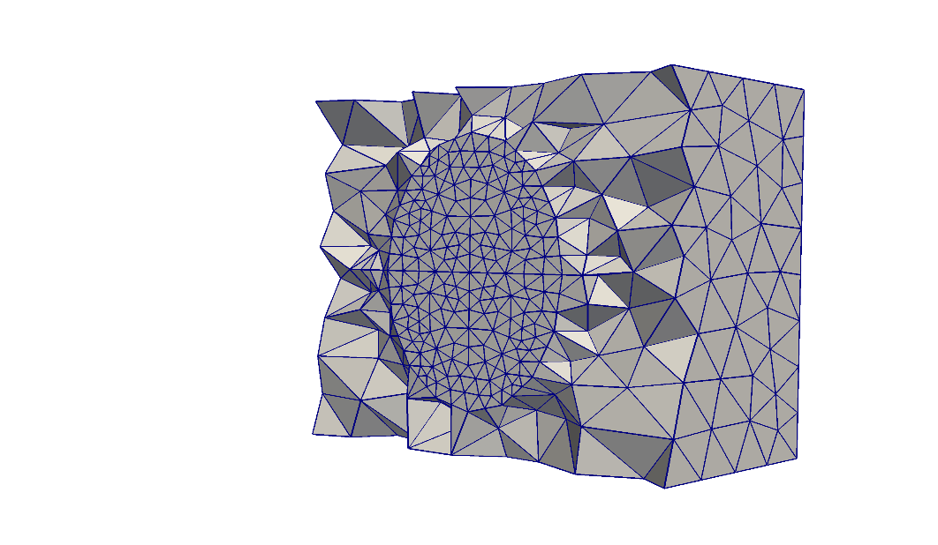
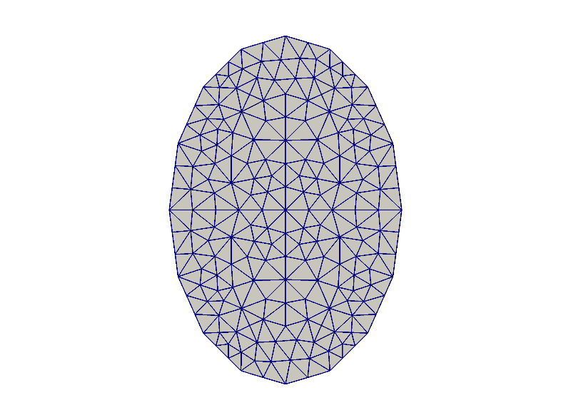
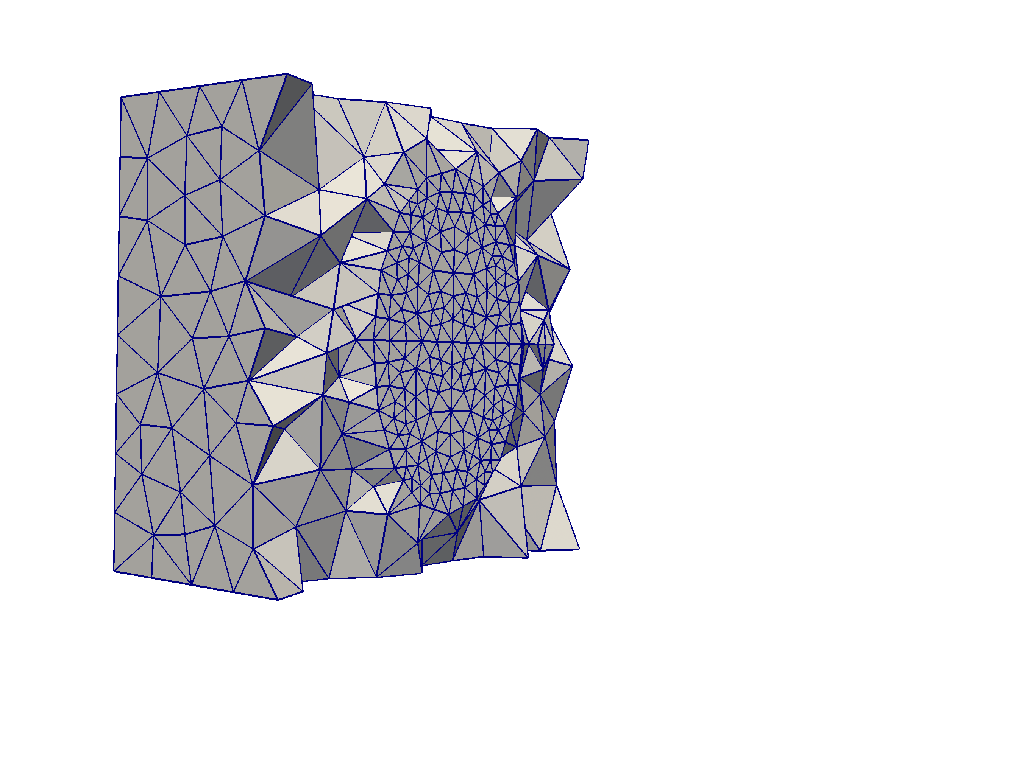
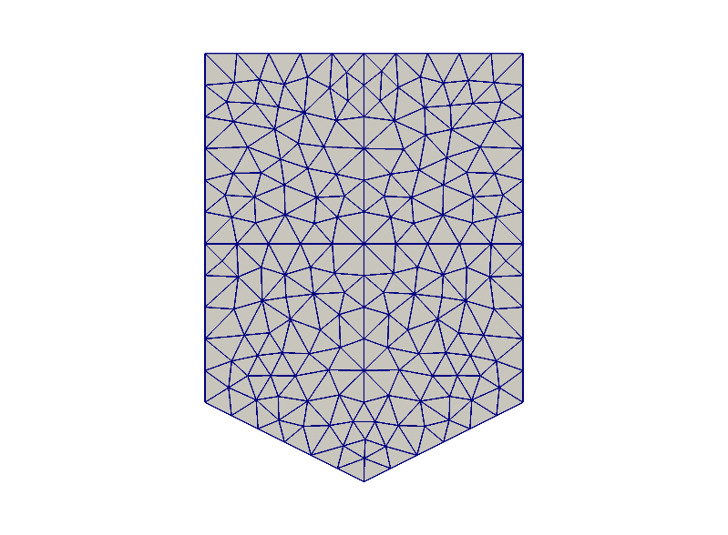




Geometry and meshing
Divide geometry into:
D-dimensional host medium
(D-1)-dimensional fractures
(D-2)- and (D-3)-dimensional intersections
Assign subdomains to each geometric object
$$Ω_{1}^{1}$$
$$Ω_{1}^{0}$$
$$Ω_{2}^{1}$$
$$Ω_{1}^{2}$$
Mesh conforms to objects of all dimensions

Slide 7
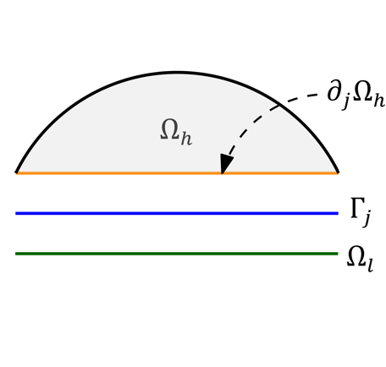
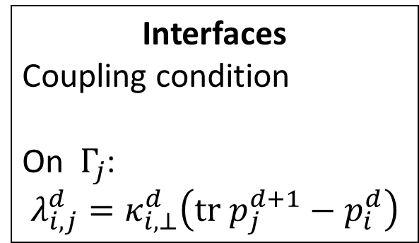
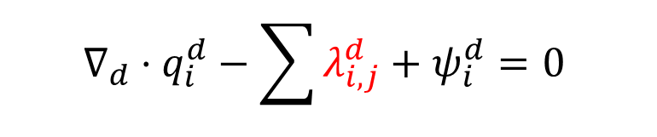


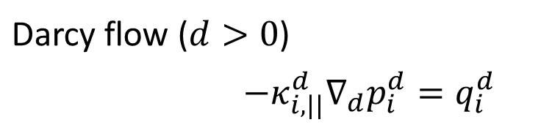
Example equations: Mixed-dimensional flow
Subdomains
Conservation (matrix, fractures, fracture intersections):
$λ^{d}$: Flow in/out of higher-dimensional objects (source/sink)
$λ^{d−1}$: Flow in/out of lower-dimensional objects (boundary condition)
$ψ$: Standard sources and sinks
Interfaces
Coupling condition
On $Γ_{j}$:
$$λ_{i,j}^{d}=κ_{i,⊥}^{d}\left(tr p_{j}^{d+1}−p_{i}^{d}\right)$$
$$∇_{d}⋅q_{i}^{d}−\sum{λ_{i,j}^{d}}+ψ_{i}^{d}=0$$
$q_{j}^{d}⋅n_{j}^{d}=λ_{i,j}^{d−1}$
Darcy flow ($d>0$)
$−κ_{i,||}^{d}∇_{d}p_{i}^{d}=q_{i}^{d}$
The model is also explained in the course material
Notes:
Fractures as lower-dimensional objects

Slide 8
Modular approach to setting up simulations
Templates for standard physics (including flow and poromechanics):
Provide full-scale models, will give trivial solutions
Can be modified to change parameters or constitutive laws
Course material provides examples of modifications – pay attention to comments regarding accuracy in programming
Getting to know the full flexibility of the modular design requires some effort

Slide 9
Exercises
Goals:
See PorePy and mixed-dimensional simulations in action
Give an idea of how models can be modified
Approach:
Split into groups of 2-3 people (at most 1 experienced user per group)
Start the Docker container and the jupyter server (follow instructions)
Open the notebook on mixed-dimensional flow, save under a different name, start experimenting

